Slide 1

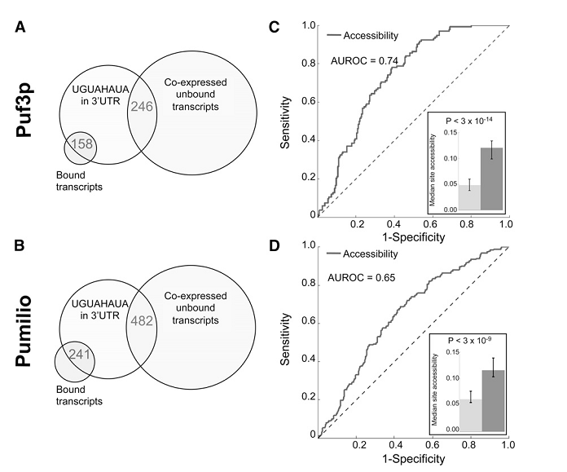
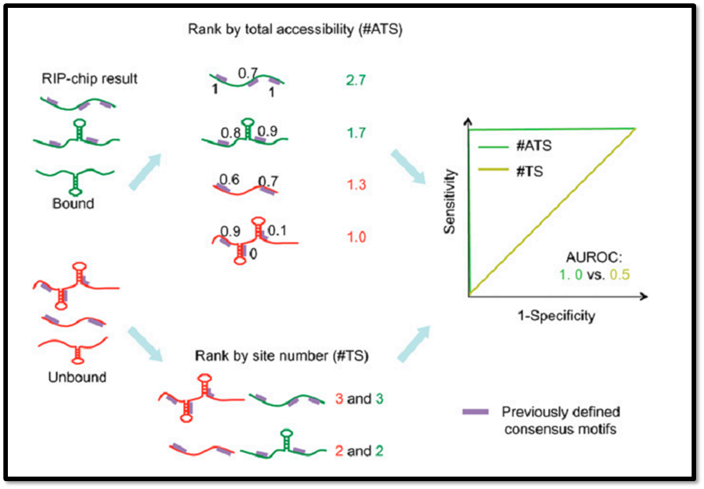
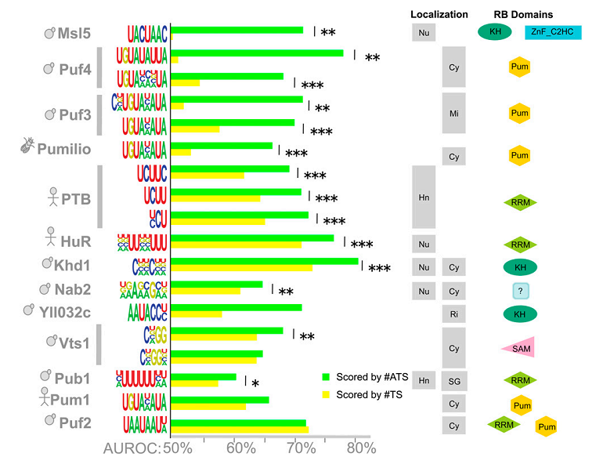
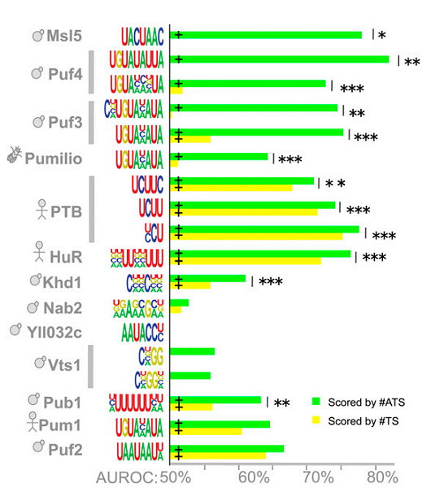
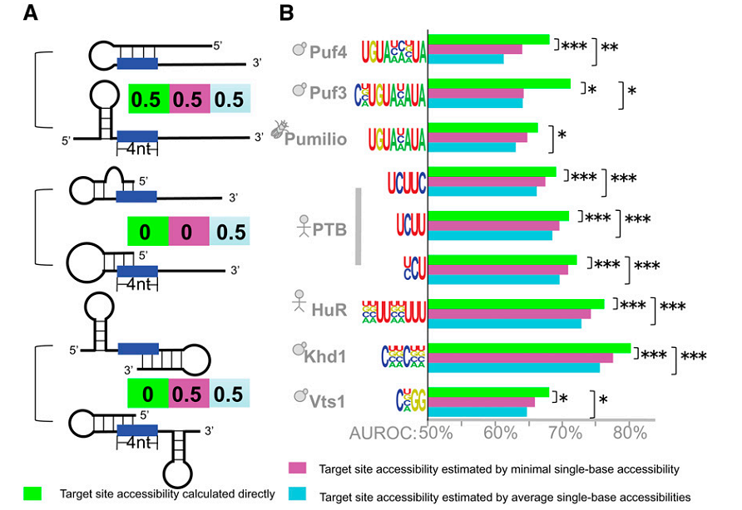
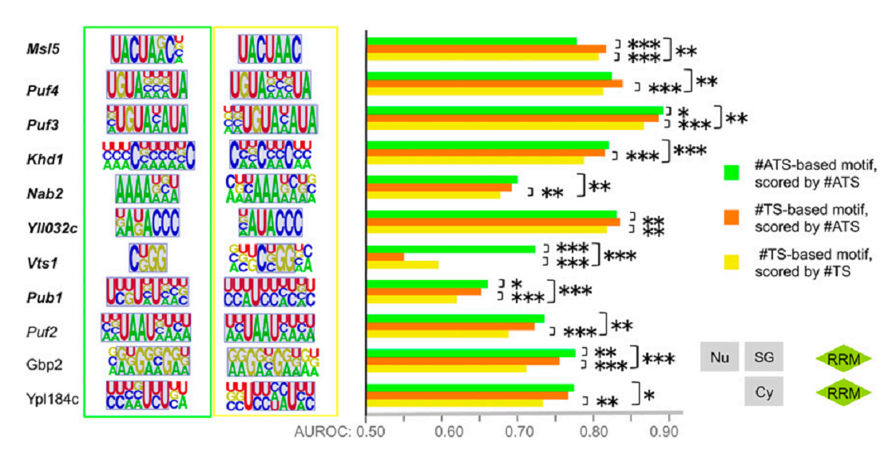
Predicting in vivo binding sites of RNA-binding proteins using mRNA secondary structure
Naimul Arif(0905004), Tanvir Ahmed(0905086)
Abstract:
Introduce a motif finding algorithm that identifies sequence specific RBP motifs.
Uses sequence preference and accessibility of motifs.
Focus mainly on accessibility predicted based on intrinsic mRNA secondary structure.
A lot of RBP is studied systematically to predict the features of target transcripts.
Motif finding procedure:
#TS and #ATS calculated for all possible 6-mers (substring of length 6)
6-mers selected based on these AUROCs
Two separate consensus sequence motif model selected for each RBP, one seeded with five 6-mers with highest #ATS scored AUROCs and another with highest #TS scored AUROCs
For each seed
  The motif giving largest AUROC on the training set selected (based on #TS or #ATS which is appropriate).
  The procedure is terminated when AUROC failed to increase or the ‘associated Bonferroni-corrected Wilcoxon–Mann–Whitney P-value’
  failed to decrease.
Once the motif finding converged for all five seeds, the motif with the highest AUROC on the training set is selected.
The AUROC of each model is evaluated on the test set to assess its predictive accuracy.
Materials and methods:
RBP co-purification date is derived from RIP-chip assay.
Fly, human and yeast cDNA and 3’ UTR are the sources of transcript sequence
Based on relative enrichment in RNA fraction co-purifying positive and negative threshold are defined, the crossing upward positive threshold and crossing downward negative transcripts are defined as bound and unbound transcript.
Accessibility is calculated using RNAplfold moedel which estimated probability that a site or a single base is unpaired calculating local pair probabilities for base with max span of L nucleotide.
A target site and the flanking region upto X bases upstream and Y bases downstream accessibility are scored by summing the single base accessibilities for all counted bases and adding the accessibility of the target site times the length of the
target site.
Result:
Data derived from RNP immuno-precipitation microarray co-purification assay (RIP-chip) is compiled for in vivo mRNA targets of a set of 30 RBPs.
Impact of mRNA secondary structure on probable RBP binding site by scoring each site by its accessibility which is related to the likelihood to be bound
Target site accessibility is the probability that the entire site is unpaired calculated considering the relative stability of possible secondary structures containing that site and flanking sequence.
Consensus UGUAHAUA matches more with unbound than bound. Demonstrate that sequence is not enough to select target site;
Experimented in 3’ UTR
#ATS = the expected accessible sites in the transcripts
#TS = how well transcript sites bound or unbound predicted
Accuracy of #ATS and #TS predicting bound transcript
Green bar for #ATS and Yellow bar for #TS
Accuracy of #ATS and #TS predicting bound transcript
Only restricted to 3’ UTR
Target site accessibility is a better predictor than average/minimal accessibility of single bases in the target site
Two motifs based on #TS and #ATS for each RBP. Scored in 3 different ways
Discussion and future remark:
There are plenty of opportunity of improving the prediction accuracy of the in vivo binding sites of RBP. The current model do not perfectly reproduce in vivo binding data. This model does not consider if a site is associated with a particular element and does not count competition with other trans-factor and long-range interaction.
In future partial pairing which reduces the accuracy and site clustering which increases the number of putative target sites may also be a good point to be worked on. 5` UTR which is almost untested can be studied too.
References:
http://morrislab.med.utoronto.ca/datamain http://www.rnajournal.org
Gao FB, Carson CC, Levine T, Keene JD. 1994. Selection of a subset of mRNAs from combinatorial 3 9 untranslated region libraries using neuronal RNA-binding protein Hel-N1. Proc Natl Acad Sci 91: 11207–11211
Ule J, Stefani G, Mele A, Ruggiu M, Wang X, Taneri B, Gaasterland T, Blencowe BJ, Darnell RB. 2006. An RNA map predicting Nova-dependent splicing regulation. Nature 444: 580–586.
Wang X, McLachlan J, Zamore PD, Hall TM. 2002. Modular recognition of RNA by a human pumilio-homology domain. Cell 110: 501-512
Department of Computer Science and Engineering (CSE), BUET

