Slide 1

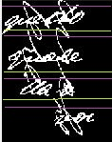
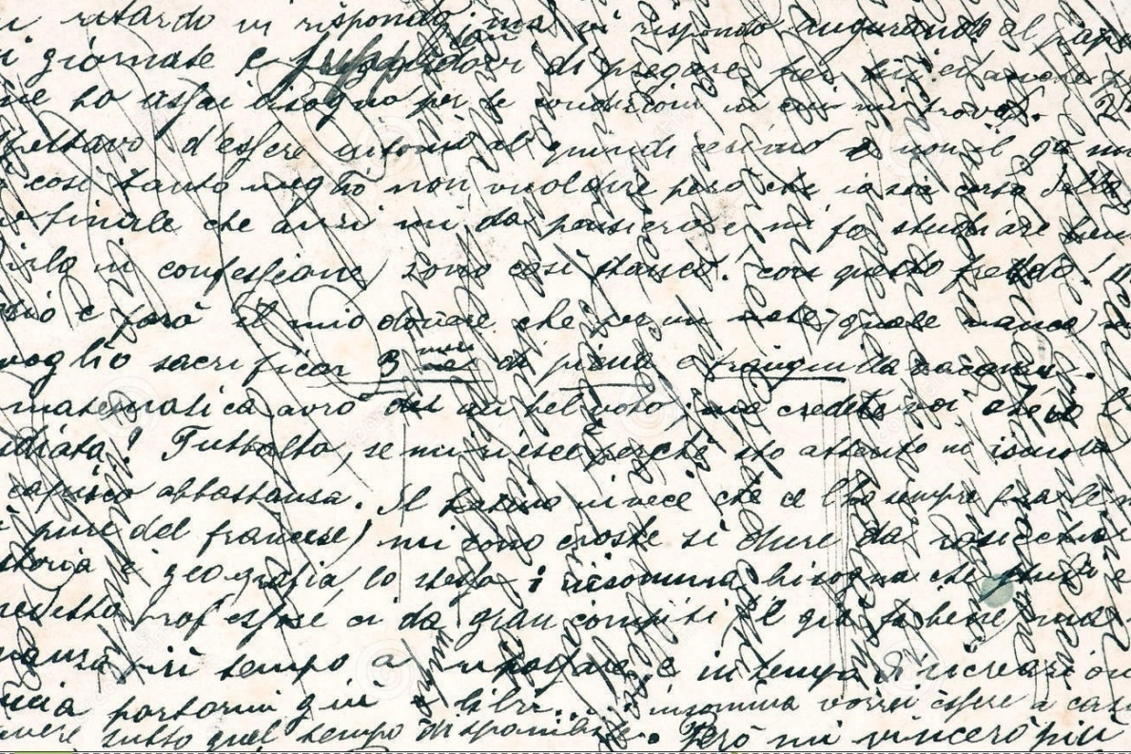
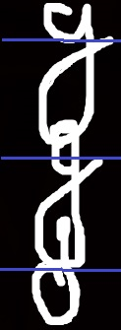
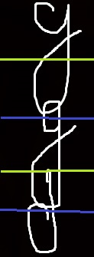

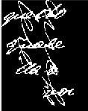



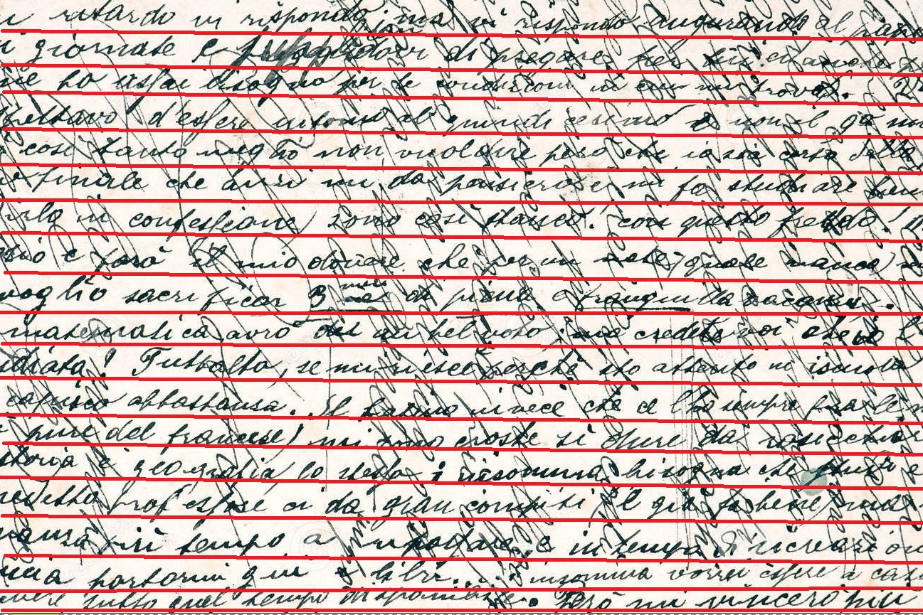

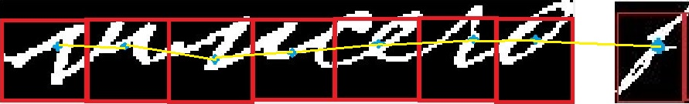
Segmentation of Hand Written Text Document
Md. Samiul Haque(0905087) and Md. Ariful Islam(0905118)
Objective
Line Segmentation Word Segmentation Character Segmentation
Method:
3. Post Processing : Two steps Firstly, (i) a merging technique over the result of the Hough transform is applied to correct some false alarms (ii) CCs of “Subset 1” that were not clustered to any line are examined to determine whether a new line is detected. The second step deals with large components lying in the subdomain “Subset 2”
Application:
Enhancement of old hand written text document. Signature matching Content-based image retrieval. Optical character recognition.
Method:
Three Steps: 1.Pre-processing: 2. Hough Transform : Text line detection using Hough Transformation.
Connected component that is not split
y_{i} +(y_{i+1} - y_{i})/2<y<y_{i+1}
Input Document
((H < 3*AH) and (0.5*AW > W)) or ((H < 5*AH) and (0.5*AW<W))
H ≥ 3*AH
Connected Component Split into three parts
0.5*AH ≤H≤ 3*AH
Subset 2
Subset 1
Subset 3
Possible Outcome
Bounding Box with Average height and Width of a Character
Gravity Center within Bounding Box
Draw back
Poor performance at noisy document . For long character, performance may decrease in line segmentation.
References
G. Louloudisa, B. Gatos, I. Pratikakis, C. Halatsis, Text line and word segmentation of handwritten documents
Department of Computer Science and Engineering (CSE), BUET

