Slide 1

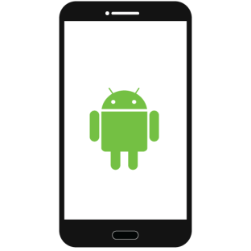



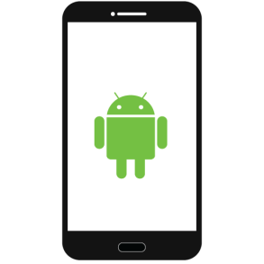

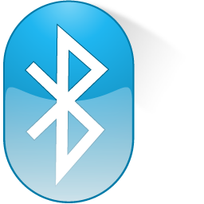


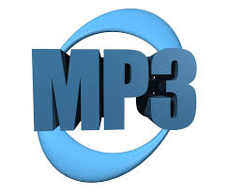



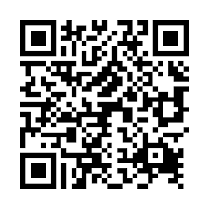








Code Injection In HTML5 And Java Based Android Apps
Saidur Rahman(0905111,sujon335@yahoo.com)
Ashiqul Mostofa(0905024,ashiqulmostofa@gmail.com)
INJECTION SCENARIO IN HTML5 BASED APPS
Any Free WIFI Available???
I Need To Pair Device
Victim Device
Contacts,
Calender,profile,Call Log,History bookmark…
HTML5 Based
Mobile App
WEB VIEW
DISPLAY
payload
Internal
channels
DATA
payload
What’s The Price???
CODE
DATA
External
channels
CODE
DATA
CODE
WiFi , MP3,Bluetooth,SMS,2D Barcode,JPEG
Render
Engine
JavaScript
Engine
Channels used by attackers to inject malicious JS code
Attack Strategy
INJECTION SCENARIO IN JAVA BASED ANDROID APPS
Loads
Needs
APP
Update
DexClassLoader
Does Not Require Signature
Requests Update
PROBLEM SPECFICATION
MITM
WEB SERVER
The design of the Android system allows applications to load additional code from external sources at runtime.
On the one hand, malware can use this capability to add malicious functionality after it has been inspected by an application store or anti-virus engine at installation time.
Developers of benign applications can inadvertently introduce vulnerabilities.
attackers could use dynamic code-loading to avoid detection by offline application analysis engines.
Currently In Bangladesh there are a lots of mobile
applications which are developed with vulnerable frameworks.
Our target is to exploit the vulnerability of those apps
to ensure that users are getting those apps services
with expected security.
1
REDIRECTS
ATTACKER
ATTACKER SERVER
2
PROVIDES
MD5 HASH MATCHES
OUR OBJECTIVE
CUSTOMIZED
Loads
Using DexClassLoader
References
[1] “Execute This! Analyzing Unsafe and Malicious Dynamic Code Loading in Android Applications” [online] . Available: https://cs.ucsb.edu/~vigna/publications/2014_NDSS_ExecuteThis.pdf
[2] “Code Injection Attacks on HTML5-based Mobile Apps : Characterization, Detection and Mitigation”
[online] . Available: http://www.cis.syr.edu/~wedu/android/JSCodeInjection/index.html
Department of Computer Science and Engineering (CSE), BUET

