Slide 1

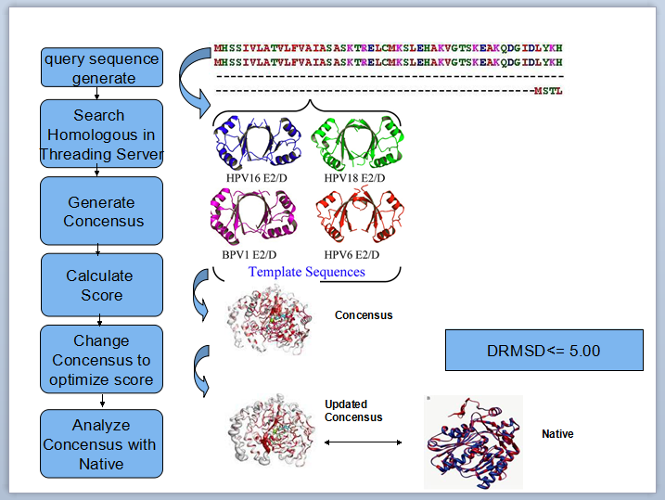
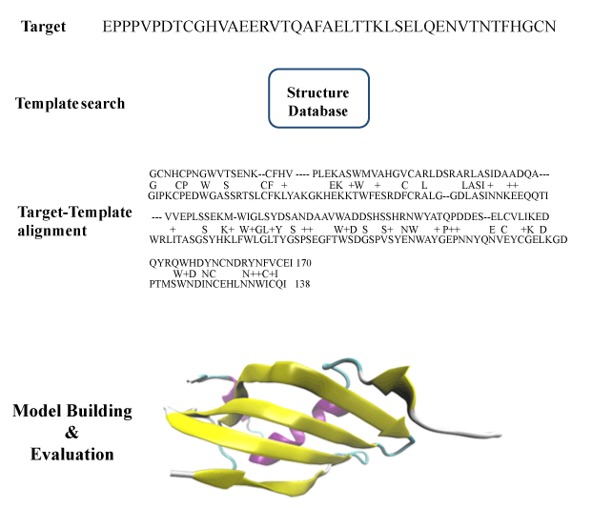
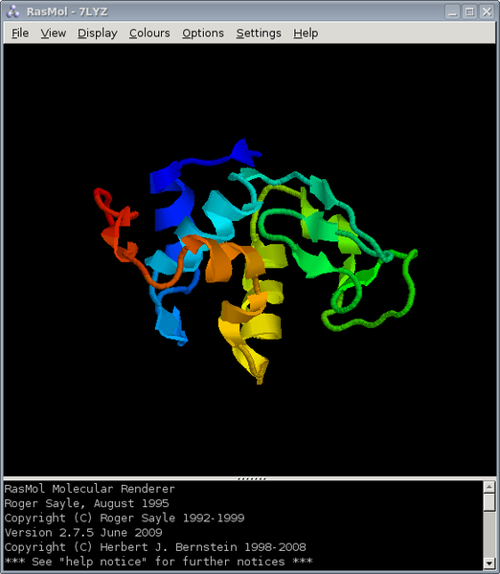
Protein Threading Optimization Using Consensus
Homology Modeling
Maliha Sarwat (0905095), Tasmin Tamanna Haque (0905065)
Protein – Sequence of amino acids.
Protein structure prediction - Prediction of the three-dimensional structure of a protein from its amino acid sequence.
Homology Modeling - Comparative modeling of protein, refers to constructing an atomic-resolution model of the "target" protein from its amino acid sequence and an experimental three-dimensional structure of a related homologous protein (the "template").
Threading - The basis of template matching method is Threading or Fold Recognition. Threading works by using statistical knowledge of the relationship between the structures deposited in the PDB (Protein Data Bank) and the sequence of the protein which one wishes to model.
In this research poster, we have worked on homology modeling and tried to optimize the protein threading techniques of several well-known threading servers like SPARKS-X, LOMETS etc.
Our idea is to use the best 10 matched homologs found from the SPARKS-X server and superimpose them on one another, pairwise to generate a consensus model.
We searched in CASP-10 to find a target protein whose structure is to predict.
SPARKS-X gives us 10 best matched homologous proteins for that target.
Superimposing the templates on one another, pairwise, along the aligned residues , we get the initial consensus model, Tc.
Performing some local changes, i.e fragment matching, insertion, deletion of aligned residues, we optimized Tc.
Measured the distance between optimized consensus model Tc and target protein Tin using DRMSD.
dRMSD(Tin, Tc) =[(2/n(n-1))Σ_{i=1,…,n-1}Σ_{j=i+1,…,n}(d_{ij}(Tin) – d_{ij}(Tc))²]^{1/2}
Introduction
Method
Homology Modeling is one of the most important goals pursued by bioinformatics and theoretical chemistry. It is highly important in medicine (drug design) and biotechnology (design of novel enzymes). Every two years, the performance of current methods is assessed in the CASP experiment (Critical Assessment of Techniques for Protein Structure Prediction).
Application
Approach
Tc=generateAtRandom()
iniital_score=calculateInitialScore (Tc, T[])
while timeout{
Tc’= performSomeChange(Tc)
score=calculateInitialScore (Tc’, T[])
If score < initial_score Tc=Tc’
else discard Tc’
}
performSomeChange (Template Tc) {
do some insertion, deletion, change in residues of Tc that are aligned with some of the homologous templates
}
Our latest calculated DRMSD after performing changes in consensus model is 6.223 A.
Algorithm
Result
The expected value of DRMSD is within 5A.
We have seen that the value can be optimized if we generate the consensus model using all the 10 matched templates. Local change i.e insertion/ deletion of residues in Tc according to fragment matching leads to more optimized score.
Discussion
CASP 10 : obtained query protein sequence from CASP 10 target list with chain lengths in between 100-150.
Threading Server : built the dataset of homologous proteins from SPARKS-X server , obtained the protein information files (.pdb files) of the homologs from the PDB
Rasmol : We have used Rasmol to view the superimposition of two best matched templates.
Materials
[1]wikipedia.org/wiki/Homology_modeling
[2] J. Peng and J. Xu. A multiple-template approach to protein threading. Proteins: Structure, Function, and
Bioinformatics, 79(6):1930{1939, 2011.
[3] S. Wu and Y. Zhang. Lomets: a local meta-threading-server for protein structure predition
[4]Yuedong Yang, Jian Zhan, Huiying Zhao, and Yaoqi Zhou* .A new size-independent score for pairwise protein structure alignment and its application to structure classification and nucleic-acid binding
prediction
We aim on rotational superposition of matched templates to generate a better Tc.
one best matched template should be kept standard and residues of others are rotated to match the residues of the standard template along the aligned portion.
References
Future Work
Department of Computer Science and Engineering (CSE), BUET

