Slide 1

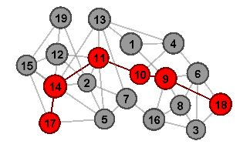
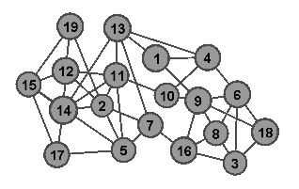
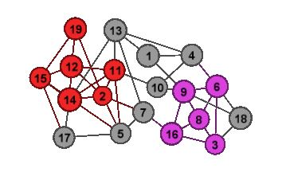
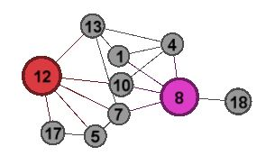
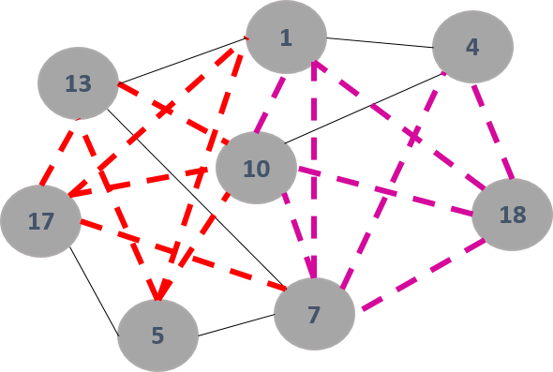
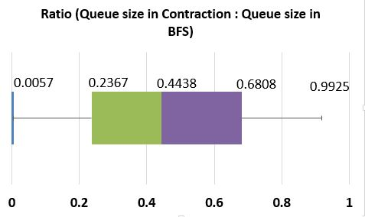
Shortest Path in Large Graph : A Memory Efficient Exact Method
Taslim Arefin Khan, Sadia Nahreen
Problem Definition
Finding point-to-point (P2P) shortest path (SP) in a large scale graph is computationally difficult problem.
Two main challenges : latency and memory.
Given an un-directed and un-weighted graph G(V,E), we are interested in answering the shortest path distance between s and d, where s,d ϵ V.
Application
Several applications require fast computation of P2P shortest path, for example, query for ride sharing with Uber, query for a potential candidate for a job in LinkedIn by a recruiter, etc.
Challenges
Memory : We cannot pre-compute and store all-pair shortest path, since memory is limited.
Latency : P2P query on the fly is time consuming and traditional algorithms like BFS and Dijkstra’s algorithm perform poorly.
Methodology
We answer these challenges in the following manner :
Large graphs tend to have sparsely connected dense subgraphs.
We locate these subgraphs and contract them in a single super node.
Two challenges –
  How to locate dense subgraphs?
  How to keep the original path information, given that we are able to contract the subgraphs?
Locating Dense Subgraphs
For each vertex v ϵ V, we compute q(v), where
q(v) = 1 + 2*e / n.
Here, n = |N_{G}(v)| and e is the number of edges between all u ϵ N_{G}(v), where u ≠ v.
Higher values of q(v) tends to represent a subgraph centered at v.
Contraction of Subgraphs and Pre-computation
The contracted subgraphs are replaced by a super node, effectively reducing the graph from the original size.
No two super nodes share a direct edge between them.
For all u ϵ N_{G}(supernode(v)), we pre-compute and store all-pair shortest path, the resultant graph is a weighted graph.
Query Answering
We answer the shortest path query Q(s,d), where s,d ϵ V on a graph consisting of super nodes and precomputed paths.
We run Dijkstra’s algorithm from s until d, where none of the super nodes are expanded. The effective queue size during run time is much less than a Breadth-First Search on the original graph.
Example
Original Graph Locating Dense Subgraph Contraction and Super Node Final Graph (colored edge represents weight)
Experimental Results
Conclusion
Experimental results show that our method outperforms BFS both in latency and memory complexity.
The proposed method produces exact answers to P2P queries.
The proposed method can compute all-pair exact P2P shortest path distance.
We compare our implementation with BFS on more than couple of hundred random queries per sample graph.
References
T. Akiba et.al. Fast exact shortest-path distance queries on large networks by pruned landmark labeling. [2013]
R. Agarwal et.al. Shortest path in microseconds. [2013]
J. Leskovec et.al. Community Structure in Large Networks. [2009]
Department of Computer Science and Engineering (CSE), BUET

