Slide 1






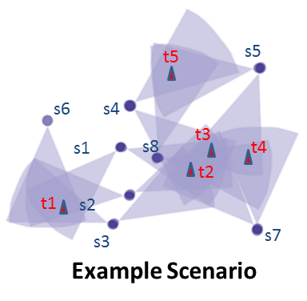
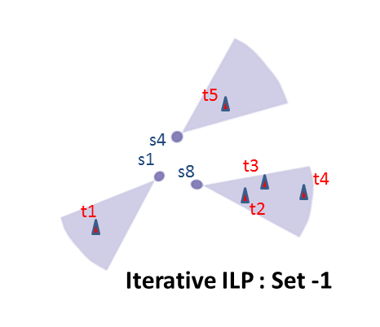
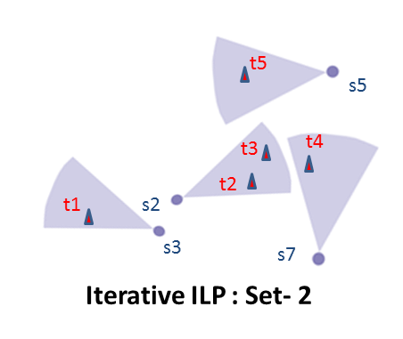

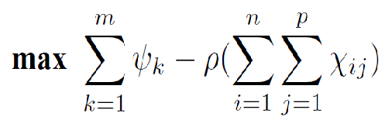
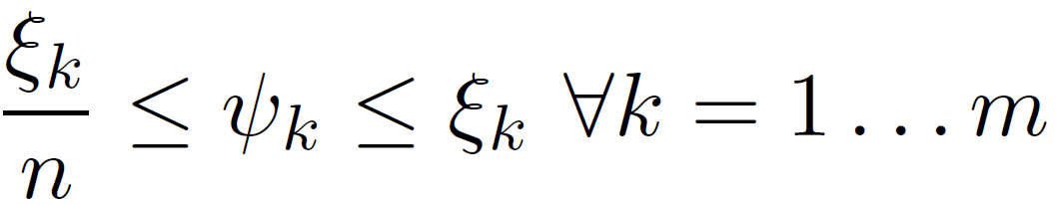
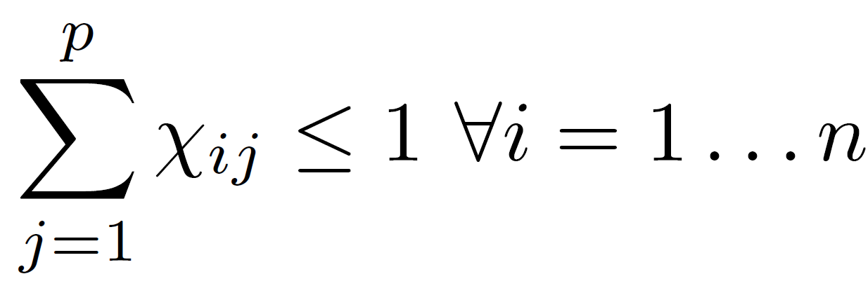
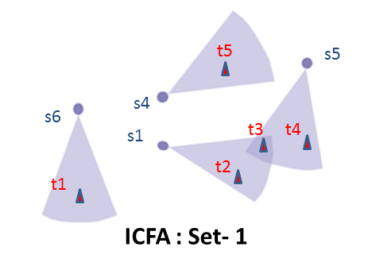
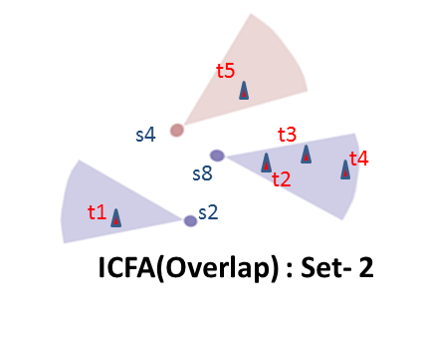
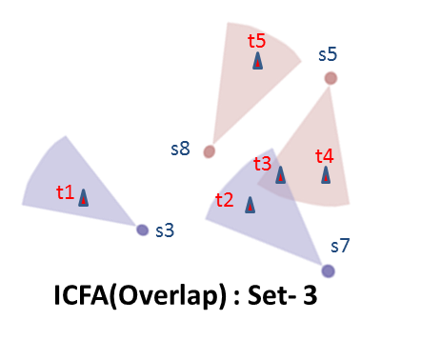

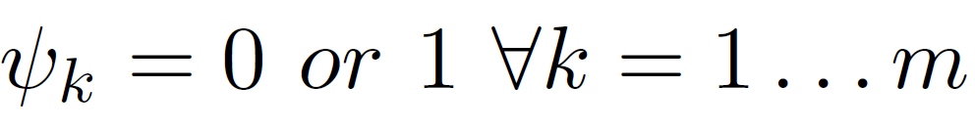
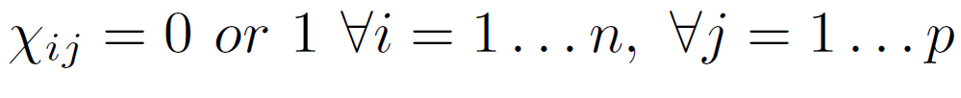
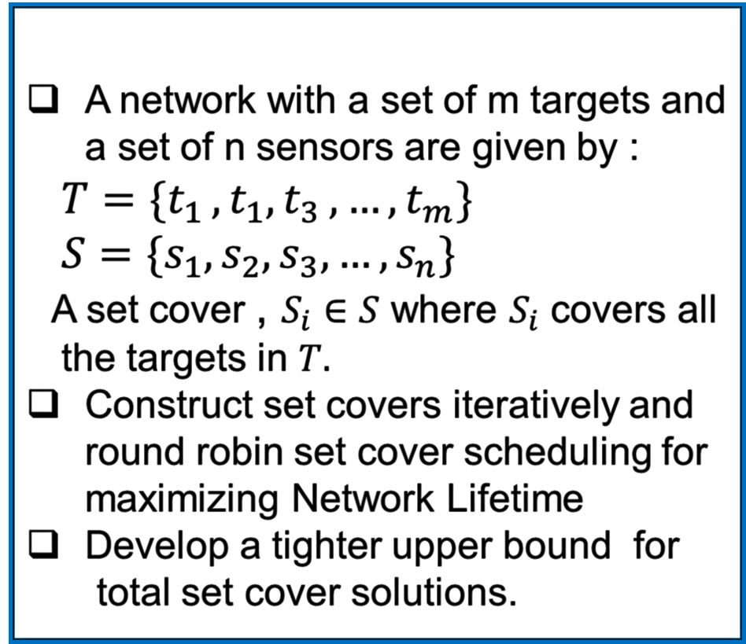
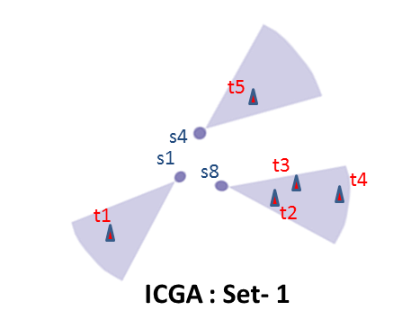
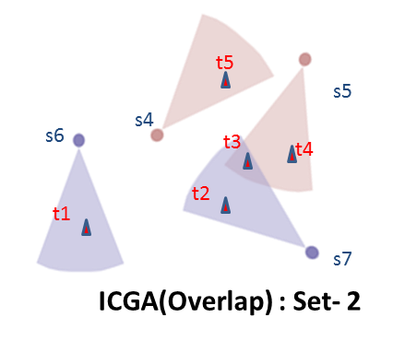
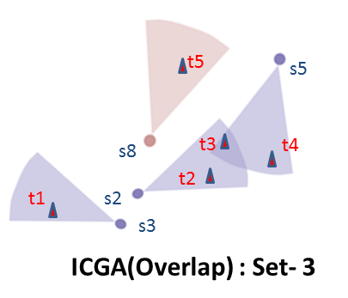


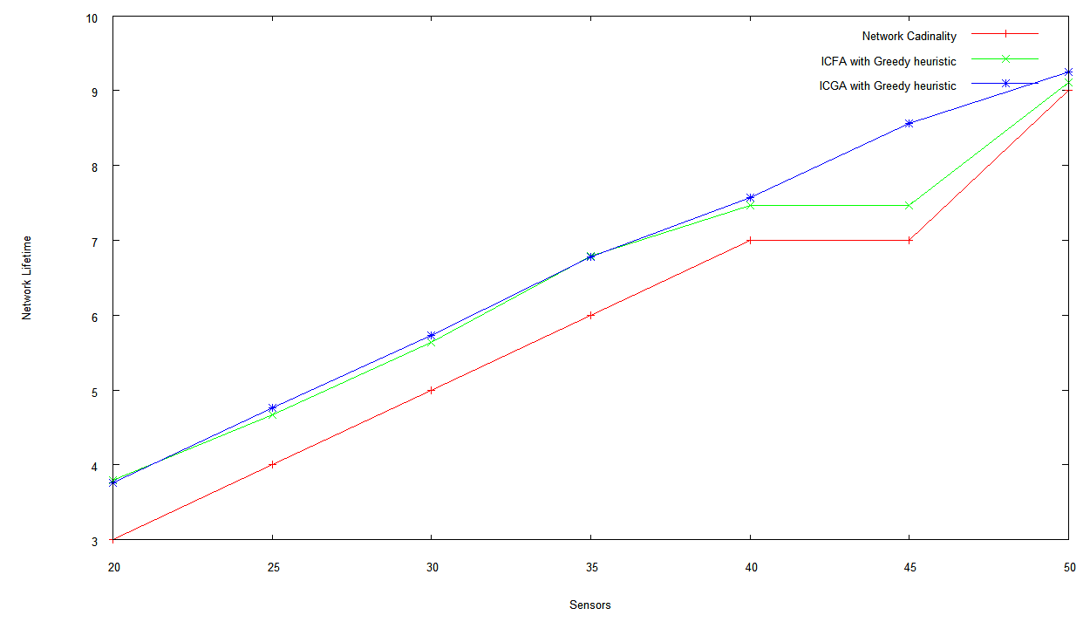

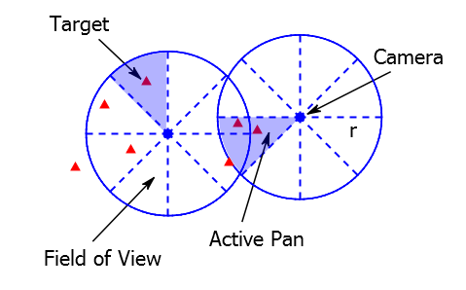


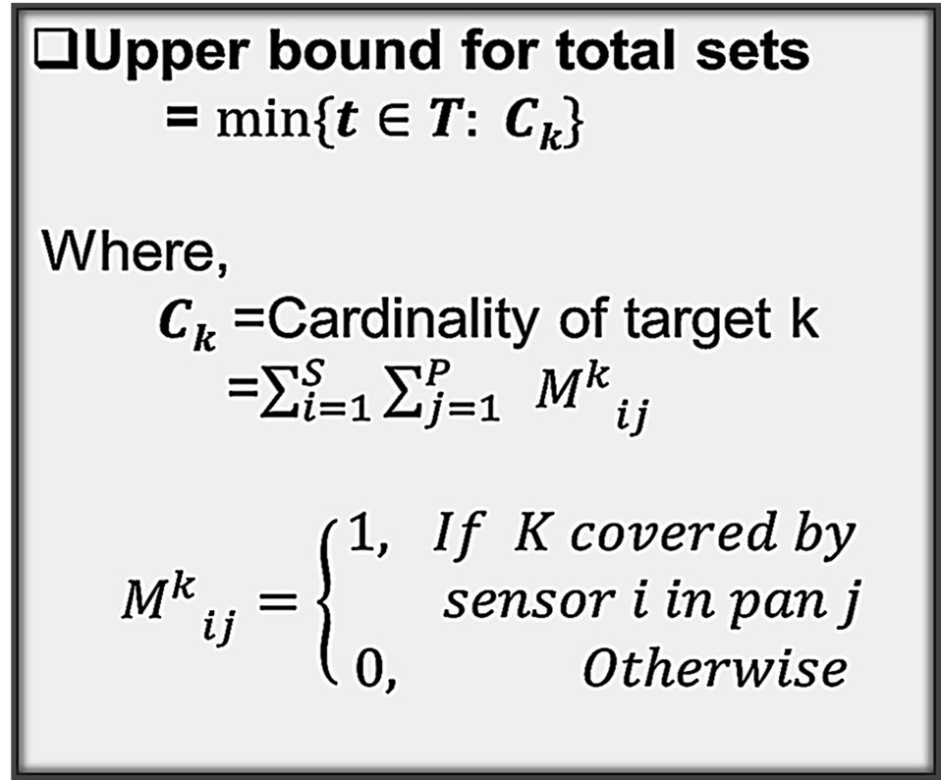
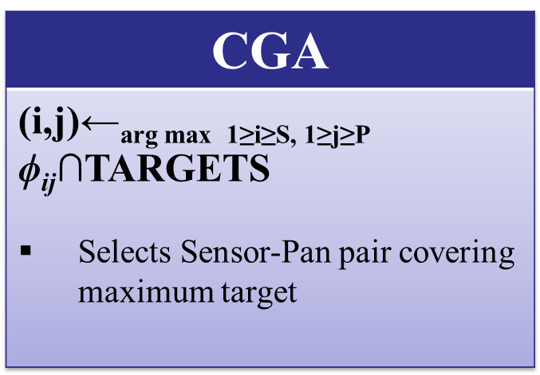
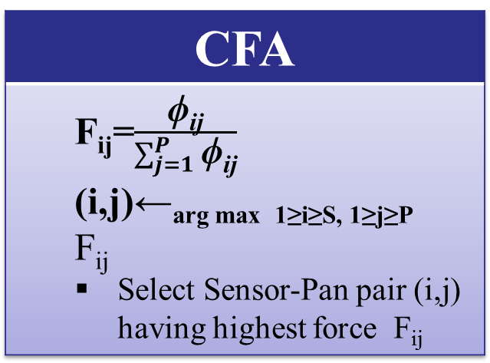


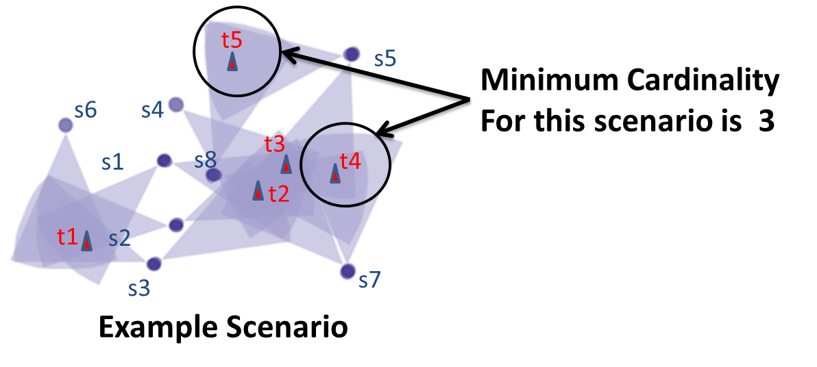

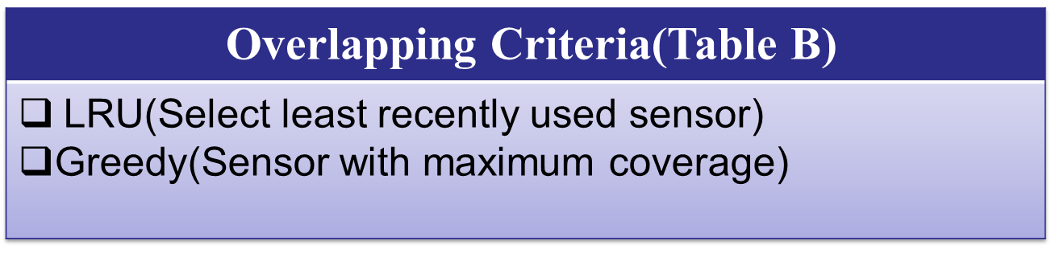
Energy-Efficient Scheduling Heuristic for
Directional Sensors in Wireless Visual Sensor Networks
Visual Sensor network (VSNs)- for Overprovision system-Consisting of
  A set of Targets in 2D plane
  Randomly deployed Directional Sensors
Set Cover Scheduling:
  A Set Cover in visual Sensor Network covers all the targets
  Different heuristics for constructing set cover :
  1. Integer Linear Programming(ILP)
    2. Centralized Force Algorithm(CFA)
    3. Centralized Greedy Algorithm(CGA)
Ds
Performance Analysis
Network Lifetime Comparison between ICFA
and ICGA with greedy Approach
Where, Number of targets=10, Sensor range =30 units ant the network area is 100*100 square units
Iterative Integer Linear Programming(IILP)
ILP Formulation:
ILP Formulation:
Subject to:
ILP constructs set cover using minimum sensor covering all targets
Runs iteratively for disjoint set covers
Iterative Set Cover Heuristic (ISCH)
Goal:
  Iteratively construct K number of set covers by selecting sensors greedily based on their coverage
  Input: S= set of sensors, T= set of randomly deployed targets,
  P=set of non-overlapping sensor pans, K= # of cover set, E=edges
  E = {ϕ_{ij} : targets t ϵT covered by sensor i ϵ S and pan j ϵ P};
  Output: Z= Collection of cover sets C_{1,} C_{2,…………,} C_{k}
t=0
While t<K or all targets in T are covered do
A new cover set C_{t} is formed
t=t+1
C_{t}=ϕ
TARGETS=T
While T is not empty do
Select Sensor-Pan pair(i,j) based on heuristics given in Table A
if |ϕ_{ij}∩ TARGETS|==0 then
if atleast a new sensor selected in the iteration then
use overlapping criteria given in Table B
else break ;
else
C_{t} =C_{t} U {(i,j)}
S=S\{i}
TARGETS=TARGETS \ ϕ_{ij}
end if
end While
Z=Z U C_{t}
end While
return Z
Every Sensors covers targets in range r by different pans
Only one pan becomes active at a time
Figure : A Network of wireless Pan Cameras
In our work, we have :
Studied the MSC(Maximum Set Cover) problem of directional VSN
Proposed our Iterative Set Cover Heuristic for disjoint sets and selection criteria for overlapping solution
Developed Upper-bound for total set cover
Simulated the performance of proposed solution
Overlapping Criteria
Sensor-Pan pair Selection(Table A)
C₁ =4, C₂ =6, C₃ =4, C₄ =3, C₅=3
Jing Ai , A. A. Abouzeid. Coverage by directional sensors in randomly deployed wireless sensor networks, Journal of Combinatorial Optimization,11(1):21–41, 2006.Simulated the performance of proposed solution
Mihaela Cardei, My T. Thai,Yingshu Li, Weili Wu. Energy-Efcient Target Coverage in Wireless
Sensor Networks, INFOCOM 2005. 24th Annual Joint Conference of the IEEE Computer and Communications Societies. Proceedings IEEE
Overlapping Criteria
Department of Computer Science and Engineering (CSE), BUET

