Slide 1

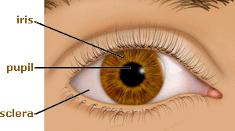
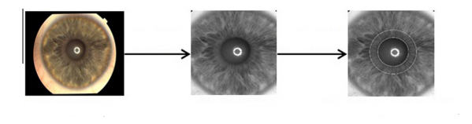
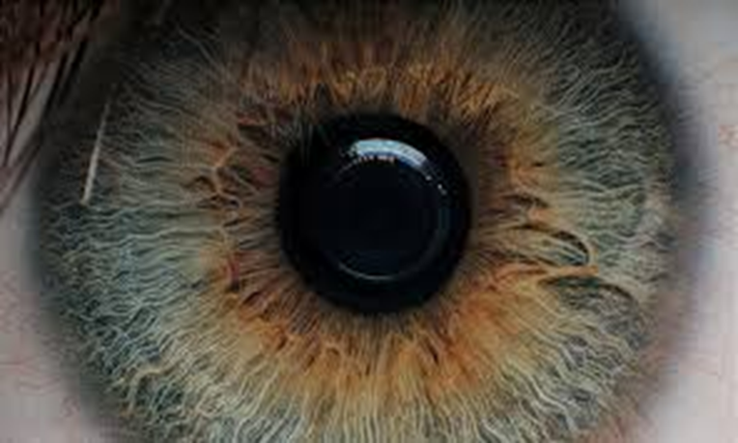
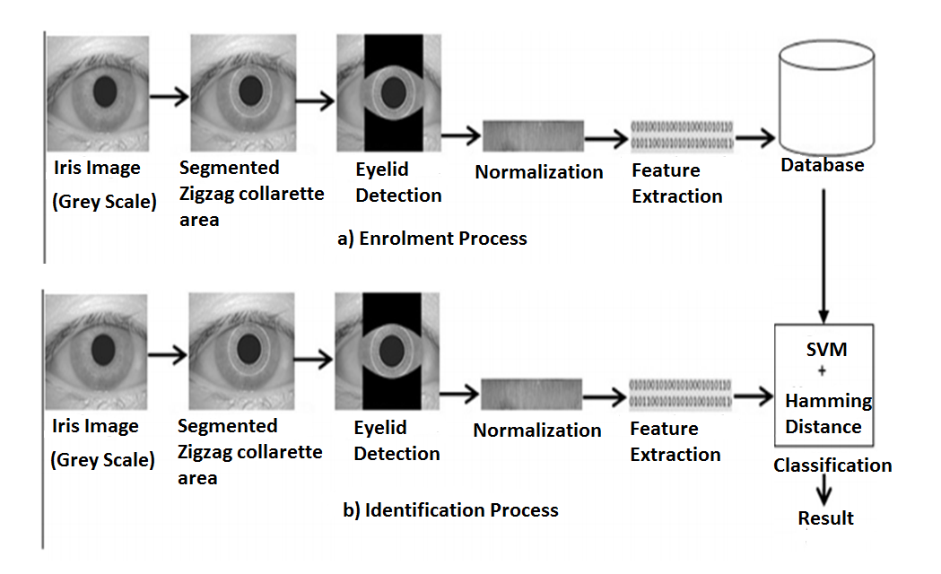

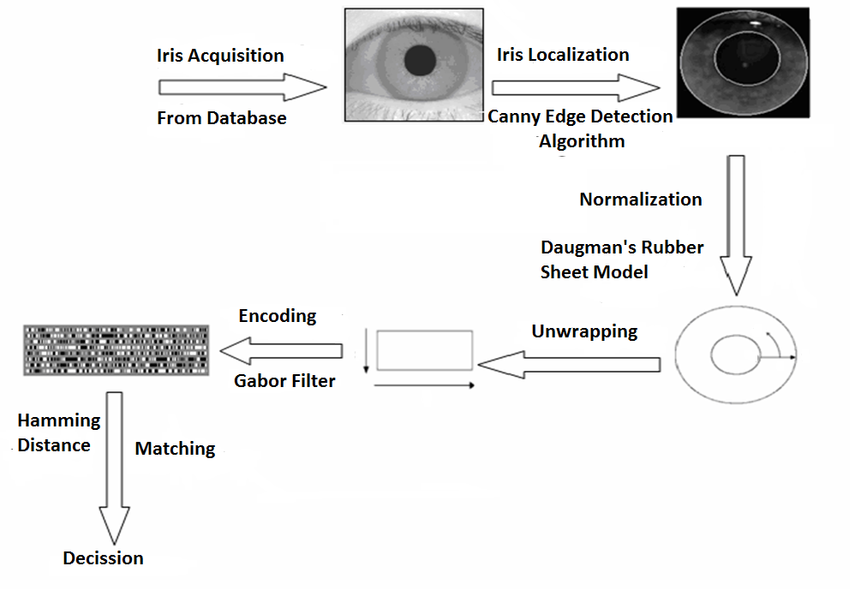
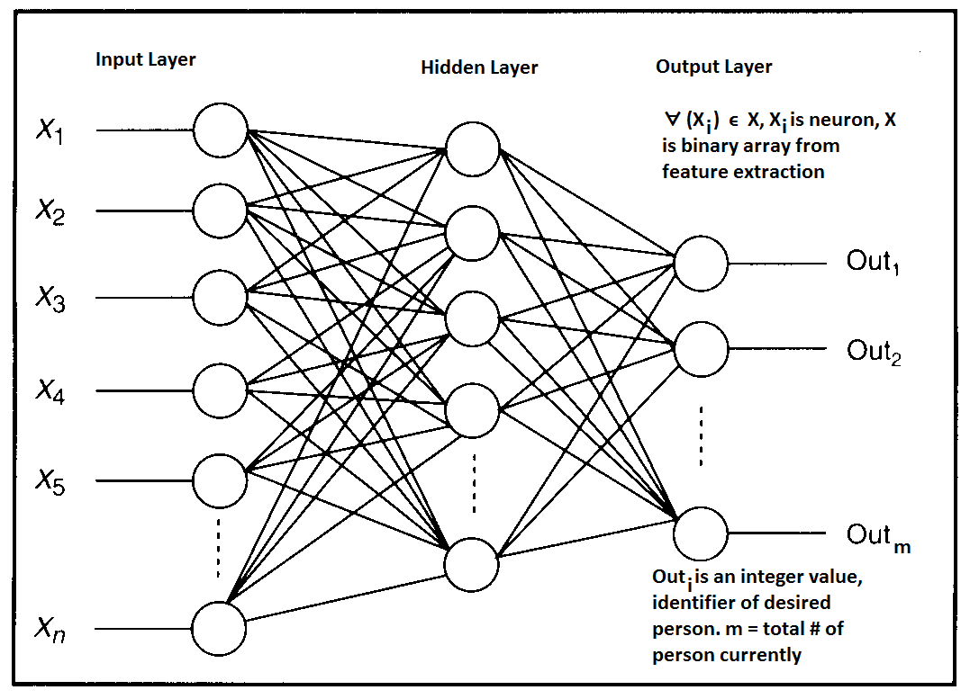
Iris Recognition using Hamming Distance and Neural Network
Soud Al-Raihan, Md. Ahsanul Kabir
Introduction :
Proposal :
Iris is the most reliable and accurate among all biometric traits .
Working with zigzag collarette area of iris
Neural Network
Iris
Pupil
rgb2grey
Iris Localization
Sclera
Original RGB Image
Grey Level Image
Zigzag collarette area localization
Different parts of Iris :
Pupilliary zone
Ciliary zone
010101010101
101001011011
Collarette
1
010101010101
101001011011
1
r
θ
r
θ
Iris Recognition System
Mission and Vision :
Scability
Accuracy
Process 2 : Neural network
Department of Computer Science and Engineering (CSE), BUET

