Slide 1
Welcome to
Moodle Training Program
Day: 1

Slide 2
Server

Slide 3
Server
I. Server login and remote access.
II. How to check server configuration?
III. How to check OS version?

Slide 4
Server login and remote access
Download AnyDesk
Remote Address = 821676090
Pass: OS password

Slide 5
Check Server Configuration
How to View Linux System Information? => $ uname
How to View Linux System Hardware Information? => $ sudo lshw -short
How to check OS version? => $ uname -a

Slide 6
Check OS Version
How to check OS version? => $ uname -a

Slide 7
SPSS

Slide 8
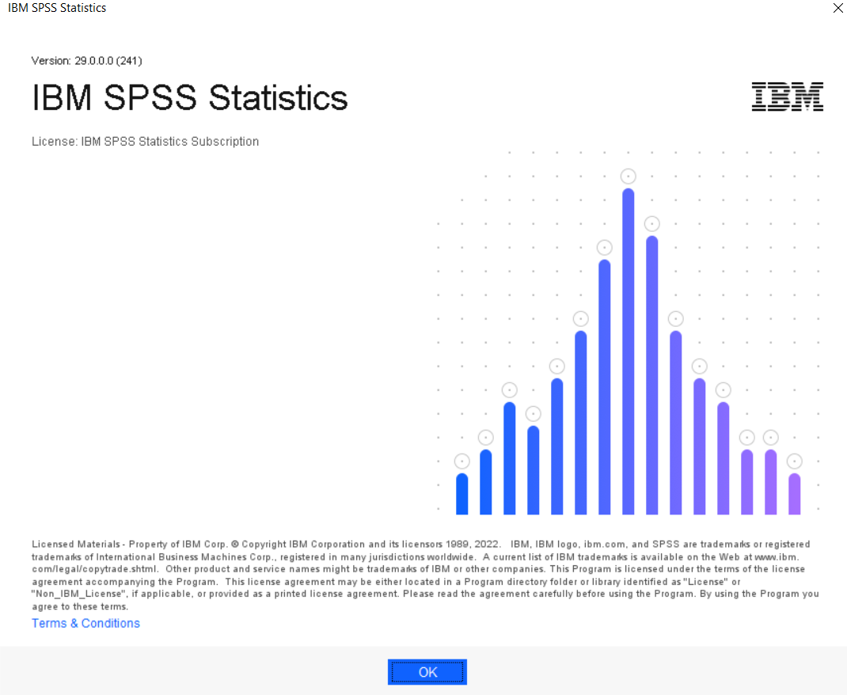
How to check SPSS Version?
SPSS Version
Click: Help → About

Slide 9
Laptop

Slide 10
Laptop
I. Laptop configuration.
II. How to check laptop configuration?

Slide 11
Laptop configuration
Name: ASUS TUF GAMING F15
Processor: INTEL 12TH GEN CORE i7
Ram: 32GB
Storage: 1TB M.2 NVME PCIE G3 SSD
Graphics: NVIDIA GeForce RTX3050 4GB VRAM
OS: WIN11 Pro. /Office Business 2021

Slide 12
How to check laptop configuration
open Settings > System > About

Slide 13
Moodle

Slide 14
Moodle Training Outline
login/logout
Cognitio Basic Theme Setting
User Upload
Password reset by single student
Course and Category
Upload Course
Assignments and Quizzes
Customizing Moodle Themes and Appearance

Slide 15
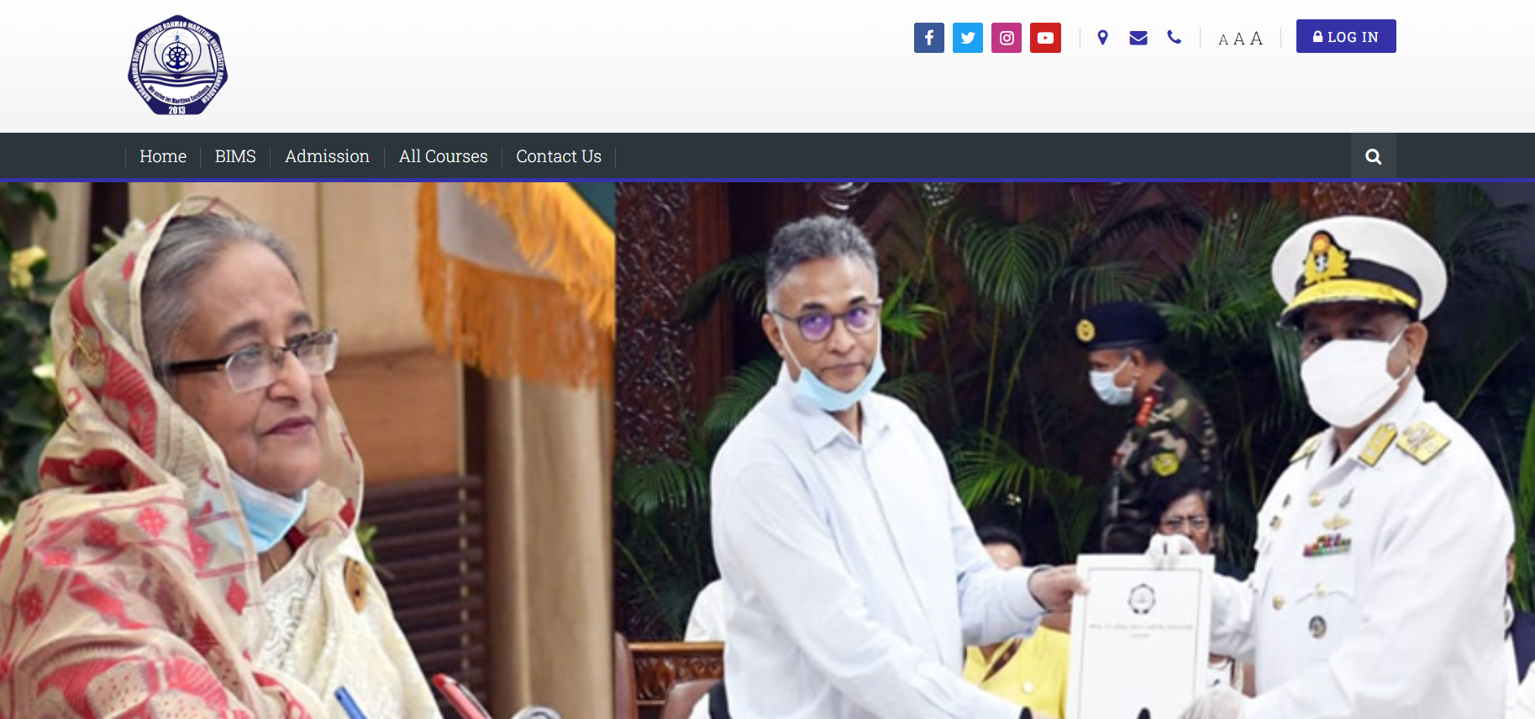
login/logout
Login Url: lms.bsmrmu.edu.bd

Slide 16
Cognitio Basic Theme Setting
How to change site logo
Site email
Phone
Location
Footer
Site menu
Main menu
Social list
Colors

Slide 17
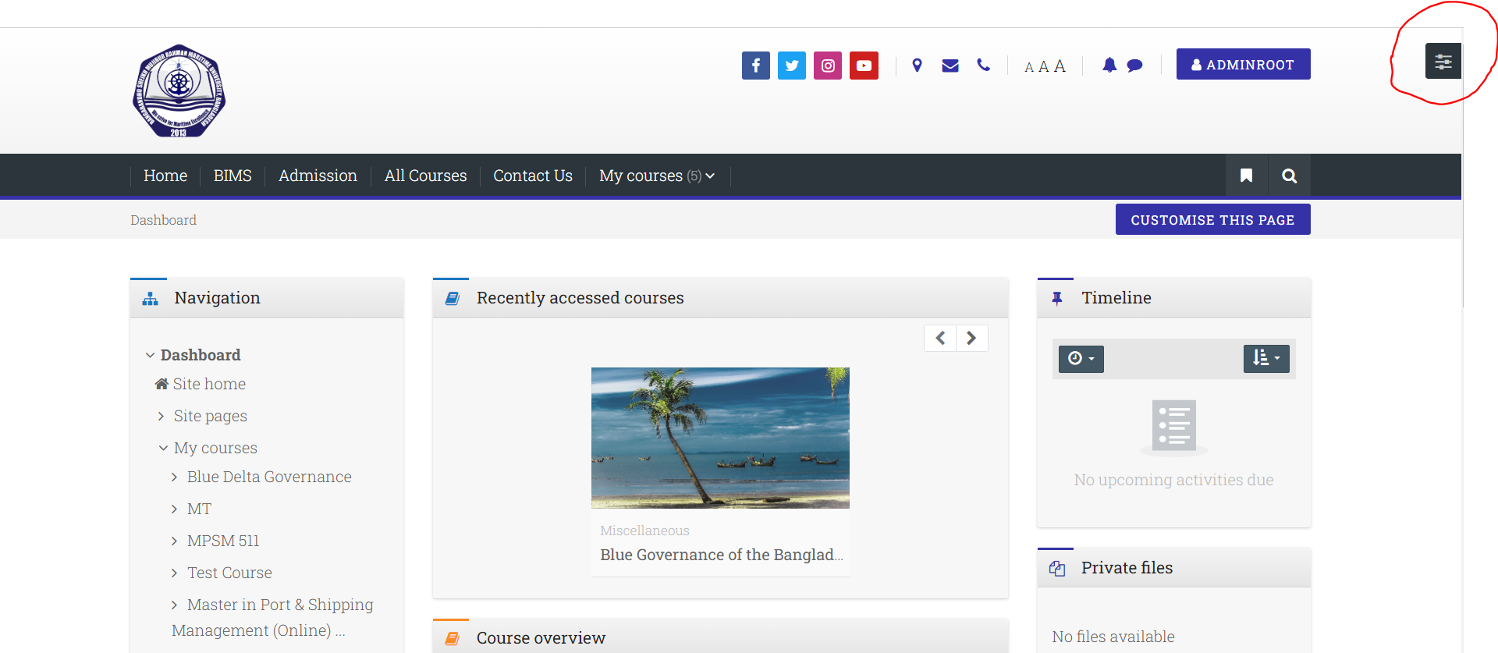
Change Site Logo
Setting → Site administration → Appearance → Themes → Cognitio → Logo Image

Slide 18
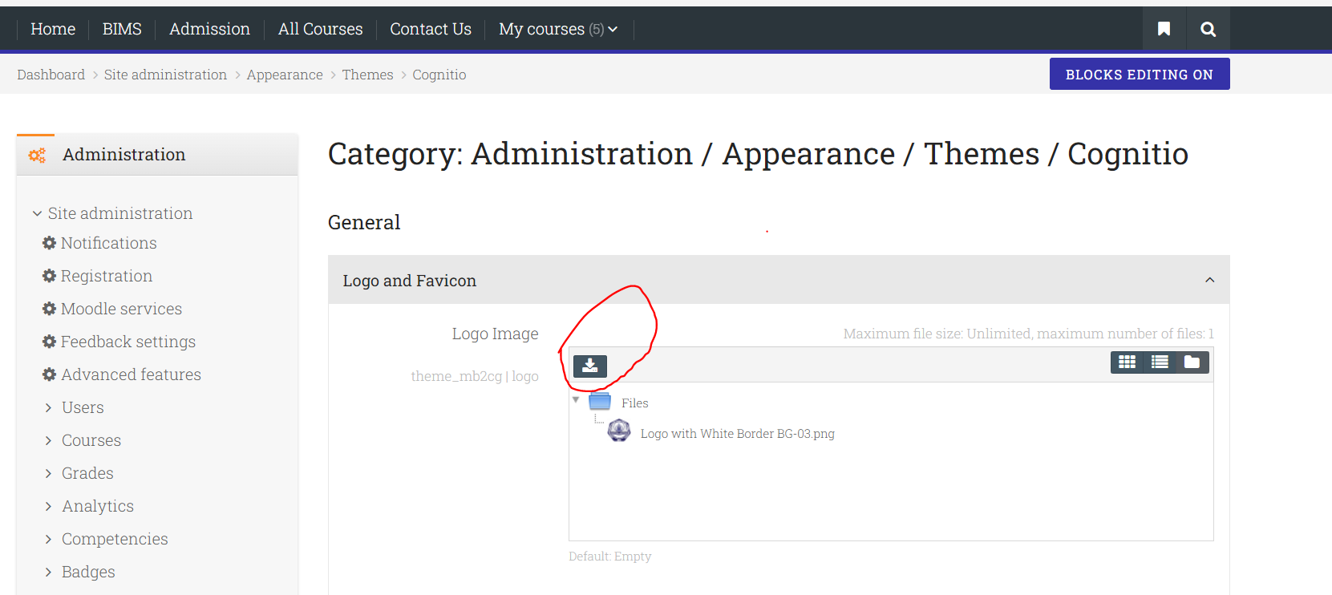
Change Site Logo
Setting → Site administration → Appearance → Themes → Cognitio → Logo Image

Slide 19
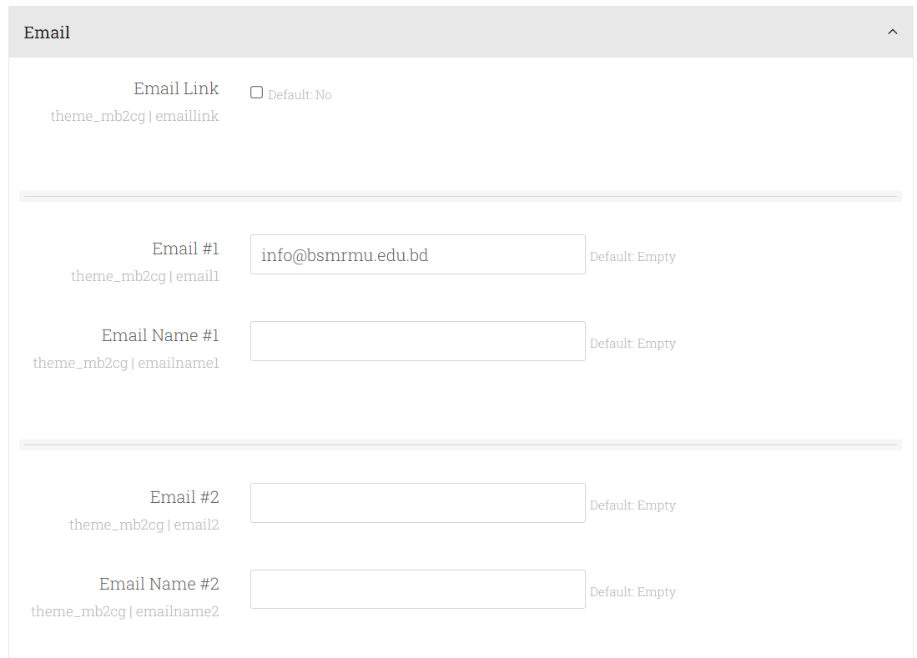
Site Email
Setting → Site administration → Appearance → Themes → Cognitio → Site Email

Slide 20
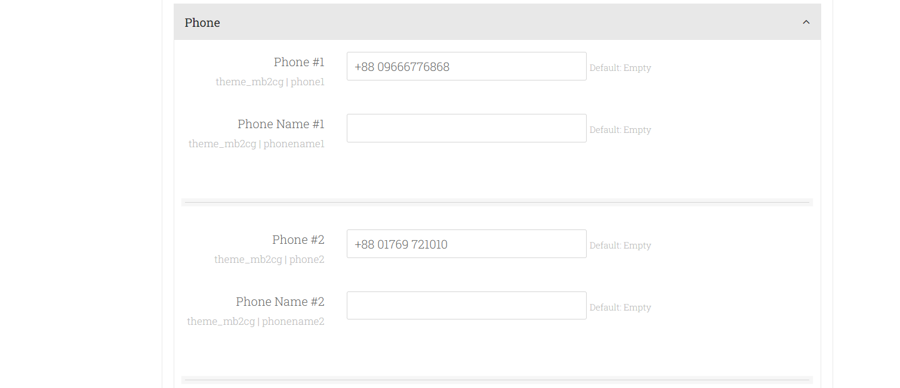
Phone
Setting → Site administration → Appearance → Themes → Cognitio → Phone

Slide 21
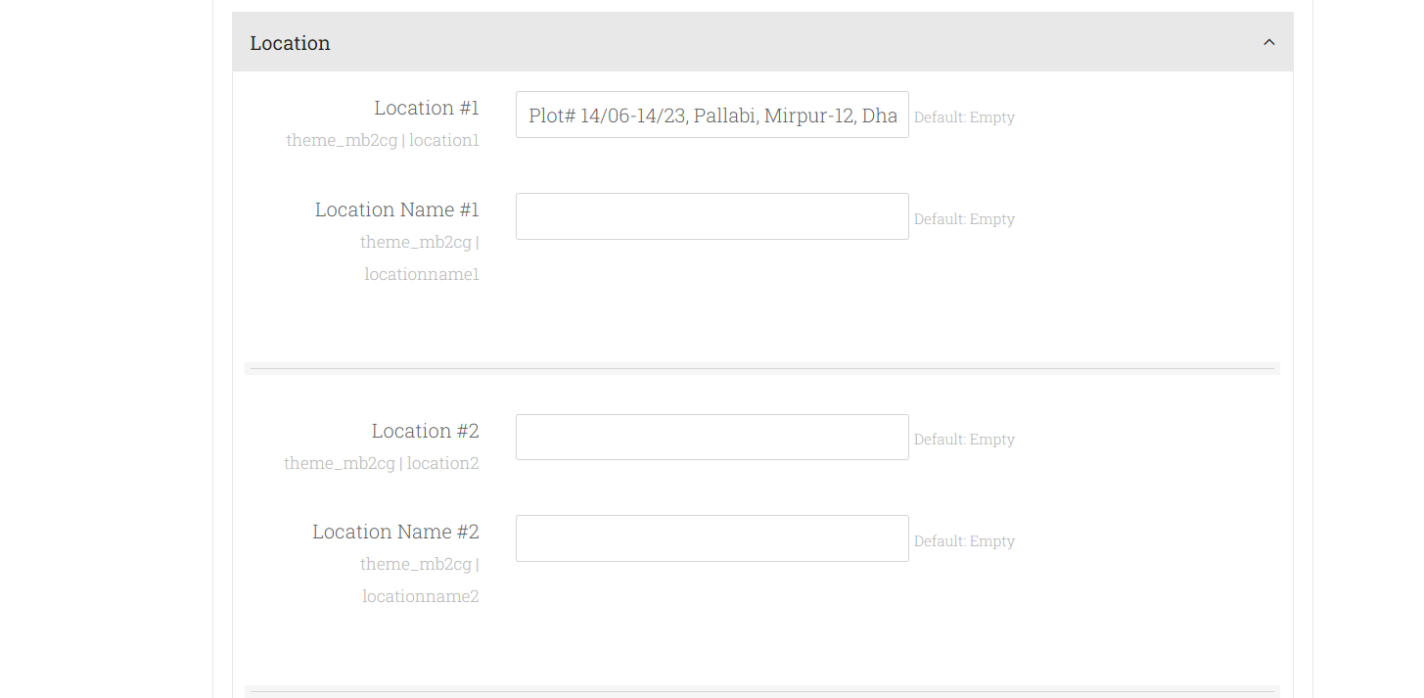
Location
Setting → Site administration → Appearance → Themes → Cognitio → Location

Slide 22
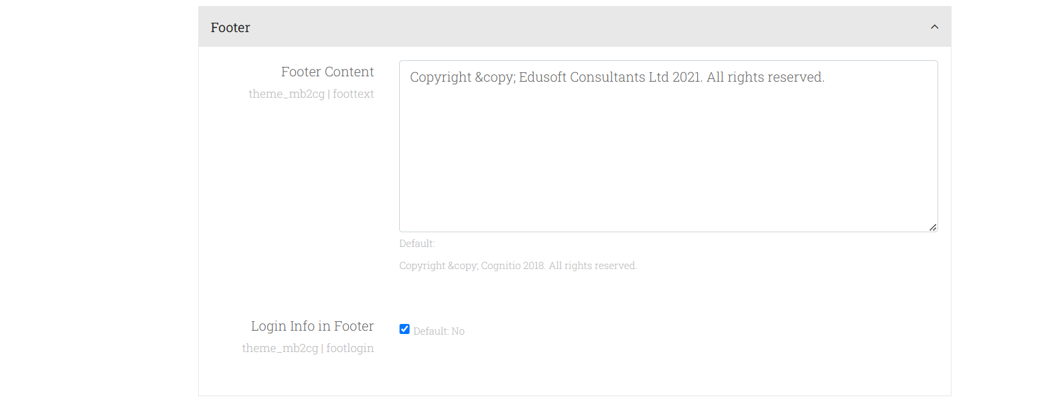
Footer
Setting → Site administration → Appearance → Themes → Cognitio → Footer

Slide 23
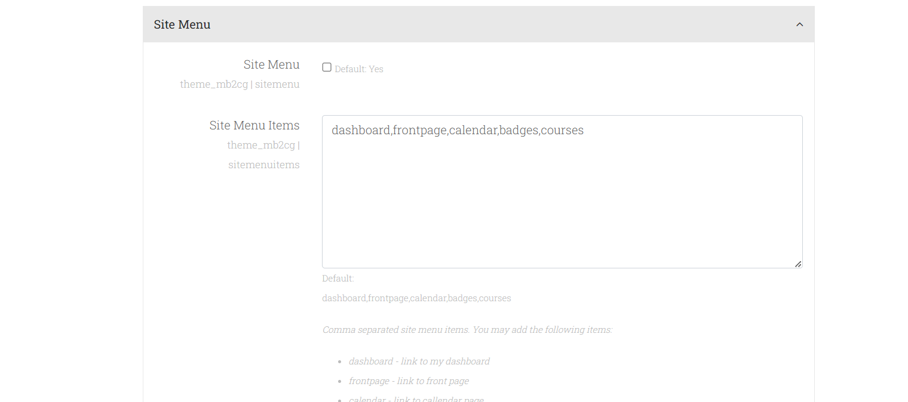
Site Menu
Setting → Site administration → Appearance → Themes → Cognitio → Site Menu

Slide 24
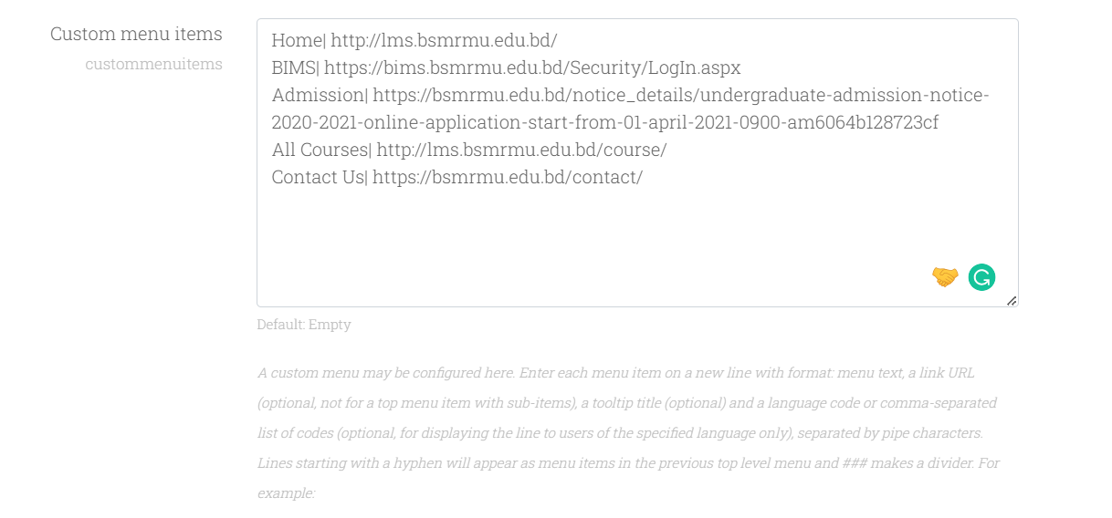
Main Menu
Setting → Site administration → Appearance → Themes setting

Slide 25
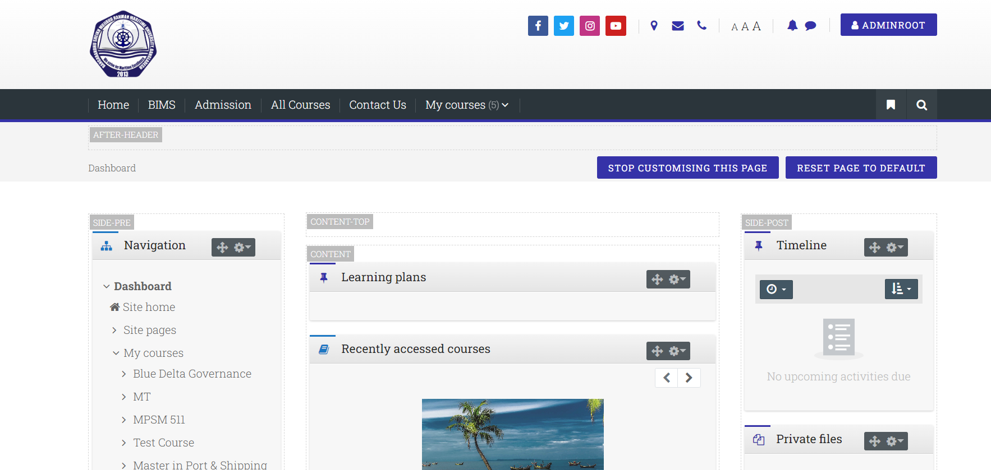
Main Menu
Setting → Site administration → Appearance → Themes setting
Menu

Slide 26
User Upload and Export
CSV file format
Bulk user upload
Single user upload
Single user update
User export/download
User Roles Assign

Slide 27
CSV file format
username,firstname,lastname,email,password
URL : https://github.com/nazmulkhanliton/MaritimeUniversity/blob/main/Users.txt

Slide 28
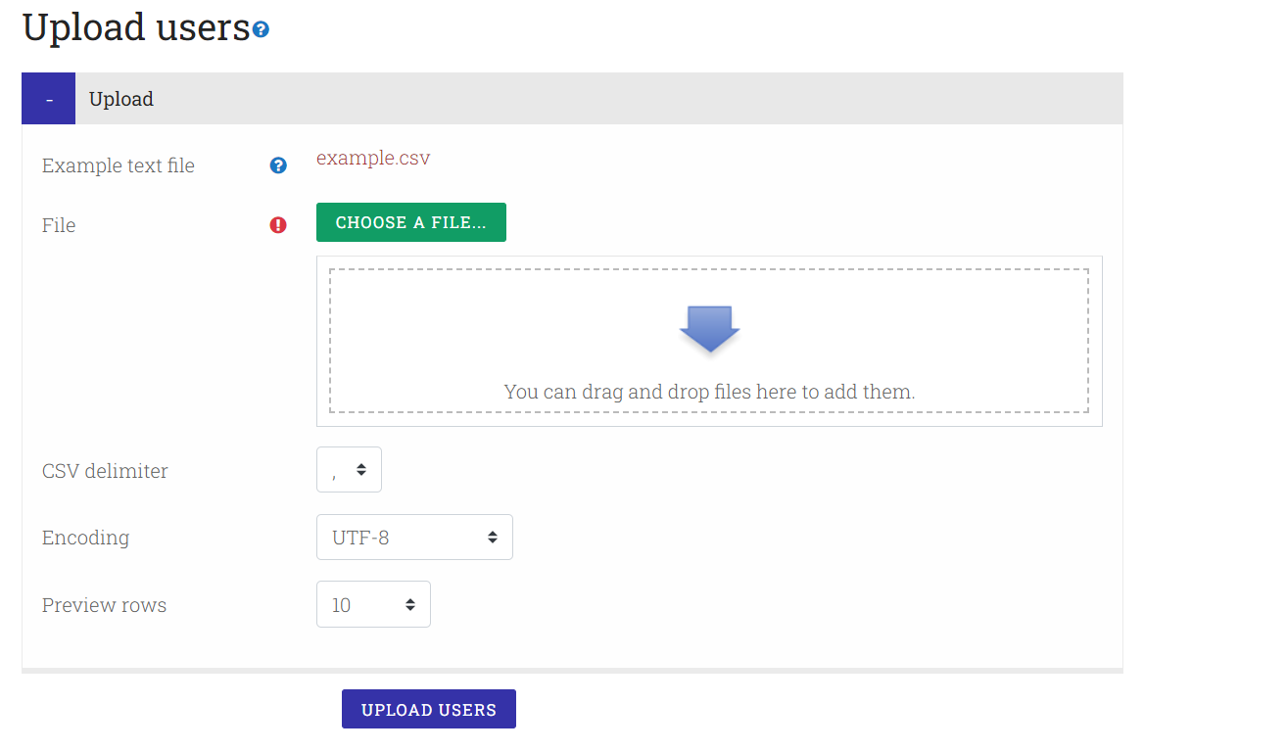
Bulk user upload

Slide 29
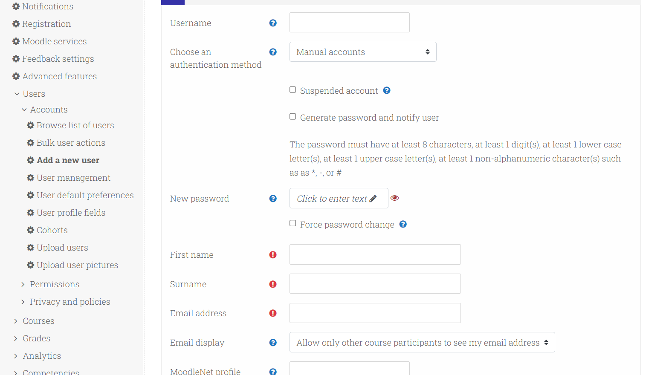
Single user upload
Site administration → Users → Accounts → Add a new user

Slide 30
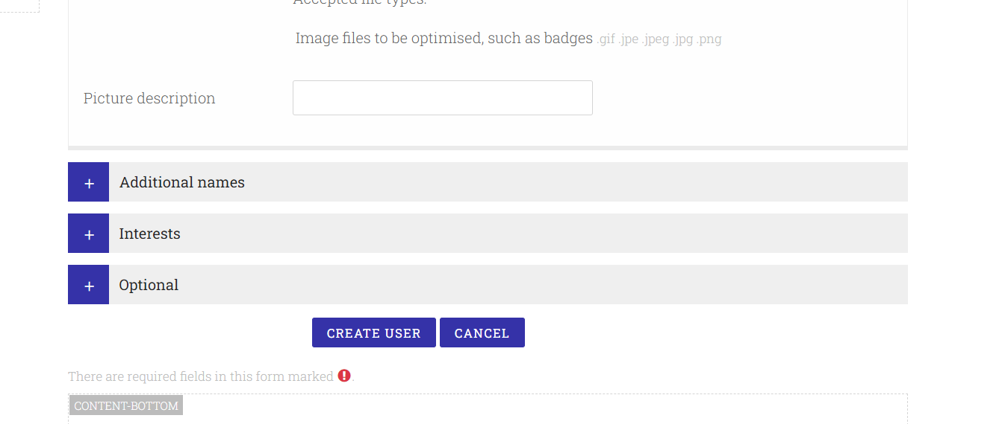
Single user upload
Site administration → Users → Accounts → Add a new user

Slide 31
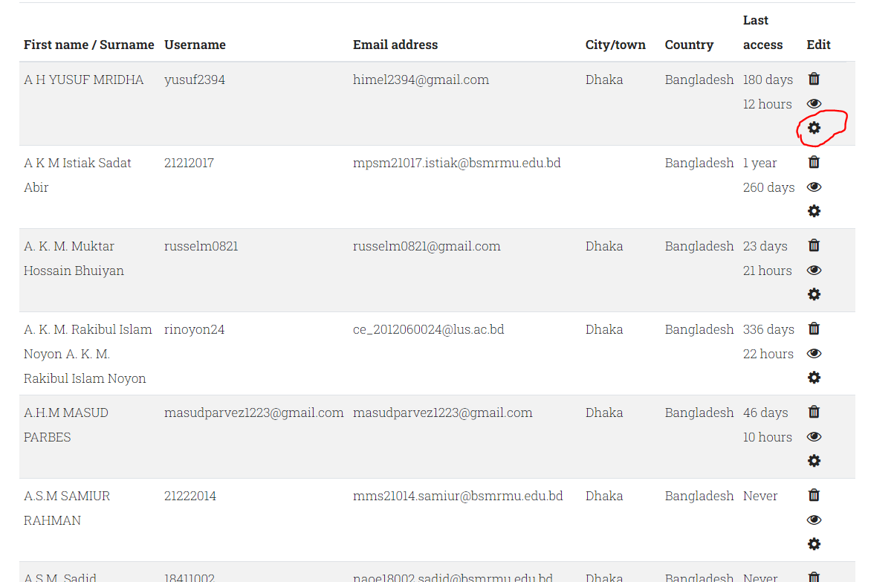
Single user update
Site administration → Users → Accounts → Browse list of users

Slide 32
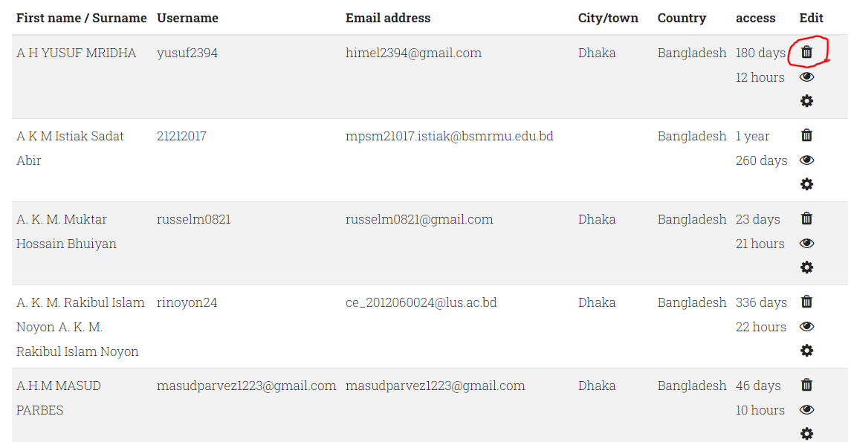
Delete user
Site administration → Users → Accounts → Browse list of users

Slide 33
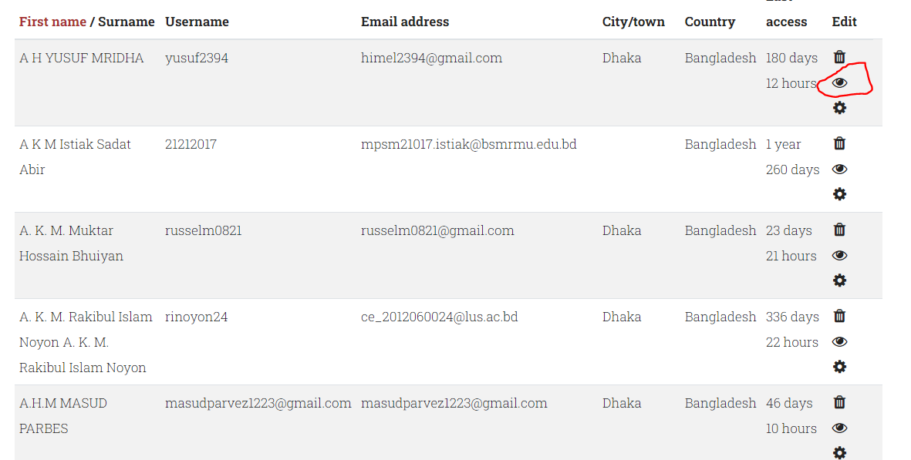
InActive user
Site administration → Users → Accounts → Browse list of users

Slide 34
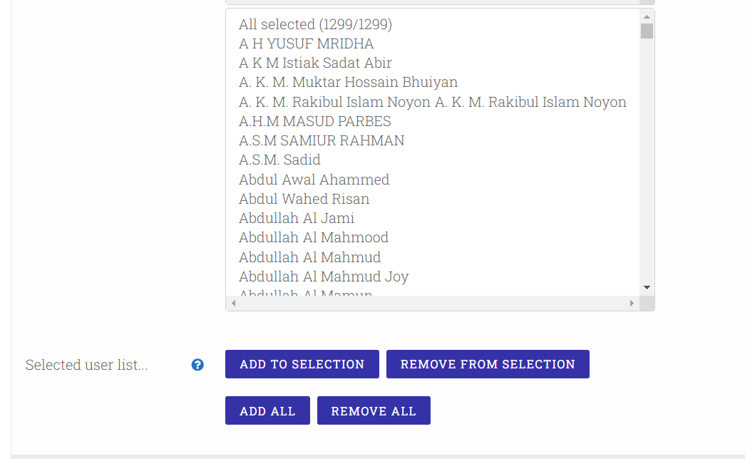
User export
Site administration → Users → Accounts → Bulk user actions

Slide 35
User export
Site administration → Users → Accounts → Bulk user actions
Step 1: Add all
Step 2: Select download option
Step 3: Go
Step 4: Select file type
Step 5: Download

Slide 36
User Roles Assign
Site administration → Users → Accounts → Bulk user actions
Step 1: Add all
Step 2: Select download option
Step 3: Go
Step 4: Select file type
Step 5: Download

Slide 37
Thank You

Slide 38
Moodle Training Outline
login/logout
Theme Setting
User Upload
Course and Category
Upload Course
Password reset by single student
Assignments and Quizzes
Customizing Moodle Themes and Appearance

