Slide 1

iSpring Cloud
The Only Service that Preserves All PowerPoint Effects

Slide 2

Reproduces all animations
Faded Swivel
Spinner
Pinwheel
Compress
Stretch
Swish
Grow & Turn
Glide
Swivel

Slide 3




Reproduces even advanced animations

Slide 4
Advanced Text Formatting
Regular Texts
Bold Texts
Underlined texts
Shadowed texts
Texts of multiple style^{s}, fonts, sizes and colors
Various styles of bullets
Picture bullets
Numbered bullets
Character bullets

Slide 5
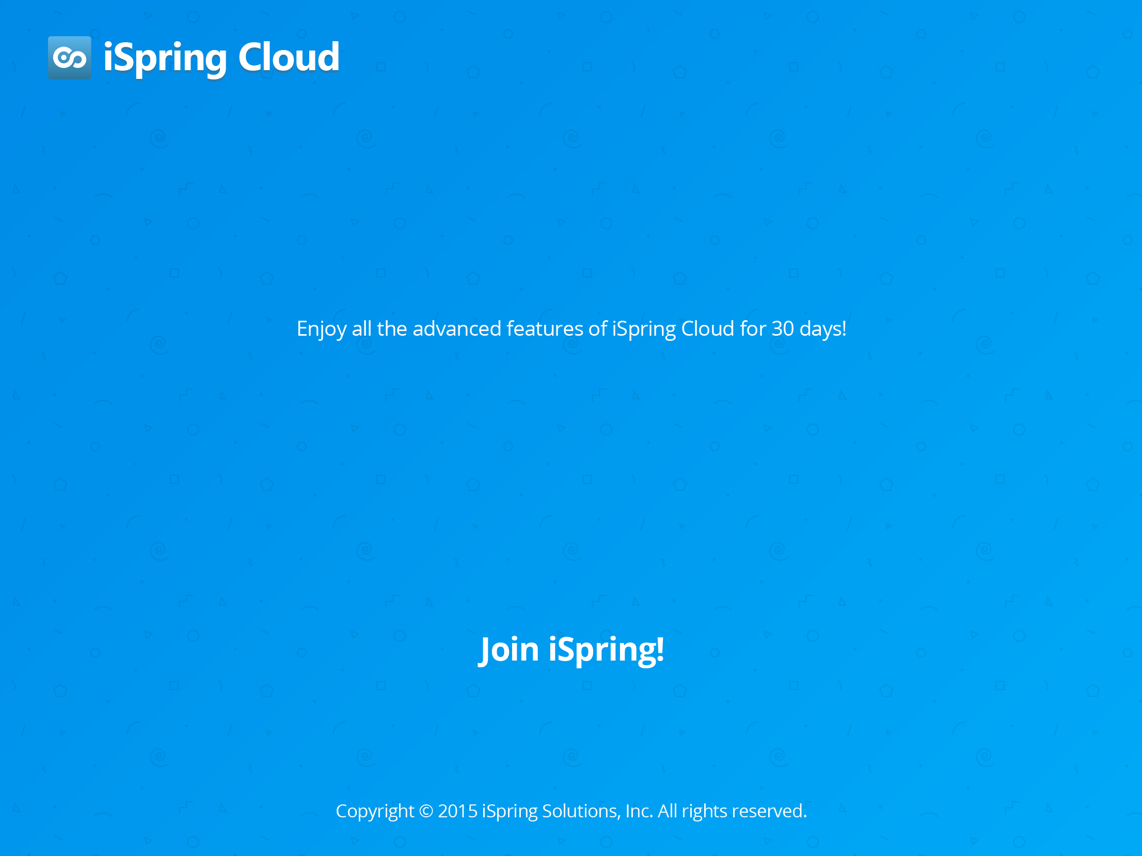

Join iSpring!
Enjoy all the advanced features of iSpring Cloud for 30 days!
Start Now for Free
Copyright © 2015 iSpring Solutions, Inc. All rights reserved.

