Slide 1
WORDPRESS SETUP
LOCAL SERVER SETUP
ONLINE SERVER OVERVIEW
DATABASE SETUP
WORDPRESS INSTALLATION
WORDPRESS LOGIN

Slide 2
WORDPRESS SETUP
(A) LOCAL SERVER SETUP (B) ONLINE SERVER OVERVIEW (C) DATABASE SETUP (D) WORDPRESS INSATLLATION (E) WORDPRESS LOGIN
(A) LOCAL SERVER SETUP
What You Need?
Xampp for Windows
WordPress (ver 4.5)

Slide 3
WORDPRESS SETUP
(A) LOCAL SERVER SETUP (B) ONLINE SERVER OVERVIEW (C) DATABASE SETUP (D) WORDPRESS INSATLLATION (E) WORDPRESS LOGIN
(A) LOCAL SERVER SETUP
What Is XAMPP?
A Xampp (Apache, MySQL, PHP and …) bundle
A suite of the following software
Apache
MySQL
PHP
phpMyAdmin

Slide 4
WORDPRESS SETUP
(A) LOCAL SERVER SETUP (B) ONLINE SERVER OVERVIEW (C) DATABASE SETUP (D) WORDPRESS INSATLLATION (E) WORDPRESS LOGIN
(A) LOCAL SERVER SETUP
How To Do
Install Xampp
Create a database in MySQL with PhpMyAdmin
Install WordPress Software
Set up your blog

Slide 5
WORDPRESS SETUP
(A) LOCAL SERVER SETUP (B) ONLINE SERVER OVERVIEW (C) DATABASE SETUP (D) WORDPRESS INSATLLATION (E) WORDPRESS LOGIN
(A) LOCAL SERVER SETUP
Install Xampp
Double Click xampp-win32-?.?.?-installer.exe to launch the installer
Select the Apache & MySQL as component and Click “Next”

Slide 6
WORDPRESS SETUP
(A) LOCAL SERVER SETUP (B) ONLINE SERVER OVERVIEW (C) DATABASE SETUP (D) WORDPRESS INSATLLATION (E) WORDPRESS LOGIN
(A) LOCAL SERVER SETUP
Install Xampp
Click “Next” to Continue
Installation in Progress…
Select Language and save
Installation Complete. Now click finish

Slide 7
WORDPRESS SETUP
(A) LOCAL SERVER SETUP (B) ONLINE SERVER OVERVIEW (C) DATABASE SETUP (D) WORDPRESS INSATLLATION (E) WORDPRESS LOGIN
(A) LOCAL SERVER SETUP
Install Xampp
Services Started

Slide 8
WORDPRESS SETUP
(A) LOCAL SERVER SETUP (B) ONLINE SERVER OVERVIEW (C) DATABASE SETUP (D) WORDPRESS INSATLLATION (E) WORDPRESS LOGIN
(A) LOCAL SERVER SETUP
Install Xampp
Checking the Xampp Installation,
Type http://localhost on the address bar of your web browser. The following screen appears…

Slide 9
WORDPRESS SETUP
(A) LOCAL SERVER SETUP (B) ONLINE SERVER OVERVIEW (C) DATABASE SETUP (D) WORDPRESS INSATLLATION (E) WORDPRESS LOGIN
(A) LOCAL SERVER SETUP
Create a database
Launch PhpMyAdmin
Create a database named “your database name”
Create a user named “your database name”
Grant all privileges to the user “your database name”
on the database “your database name”

Slide 10
WORDPRESS SETUP
(A) LOCAL SERVER SETUP (B) ONLINE SERVER OVERVIEW (C) DATABASE SETUP (D) WORDPRESS INSATLLATION (E) WORDPRESS LOGIN
(A) LOCAL SERVER SETUP
Create a database
Select “phpMyadmin” in Tools
Create a new database
by name “YOUR DATABASE NAME” (or any other name)

Slide 11
WORDPRESS SETUP
(A) LOCAL SERVER SETUP (B) ONLINE SERVER OVERVIEW (C) DATABASE SETUP (D) WORDPRESS INSATLLATION (E) WORDPRESS LOGIN
(A) LOCAL SERVER SETUP
Create a database
Browse to the “htdocs” folder

Slide 12
WORDPRESS SETUP
(A) LOCAL SERVER SETUP (B) ONLINE SERVER OVERVIEW (C) DATABASE SETUP (D) WORDPRESS INSATLLATION (E) WORDPRESS LOGIN
(B) ONLINE SERVER OVERVIEW
System Requirements for WordPress
Database − MySQL 5.0 +
Web Server −
WAMP (Windows)
LAMP (Linux)
XAMP (Multi-platform)
MAMP (Macintosh)
Operating System − Cross-platform
Browser Support − IE (Internet Explorer 8+), Firefox, Google chrome, Safari, Opera
PHP Compatibility − PHP 5.2+

Slide 13
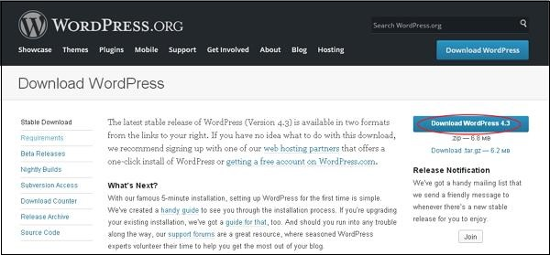
WORDPRESS SETUP
(A) LOCAL SERVER SETUP (B) ONLINE SERVER OVERVIEW (C) DATABASE SETUP (D) WORDPRESS INSATLLATION (E) WORDPRESS LOGIN
(B) ONLINE SERVER OVERVIEW
Download WordPress
When you open the link https://wordpress.org/download/, you will get to see a screen as the following snapshot −

Slide 14
WORDPRESS SETUP
(A) LOCAL SERVER SETUP (B) ONLINE SERVER OVERVIEW (C) DATABASE SETUP (D) WORDPRESS INSATLLATION (E) WORDPRESS LOGIN
(B) ONLINE SERVER OVERVIEW
Create Store Database
WordPress requires MySQL database. So create a new empty database with user/password (for example, user as "root" and password as "root" or else you can set as per your convenience).
Then, you can continue with the installation process as discussed further.

Slide 15
WORDPRESS SETUP
(A) LOCAL SERVER SETUP (B) ONLINE SERVER OVERVIEW (C) DATABASE SETUP (D) WORDPRESS INSATLLATION (E) WORDPRESS LOGIN
(B) ONLINE SERVER OVERVIEW
Set Up Wizard
It's very easy to set up WordPress into your system. The following steps describe how to set up WordPress locally on your system.
Step 1 − Extract the downloaded WordPress folder and upload it into your web server or localhost.

Slide 16
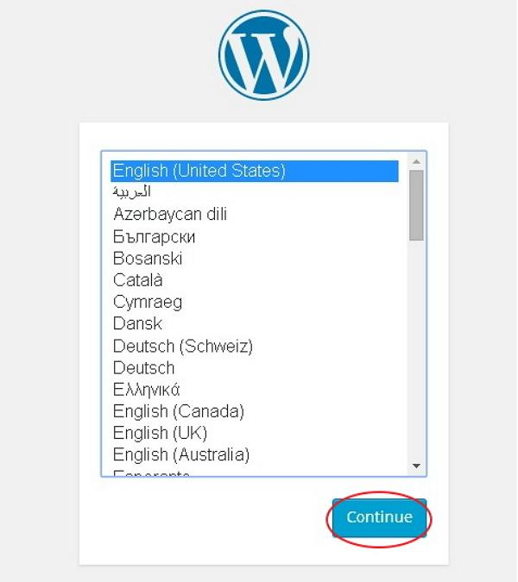
WORDPRESS SETUP
(A) LOCAL SERVER SETUP (B) ONLINE SERVER OVERVIEW (C) DATABASE SETUP (D) WORDPRESS INSATLLATION (E) WORDPRESS LOGIN
(B) ONLINE SERVER OVERVIEW
Set Up Wizard
Step 2 − Open your browser and navigate to your WordPress file path, then you will get the first screen of the WordPress installer as shown in the following screen. In our case, the path is localhost/< Your_wordpress_folder >.
Select your language for the WordPress and click on Continue.

Slide 17
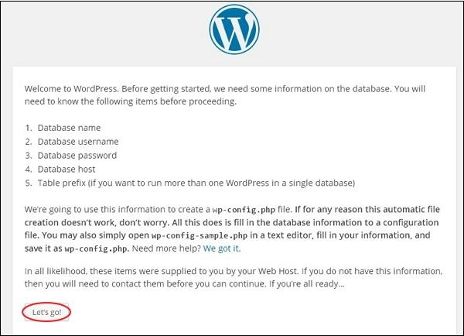
WORDPRESS SETUP
(A) LOCAL SERVER SETUP (B) ONLINE SERVER OVERVIEW (C) DATABASE SETUP (D) WORDPRESS INSATLLATION (E) WORDPRESS LOGIN
(B) ONLINE SERVER OVERVIEW
Set Up Wizard
Step 3 − In this step, you can view the information needed for the database before proceeding with WordPress installation.
Click on Let's go!

Slide 18
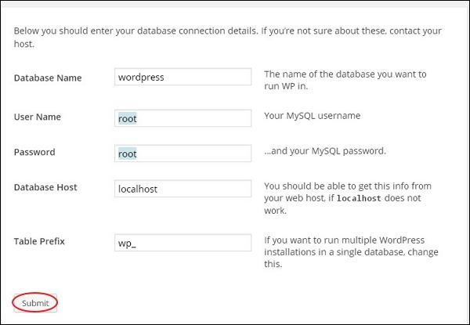
WORDPRESS SETUP
(A) LOCAL SERVER SETUP (B) ONLINE SERVER OVERVIEW (C) DATABASE SETUP (D) WORDPRESS INSATLLATION (E) WORDPRESS LOGIN
(B) ONLINE SERVER OVERVIEW
Set Up Wizard
Step 4 − Here, you have to enter the information about the MySQL database as described in the following screen.
Database Name − Enter the database name which you have created in MySQL database for WordPress.
Username − Enter the user name of your MySQL database.
Password − Enter the password which you had set for MySQL database.
Database Host − Write the host name, by default it will be localhost.
Table Prefix − It is used to add prefix in the database tables which helps to run multiple sites on the same database. It takes the default value.
After filling all information, click on Submit button.

Slide 19
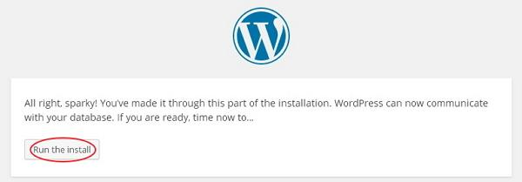
WORDPRESS SETUP
(A) LOCAL SERVER SETUP (B) ONLINE SERVER OVERVIEW (C) DATABASE SETUP (D) WORDPRESS INSATLLATION (E) WORDPRESS LOGIN
(B) ONLINE SERVER OVERVIEW
Set Up Wizard
Step 5 − WordPress checks the database setting and gives you the confirmation screen as shown in the following snapshot
Click on Run the install

Slide 20
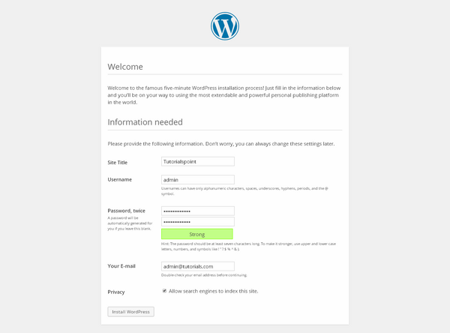
WORDPRESS SETUP
(A) LOCAL SERVER SETUP (B) ONLINE SERVER OVERVIEW (C) DATABASE SETUP (D) WORDPRESS INSATLLATION (E) WORDPRESS LOGIN
(B) ONLINE SERVER OVERVIEW
Set Up Wizard
Step 6 − Enter administrative information.
Site Title − Enter the name of the site which you are going to create in WordPress.
Username − Enter the username as per your choice while logging in the WordPress.
Password twice − Enter password two times to protect your site.
Your E-mail − Enter your e-mail address which helps to recover the password or any update.
Privacy − It allows the search engine to index this site after checking the checkbox.
After filling all the information, click on the Install WordPress button.

Slide 21
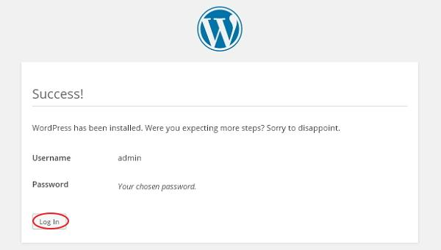
WORDPRESS SETUP
(A) LOCAL SERVER SETUP (B) ONLINE SERVER OVERVIEW (C) DATABASE SETUP (D) WORDPRESS INSATLLATION (E) WORDPRESS LOGIN
(B) ONLINE SERVER OVERVIEW
Set Up Wizard
Step 7 − After installation being successful, you will get a screen of the stating success as seen in the following screen.
You can view your username and password detail added in WordPress.
Click on Log In button.

Slide 22
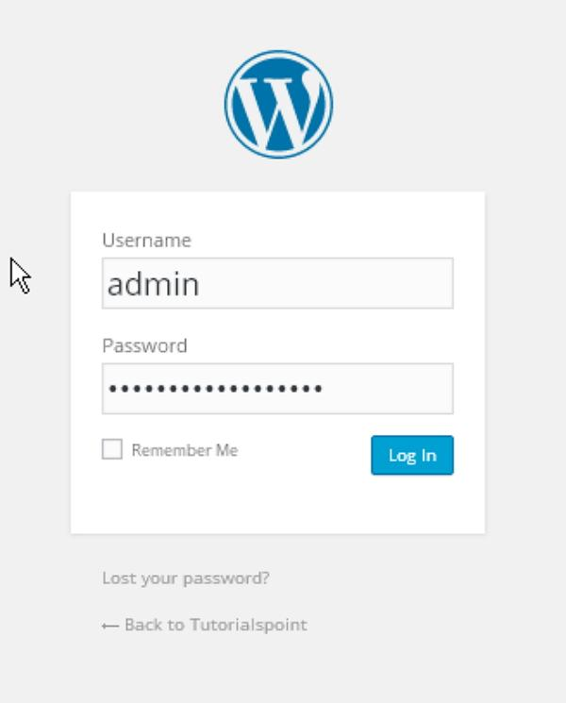
WORDPRESS SETUP
(A) LOCAL SERVER SETUP (B) ONLINE SERVER OVERVIEW (C) DATABASE SETUP (D) WORDPRESS INSATLLATION (E) WORDPRESS LOGIN
(B) ONLINE SERVER OVERVIEW
Set Up Wizard
Step 8 − After clicking on login, you will get a WordPress Admin Panel as depicted in the following screen.
Enter the username and password which you had mentioned during installation as shown in step 6 and click on the Log In button.

