Slide 1
HEALTHCARE DATABASE
CREATED BY KARIMOVA NAZRIN AND SHAFAYAT ABDULLAYEVA

Slide 2
WHY DO WE CREATE THIS DATABASE?
We think that there are many changes taking places in healthcare sector.
Every time patient visits a medical institution ,there is a lot of information
that is collected. These patients have procedures, drug prescriptions,
diagnosis. Now, imagine that a typical day and number of patients
who come to the hospital, for example doctor may not have time to go
through mounds of data when a patient comes in. It requires the
information undergoes query, filtering using this database So for showing
quality of healthcare in a hospital like: quality of Diagnosis, Procedures,
length of stay, charges and etc. We have created HEALTHCARE database.

Slide 3

Miniworld requirements
Healthcare system: Patients go to the hospital and assign to doctors for controlling.
Doctors take procedures and write some medications for patients according the
disease of patients they can stay in the hospital . Doctors are employee
in the hospital , and they get salary. Each procedure has a cost ,for
including procedure every patient must pay a bill.

Slide 4
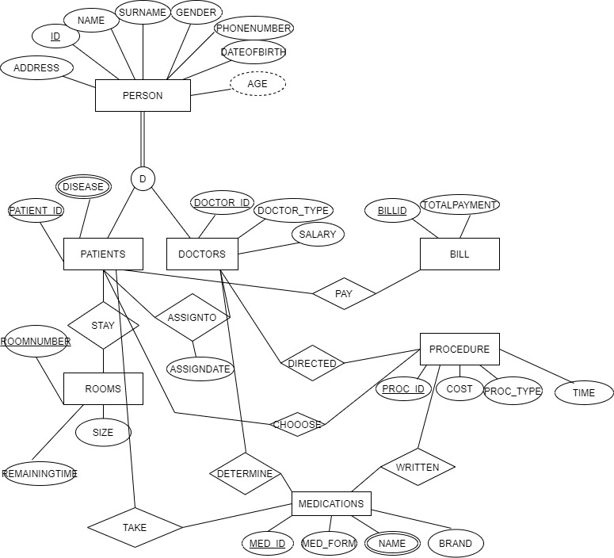
OUR EER DIAGRAM

Slide 5
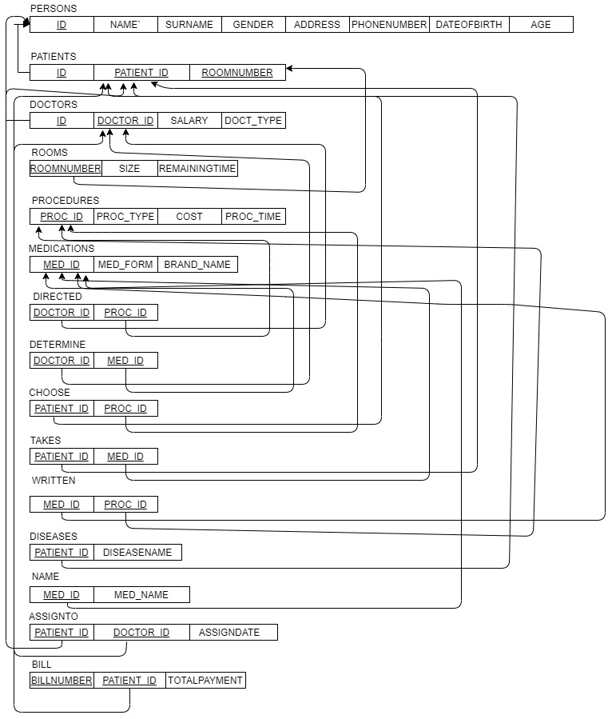
MAPPING PROCESS

Slide 6
CREATING TABLES
We use Microsoft Sql Server for writing code.First we create the database which name is HEALTHCARE.
CREATE DATABASE HEALTHCARE

Slide 7
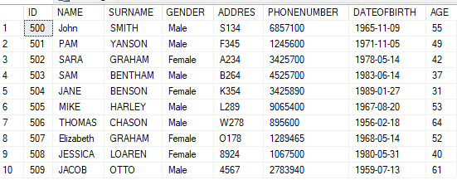
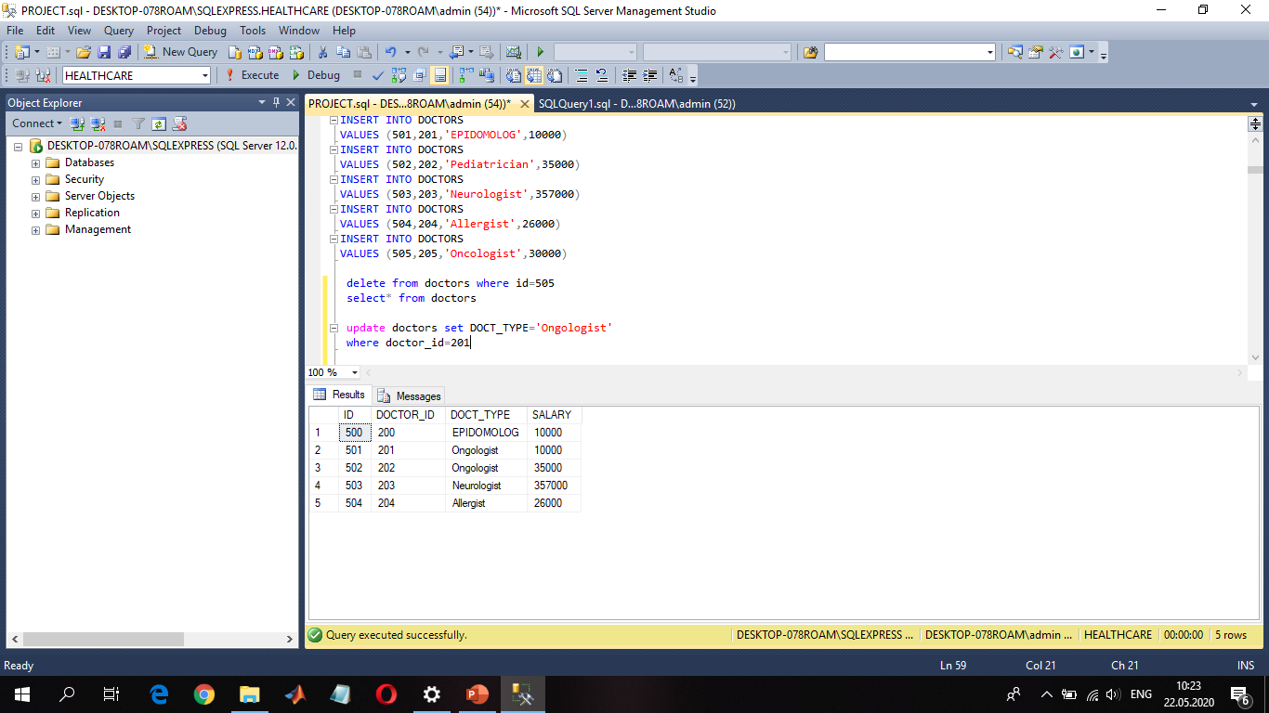
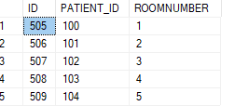
CREATING TABLES
We have superclass and subclasses.First we create table for superclass:
CREATE TABLE PERSONS(
ID INT PRIMARY KEY,
NAME VARCHAR(50) NOT NULL,
SURNAME VARCHAR(50) NOT NULL,
GENDER VARCHAR(50) NOT NULL,
ADDRES VARCHAR(30) NOT NULL,
PHONENUMBER VARCHAR(30) NOT NULL,
DATEOFBIRTH DATE NOT NULL,
AGE INT NOT NULL)
Then we create each subclass:
CREATE TABLE DOCTORS (
ID INT NOT NULL, --Here Id is foreign key references persons table
DOCTOR_ID INT PRIMARY KEY ,
DOCT_TYPE VARCHAR(50) NOT NULL,
SALARY INT NOT NULL);
CREATE TABLE PATIENTS(
ID INT , --Here Id is foreign key references persons table
PATIENT_ID INT PRIMARY KEY,
ROOMNUMBER INT NOT NULL
)

Slide 8
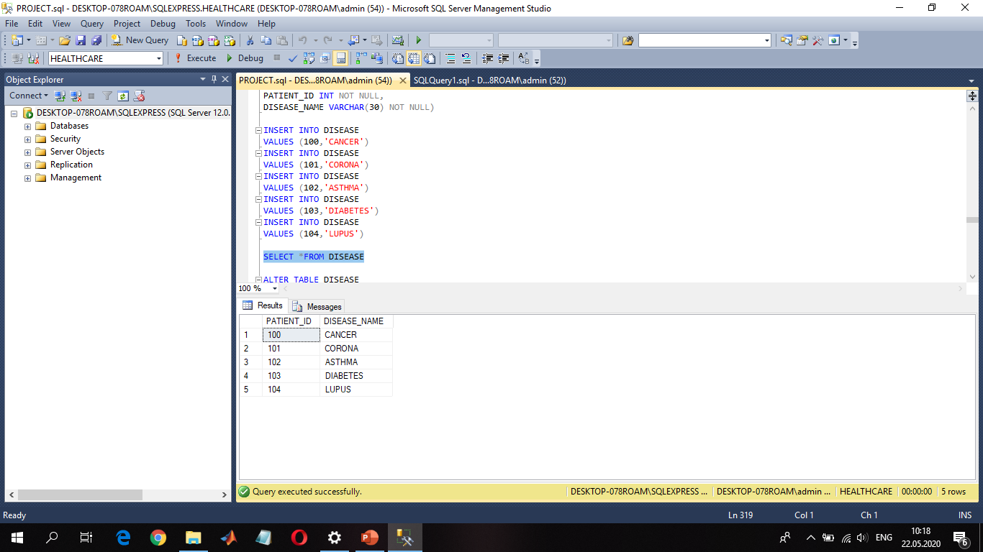
CREATING TABLES
In PATIENTS table we have multivaluedattribute.We create new table and add the primary key of patients:
CREATE TABLE DISEASE(
PATIENT_ID INT NOT NULL,
DISEASE_NAME VARCHAR(30) NOT NULL)
ALTER TABLE DISEASE
ADD CONSTRAINT FK_DISEASE_ID
FOREIGN KEY(PATIENT_ID)
REFERENCES PATIENTS(PATIENT_ID)
Here patient_id is foreign key references to PATIENTS TABLE.

Slide 9
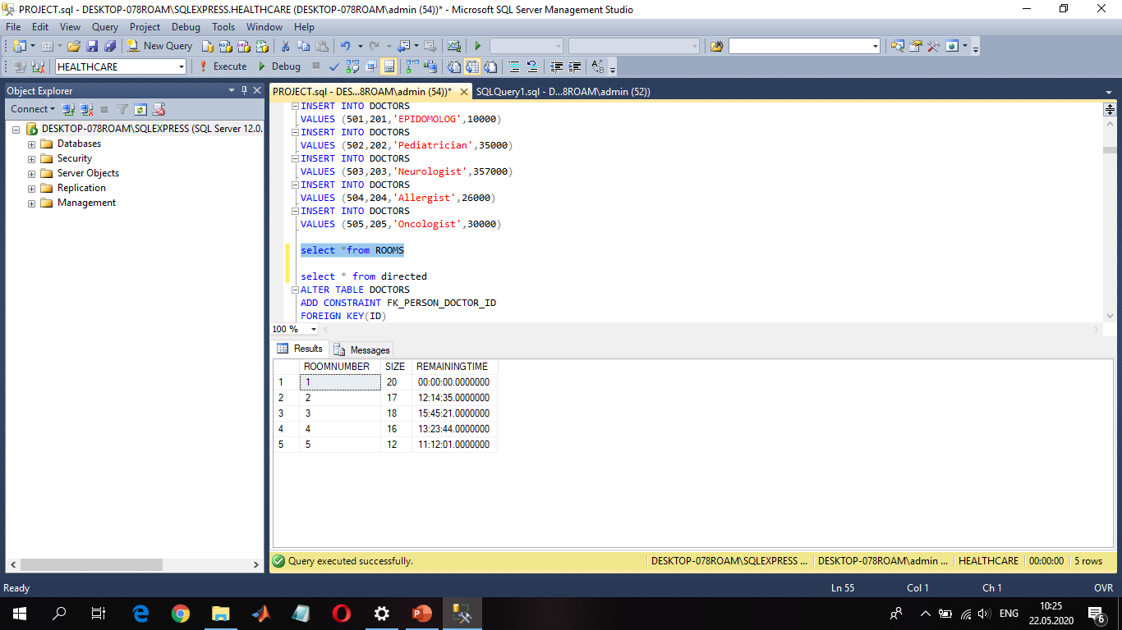
CREATING TABLES
Then we have ROOMS table:
CREATE TABLE ROOMS(
ROOMNUMBER INT PRIMARY KEY,
SIZE INT NOT NULL,
REMAININGTIME TIME NOT NULL)
There is a relationship between PATIENTS and ROOMS.The relationship is N:1.We add foreign key to the Patients.
ALTER TABLE PATIENTS
ADD CONSTRAINT FK_PATIENTROOM_ID
FOREIGN KEY(ROOMNUMBER)
REFERENCES ROOMS(ROOMNUMBER)
)

Slide 10

CREATING TABLES
Between PATIENTS and DOCTORS has relationship name is ASSIGN TO.This relationship also have a special attribute.This relationship is M:N.We use Cross Reference approach.We create third table which name is ASSIGN TO ,add special attribute and primary keys of PATIENTS and DOCTORS.And these primary keys will be the foreign key of new relationship.
CREATE TABLE ASSINGTO(
PATIENT_ID INT NOT NULL,
DOCTOR_ID INT NOT NULL,
ASSIGNDATE DATE NOT NULL)
ALTER TABLE ASSINGTO
ADD CONSTRAINT FK_PATASSIGN_ID
FOREIGN KEY(PATIENT_ID)
REFERENCES PATIENTS(PATIENT_ID)
ALTER TABLE ASSINGTO
ADD CONSTRAINT FK_ASSIGNDOC_ID
FOREIGN KEY(DOCTOR_ID)
REFERENCES DOCTORS(DOCTOR_ID)

Slide 11
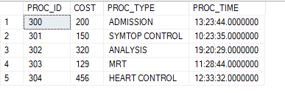
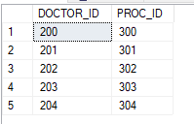
CREATING TABLES
Then we have another table is PROCEDURES:
CREATE TABLE PROCEDURES(
PROC_ID INT PRIMARY KEY,
COST INT NOT NULL,
PROC_TYPE VARCHAR(50) NOT NULL,
PROC_TIME TIME NOT NULL)
There is relationship between DOCTORS and PROCEDURES.This relationship is M:N.And we create third table which name is DIRECTED. And add primary keys of PROCEDURES and DOCTORS.
CREATE TABLE DIRECTED(
DOCTOR_ID INT NOT NULL,
PROC_ID INT NOT NULL)
ALTER TABLE DIRECTED
ADD CONSTRAINT FK_DOCTOR_ID
FOREIGN KEY(DOCTOR_ID)
REFERENCES DOCTORS(DOCTOR_ID)
ALTER TABLE DIRECTED
ADD CONSTRAINT FK_PROCDOCTOR_ID
FOREIGN KEY(PROC_ID)
REFERENCES PROCEDURES(PROC_ID)

Slide 12

CREATING TABLES
We have relationship between PATIENTS and PROCEDURES.And This relationship is M:N.We create third table which name is CHOOSE,add primary keys of PROCEDURES AND CHOOSE.
CREATE TABLE CHOOOSE(
PATIENT_ID INT NOT NULL,
PROC_ID INT NOT NULL)
ALTER TABLE CHOOOSE
ADD CONSTRAINT FK_PATIENTCHOOSE_ID
FOREIGN KEY(PATIENT_ID)
REFERENCES PATIENTS(PATIENT_ID)
ALTER TABLE CHOOOSE
ADD CONSTRAINT FK_PATIENTPROC_ID
FOREIGN KEY(PROC_ID)
REFERENCES PROCEDURES(PROC_ID)

Slide 13


CREATING TABLES
We have another table which Is called MEDICATIONS:
CREATE TABLE MEDICATIONS(
MED_ID INT PRIMARY KEY,
MED_FORM VARCHAR(50) NOT NULL,
BRAND_NAME VARCHAR(50) NOT NULL)
There is a relationship between MEDICATIONS AND DOCTORS.The name is relation DETERMINE.This relationship is M:N.We create third table which name is DETERMINE.
CREATE TABLE DETERMINE(
DOCTOR_ID INT NOT NULL,
MED_ID INT NOT NULL)
ALTER TABLE DETERMINE
ADD CONSTRAINT FK_DOCTORDETERMINE_ID
FOREIGN KEY(DOCTOR_ID)
REFERENCES DOCTORS(DOCTOR_ID)
ALTER TABLE DETERMINE
ADD CONSTRAINT FK_MEDDOCTOR_ID
FOREIGN KEY(MED_ID)
REFERENCES MEDICATIONS(MED_ID)

Slide 14
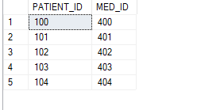
CREATING TABLES
Another relationshio between is MEDICATIONS and PATIENTS.This relationship is M:N.We create third table which name is TAKES,and add primary keys of MEDICATIONS and PATIENTS.
CREATE TABLE TAKES(
PATIENT_ID INT NOT NULL,
MED_ID INT NOT NULL)
ALTER TABLE TAKES
ADD CONSTRAINT FK_PATIENTMED_ID
FOREIGN KEY(MED_ID)
REFERENCES MEDICATIONS(MED_ID)
ALTER TABLE TAKES
ADD CONSTRAINT FK_PATIENT_ID
FOREIGN KEY(PATIENT_ID)
REFERENCES PATIENTS(PATIENT_ID)

Slide 15

CREATING TABLES
In MEDICATIONS TABLE we have multivalued attribute NAME.WE create new table and add
primary key of MEDICATIONS.
CREATE TABLE NAME(
MED_ID INT NOT NULL,
MED_NAME VARCHAR(30))
ALTER TABLE NAME
ADD CONSTRAINT FK_NAME_ID
FOREIGN KEY(MED_ID)
REFERENCES MEDICATIONS(MED_ID)
Here MED_ID is foreign key references to MEDICATIONS table MED_ID column

Slide 16

CREATING TABLES
Another relationship between is MEDICATIONS and PROCEDURES is WRITTEN.This is again M:N relationship.
CREATE TABLE WRITTEN (
PROC_ID INT NOT NULL,
MED_ID INT NOT NULL)
ALTER TABLE WRITTEN
ADD CONSTRAINT FK_PROCMED_ID
FOREIGN KEY(PROC_ID)
REFERENCES PROCEDURES(PROC_ID)
ALTER TABLE WRITTEN
ADD CONSTRAINT FK_PROCMEDD_ID
FOREIGN KEY(MED_ID)
REFERENCES MEDICATIONS(MED_ID)

Slide 17

CREATING TABLES
WE have another table is BILL.
CREATE TABLE BILL(
BILLNUMBER INT PRIMARY KEY,
TOTALPAYMENT INT NOT NULL,
PATIENT_ID INT NOT NULL)
There is relationship between BILL and PERSON.This relationship is 1:1.That is why we use foreign key approach.
ALTER TABLE BILL
ADD CONSTRAINT FK_BILL_ID
FOREIGN KEY(PATIENT_ID)
REFERENCES PATIENTS(PATIENT_ID)

Slide 18
QUERIES WRITTEN BY NAZRIN
--1.HOW MANY PROCEDURE PATIENT CAN TAKE?
SELECT COUNT(PROC_ID) AS COUNT FROM PROCEDURES
--2.SELECT PERSON NAME WHERE ROOMNUMBER IS EQUAL TO 4.
SELECT NAME FROM PERSONS
WHERE ID=(SELECT ID FROM PATIENTS WHERE ROOMNUMBER=4)
--3.SELECT THE DOCTOR NAME WHO IS ASSIGN TO PATIENT_ID=104.
SELECT NAME FROM PERSONS
WHERE ID=(SELECT ID FROM DOCTORS
WHERE DOCTOR_ID=(SELECT DOCTOR_ID FROM ASSINGTO
WHERE PATIENT_ID=104))
--4.FIND MED_FORM WHICH TAKEN PATIENT WHERE HIS ID =102.
SELECT MED_FORM FROM MEDICATIONS
WHERE MED_ID=(SELECT MED_ID FROM TAKES WHERE PATIENT_ID=102)

Slide 19
QUERIES WRITTEN BY NAZRIN
--5.SELECT TOTALPAYMENT WHICH PAY BY PATIENT_ID=100.
SELECT TOTALPAYMENT FROM BILL
WHERE PATIENT_ID=100
--6.WRITE THE INNER JOIN OF TWO TABLES(PATIENTS AND BILL).
SELECT * FROM PATIENTS
INNER JOIN BILL
ON PATIENTS.PATIENT_ID=BILL.PATIENT_ID
--7.FIND AVG TOTALPAYMENT FROM BILL TABEL.
SELECT AVG(TOTALPAYMENT) FROM BILL
--8.FIND THE MAX REMAININGTIME IN ROOMS.
SELECT MAX(REMAININGTIME) FROM ROOMS

Slide 20
QUERIES WRITTEN BY SHAFAYAT
--9.FIND THE MRT PROCEDURE’S COST.
SELECT COST FROM PROCEDURES
WHERE PROC_TYPE='MRT’
--10. FIND THE DOCTOR TYPE WHERE HIS AGE IS 42.
SELECT DOCT_TYPE FROM DOCTORS
WHERE ID =(SELECT ID FROM PERSONS WHERE AGE=42)#
--11.DISPLAY AVERAGE AGE,GENDER AND GROUP RESULTS BY GENDER.
SELECT AVG(AGE),GENDER FROM PERSONS GROUP BY GENDER
--12. FIND THE MAXIMUM AGE ACCORDING THE GENDER WHERE MAX(AGE) IS GREATER THAN 50 AND ORDER MAX(AGE) DESCENDING ORDER.
SELECT MAX(AGE),GENDER FROM PERSONS
GROUP BY GENDER
HAVING MAX(AGE)>50
ORDER BY MAX(AGE)
DESC

Slide 21
QUERIES WRITTEN BY SHAFAYAT
--13.FIND THE DISEASE NAME WHERE ITS NAME BEGINS WITH C.
SELECT * FROM DISEASE
WHERE DISEASE_NAME LIKE 'c%'
ORDER BY DISEASE_NAME
DESC
--14. FIND THE PROCEDURE TYPE WHERE ITS COST BETWEEN 100 AND 150.
SELECT PROC_TYPE FROM PROCEDURES
WHERE COST BETWEEN 100 AND 150
--15.DISPLAY NAME AND AGE WHERE ITS GENDER IS MALE AGE IS GREATER THA 50 AND NAME BEGINS WITH T.
SELECT NAME, AGE FROM PERSONS
WHERE GENDER='Male' AND AGE>50 AND NAME LIKE 'T%'
ORDER BY AGE
ASC

Slide 22
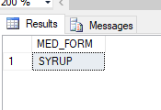
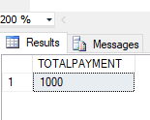

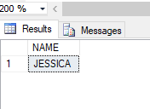
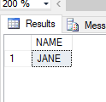
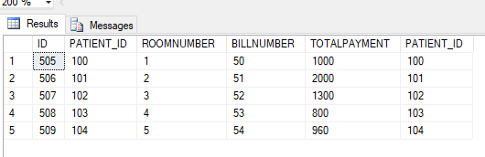
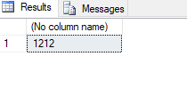
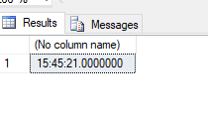
RESULT OF QUERIES
1.
2.
3.
4.
5.
6.
7.
8.

Slide 23

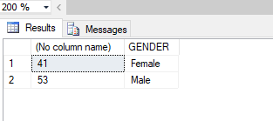
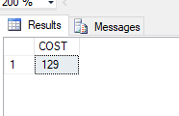
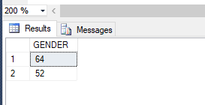
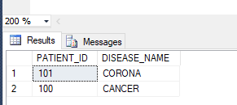
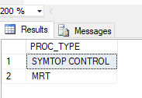
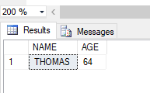
9.
10.
11.
12.
13.
14.
15.

Slide 24


