Slide 1
Seismic First-Break Picking with a 2D CNN
Automatic first-arrival detection across four real seismic assets
Brunswick · Halfmile · Lalor · Sudbury
Final model: Gather2DCNN
Nazrin Burziyeva

Slide 2
First breaks are the earliest detectable seismic arrivals
Source
A hammer, vibrator, or small explosive launches a wave into the near surface.
Moveout intuition
Farther receiver → later arrival.
Each receiver records a 1D time series. Before the wave arrives it is mostly noise.
time
Trace
Onset
The first break is the moment energy organizes. After that, amplitude jumps.
Why it matters
Refraction and near-surface tomography invert these times. Bad picks corrupt velocity.
offset →
Lined up by offset, first breaks form a trajectory — not four independent numbers.
Gather-level 2D CNN · seismic first-break picking
2 / 20

Slide 3
Four real assets, uneven labels, real distribution shift
Loaded subset used by the final 2D run (max_shots = 100). Full files are several times larger.
Brunswick
Halfmile
Lalor
Sudbury
82.3%
90.2%
50.3%
10.5%
labeled
labeled
labeled
labeled
241,546 / 293,418
143,705 / 159,398
134,952 / 268,500
18,293 / 174,103
Dense 3D · 2 ms
Best coverage · 2 ms
1 ms native · half labeled
Sparse labels · 2 ms / 2000 ms
Fields that actually enter the pipeline
data_array · SHOTID · OFFSET · SAMP_RATE · SPARE1 (0 / –1 = unlabeled)
SOURCE / REC coordinates and COORD_SCALE are fallbacks only. The loader prefers the stored OFFSET field because raw coordinates are unusable on Sudbury (~100× scale error).
Gather-level 2D CNN · seismic first-break picking
3 / 20

Slide 4
The raw dataset is flat. The signal is spatially structured.
1
2
3
4
HDF5 traces
Group SHOTID
Sort by offset
Shot gather
One flat array
(n_traces × n_samples)
Recover the shot
that produced each trace
Near traces left,
far traces right
A 2D image with a
first-break trajectory
Why group at all?
A shot is not a bag of unrelated 1D signals. Neighboring traces share a source, nearby geology, and a continuous first-break trajectory. If you throw that structure away, every later model has to rediscover moveout from a single waveform plus a scalar offset.
That reorganization is data_utils.build_gathers(). It is the prerequisite for the 2D model, not a plotting convenience.
Gather-level 2D CNN · seismic first-break picking
4 / 20

Slide 5
Every gather is forced onto one time grid and one window size
2.0 ms
750
64
99.5%
target sample interval
time samples (~1500 ms)
max traces per window
robust amplitude scale
Resample
Linear interpolation onto 2 ms × 750. Needed because Lalor is 1 ms and Sudbury records 2000 ms.
Normalize
Per-trace 99.5th percentile of |amp|, then clip to ±3. Max-abs norm is wrecked by spike samples.
Window
Long gathers become 64-trace tiles. A tail window is added so the last traces are never dropped.
Offset scale
Divide by that asset’s 99th-percentile offset.
Gather-level 2D CNN · seismic first-break picking
5 / 20

Slide 6
Unlabeled traces stay in the gather. They just do not train the loss.
One 64-trace window
Trace mask
Is this slot a real seismic trace or padding?
This mask is an input channel. The network can see where the gather ends.
Label mask
Does this real trace have a SPARE1 time?
This mask is loss-only. Dropping unlabeled traces would throw away the neighbors the 2D kernel needs.
trace mask = 1 for every real column, 0 for padding
label mask = 1 only on green columns
Blue columns are context. They never enter masked MAE.
Gather-level 2D CNN · seismic first-break picking
6 / 20

Slide 7
The 1D baseline treats every trace as an isolated regression
FBPickerCNN · historical
Historical leave-one-asset-out 1D MAE
trace + offset → time (ms)
Held-out asset | MAE
Brunswick | 108.64 ms
Halfmile | 131.21 ms
Lalor | 20.73 ms
Sudbury | 18.34 ms
Three Conv1D blocks, AdaptiveMaxPool1d(4), dense head. Offset is concatenated only at the head. No neighboring traces. No gather image.
Predicts milliseconds directly so the training loss equals the evaluation metric.
Useful as motivation. Not the contribution of this talk.
Different protocol from the final 2D benchmark. Do not subtract these from 13.20 ms. The message is cross-asset variation, not a bake-off.
Gather-level 2D CNN · seismic first-break picking
7 / 20

Slide 8
Neighboring traces already contain the first-break trajectory
1D
2D
Trace A → prediction A
Trace A
2D CNN
one pick
per trace
Trace B → prediction B
Trace B
Trace C → prediction C
Trace C
Local continuity is visible to the kernel.
Gather-level 2D CNN · seismic first-break picking
8 / 20

Slide 9
The final model predicts one first break time per trace, in milliseconds
Input [B, 3, 64, 750] → Output [B, 64]
batch · channels · traces · time samples one millisecond pick per trace slot
B
3
64
750
shots / windows in the batch
waveform, offset, trace mask
trace axis is never pooled away
2 ms samples, ~1500 ms window
Kernels live on neighboring traces × nearby time. That is the entire methodological bet.
Gather-level 2D CNN · seismic first-break picking
9 / 20

Slide 10
Three channels: waveform, geometry, and ‘is this real?’
Normalized waveform
0
Seismic amplitude after robust percentile scaling and ±3 clip. This is the onset pattern the network has to find.
Normalized offset
1
Source–receiver distance, tiled across time, scaled by the training 99th percentile for that asset. Auxiliary geometry, not a travel-time solver.
Trace / padding mask
2
One across real traces, zero across padding. Stops the network from treating zeros on the right as silent earth.
Gather-level 2D CNN · seismic first-break picking
10 / 20

Slide 11
Gather2DCNN keeps the trace axis and compresses time
Input
Conv 5×9
Pool 1×2
Conv 5×7
Pool 1×2
Conv 3×5
Conv 3×3
Adapt pool
Head
3 × 64 × 750
3 → 16
time only
16 → 32
time only
32 → 64
64 → 64
H × 4 bins
256 → 64 → 1
What is preserved
What is not claimed
Trace dimension H is never pooled. MaxPool kernels are (1, 2): time shrinks, neighbors stay aligned.
Adaptive average pooling keeps four coarse time regions so the head still knows early versus late.
Output: 64 numbers, milliseconds.
This is not a U-Net, not a picker head over every time sample, and not a physics solver.
Verified against model_2d.py: base_ch = 16, pool_k = 4, BatchNorm + ReLU after each conv.
Do not paste the Python onto the slide.
Gather-level 2D CNN · seismic first-break picking
11 / 20

Slide 12
Evaluation is split by shot so neighboring traces cannot leak
Final protocol: in-domain, shot-level
Training setup
Asset | Train | Val | Test
Brunswick | 75 | 15 | 10
Halfmile | 75 | 15 | 10
Lalor | 75 | 15 | 10
Sudbury | 50 | 9 | 6
▸ 20 epochs max, patience 5
▸ batch size 32, seed 42
▸ max_shots 100 per asset
▸ Adam, lr 1e-3
▸ masked MAE on labeled traces
Split happens before windows are cut. Checkpoint stores every SHOTID so inference can say TRAIN / VAL / TEST / UNSEEN.
▸ asset-balanced sampler on
▸ best epoch restored before save
Gather-level 2D CNN · seismic first-break picking
12 / 20

Slide 13
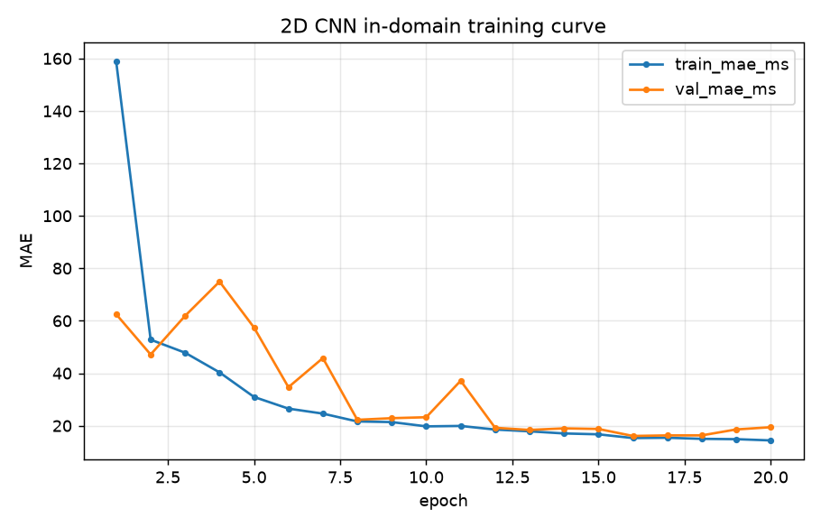
Validation MAE bottoms out at 16.09 ms on epoch 16
Read this curve
Train MAE falls quickly, then plateaus near 15 ms.
Val is noisier early, then tracks train after epoch 12.
Best checkpoint: epoch 16, val MAE 16.09 ms. Early stopping patience is 5.
73.7 s / epoch on CUDA.
Gather-level 2D CNN · seismic first-break picking
13 / 20

Slide 14
Pooled held-out test MAE is 13.20 ms, not the validation number
TEST MAE
28.6%
51.5%
76.2%
13.20 ms
within ±4 ms
within ±8 ms
within ±16 ms
56,195 labeled traces
across held-out shots
How to say this out loud
Median 7.69 ms
Validation was 16.09 ms on 75,964 labeled traces. Test is better, not worse. That can happen when the val shots are simply harder; it is not a license to tune on test.
These tolerance percentages give a more informative view of picking accuracy than MAE alone.. A picker that is close most of the time beats a picker that is mediocre everywhere.
Mean is pulled by a long tail. Most picks are tighter than 13 ms.
Gather-level 2D CNN · seismic first-break picking
14 / 20

Slide 15
Assets differ in labels, sampling, and first-break behavior
The final 2D report publishes pooled metrics only. Per-asset structure still explains where errors should live.
Brunswick
Halfmile
Lalor
Sudbury
Largest loaded subset. 82.3% labeled. Shots with 2k–3k traces, so many 64-trace windows per gather.
Highest label coverage at 90.2%. Historical 1D LOO was the worst (131 ms) — in-domain ≠ transfer.
Only 1 ms survey, 50.3% labeled, highly variable traces/shot including near-empty IDs.
10.5% labeled, 2000 ms records, broken raw coordinates. Fewest test shots (6).
Do not invent a per-asset 2D MAE. It is not in fbpick_2d_final.txt.
What we can say: Sudbury contributes the fewest labels, Lalor is the resample edge case, and historical 1D leave-one-out already proved that pooling four names does not make them one distribution.
Gather-level 2D CNN · seismic first-break picking
15 / 20

Slide 16
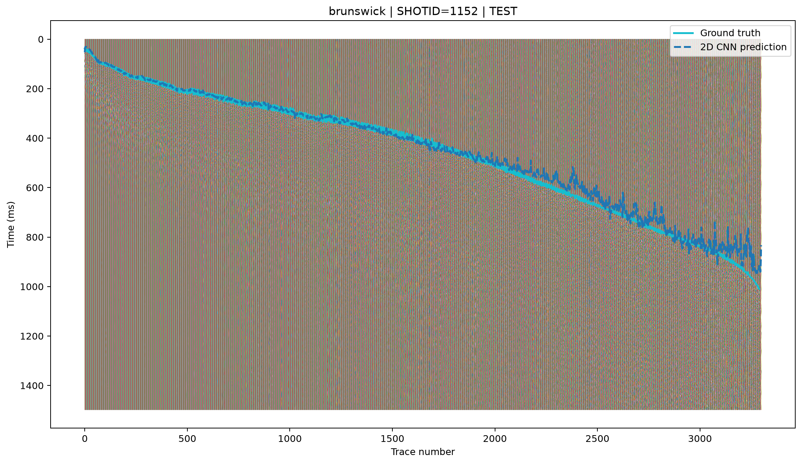
A confirmed TEST shot, Brunswick 1152, scores 14.09 ms MAE
Held-out example
SHOTID 1152
split = TEST
Traces
3,299
Labeled
2,649
MAE
14.09 ms
Median
7.86 ms
±4 ms
28.3%
±8 ms
50.8%
±16 ms
73.1%
Gather-level 2D CNN · seismic first-break picking
16 / 20

Slide 17
Inference loads one shot, not the entire seismic cube
1
Read SHOTID index only
2
Classify TRAIN / VAL / TEST / UNSEEN
3
Load matching rows from data_array
4
Rebuild gather, resample, normalize
5
Window, predict, average overlaps
6
Score labels if SPARE1 exists, plot
Gather-level 2D CNN · seismic first-break picking
17 / 20

Slide 18
The benchmark is in-domain. Cross-asset transfer is unfinished.
01
02
03
In-domain only
Sudbury sparsity
Local windows
Reported 2D numbers use shot splits inside assets the model already saw.
10.5% labels and six test shots. That asset is under-constrained.
64 traces is a neighborhood, not a 3,000-trace gather.
04
05
06
Thin geometry
Linear resample
Spatial leakage
Scalar offset, not full source/receiver layout or a travel-time prior.
No anti-alias filter on Lalor 1 ms → 2 ms. Defensible, not perfect.
Nearby 3D shots can still share near-surface geology. Not a block split.
Gather-level 2D CNN · seismic first-break picking
18 / 20

Slide 19
Cross-asset evaluation is the next experiment, not a new slogan
Leave-one-asset-out 2D
train_2d.py --mode leave_one_out already exists. Report it as a separate table.
Spatial-block splits
Hold out source-coordinate regions instead of random SHOTIDs.
Richer geometry
Source and receiver coordinates, or a simple moveout prior, beyond scalar offset.
Larger context
Wider windows or a gather encoder that sees more than 64 traces.
Onset maps
Per-sample probability instead of a single regression — a confidence signal comes free.
Human QC loop
Run the picker on unlabeled traces and spot-check. That is the product.
Gather-level 2D CNN · seismic first-break picking
19 / 20

Slide 20
A gather is a 2D object. The picker should use that.
13.20 ms
pooled in-domain test MAE on 56,195 labeled traces
16.09 ms
best validation MAE, epoch 16 — used only to pick weights
14.09 ms
Brunswick TEST shot 1152, confirmed held-out before inference
Sources for figures and numbers
fbpick_2d_final.txt · fbpick_2d_final_in_domain_curve.png · inference_brunswick_test0.png
model_2d.py · gather_dataset_2d.py · train_2d.py · inference_2d.py · data_utils.py · resample.py
Historical only: model.py, *_450 summaries, baseline/, 1D leave-one-asset-out table
In-domain is not deployment on an unseen asset. That experiment is next.

