Slide 1
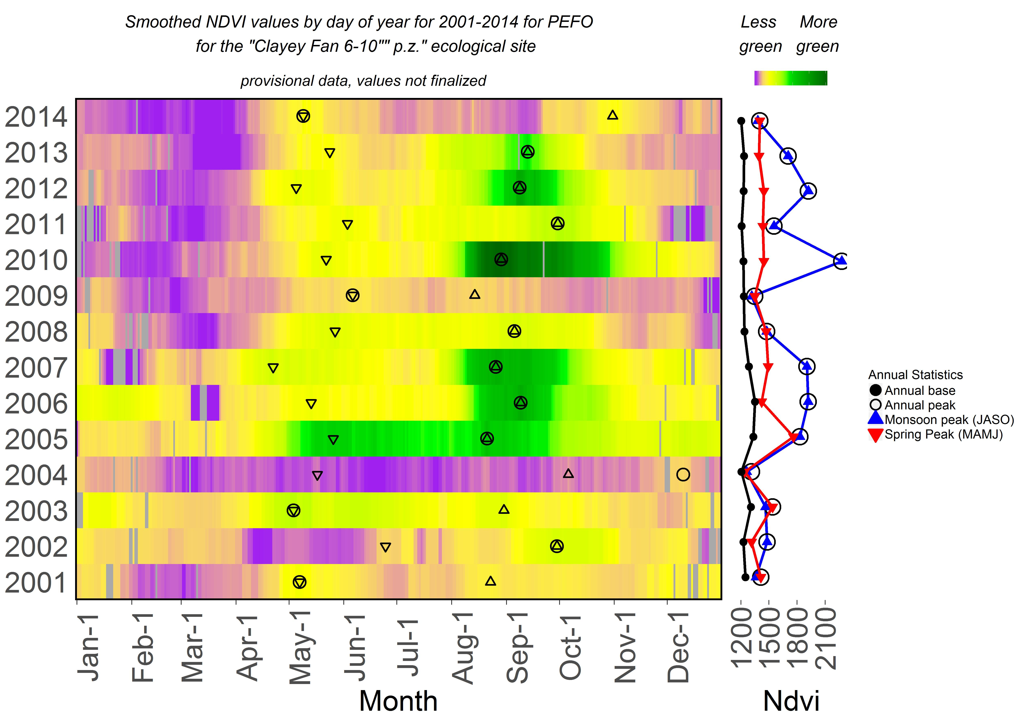
Notes:
Example of a complex graph

Slide 2
Notes:
To make it, we have pieces that go into different cells of a page

Slide 3
1, 1
1, 2
1, 3
2, 1
2, 2
2, 3
3, 1
3, 2
3, 3
Notes:
The cells are identified by row and column number, see the scripts for how this all happens.

