Slide 1

Welcome To Our
Presentation

Slide 2

.
Presentation
On
Software Quality
Dimension
& Testing
(Quotes.tolscrape.com)

Slide 3

.
PRESENTED FOR
Md.Safaet Hossain
Head the Department Of CSE
City University

Slide 4
.
PRESENTED BY
Name: Id:
Md Al Amin Pramanik 161412344
Nazrul Islam 161412329
Akash shah 161412341
Rabeya Khatun 161412333

Slide 5
.
INTRODUCTION
Software testing is the process used to identify the correctness, completeness and quality of developed computer software.
It is the process of executing a program/application under positive and negative conditions by manual or automated means. It checks for the-
❖ Specification
❖ Functionality
❖ Performance

Slide 6
.
OBJECTIVES
Uncover as many as errors (or bugs) as possible in a given product.
Demonstrate a given software product matching its requirement specifications.
Validate the quality of a software testing using the minimum cost and efforts.
Generate high quality test cases, perform effective tests, and issue correct and helpful problem reports.

Slide 7
.
Why Software Testing?
Software Testing is important for finding –
❖ Error
❖ Bug
❖ Fault &
❖ Failure

Slide 8
.
Error, Bug, Fault & Failure
Error : It is a human action that produces the incorrect result that produces a fault.
Bug : The presence of error at the time of execution of the software.
Fault : State of software caused by an error.
Failure : Deviation of the software from its expected result. It is an event.

Slide 9
.
Softwere Quality Dimension
Software Quality Dimension listed here are some of the major ones out of hundreds.

Slide 10
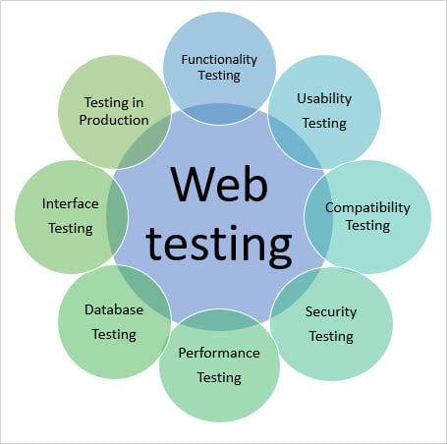
.
Web Testing Dimension

Slide 11
.
Functionality Testing
Software Quality Dimension listed here are some of the major ones out of hundreds.

Slide 12
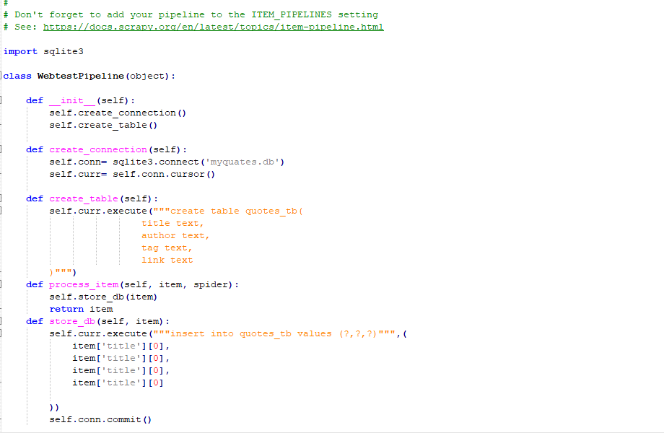
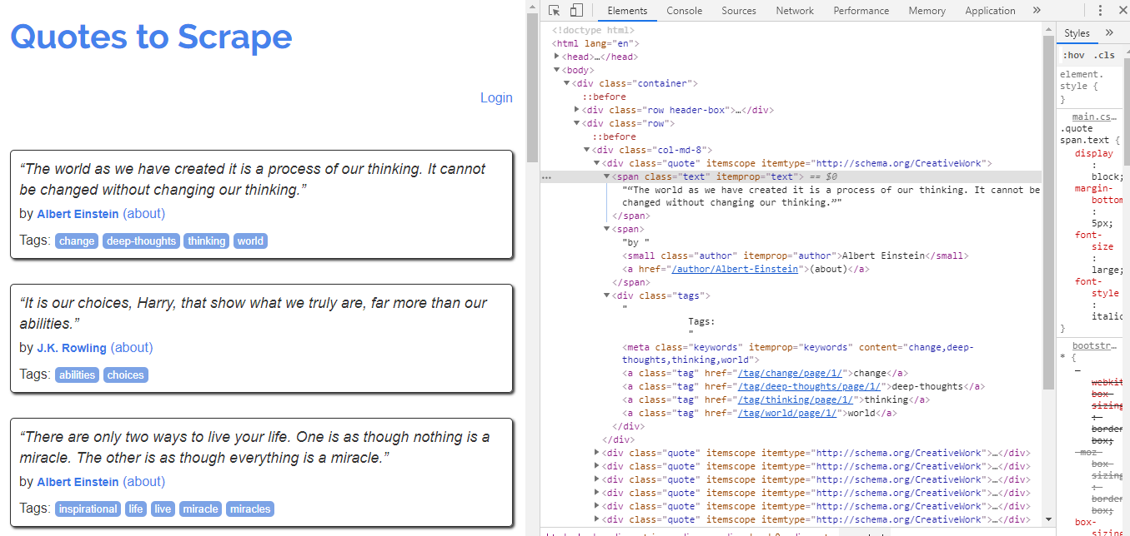
.
Functionality With HTML/CSS Testing

Slide 13
.
Usability Testing
Usability testing is the process by which the human-computer interaction characteristics of a system are measured, and weaknesses are identified for correction.

Slide 14
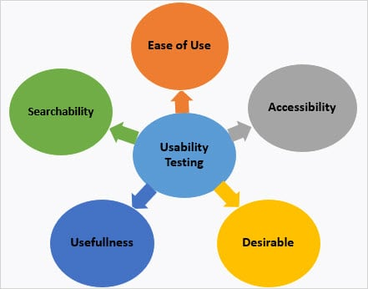
.
Usability Testing

Slide 15
.
Compatibility Testing
The compatibility of your website is a very important testing aspect. See which compatibility test to be executed:
Browser compatibility
Operating system compatibility
Mobile browsing
Printing options

Slide 16
.
Performance Testing
The web application should sustain to heavy load. Web performance testing should include:
Web Load Testing
Web Stress Testing
Test application performance on different internet connection speeds.

Slide 17
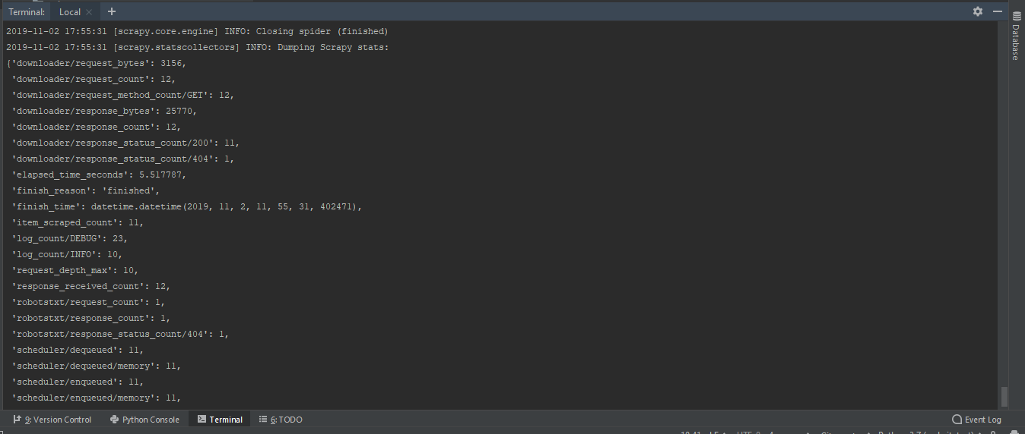
Performance Testing

Slide 18
.
Security Testing
Test if SSL is used for security measures. If it is used, the proper message should get displayed when users switch from non-secure HTTP:// pages to secure HTTPS:// pages and vice versa
Network Scanning
Vulnerability Scanning
Password Cracking
Log Review
Integrity Checkers
Virus Detection

Slide 19
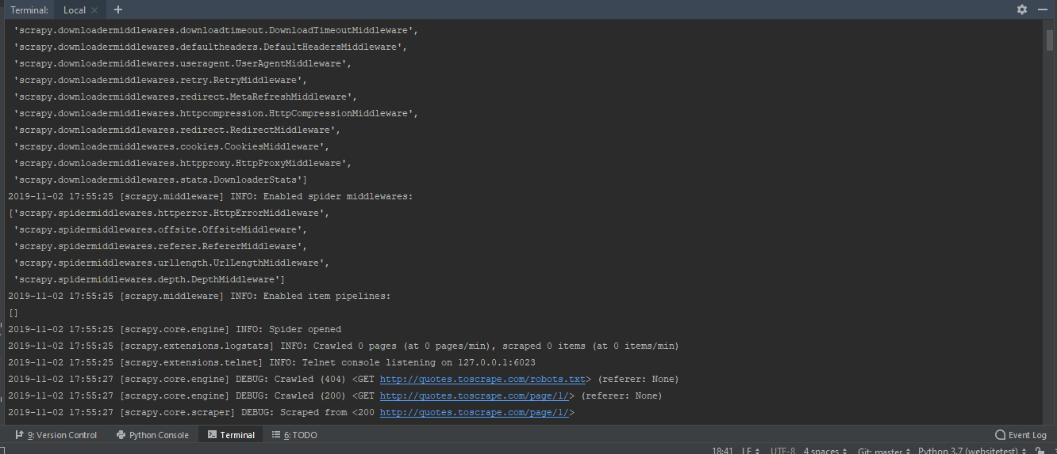
.
Security Testing

Slide 20
.
Types Of Web Testing
A website is classified into many types, it is about 20 types. All these are shrinking under static and dynamic type. Among them let’s discuss 4 types and its testing methods in a detailed manner. Before that, I just want to bullet those types.
Simple static website testing
Dynamic web application testing
E-commerce website testing
Mobile website testing

Slide 21
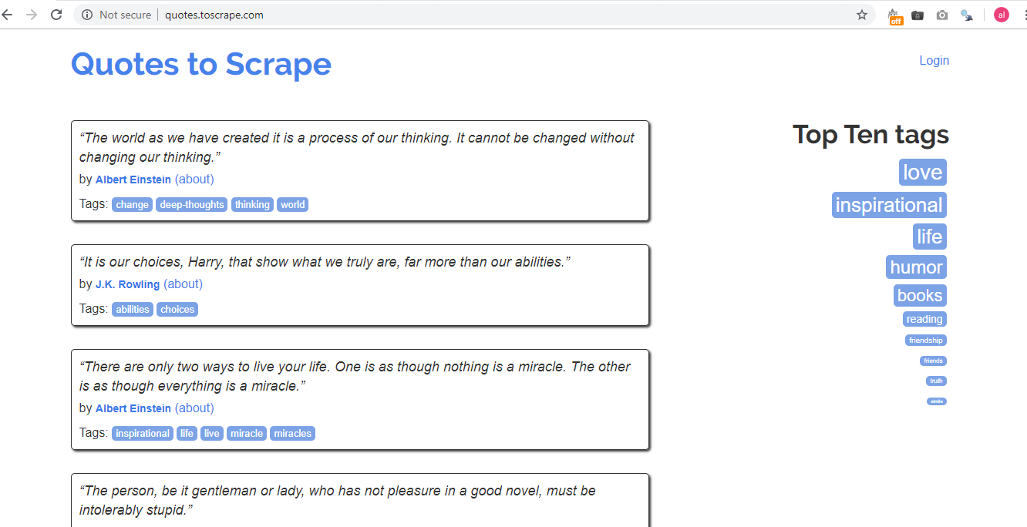
Types Of Web Testing

Slide 22
.
Simple Static Website
A simple static website will display the same content for all visitors who are visiting the website at different times. It is also known as an informational website. In a static website, the only developer can do changes that too in code only. This type of website will not have any major functionalities and it purely depends on UI design

Slide 23
.
Dynamic Web Application (CMS Website)
It is the type where the user can update and change their website content regularly. From here I am going to use the word “web application testing” instead of dynamic website testing. The web application is a combination of front-end and back-end programming

Slide 24
.
E-commerce Website
An e-commerce website is somewhat complicated when compared to the above two. The tester needs to be very cautious while testing an e-commerce site. There are huge things to be checked in e-commerce sites out of them I just cover some of my experienced issues on e-commerce website testing.

Slide 25
.
Mobile Website
Testing any mobile apps, decide what testing is required to test the specific mobile app: functional, usability, compatibility, performance, security, etc. Decide on which target devices to use and what functional requirements should be tested. You must also determine what target devices to include.

Slide 26
.
Web Test Language
.NET
Javascript
C++
Python

Slide 27
.
Web Test Tools
Selenium
Scrapy
Beautiful Soup

Slide 28
.
Web Site Goal
Search engine optimization, well-organized content, user-friendly site, effective calls to action, increase conversion rate.
Providing quality content on your website, regularly adding new information, establishing trust, marketing your site on other websites and social media.
E-mail marketing lists, online support (live chat), webinars, and content designed to give your visitor a reason to come back.
Active social media program, promotions, reputation management.

Slide 29


Thank You

