Slide 1
Sales ETL Pipeline Project
Automated data pipeline from Airflow to Power BI

Slide 2
Agenda
1. Project Overview
2. Tools & Technologies
3. ETL Flow Diagram
4. Power BI Dashboard
5. Conclusion & Q&A

Slide 3
Project Overview
This project automates the sales data pipeline from data generation to visualization. It uses Apache Airflow to orchestrate tasks, AWS services for storage and transformation, and Power BI for dashboard reporting.

Slide 4
Tools & Technologies
Backend:
• Apache Airflow
• AWS S3, Glue, Redshift
Frontend:
• Power BI

Slide 5
ETL Architecture Diagram
Airflow DAG
S3 (Raw Orders)
AWS Glue (Clean & Transform)
Redshift (sales_orders table)
S3 (Processed Orders)
Power BI (Scheduled Refresh)

Slide 6
Power BI Dashboard
The Power BI dashboard is scheduled to refresh daily after the ETL pipeline finishes.
It visualizes:
Total Sales Over Time
Total Sales Amount
Total Purchase By Each Customers
Average amount of Sales per day

Slide 7
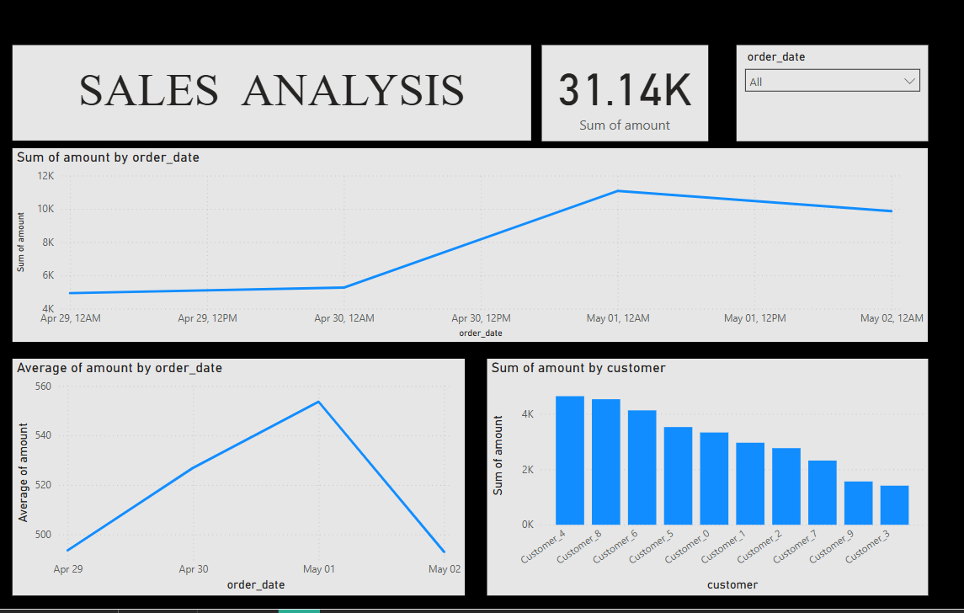

Slide 8
Conclusion
This project demonstrates how to build an end-to-end automated data pipeline using modern data tools. It enables reliable and scalable reporting for business insights.

Slide 9
THANK YOU …

