Slide 1
PIZZA DELIVERY
Nuhi Besimi
Steve Ryder Smith

Slide 2
Specification
The required system is a pizza delivery system. It needs to allow users to order pizza from their smart phones (Android OS). Each user must be registered in our system before ordering a pizza. The registration has to be done from the user side. The manager of the store must keep track on all orders and be able to modify the prizes. There should be also a small app for the pizza store which shows the orders on real-time. The payment will be done at delivery in cash.

Slide 3
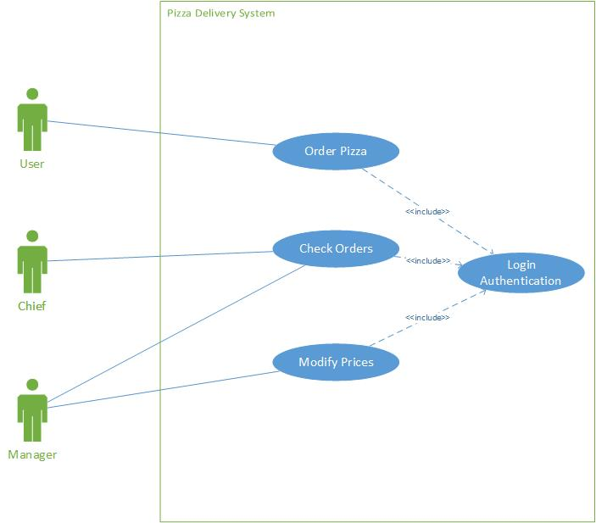
UML
Use Case

Slide 4
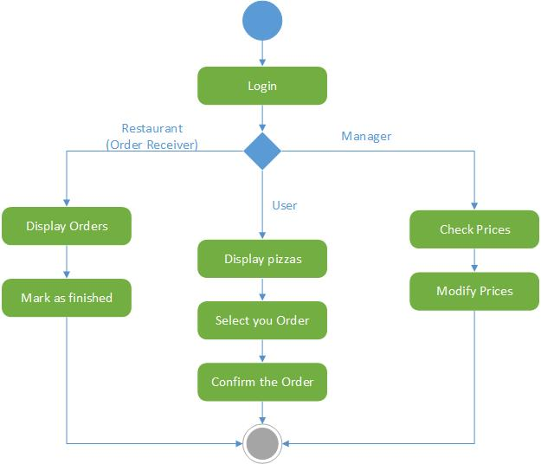
UML
Activity Diagram

Slide 5
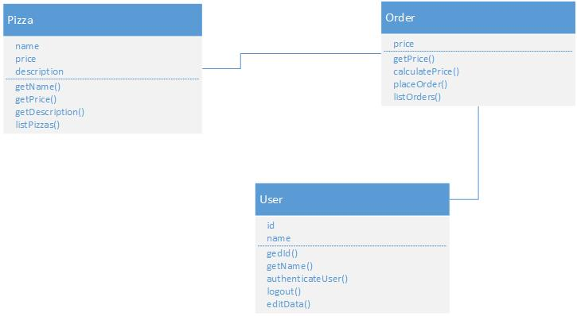
UML
Class Diagram

Slide 6
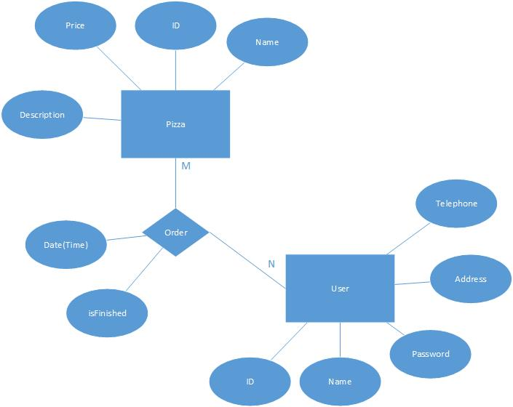
UML
ER Diagram

Slide 7
THANK YOU!
??!

