Slide 1

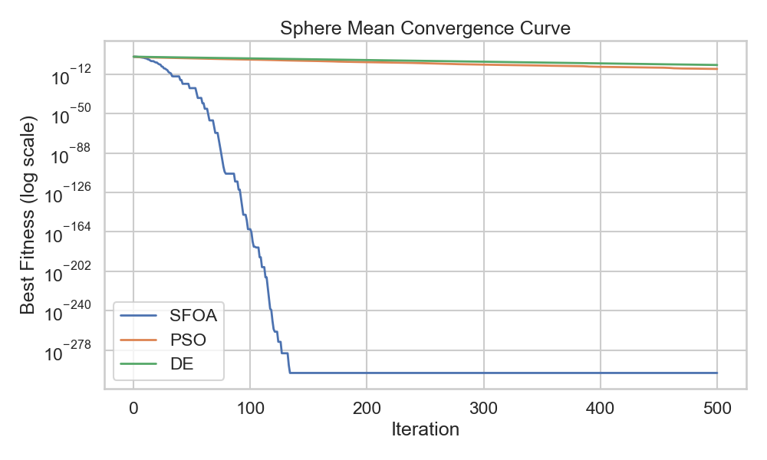
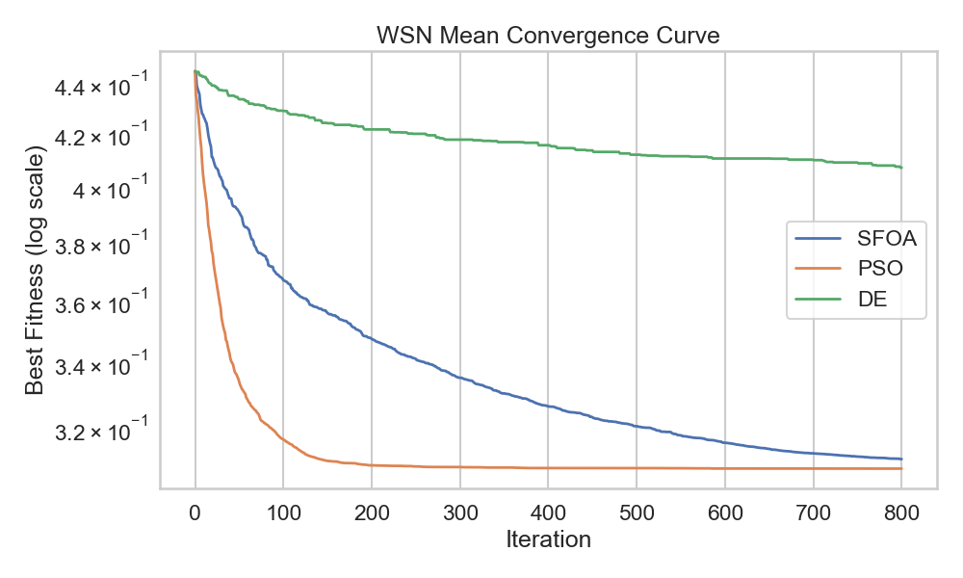
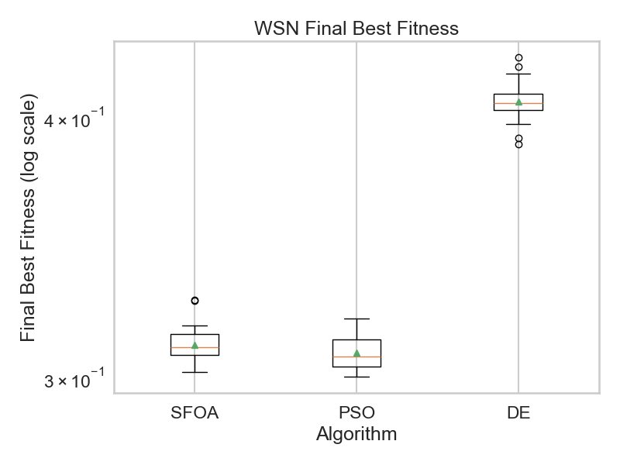
Benchmarking Starfish Optimization Algorithm
Nicholas Boulos
Introduction
Statistical Tests
WSN Success Rate
 | Success | Failure
SFOA | 28 | 2
PSO | 30 | 0
DE | 0 | 30
Sphere Significance
 | Raw P-Value | Holm P-Value | Significant
SFOA vs PSO | 1.86E-09 | 1.67E-02 | Yes
SFOA vs DE | 1.86E-09 | 2.50E-02 | Yes
PSO vs DE | 1.86E-09 | 5.00E-02 | Yes
WSN Significance
Methodology
 | Raw P-Value | Holm P-Value | Significant
SFOA vs PSO | 1.73E-06 | 1.67E-02 | Yes
SFOA vs DE | 1.73E-06 | 2.50E-02 | Yes
PSO vs DE | 1.18E-01 | 5.00E-02 | No
Results
Sphere Function Results:
Discussion
WSN Problem Results:
Acknowledgments and Citations

