Slide 1


Cal-Counter
A website to track your Calories.
James Huynh
Steven Kim
Sibo Song
Tianfang Wang

Slide 2










Purpose | Logo | Name | Rating
Version control |  | Git | 5/5
Automated testing |  | Ghost Inspector | 5/5
Database connection |  | phpMyAdmin | 5/5
Web server |  | Apache | 5/5
Tunnel tool |  | ngrok | 4/5
development environment |  | HTML | 4/5
Database of food |  | MySQL | 3/5
Project tracker |  | Trello | 3/5
Auto documenter |  | Doxygen | 3/5
Host website |  | Python web server | 3/5

Slide 3

git
Easy way to make sure that we are not overwriting each other code. Git allows to working on the project remotely.
Version control

Slide 4
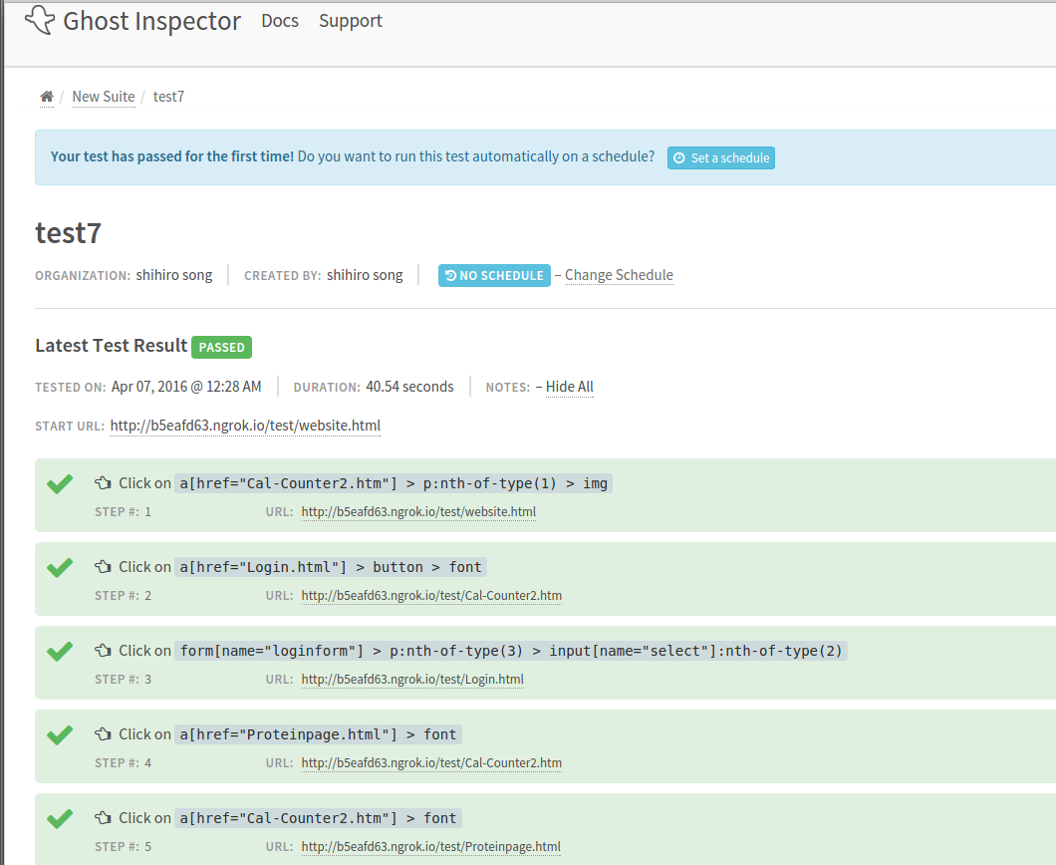
Software
Ghost Inspector
Ghost Inspector is an Automated testing software. It catches website bugs and regressions before they cost you.

Slide 5
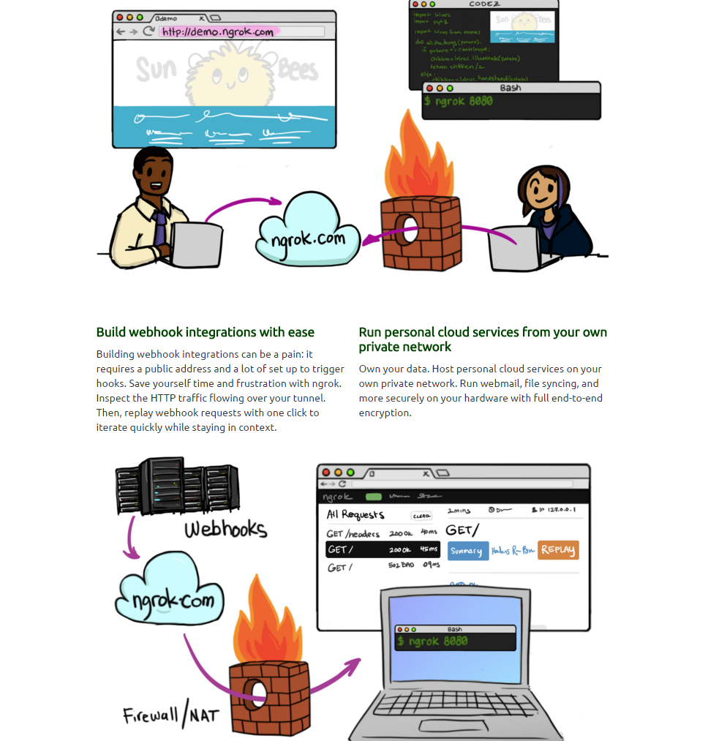
ngrok
ngrok is a tunnel tool for automated testing local website.
It's free but not visual. Need to use terminal commands to set up the server.

Slide 6
Apache
It allowed to do everything on local host from HTML to PHP pages, we were able to also connect it to phpMyAdmin which made it a really great tool to use.

Slide 7
phpMyAdmin
This tool connected to the Apache server easily and allowed us to create a database in an organized way. We were able to create user logins with this tool.
Database connection

Slide 8
MySQL
MySQL is an open-source relational database management system
It was really easy to work with and we were able to store all of our information in a hassle free way. It allowed us to organize our food groups into categories.

Slide 9
HTML
HTML is a markup language used for structuring and presenting content on the World Wide Web
Although HTML was new to all of us in the group, learning it was pretty simple and it allowed us to create a basic website for our calorie tracker. The syntax was fairly simple to use.

Slide 10
Python Web Server
We were able to run our website on a local host server, but it didn't support PHP websites which is a big downside.

Slide 11
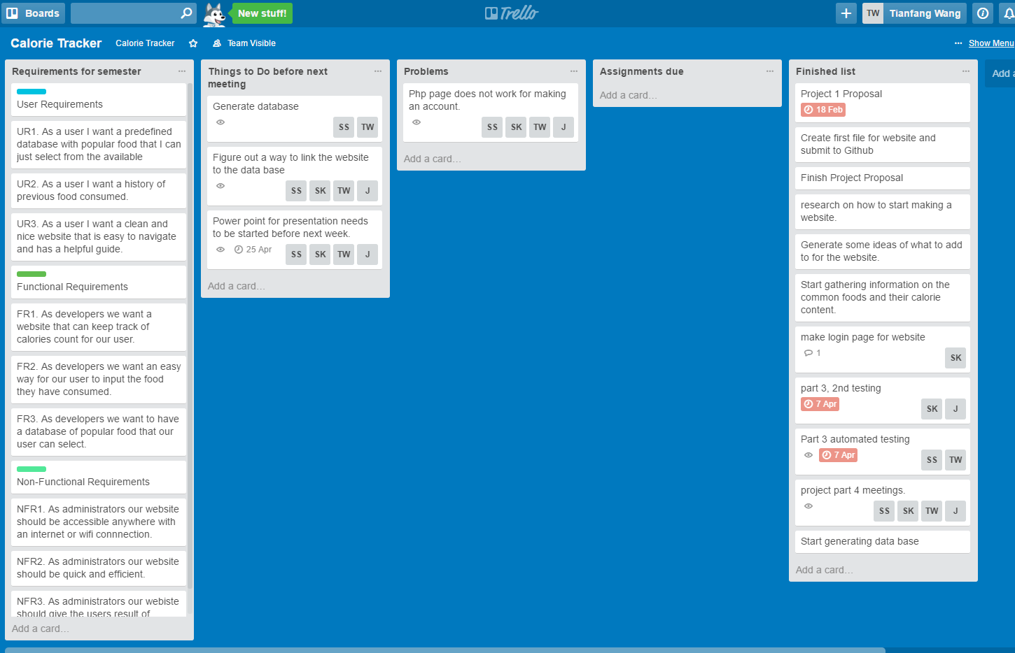
Trello
Team tracker
Trello was an okay application to track our progress of the project, but it was easy to lose track of what things need to get done.

Slide 12
Methodologies
Agile
-We meet once a week and before our meeting we conduct our Agile meeting. What we did last week? What should we do this week? If we ran any troubles?
Pair programming
-We use git for pair programming.
Peer code review
-Lab recitation for peer code review

Slide 13
Challenges
Window size not formatting properly on different laptop screen. Minor since project was still able to proceed.
Linking data base to website. We just ran of time, It greatly affected our project plans since that was the main goal of project. But we were able to create a database of login for users.

Slide 14
Thank You!

