Slide 1
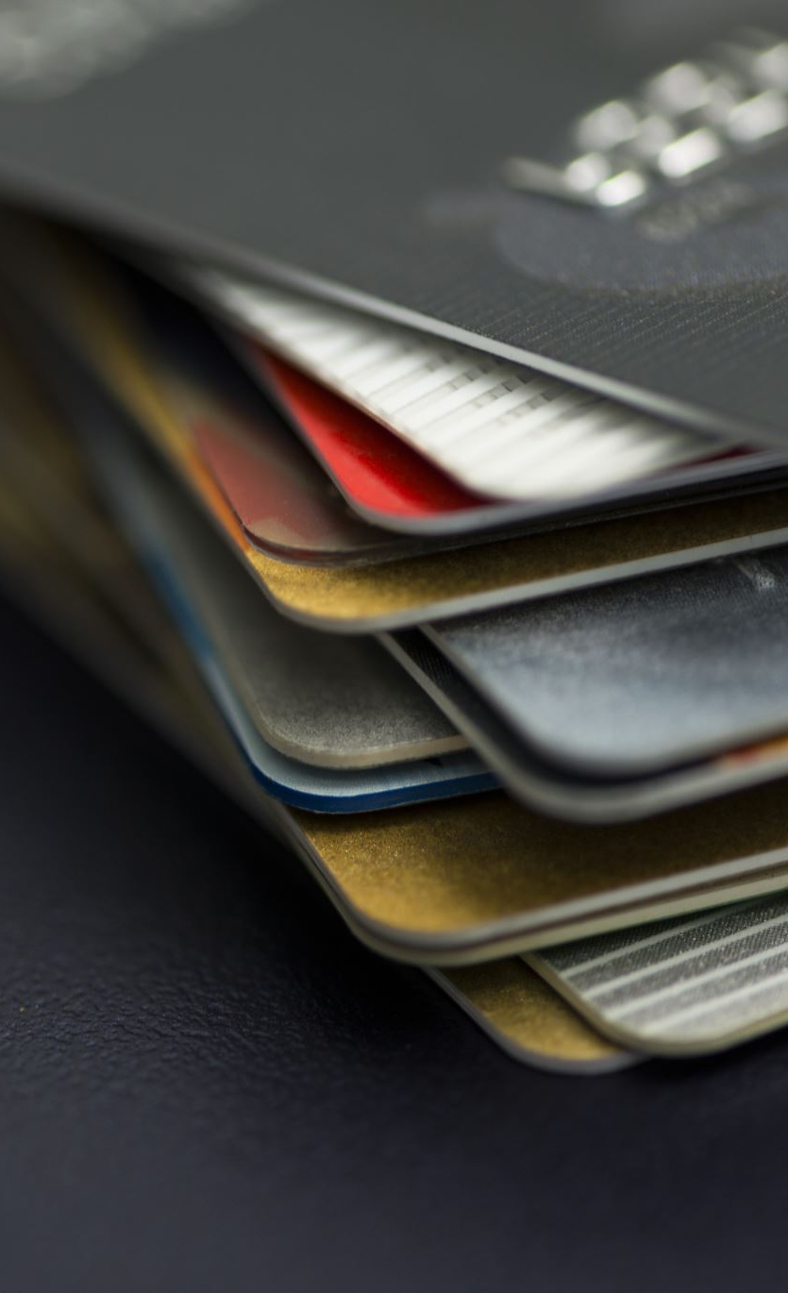
Fraud Detection in Payment Card Transactions
Presented by Team C:
Narayani Bakhati
Sahithi Bikumalla
Keerthi Reddy Chimmula
Harinath Reddy Nallagondu
Course: DSCI-8950
Instructor: Lochana Palayangoda, PhD

Slide 2
Table of Contents
Introduction
Data Overview
Data Cleaning & Preprocessing
Univariate and Multivariate Analysis
Limitations & Challenges
Next Steps

Slide 3
Introduction
Fraudulent transactions cause financial losses, reputational damage, and security risks, reducing trust in digital payments.
Annual global fraud losses (credit & debit card): $34.36 billion (2022)
Fraud patterns constantly evolving
Limitations of traditional fraud detection
Static rule-based methods are ineffective
Objective:
Develop a predictive fraud detection model
Minimize false positives and false negatives
Notes:
Narayani

Slide 4
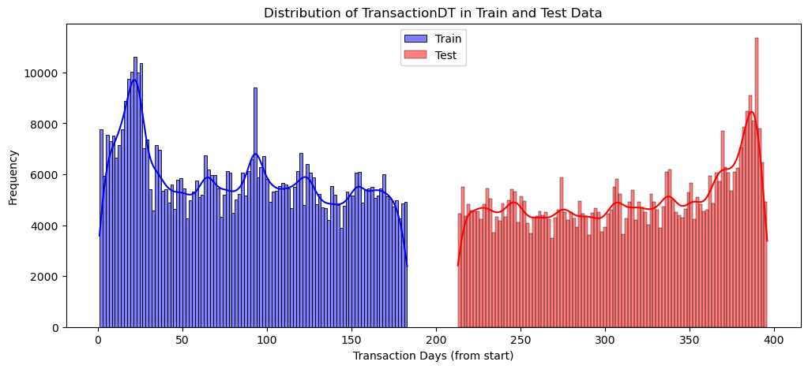
Data Overview
IEEE Computational Intelligence Society (IEEE-CIS), in collaboration with Vesta Corporation
Dataset, sourced from real-world e-commerce transactions
The IEEE-CIS fraud detection dataset consists of two primary files:
Transaction Data: Contains information on payment transactions, including timestamps, transaction amounts, and payment methods.
Identity Data: Includes details related to the user’s identity, such as IP address, device type, and behavioral patterns.
We have train data of shape (590540, 434) and test data of shape (506691, 433).
Only 28% of test transactions and 24.4% of train transactions have associated identity data.
Notes:
Sahithi

Slide 5
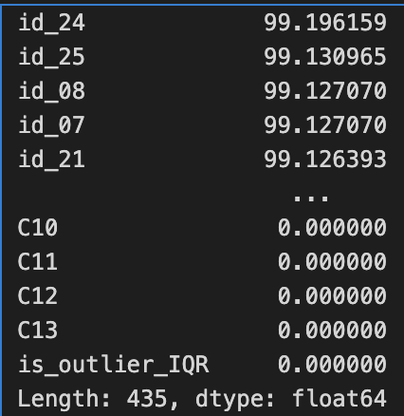
Data Cleaning & Preprocessing
Removed columns with more than 30% missing values.
Imputed categorical missing values with mode and numerical missing values with the median.
Applied Feature Engineering on TransactionDT and extracted Transaction Hour and Day.
Translated category data such as card type and card categories into numerical representations using Label Encoding.
Did MinMax Scaling to normalize numerical features to a 0-1 range, ensuring consistency across the dataset. Missing numerical values in the test set were filled with 0.0.
Notes:
Keerthi

Slide 6
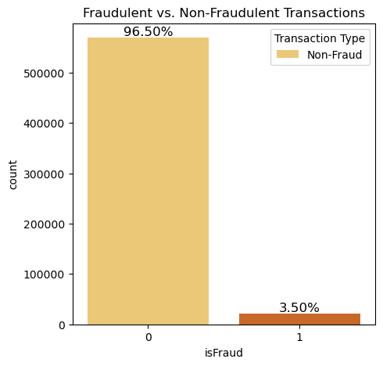
Target Distribution
Predicting the probability that an online transaction is fraudulent, as denoted by the binary target isFraud.
Transactions are labeled as fraudulent (isFraud = 1) or legitimate (isFraud = 0)
Imbalance in datasets, with legitimate claims vastly outnumbering the fradulent ones.
Handle class imbalanced data using SMOTE(Synthetic Minority Over-sampling Technique).
Use Area under the ROC curve (AUC) as a metric
Notes:
Narayani

Slide 7
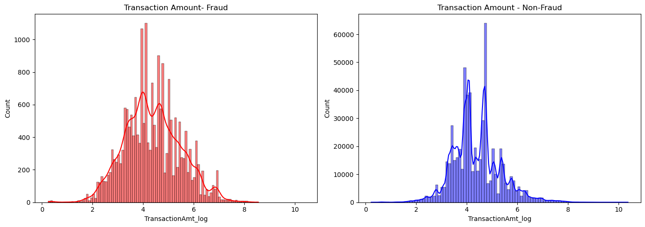
Fraud vs Non-Fraud Transaction Amount Distribution
Non-fraudulent transactions have higher transaction amounts, whereas fraudulent transactions are more evenly distributed and tend to cluster at lower values.
Notes:
Narayani

Slide 8
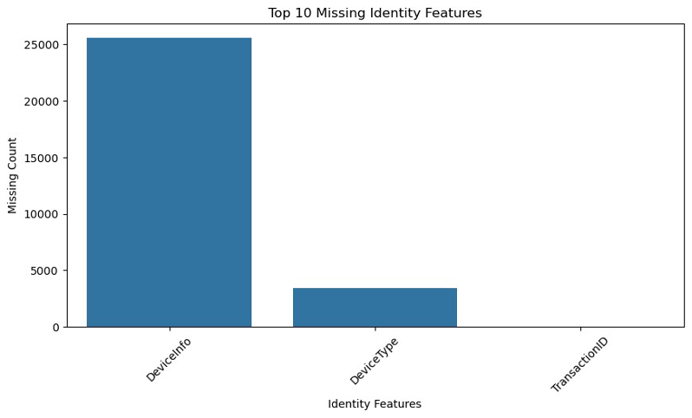
Exploratory data analysis
Device-Info has the highest missing values, possibly due to privacy settings or incomplete data collection.
Device-Type has some missing values, but significantly fewer than Device Info.
Transaction-ID has the least missing values, ensuring accurate tracking of transactions.
Missing identity data may reduce fraud detection accuracy by limiting behavioral insights.
Possible Reasons for Missing Data:
Users opting out of sharing device details due to privacy settings.
Certain transactions not requiring identity verification, leading to incomplete records.
Data collection inconsistencies across different transactions.
Notes:
Keerthi

Slide 9
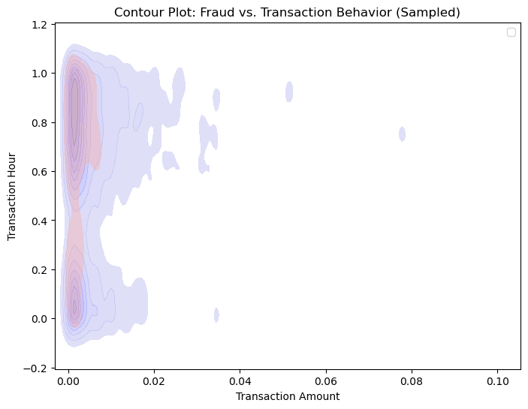
Exploratory Data Analysis
The contour plot visualizes the relationship between transaction amount and transaction time (hour).
It helps identify fraud patterns based on transaction behavior.
Observations
Most fraudulent and non-fraudulent transactions occur at lower transaction amounts.
Fraudulent transactions (red regions) non-fraudulent transactions (blue).
Fraud activity is seen at different times of the day.
Notes:
Sahithi

Slide 10
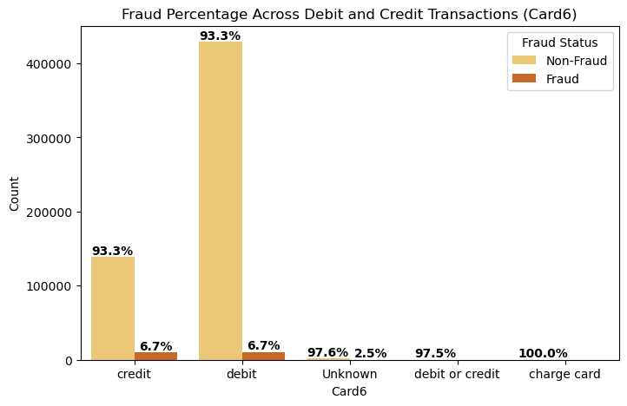
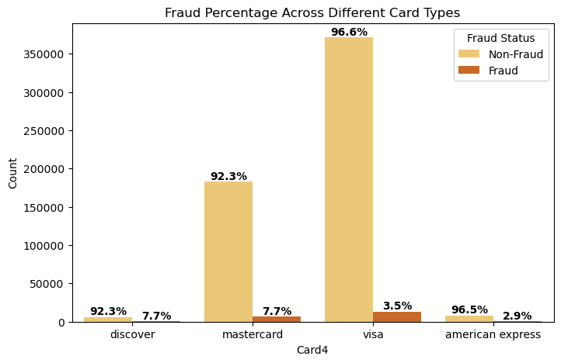
Fraud Rate by Card Type and Categories
The chart compares the fraud rates across Visa, Mastercard,Amex and Discover cards.
Visa cards have the highest overall transaction volume, but Discover cards show a higher percentage of fraudulent transactions.
Discover cards require focused attention due to a higher fraud rate relative to non-fraudulent transactions.
Credit cards have much fraud activities 6.6%)compared to debit card (2.4%).
Notes:
Harinath Reddy

Slide 11
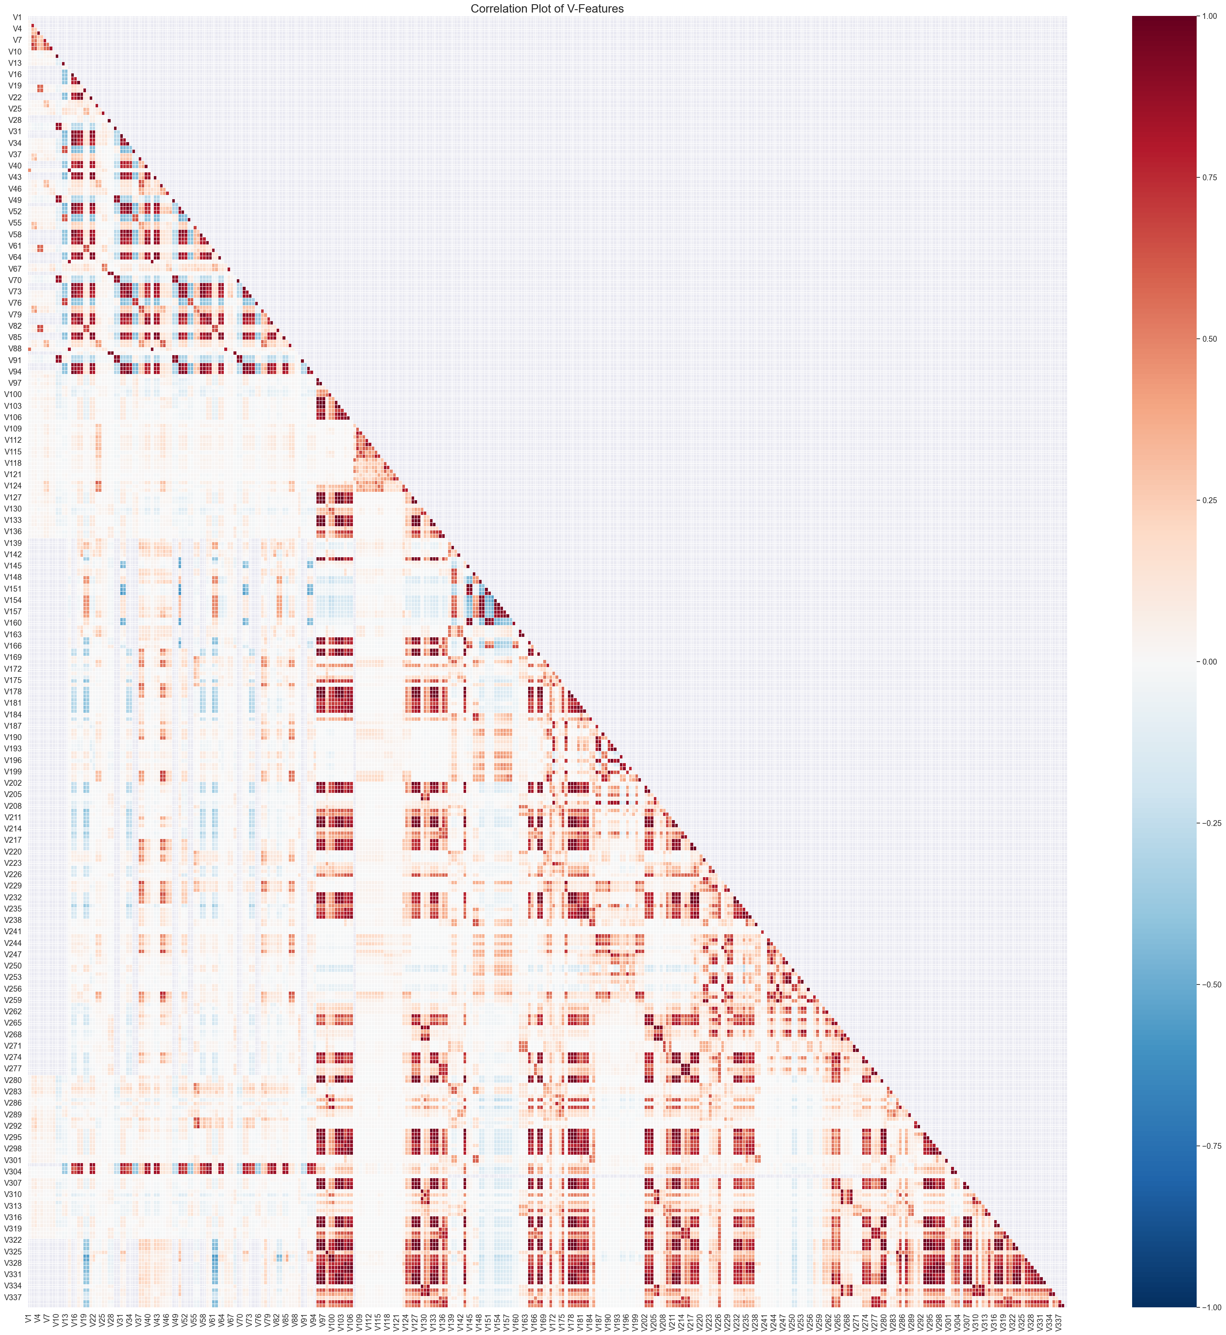
Correlation Heatmap of Vxxx Columns
V1-V339: Vesta engineered rich features, including ranking, counting, and other entity relations.
Triangular form to reduce redundancy.
Detected high correlation among features.
Notes:
Narayani

Slide 12
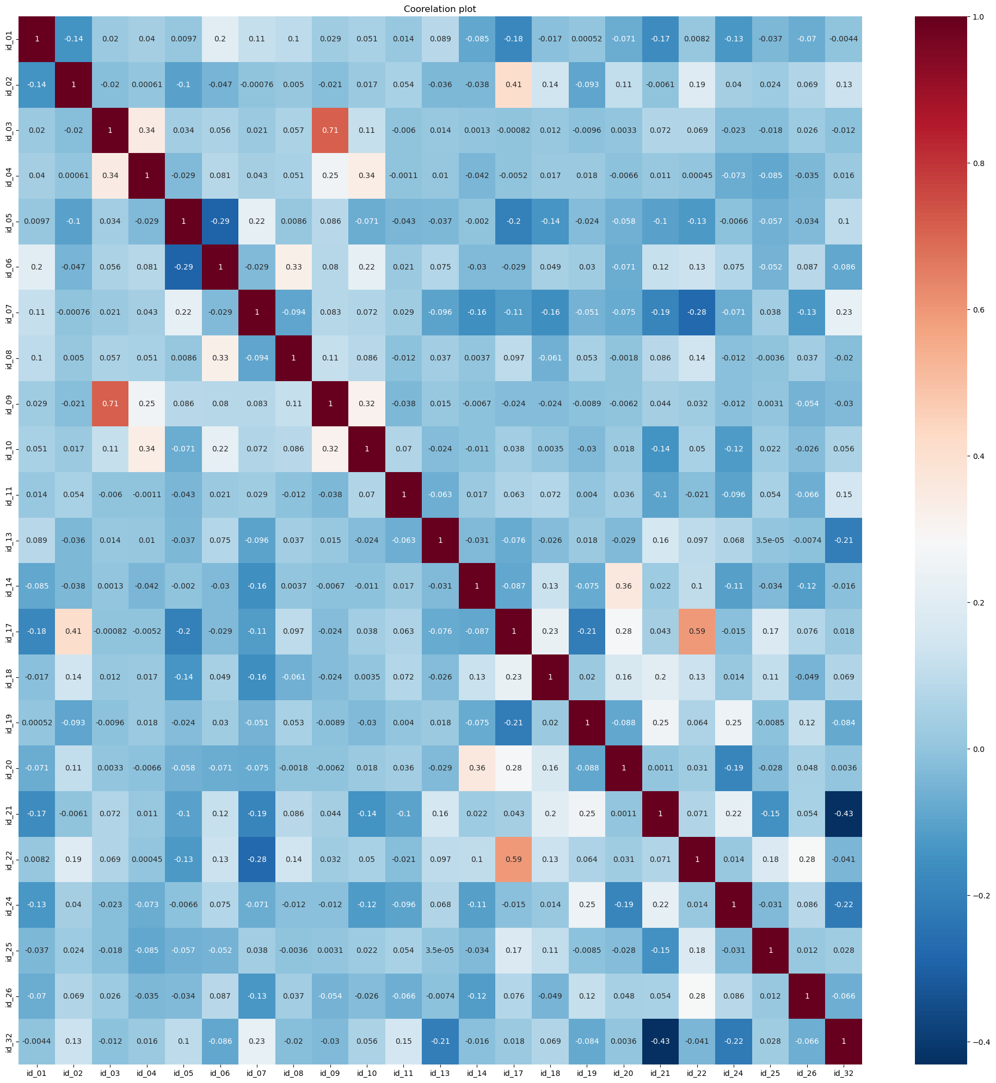
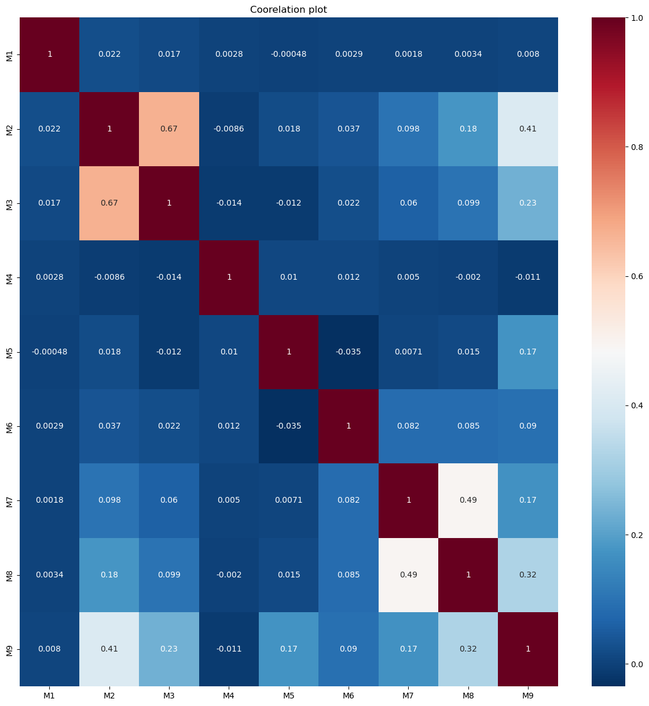
Correlation analysis
id1-id32 columns: identity from Vesta and security partners, capturing device, IP, proxy ratings, and behavioral fingerprints like login attempts and session duration
M1-M9: match, such as names on cards and addresses, etc.
Notes:
Narayani

Slide 13
Limitation and Challenges
Memory Issues because of the large dataset.
Large number of missing values in the datasets.
Inconsistent encoding of categorical variables.
Too many columns to analyze and understand its importance.
Highly correlated columns (e.g. Vxxx)
Assumptions: When working with the TransactionDT, assumed reference date (e.g., "2017-12-01") as in the kaggle discussion many assumed and used this as a start date.
Notes:
Harinath Reddy

Slide 14
Next Steps
Explore Class Imbalance Handling Strategies:
For Logistic Regression & Random Forest
Experiment with undersampling the majority class or oversampling the minority class (e.g., SMOTE).
For XGBoost
Experiment with SMOTE + Tomek links(to balance data while reducing noise)
Notes:
Harinath Reddy

Slide 15
REFERENCE
Addison Howard, Bernadette Bouchon-Meunier, IEEE CIS, inversion, John Lei, Lynn@Vesta, Marcus2010, and Prof. Hussein Abbass. IEEE-CIS Fraud Detection. https://kaggle.com/competitions/ieee-fraud-detection, 2019. Kaggle.

Slide 16

THANK YOU!

Slide 17
APPENDICES
Dataset Description: Transaction Table
- TransactionDT: timedelta from a given reference datetime (not an actual timestamp)
- TransactionAMT: transaction payment amount in USD
- ProductCD: product code, the product for each transaction
- card1 - card6: payment card information, such as card type, card category, issue bank, country, etc.
- addr: address (both addresses are for purchaser addr1 as billing region & addr2 as billing country)
- dist: distance (distances between (not limited) billing address, mailing address, zip code, IP address, phone area, etc)
- P_ and (R__) emaildomain: purchaser and recipient email domain
- C1-C14: counting, such as how many addresses are found to be associated with the payment card, etc. The actual meaning is masked.
- D1-D15: timedelta, such as days between previous transaction, etc.
- M1-M9: match, such as names on card and address, etc.
- Vxxx: Vesta engineered rich features, including ranking, counting, and other entity relations. (339 columns)
Idnetity table- Categorical Features:
- DeviceType: Desktop, mobile
- DeviceInfo: iOS Device, Windows, Samsung, MacOS
- id_12 – id_38: id01 to id11 are numerical features for identity, which is collected by Vesta and security partners such as device rating, ip_domain rating, proxy rating, etc. Also it recorded behavioral fingerprint like account login times/failed to login times, how long an account stayed on the page, etc.

Slide 18
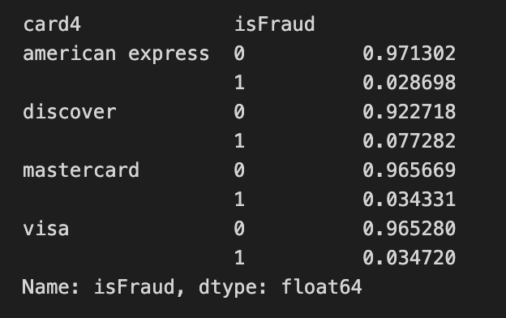
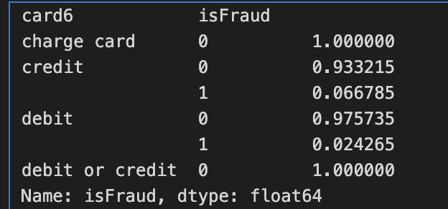
Card4 and Card6 grouped by fraud status

Slide 19
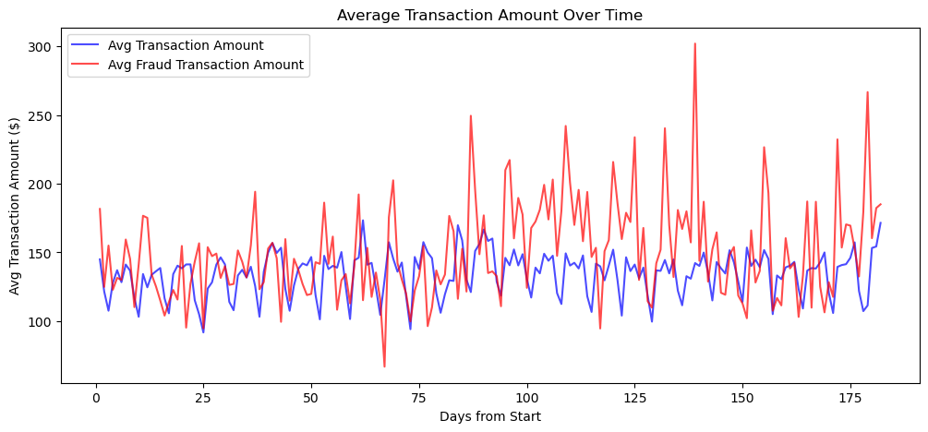
The fraudulent transactions amounts align with normal transaction amounts, which may indicate attempts to mimic genuine transaction behavior to avoid detection.

Slide 20
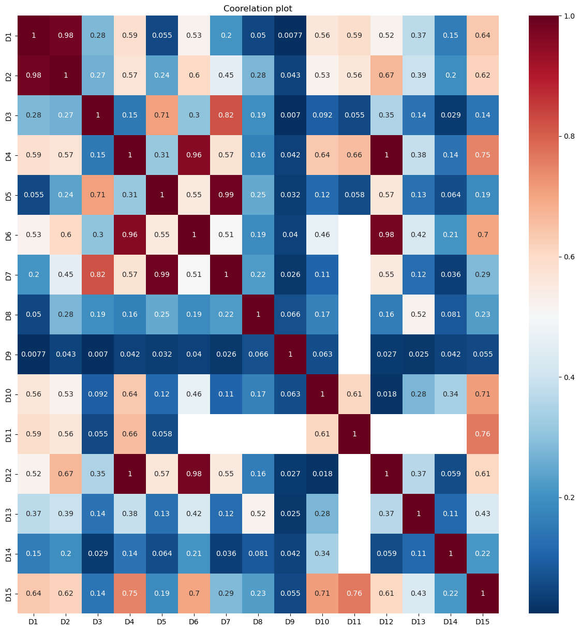
Correlation analysis of D columns

