Slide 1
Staten_Island_Arrest_Analysis
File created on: 12/7/20 5:36:18 PM EST

Slide 2
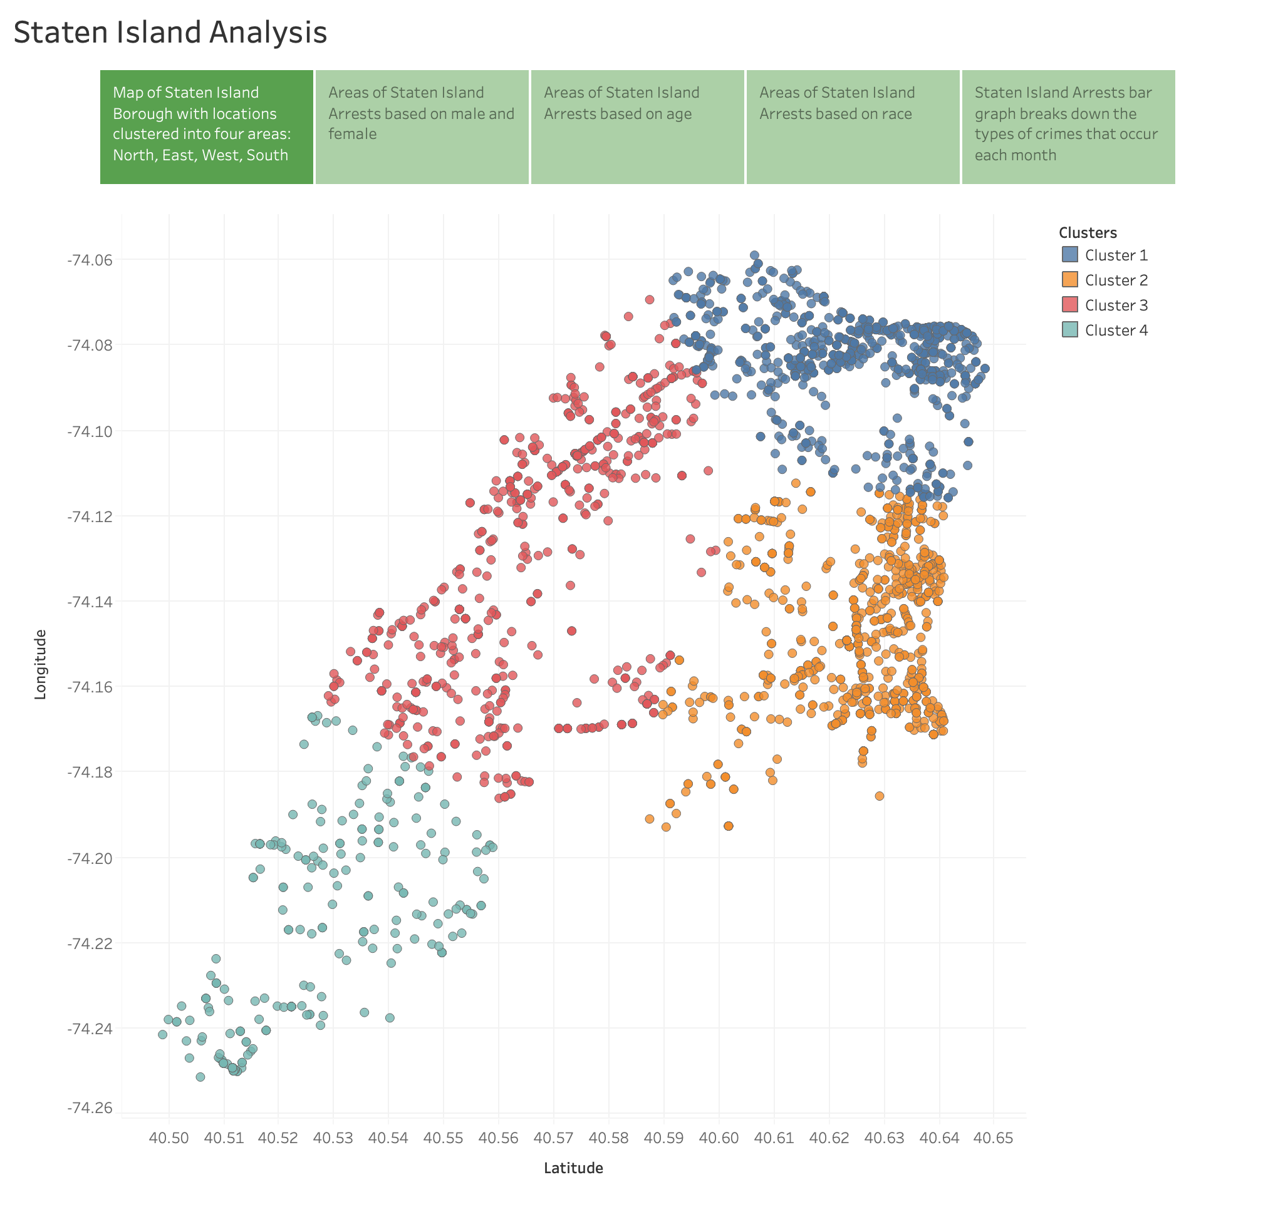

Slide 3
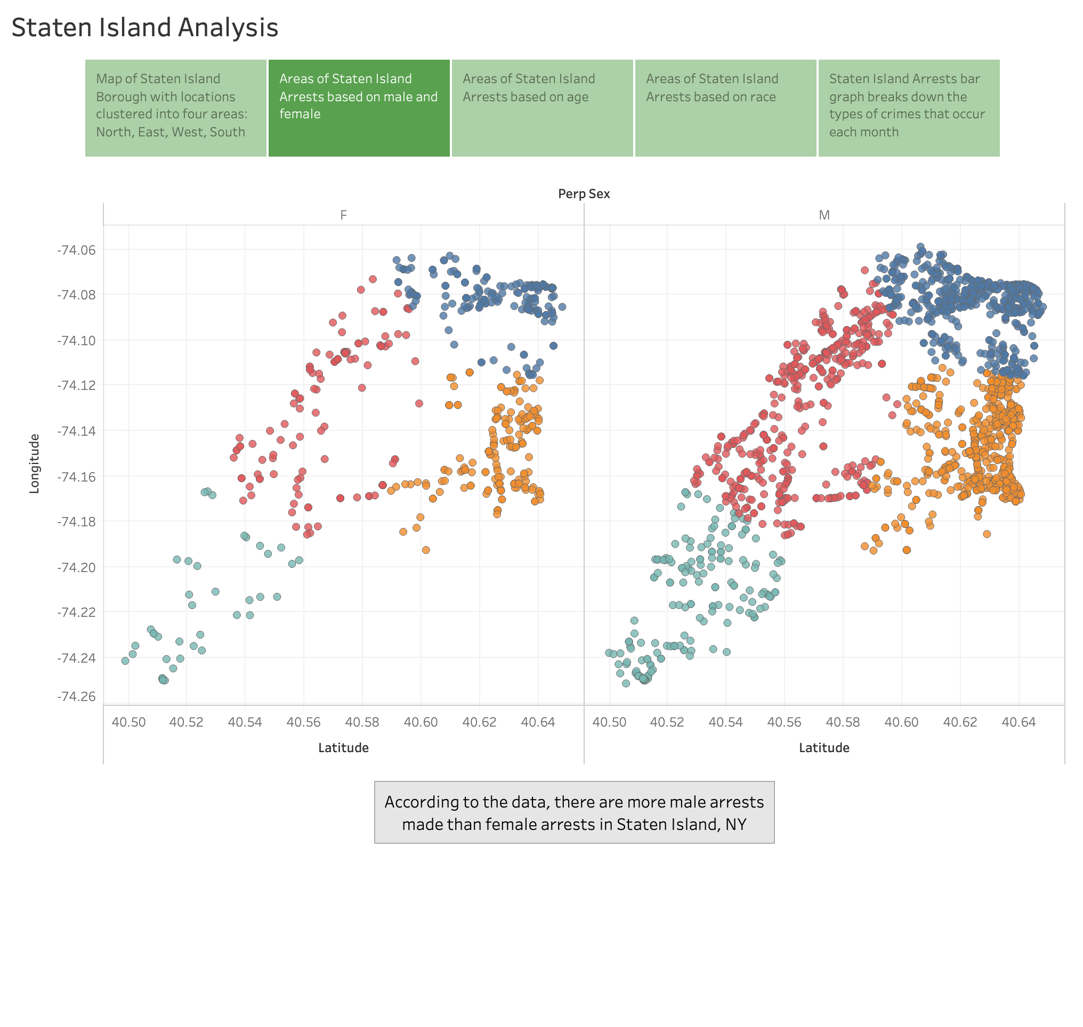

Slide 4
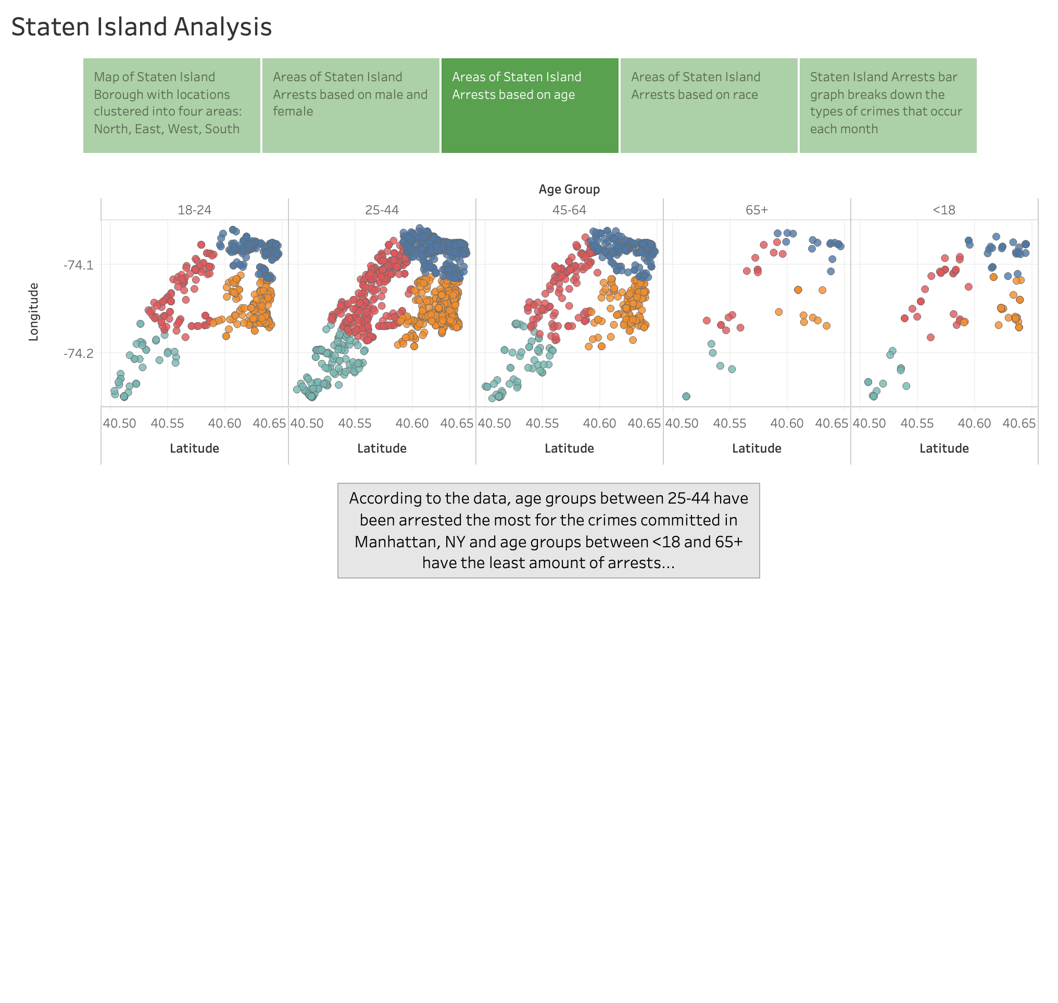

Slide 5
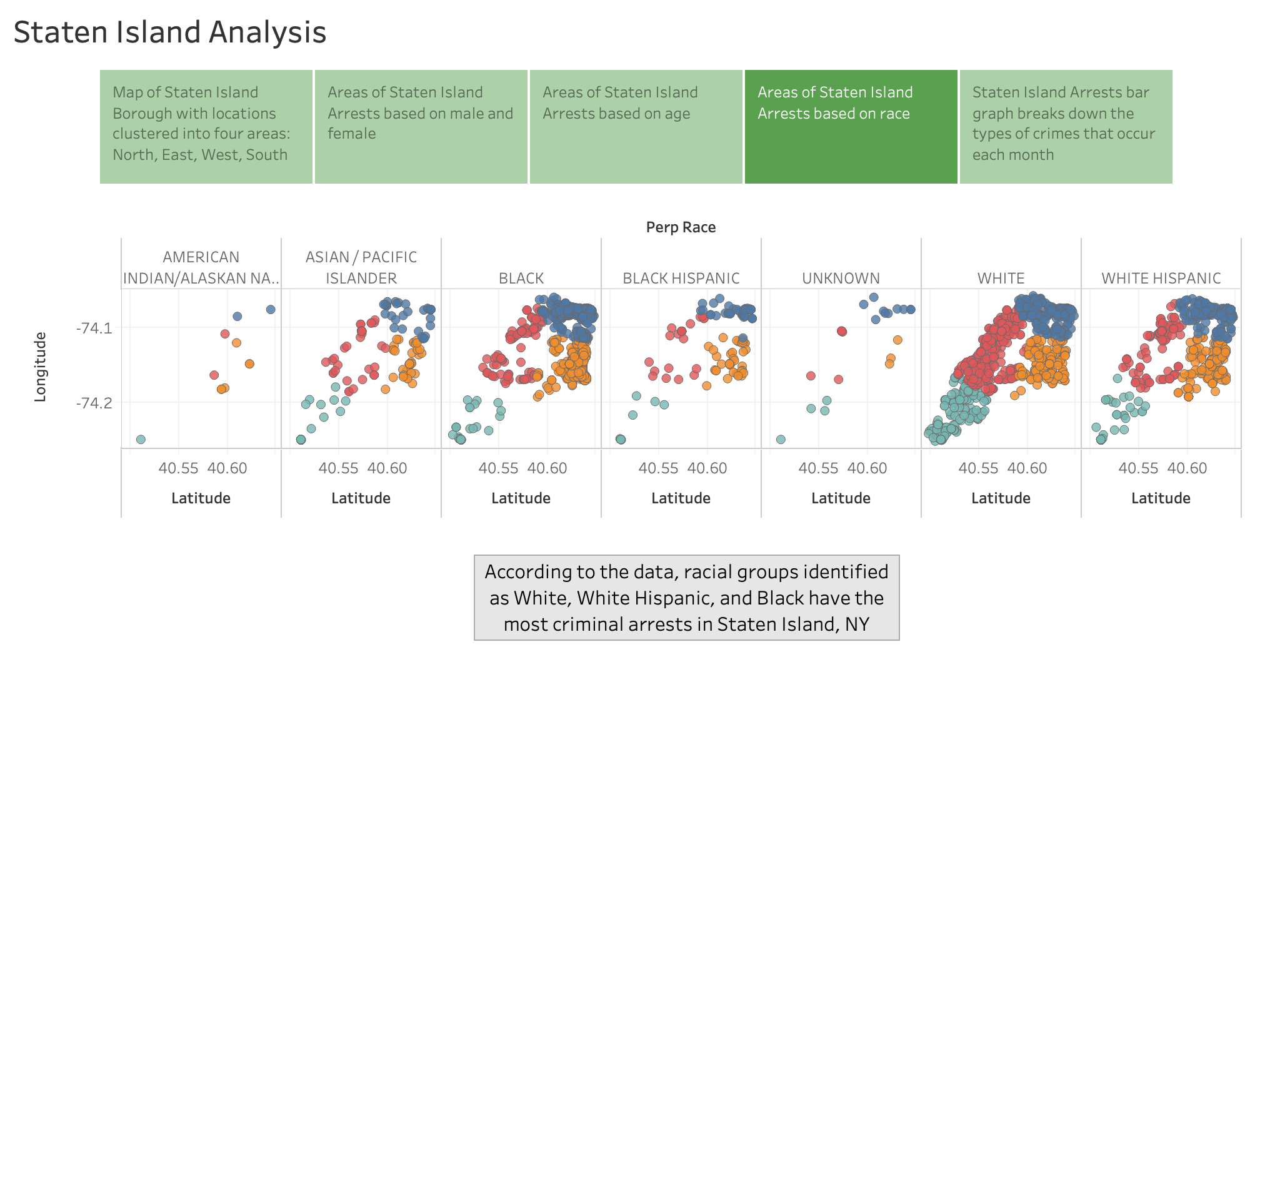

Slide 6
