Slide 1

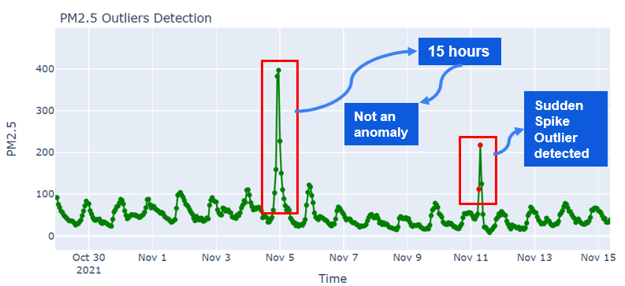
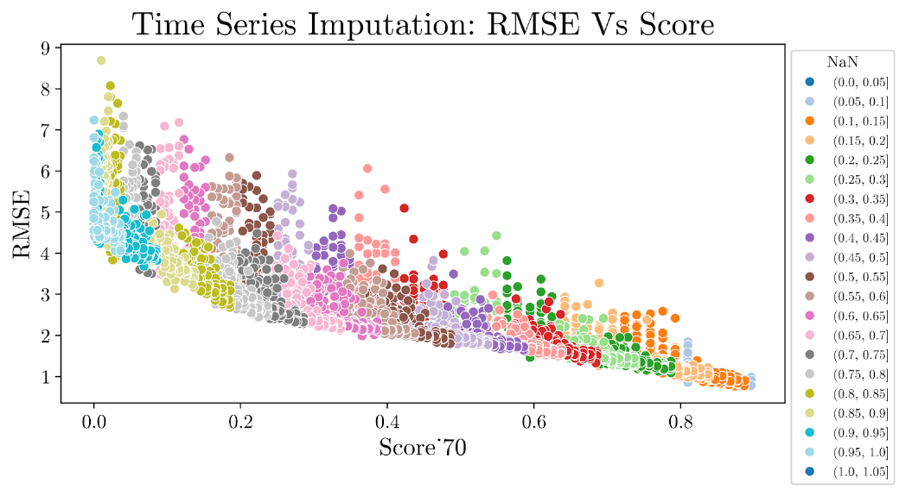

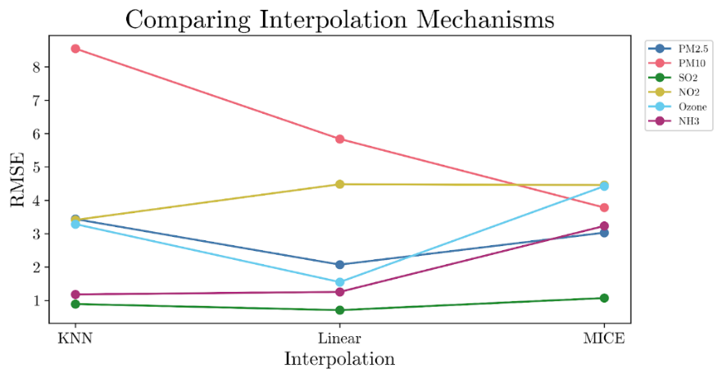
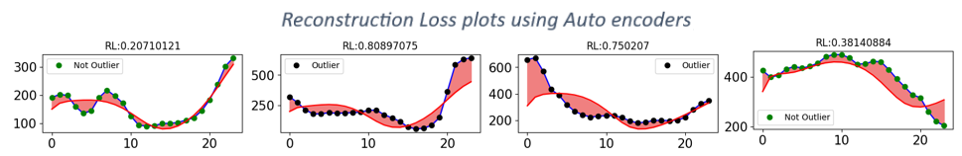
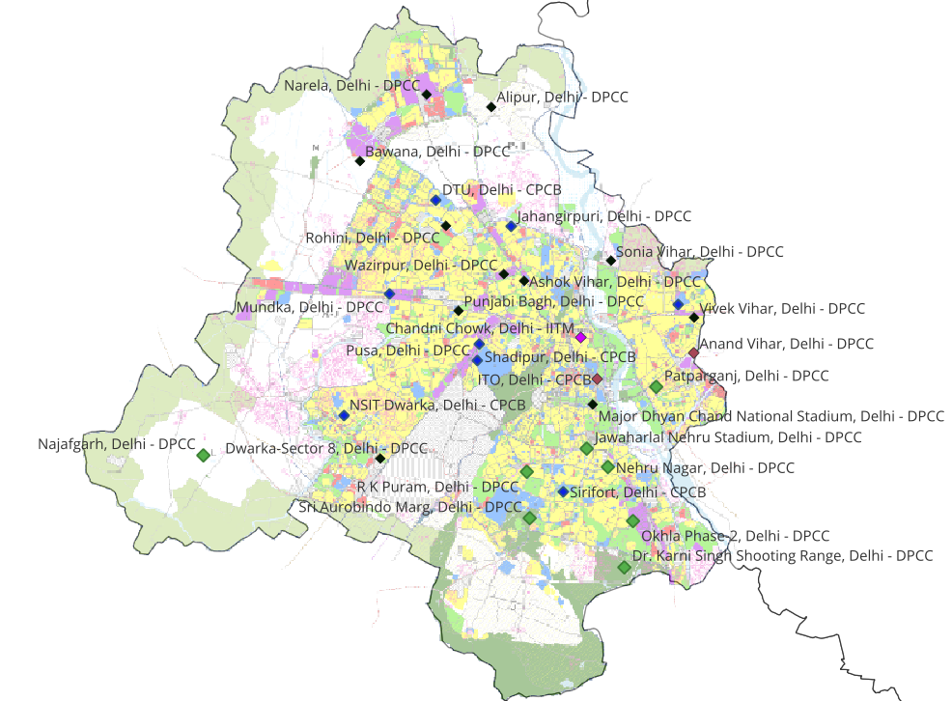
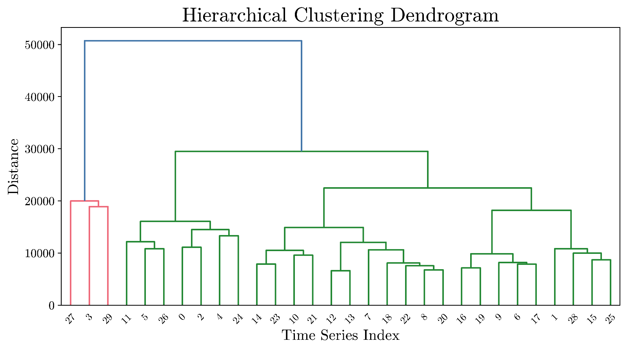
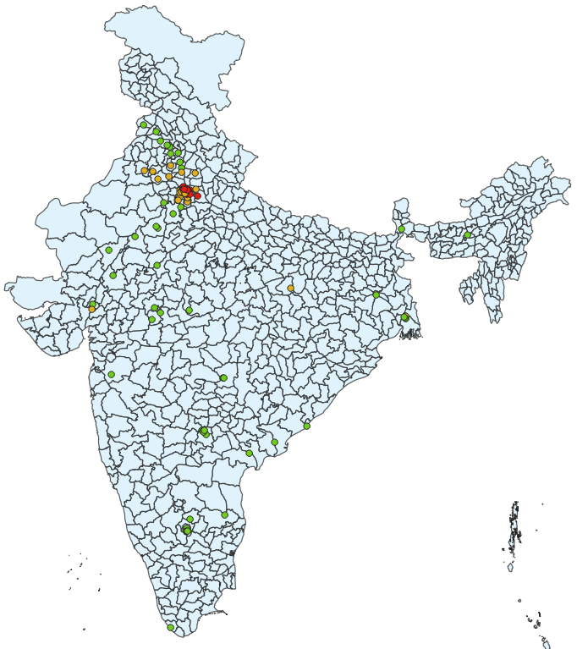
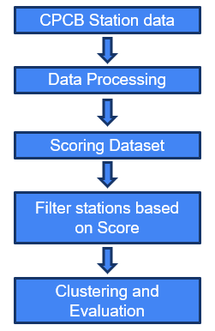
Identification of Sister Cities using Pollution data in India
B.Tech Project June 2023-July 2024
Balaji Nagappan (CH20B022), Prof Ragunathan Rengasamy
Department of Chemical Engineering, IIT Madras
HIGHLIGHTS
HIGHLIGHTS
In this project, the primary objective is to identify the sister cities, i.e. cities exhibiting similar pollution patterns. Sister cities offer valuable insights, enabling the interpolation of missing data points and facilitating the adoption of pertinent technologies.
Researchers have previously explored the clustering of air quality monitoring stations based on sister cities, acknowledging the potential benefits of such analyses. In this paper we show the importance of filtering out stations based on data quality score in order to mitigate the risk of misclassifications.
Results demonstrate tangible need for scoring mechanism and hierarchical clustering gave superior results as compared to K-Means clustering in terms of speed and accuracy.
Interpolation: MICE for PM_{2.5} and PM_{10,} linear interpolation for other parameters is best mechanism for interpolation.
INTRODUCTION
Clustering: K-Means and hierarchical clustering were implemented using DTW as the dissimilarity metric.
With urbanization and industrialization, air pollution in many countries and cities has become increasingly serious. Previous studies have shown that long-term inhalation of air pollutants causes adverse effects on human health. Thus monitoring air quality is at most necessary
CPCB provides high resolution data (15 min), but it suffers from high variabilities, inconsistencies and missing values. Poor-quality data can result in wasted resources, increased costs, unreliable analytics and bad business decisions.
Thus, a mechanism to score the quality of data is at most important. In this paper we have mentioned 5 key attributes for scoring any continuous dataset. Clustering algorithms like K-Means and hierarchical clustering were used to identify sister cities using DTW as distance metric to compare similarity between time series.
RESULTS AND DISCUSSION
30 Stations in Delhi clustered using Hierarchical clustering
Hourly Resolution data was used for analysis due to computational reasons (DTW – time complexity)
Land use pattern of Delhi is used as ground truth for clustering
Chandini Chowk and NSIT Dwarka have low data quality score and have been misclassified into wrong cluster.
Stations with lower data quality scores are susceptible to misclassification, likely because the data fails to capture the station's underlying pattern
STATUS OF LITERATURE
Scoring Mechanism
Literature on methodology to score data quality is relatively extensive. The overall score gives us an idea about reliability of the data. Most papers use 5 attributes to measure data quality: accuracy, validity, consistency, uniqueness and completeness.
For anomaly detection of timeseries, researchers have used Median Absolute Deviation (MAD) moving window approach and autoencoders. Both algorithms were explored in this paper.
Clustering
There are existing studies on clustering air quality parameters. Researchers have used various clustering algorithms like K-Means, Hierarchical, K-Medoid, PAM etc.. Some papers performed PCA before time series clustering.
Most papers used DTW (Dynamic Time Warping) as distance metric to measure similarity of timeseries.
Studies show that multi-hour multi-site forecasting results are better when spatial clustering (i.e. identification of sister cities) is done.
Hierarchical clustering proved to be both time-efficient and yielded superior results in comparison to k-means clustering using Rand-Index as metric for comparison.
Clustering of CPCB stations in India was done after applying threshold on overall data quality score to avoid possible misclassifications. (102 stations were clustered in 3 groups)
METHODOLOGY
CONCLUSION
Data : CPCB station data (513 stations) Resolution : 15 min
Parameters: PM_{2.5}, PM₁₀, NO₂, SO₂, NH₃, O₃
Duration: Sept 2019 – Sept 2023
The research article introduces a reliable scoring mechanism to assess the data quality of continuous datasets. Our analysis revealed that stations with lower data quality scores are susceptible to misclassification, likely because the data fails to capture the station's underlying pattern. This suggest the importance of filtering out stations before clustering. Hierarchical clustering gave us superior results as compared to k-means in terms of time and accuracy.
Data Quality Metrics
Accuracy: Detecting abnormalities in data using moving window MAD and autoencoders.
Consistency: Checks if data satisfies all the integrity constraints.
REFERENCES
3. Uniqueness: Metric tracks duplicate records. Counting any data twice will unduly weigh the results.
4. Validity: Checks if records in data conforms to data type as required.
5. Completeness: Tracks number of missing values in data. We use custom completeness score that utilizes the mean missing block length for calculating completeness score.
[1] Firas Bayram, Bestoun S. Ahmed, Erik Hallin, Anton Engman, June 2023, Oulu, Finland
DQSOps: Data Quality Scoring Operations Framework for Data-Driven Applications
[2] Xu, Z.; Liu, Z.; Tian, J.; Liu, Y.; Pan, H.; Liu, S.; Yang, B.; Yin, L.; Zheng, W. Classification of Urban Pollution Levels Based on Clustering and Spatial Statistics. Atmosphere 2022, 13, 494.
[3] Suris, F.N.A.; Bakar, M.A.A.; Ariff, N.M.; Mohd Nadzir, M.S.; Ibrahim, K. Malaysia PM10 Air Quality Time Series Clustering Based on Dynamic Time Warping. Atmosphere 2022, 13, 503.
[4] Kulanuwat, L.; Chantrapornchai, C.; Maleewong, M.; Wongchaisuwat, P.; Wimala, S.; Sarinnapakorn, K.; Boonya-aroonnet, S. Anomaly Detection Using a Sliding Window Technique and Data Imputation with Machine Learning for Hydrological Time Series. Water 2021, 13, 1862.

Slide 2
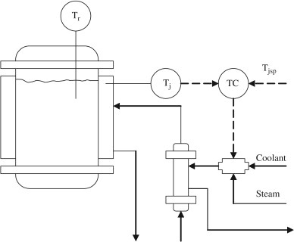
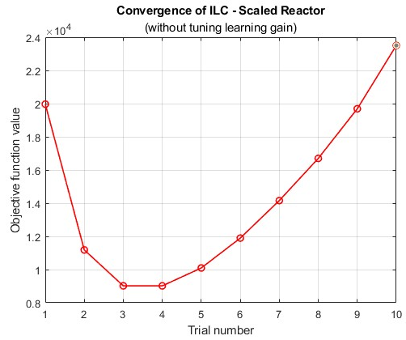
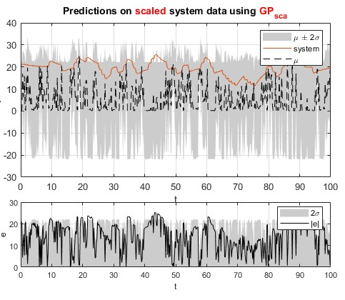
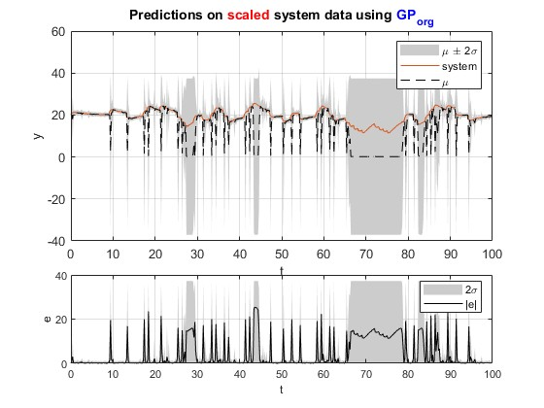
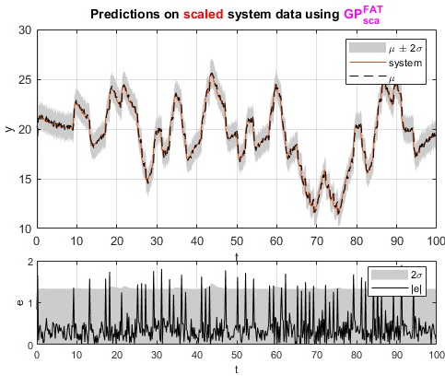
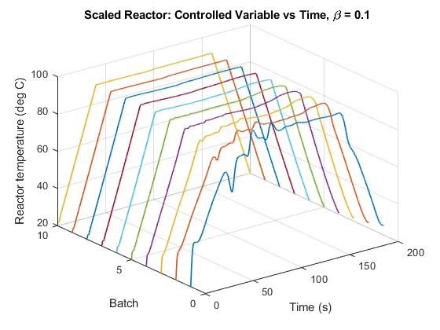
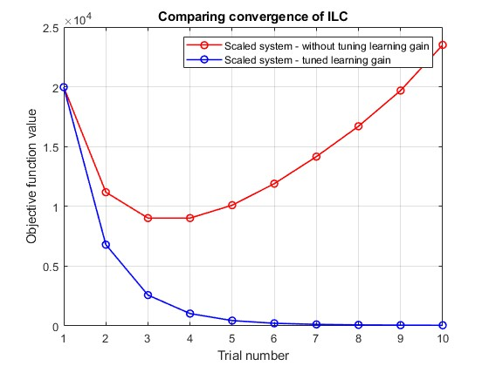
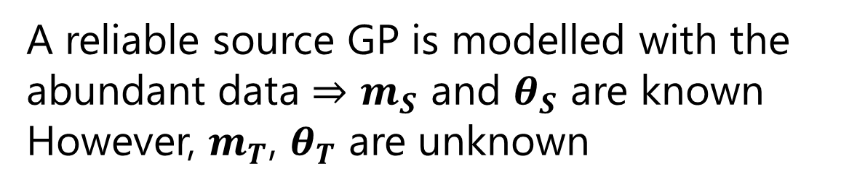
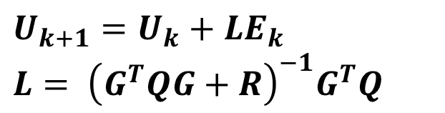
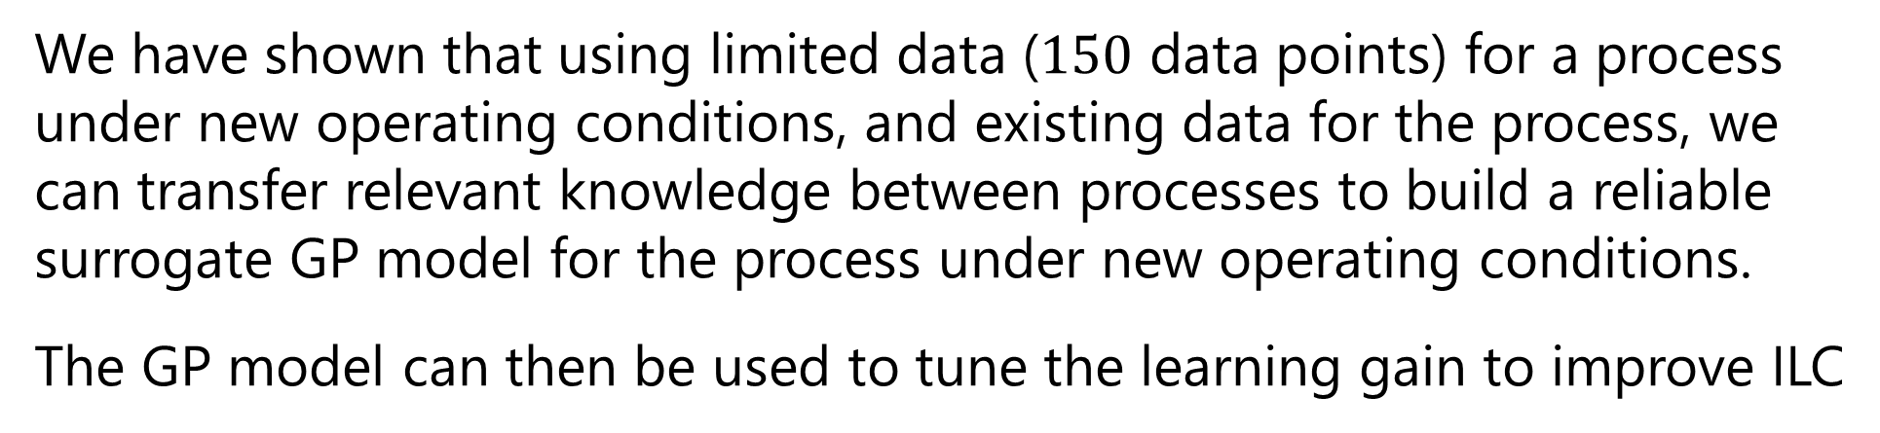
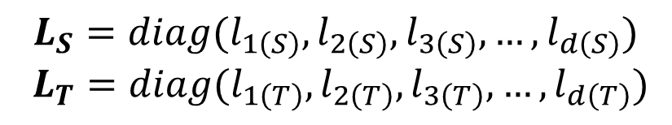
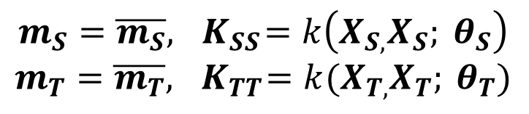
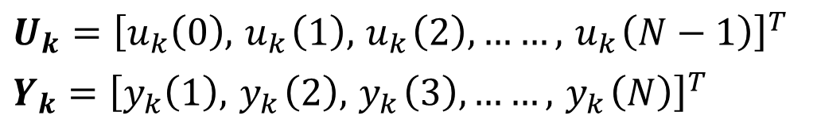
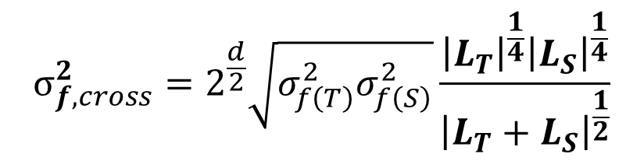

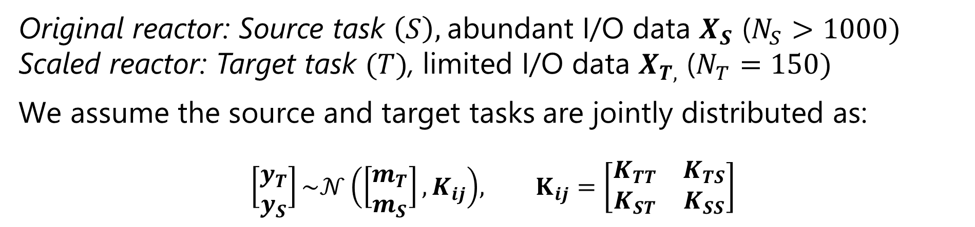


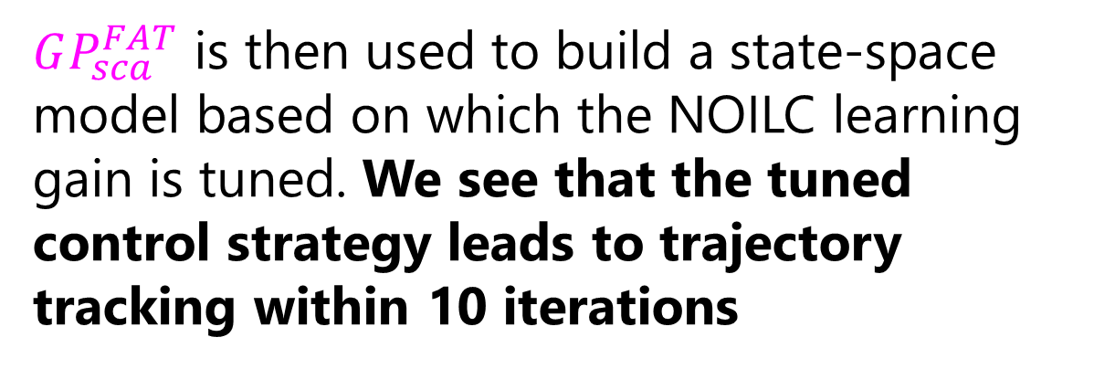


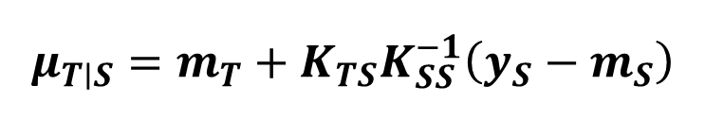

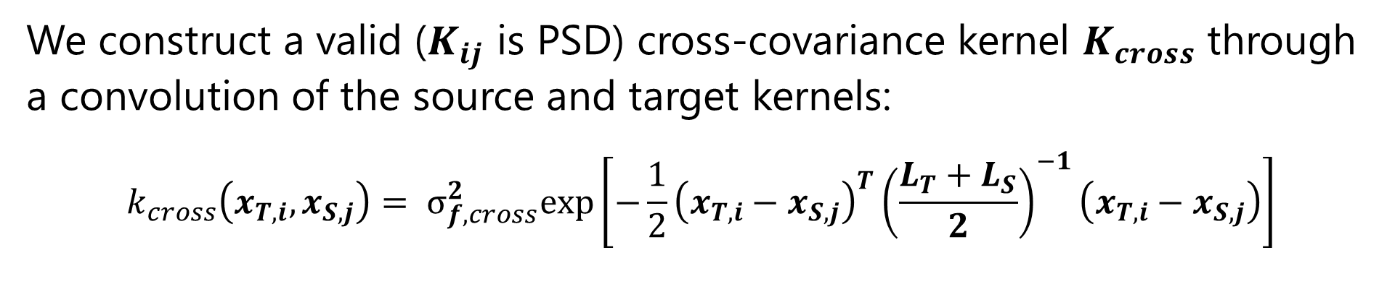

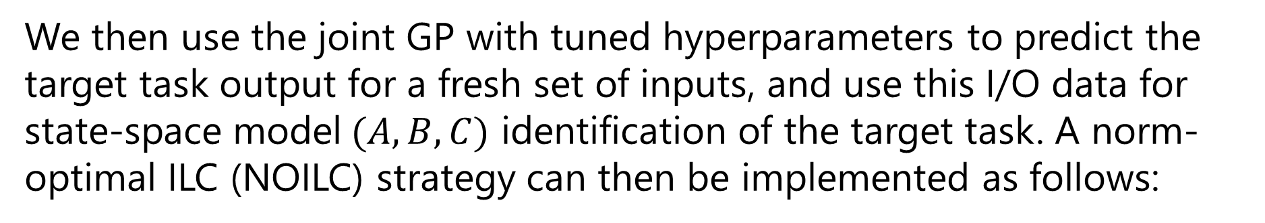


Transfer Learning for Iterative Learning Control Using Gaussian Processes
Letchumanan Muthiah (CH20B062), Dr. Arun. K. Tangirala, Department of Chemical Engineering
Highlights
We construct a valid ($K_{ij}$ is PSD) cross-covariance kernel $K_{cross}$through a convolution of the source and target kernels:
$$\begin{aligned}k_{cross}\left(x_{T,i},x_{S,j}\right)= σ_{f,cross}^{2}exp\left[−\frac{1}{2}{\left(x_{T,i}−x_{S,j}\right)}^{T}{\left(\frac{L_{T}+L_{S}}{2}\right)}^{−1}\left(x_{T,i}−x_{S,j}\right)\right] \#\end{aligned}$$
Iterative Learning Control (ILC) is used to improve the trajectory tracking performance of a repetitively operated process. The assumption of iteration invariance of the process conditions limits the extension of the ILC to similar processes and demands controller design from scratch.
In this project we aim to accelerate controller design for ILC using transfer learning, by building gaussian process (GP) models to facilitate knowledge transfer between dynamic processes.
The results show that transfer learning improves ILC for the modified process, with minimal computational cost.
$${σ_{f,cross}^{2}=2}^{\frac{d}{2}}\sqrt{σ_{f\left(T\right)}^{2}σ_{f\left(S\right)}^{2}}\frac{{\left|L_{T}\right|}^{\frac{1}{4}}{\left|L_{S}\right|}^{\frac{1}{4}}}{{\left|L_{T}+L_{S}\right|}^{\frac{1}{2}}}$$
$$L_{S}=diag(l_{1\left(S\right)},l_{2\left(S\right)},l_{3\left(S\right)},…, l_{d\left(S\right)})$$
$$L_{T}=diag(l_{1\left(T\right)},l_{2\left(T\right)},l_{3\left(T\right)},…, l_{d\left(T\right)})$$
The goal is to tune the hyperparameters $θ_{τ}=\left\{λ,m_{T},θ_{T}\right\}$ such that we maximize the log marginal likelihood of only the target response variables, given the source data
Introduction
$$θ_{τ}^{∗}=\underset{θ_{τ}}{argmax}\left[−\frac{1}{2}{\left(y_{T}−μ_{T∣S}\right)}^{T}K_{T∣S}^{−1}\left(y_{T}−μ_{T∣S}\right)−\frac{1}{2}\ln\left|K_{T∣S}\right|−\frac{N_{T}}{2}\ln{2π}\right]$$
Batch processing is used for the production of low-volume high-value products associated with the semiconductor and pharmaceutical industries
In industries, process conditions can change either due to real-time-optimisation to achieve product specifications, or for the conversion from pilot scale to an industrial scale batch process.
In the case of the Cott Batch Reactor, the ILC strategy implemented for one set of conditions is ineffective when the reactor is scaled up
$$μ_{T∣S}=m_{T}+K_{TS}K_{SS}^{−1}\left(y_{S}−m_{S}\right)$$
$$\begin{aligned}K_{T∣S}=K_{TT}−K_{TS}K_{SS}^{−1}K_{ST}\#\end{aligned}$$
We then use the joint GP with tuned hyperparameters to predict the target task output for a fresh set of inputs, and use this I/O data for state-space model$(A,B,C)$ identification of the target task. A norm-optimal ILC (NOILC) strategy can then be implemented as follows:
$$\min_{U_{k+1}}{J_{k+1}=\frac{1}{2}E_{k+1}^{T}QE_{k+1}+\frac{1}{2}{\left(U_{k+1}−U_{k}\right)}^{T}R\left(U_{k+1}−U_{k}\right)}$$
$$U_{k}={\left[u_{k}\left(0\right),{ u}_{k}\left(1\right),{ u}_{k}\left(2\right),……,{ u}_{k}\left(N−1\right)\right]}^{T}$$
$$\begin{aligned}Y_{k}={\left[y_{k}\left(1\right),{ y}_{k}\left(2\right),{ y}_{k}\left(3\right),……,{ y}_{k}\left(N\right)\right]}^{T}\#\end{aligned}$$
$$G=\left[\begin{matrix}g_{1} & 0 & 0 & ⋯ & 0 \\ g_{2} & g_{1} & 0 & ⋯ & 0 \\ g_{3} & g_{2} & g_{1} & ⋯ & 0 \\ ⋮ & ⋮ & ⋮ & ⋱ & ⋮ \\ g_{N} & g_{N−1} & g_{N−2} & ⋯ & g_{1}\end{matrix}\right]$$
$$U_{k+1}=U_{k}+LE_{k}$$
$$L= {\left(G^{T}QG+R\right)}^{−1}G^{T}Q$$
Matrix of impulse responses, $g_{i}=CA^{i−1}B$
Survey of Literature
Results and Discussion
GPs have been widely used for simultaneous multi-task learning. While this models inter-process dependencies very well, it is not useful in knowledge transfer from learned task to a new one.
Some works describe a model migration approach - an affine transformation of the input and output space of the learned GP to obtain the new GP. However such a transformation may not possess sufficient flexibility to model non-linear processes, and does not account for process similarity.
In recent years, GPs with transfer kernels have been used to tune the impact that the learned GP has on the new GP. However, this is again a simultaneous multi-task learning approach
We make predictions on fresh scaled reactor data using 3 GPs, trained using:
limited data from scaled reactor ${(X}_{T})$: $GP_{sca}$
original reactor data ${(X}_{S})$ : $GP_{org}$
$X_{S}$ and $X_{T}$, through transfer learning $GP_{sca}^{FAT}$
We can see that $GP_{sca}^{FAT}$ clearly out-performs $GP_{sca}$ and $GP_{org}$
Methodology
GPs are used to model dynamic systems by using lagged inputs $(u)$ and outputs $(y)$ as regressors $x$
$$\begin{aligned}y=𝒢𝒫\left(m\left(x\right),k\left(x,x^{′}\right)\right)\end{aligned}$$
$m(x)=\overline{m}$, $k\left(x,x^{′},θ\right)= σ_{f}^{2}\exp\left(−\frac{1}{2}\sum_{q=1}^{d}{{\left(\frac{x_{i}\left(q\right)−x_{j}\left(q\right)}{l_{q}}\right)}^{2}}\right)+σ_{n}^{2}δ_{ij}$
$$θ=\left\{σ_{f},l_{1},l_{2},l_{3},…, l_{d}, σ_{n\left(S\right)}\right\}, d=no. of regressors$$
$σ_{f}^{2}:$ magnitude of covariance, $σ_{n}^{2}k_{ij}$: covariance between outputs due to white noise
$l_{q}$:characteristic length scale/relative importance of $q^{th}$component of $x$ ($q^{th}$input),
$GP_{sca}^{FAT}$ is then used to build a state-space model based on which the NOILC learning gain is tuned. We see that the tuned control strategy leads to trajectory tracking within 10 iterations
Original reactor: Source task $\left(S\right),$abundant I/O data $X_{S}$ ($N_{S}>1000)$
Scaled reactor: Target task $(T)$, limited I/O data $X_{T,}$ ($N_{T}=150)$
We assume the source and target tasks are jointly distributed as:
$$\begin{aligned}\left[\begin{matrix}y_{T} \\ y_{S}\end{matrix}\right]\sim 𝒩\left(\left[\begin{matrix}m_{T} \\ m_{S}\end{matrix}\right], K_{ij}\right)\#\end{aligned}, K_{ij}=\left[\begin{matrix}K_{TT} & K_{TS} \\ K_{ST} & K_{SS}\end{matrix}\right]$$
Conclusion
We have shown that using limited data ($150$ data points) for a process under new operating conditions, and existing data for the process, we can transfer relevant knowledge between processes to build a reliable surrogate GP model for the process under new operating conditions.
The GP model can then be used to tune the learning gain to improve ILC
A reliable source GP is modelled with the abundant data $⇒$ $m_{S}$ and $θ_{S}$ are known
However, $m_{T}$, $θ_{T}$ are unknown
$$m_{S}=\overline{m_{S}}, { K}_{SS}=k\left(X_{S,}X_{S}; θ_{S}\right)$$
$$m_{T}=\overline{m_{T}}, { K}_{TT}=k(X_{T,}X_{T}; θ_{T})$$
References
[1] N. Wagle and E. W. Frew, “Forward adaptive transfer of gaussian process regression,” Journal of Aerospace Information Systems, vol. 14, no. 4, pp. 214–231, 2017.
[2] C. K. I. Williams and C. E. Rasmussen, Gaussian processes for machine learning, vol. 2, no. 3. MIT press Cambridge, MA, 2006.
[3] N. Amann, D. H. Owens, and E. Rogers, “Iterative learning control for discrete-time systems with exponential rate of convergence,” IEE Proceedings-Control Theory and Applications, vol. 143, no. 2, pp. 217–224, 1996.
[4] B. J. Cott and S. Macchietto, “Temperature control of exothermic batch reactors using generic model control,” Ind Eng Chem Res, vol. 28, no. 8, pp. 1177–1184, 1989.
To maintain task boundaries while accounting for the correlation between the tasks, the cross-covariance kernel $K_{TS}$ is defined as
$$\begin{aligned}K_{TS}= λK_{cross}=K_{ST}^{T}\#\end{aligned}$$
$|λ|≤1$ is the similarity measure

