Slide 1
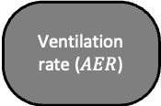


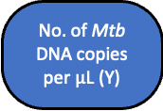
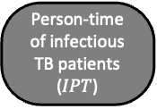
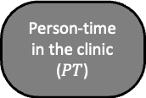



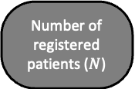
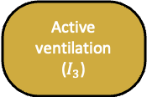

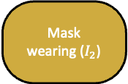



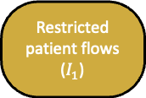
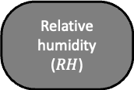
Intervention
Measured Outcome
Direction of effect
Measured variable
Unmeasured confounder
$$a$$
Effect on mediator
Latent variable
$$b$$
Effect on outcome
Pandemic situation
Pandemic-related infection control measures
Restricted patient flows ($I_{1}$)
Mask wearing ($I_{2}$)
Active ventilation ($I_{3}$)
$$a_{1}$$
$$a_{2}$$
$$a_{3}$$
Number of registered patients ($N$)
Person-time in the clinic ($PT$)
Ventilation rate ($AER$)
Relative humidity ($RH$)
Person-time of infectious TB patients ($IPT$)
$$b_{2}$$
$$b_{3}$$
$$b_{4}$$
$$b_{1}$$
No. of Mtb DNA copies per $μ$L (Y)
Seasonal effects
Other environ-mental factors

