Slide 1
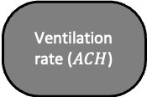


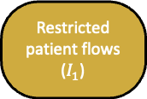
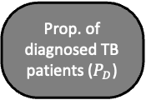
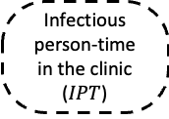


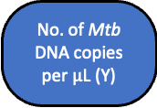

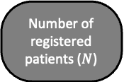
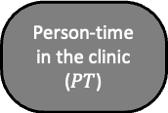

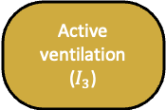




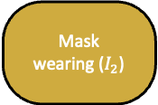

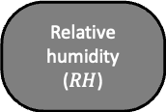
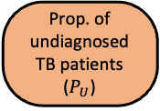
Intervention
Measured Outcome
Direction of effect
Measured variable
Unmeasured confounder
$$a$$
Indirect effect
Latent variable
$$b$$
Direct effect
General pandemic restrictions
Pandemic-related infection control measures
Restricted patient flows ($I_{1}$)
Mask wearing ($I_{2}$)
Active ventilation ($I_{3}$)
$$a_{1}$$
$$a_{4}$$
$$a_{5}$$
Number of registered patients ($N$)
Person-time in the clinic ($PT$)
$$a_{3}$$
Ventilation rate ($ACH$)
Relative humidity ($RH$)
Prop. of diagnosed TB patients ($P_{D}$)
Prop. of undiagnosed TB patients ($P_{U}$)
$$b_{2}$$
$$b_{3}$$
$$b_{4}$$
$$a_{2}$$
Infectious person-time in the clinic ($IPT$)
$$b_{1}$$
No. of Mtb DNA copies per $μ$L (Y)
Seasonal effects
Other environ-mental factors

