Slide 1
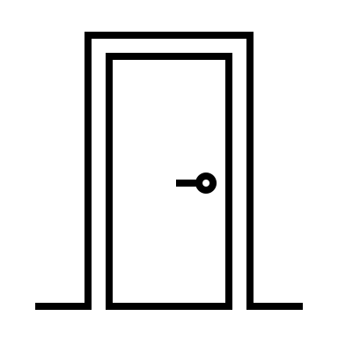
Class A
Class B
8.65m
8.65m
Door
Window
Window
Teacher desk
8.40m
8.40m
Teacher desk
Teacher desk
Door
Height: 3.20m | Area: 72m² | Volume: 233m³
Height: 3.20m | Area: 72m² | Volume: 233m³
Air cleaner
(Xiamoi HEPA filters)
Bioaerosol sampler
(BioSpot-VIVAS)
Bioaerosol sampler
(Coriolis Micro Air)
CO₂ and particles
(AQ Guard)
Cough monitoring
(Microphone)

