Slide 1
Driven to Power
Determining which factors contribute most significantly to a car’s Engine power capacity
A presentation by: Ian, Nikhil, and nadia

Slide 2
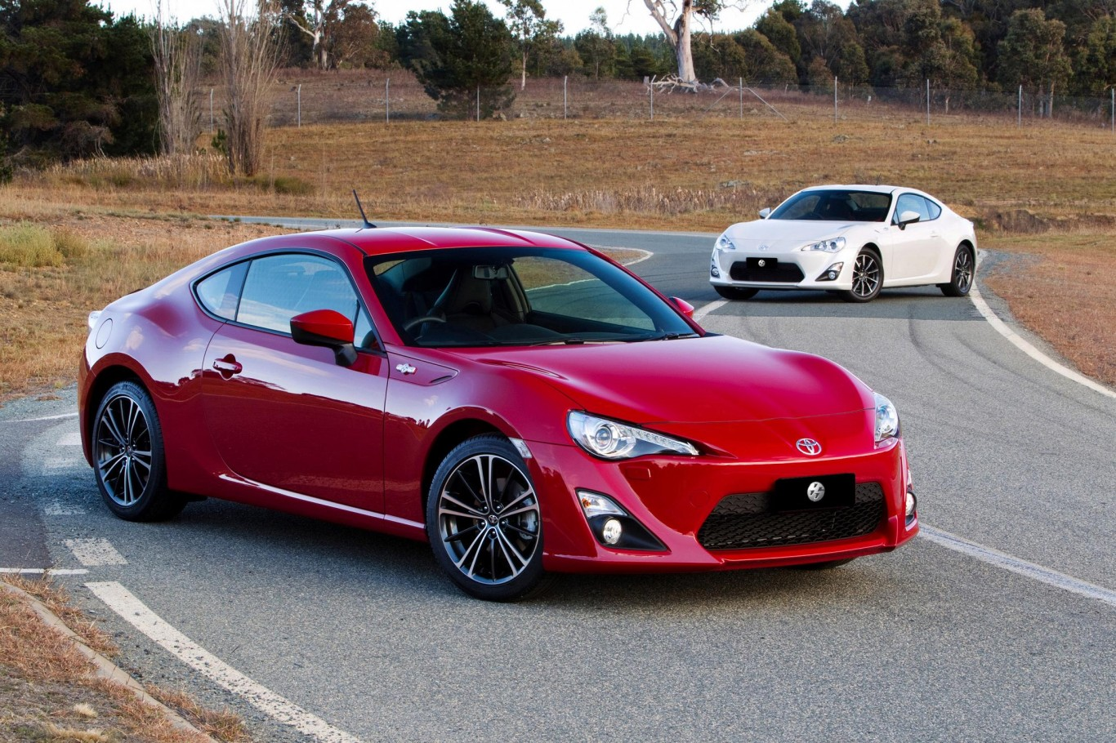
Our experiment
Calculate the power of a coupe model car’s fuel engine based upon properties of the engine
Linear regression analysis for each attribute
Positive correlation coefficient = positive contribution to the max fuel capacity
Negative correlation coefficient = negative contribution to the max fuel capacity
Hypothesis: Displacement and Turbo will have biggest positive impact, fuel delivery will have the biggest negative impact

Slide 3
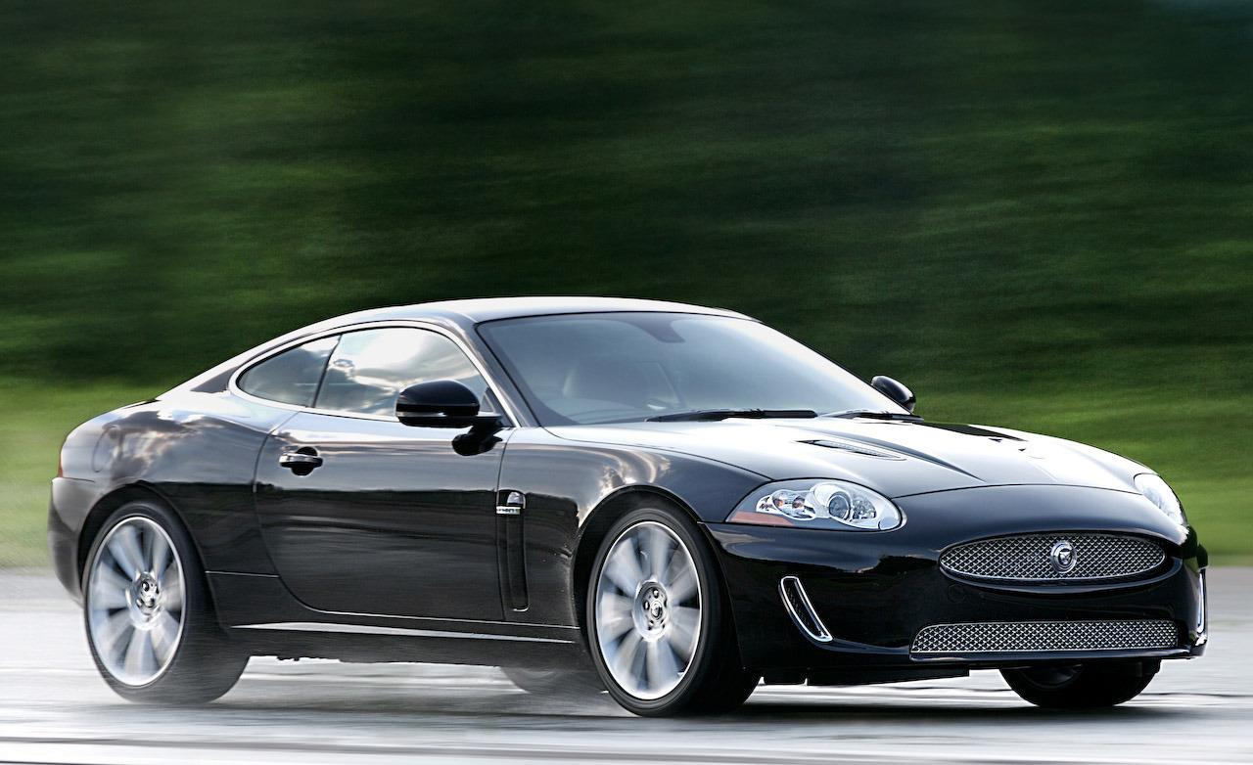
The coupe
We wanted a standard model to compare engines
Model was chosen for its wide engine variety
Over a hundred different samples on www.cars-data.com

Slide 4
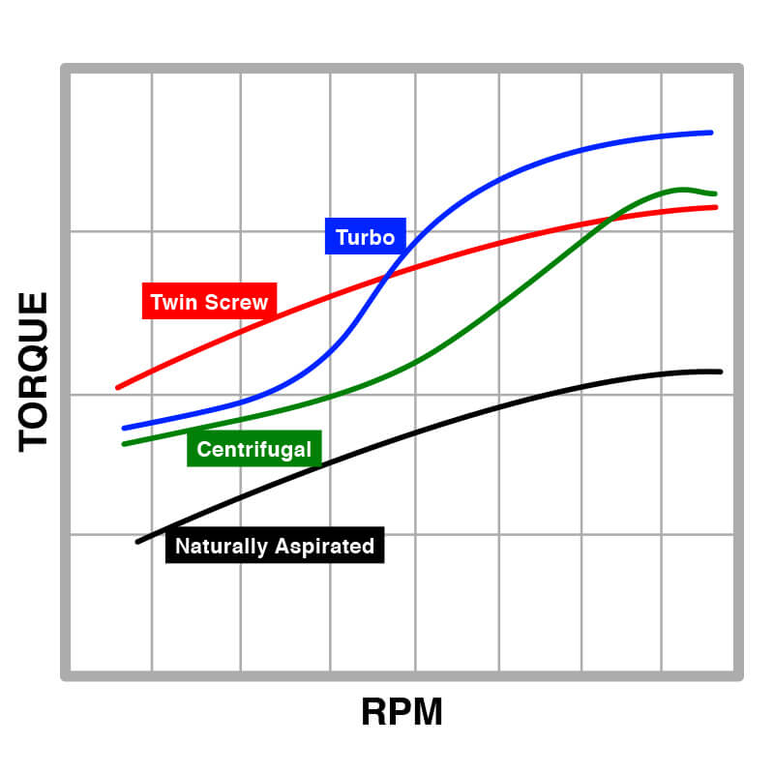
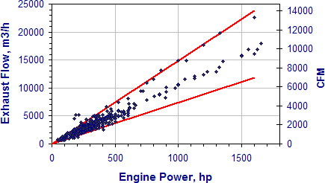
Useful graphs?

Slide 5
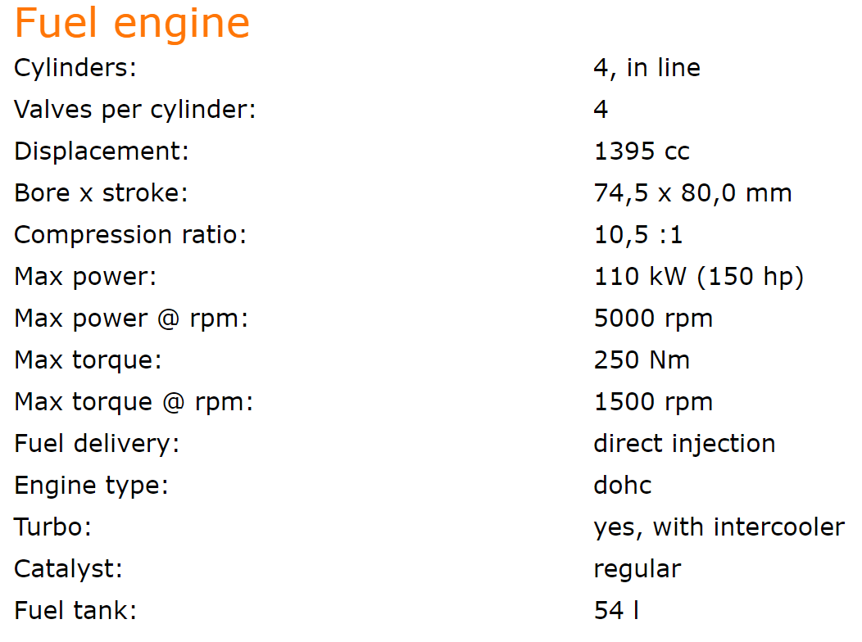
Data Cleaning
Data was hard to scrape directly from website into Jupyter Notebook
Converted to Excel spreadsheet

Slide 6
challenges

Slide 7
What’s next
After this we should show our Jupyter Notebook so far

