Slide 1
Data Mining:
Concepts and Techniques
(3rd ed.)
— Chapter 11 —
Jiawei Han, Micheline Kamber, and Jian Pei
University of Illinois at Urbana-Champaign &
Simon Fraser University
©2011 Han, Kamber & Pei. All rights reserved.

Slide 2
Review: Basic Cluster Analysis Methods (Chap. 10)
Cluster Analysis: Basic Concepts
  Group data so that object similarity is high within clusters but low across clusters
Partitioning Methods
  K-means and k-medoids algorithms and their refinements
Hierarchical Methods
  Agglomerative and divisive method, Birch, Cameleon
Density-Based Methods
  DBScan, Optics and DenCLu
Grid-Based Methods
  STING and CLIQUE (subspace clustering)
Evaluation of Clustering
  Assess clustering tendency, determine # of clusters, and measure clustering quality

Slide 3





K-Means Clustering
K=2
Arbitrarily partition objects into k groups
Update the cluster centroids
The initial data set
Loop if needed
Reassign objects
Partition objects into k nonempty subsets
Repeat
  Compute centroid (i.e., mean point) for each partition
  Assign each object to the cluster of its nearest centroid
Until no change
Update the cluster centroids

Slide 4
Hierarchical Clustering
Use distance matrix as clustering criteria. This method does not require the number of clusters k as an input, but needs a termination condition
Step 0
Step 1
Step 2
Step 3
Step 4
agglomerative
(AGNES)
a
a b
b
a b c d e
c
c d e
d
d e
e
divisive
(DIANA)
Step 4
Step 3
Step 2
Step 1
Step 0

Slide 5
Distance between Clusters
X
X
Single link: smallest distance between an element in one cluster and an element in the other, i.e., dist(K_{i}, K_{j}) = min(t_{ip}, t_{jq})
Complete link: largest distance between an element in one cluster and an element in the other, i.e., dist(K_{i}, K_{j}) = max(t_{ip}, t_{jq})
Average: avg distance between an element in one cluster and an element in the other, i.e., dist(K_{i}, K_{j}) = avg(t_{ip}, t_{jq})
Centroid: distance between the centroids of two clusters, i.e., dist(K_{i}, K_{j}) = dist(C_{i}, C_{j})
Medoid: distance between the medoids of two clusters, i.e., dist(K_{i}, K_{j}) = dist(M_{i}, M_{j})
  Medoid: a chosen, centrally located object in the cluster

Slide 6
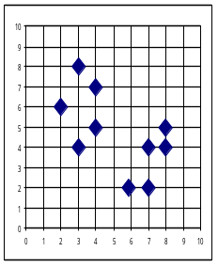
BIRCH and the Clustering Feature (CF) Tree Structure
CF = (5, (16,30),(54,190))
(3,4)
(2,6)
(4,5)
(4,7)
(3,8)
Root
B = 7
L = 6
CF₁
CF₂
CF₃
CF₆
child₁
child₂
child₃
child₆
Non-leaf node
CF₁
CF₂
CF₃
CF₅
child₁
child₂
child₃
child₅
Leaf node
Leaf node
prev
CF₁
CF₂
CF₆
next
prev
CF₁
CF₂
CF₄
next

Slide 7
Overall Framework of CHAMELEON
Construct (K-NN)
Sparse Graph
Partition the Graph
Data Set
K-NN Graph
  P and q are connected if q is among the top k closest neighbors of p
Merge Partition
Relative interconnectivity: connectivity of c₁ and c₂ over internal connectivity
Relative closeness: closeness of c₁ and c₂ over internal closeness
Final Clusters

Slide 8
Density-Based Clustering: DBSCAN
Two parameters:
  Eps: Maximum radius of the neighbourhood
  MinPts: Minimum number of points in an Eps-neighbourhood of that point
N_{Eps}(p): {q belongs to D | dist(p,q) ≤ Eps}
Directly density-reachable: A point p is directly density-reachable from a point q w.r.t. Eps, MinPts if
  p belongs to N_{Eps}(q)
  core point condition:
  |N_{Eps} (q)| ≥ MinPts
p
MinPts = 5
Eps = 1 cm
q

Slide 9




Density-Based Clustering: OPTICS & Its Applications

Slide 10

DENCLU: Center-Defined and Arbitrary

Slide 11

STING: A Statistical Information Grid Approach
Wang, Yang and Muntz (VLDB’97)
The spatial area is divided into rectangular cells
There are several levels of cells corresponding to different levels of resolution

Slide 12
Evaluation of Clustering Quality
Assessing Clustering Tendency
  Assess if non-random structure exists in the data by measuring the probability that the data is generated by a uniform data distribution
Determine the Number of Clusters
  Empirical method: # of clusters ≈√n/2
  Elbow method: Use the turning point in the curve of sum of within cluster variance w.r.t # of clusters
  Cross validation method
Measuring Clustering Quality
  Extrinsic: supervised
    Compare a clustering against the ground truth using certain clustering quality measure
  Intrinsic: unsupervised
    Evaluate the goodness of a clustering by considering how well the clusters are separated, and how compact the clusters are

Slide 13
Outline of Advanced Clustering Analysis
Probability Model-Based Clustering
  Each object may take a probability to belong to a cluster
Clustering High-Dimensional Data
  Curse of dimensionality: Difficulty of distance measure in high-D space
Clustering Graphs and Network Data
  Similarity measurement and clustering methods for graph and networks
Clustering with Constraints
  Cluster analysis under different kinds of constraints, e.g., that raised from background knowledge or spatial distribution of the objects

Slide 14
Chapter 11. Cluster Analysis: Advanced Methods
Probability Model-Based Clustering
Clustering High-Dimensional Data
Clustering Graphs and Network Data
Clustering with Constraints
Summary

Slide 15
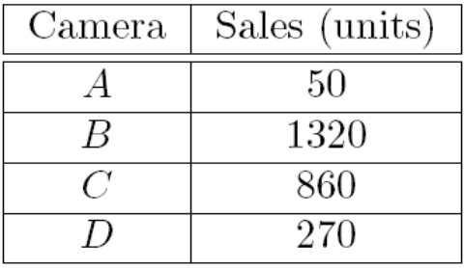
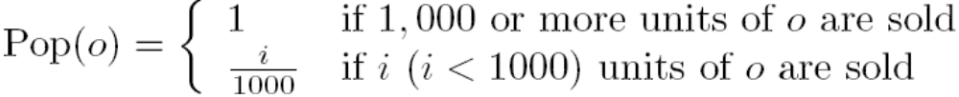
Fuzzy Set and Fuzzy Cluster
Clustering methods discussed so far
  Every data object is assigned to exactly one cluster
Some applications may need for fuzzy or soft cluster assignment
  Ex. An e-game could belong to both entertainment and software
Methods: fuzzy clusters and probabilistic model-based clusters
Fuzzy cluster: A fuzzy set S: F_{S} : X → [0, 1] (value between 0 and 1)
Example: Popularity of cameras is defined as a fuzzy mapping
Then, A(0.05), B(1), C(0.86), D(0.27)

Slide 16
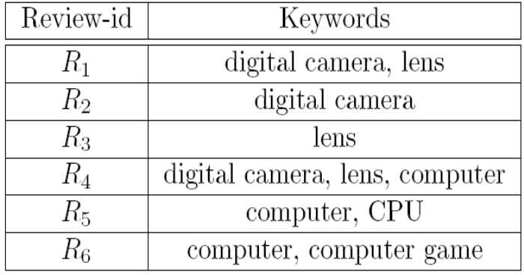
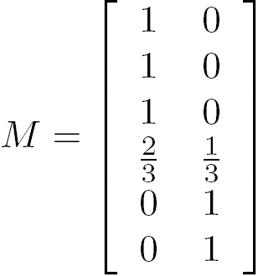


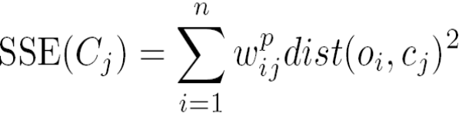
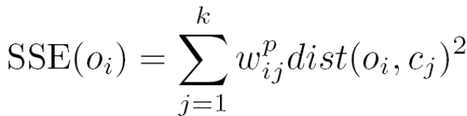
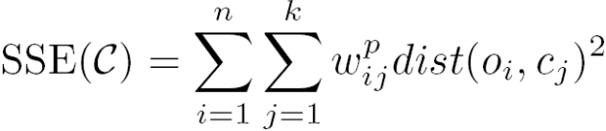
Fuzzy (Soft) Clustering
Example: Let cluster features be
  C₁ :“digital camera” and “lens”
  C₂: “computer“
Fuzzy clustering
  k fuzzy clusters C₁, …,C_{k} ,represented as a partition matrix M = [w_{ij}]
  P1: for each object o_{i} and cluster C_{j}, 0 ≤ w_{ij} ≤ 1 (fuzzy set)
  P2: for each object o_{i}, , equal participation in the clustering
  P3: for each cluster C_{j} , ensures there is no empty cluster
Let c₁, …, c_{k} as the center of the k clusters
For an object o_{i}, sum of the squared error (SSE), p is a parameter:
For a cluster C_{i}, SSE:
Measure how well a clustering fits the data:

Slide 17
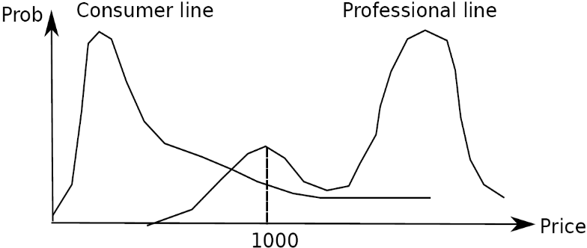
Probabilistic Model-Based Clustering
Cluster analysis is to find hidden categories.
A hidden category (i.e., probabilistic cluster) is a distribution over the data space, which can be mathematically represented using a probability density function (or distribution function).
Ex. 2 categories for digital cameras sold
  consumer line vs. professional line
  density functions f₁, f₂ for C₁, C₂
  obtained by probabilistic clustering
A mixture model assumes that a set of observed objects is a mixture of instances from multiple probabilistic clusters, and conceptually each observed object is generated independently
Out task: infer a set of k probabilistic clusters that is mostly likely to generate D using the above data generation process

Slide 18

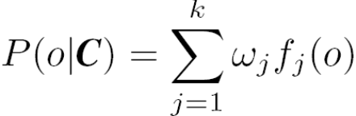
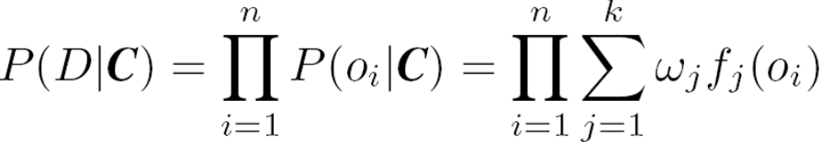
Model-Based Clustering
A set C of k probabilistic clusters C₁, …,C_{k} with probability density functions f₁, …, f_{k}, respectively, and their probabilities ω₁, …, ω_{k}.
Probability of an object o generated by cluster C_{j} is
Probability of o generated by the set of cluster C is
Since objects are assumed to be generated independently, for a data set D = {o₁, …, o_{n}}, we have,
Task: Find a set C of k probabilistic clusters s.t. P(D|C) is maximized
However, maximizing P(D|C) is often intractable since the probability density function of a cluster can take an arbitrarily complicated form
To make it computationally feasible (as a compromise), assume the probability density functions being some parameterized distributions

Slide 19
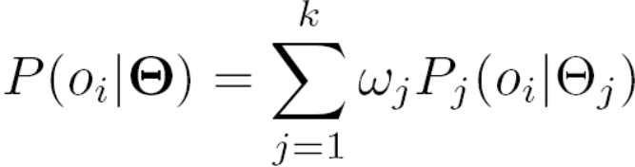
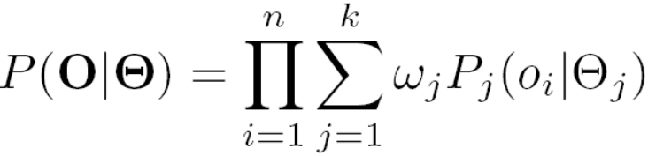
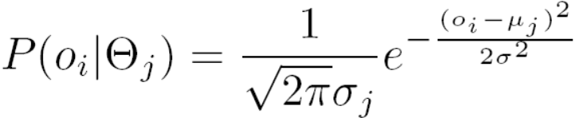
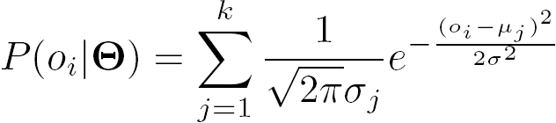
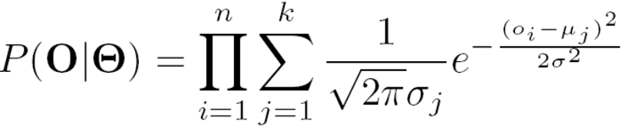
Univariate Gaussian Mixture Model
O = {o₁, …, o_{n}} (n observed objects), Θ = {θ₁, …, θ_{k}} (parameters of the k distributions), and P_{j}(o_{i}| θ_{j}) is the probability that o_{i} is generated from the j-th distribution using parameter θ_{j}, we have
Univariate Gaussian mixture model
  Assume the probability density function of each cluster follows a 1-d Gaussian distribution. Suppose that there are k clusters.
  The probability density function of each cluster are centered at μ_{j} with standard deviation σ_{j}, θ_{j}, = (μ_{j}, σ_{j}), we have

Slide 20
The EM (Expectation Maximization) Algorithm
The k-means algorithm has two steps at each iteration:
  Expectation Step (E-step): Given the current cluster centers, each object is assigned to the cluster whose center is closest to the object: An object is expected to belong to the closest cluster
  Maximization Step (M-step): Given the cluster assignment, for each cluster, the algorithm adjusts the center so that the sum of distance from the objects assigned to this cluster and the new center is minimized
The (EM) algorithm: A framework to approach maximum likelihood or maximum a posteriori estimates of parameters in statistical models.
  E-step assigns objects to clusters according to the current fuzzy clustering or parameters of probabilistic clusters
  M-step finds the new clustering or parameters that maximize the sum of squared error (SSE) or the expected likelihood

Slide 21
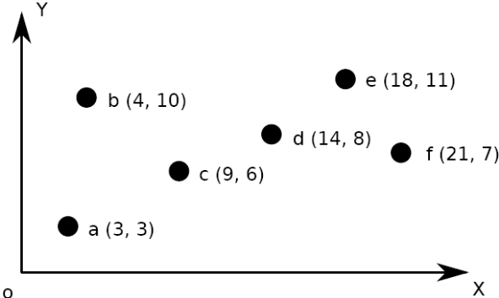
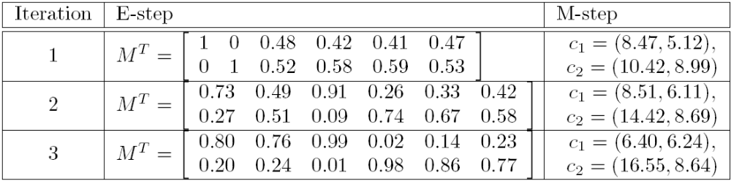
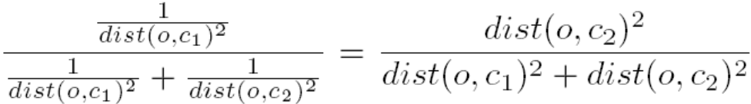

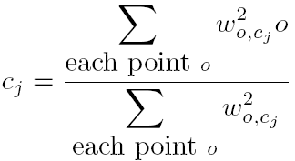
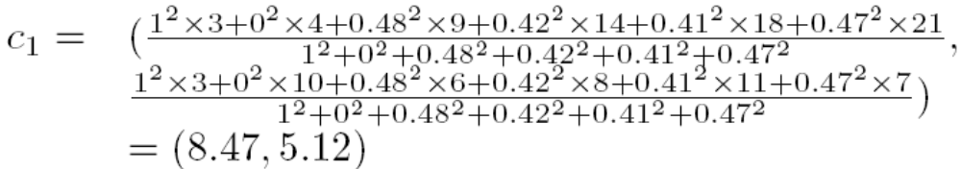
Fuzzy Clustering Using the EM Algorithm
Initially, let c₁ = a and c₂ = b
1st E-step: assign o to c₁,w. wt =
1st M-step: recalculate the centroids according to the partition matrix, minimizing the sum of squared error (SSE)
Iteratively calculate this until the cluster centers converge or the change is small enough

Slide 22
Univariate Gaussian Mixture Model
O = {o₁, …, o_{n}} (n observed objects), Θ = {θ₁, …, θ_{k}} (parameters of the k distributions), and P_{j}(o_{i}| θ_{j}) is the probability that o_{i} is generated from the j-th distribution using parameter θ_{j}, we have
Univariate Gaussian mixture model
  Assume the probability density function of each cluster follows a 1-d Gaussian distribution. Suppose that there are k clusters.
  The probability density function of each cluster are centered at μ_{j} with standard deviation σ_{j}, θ_{j}, = (μ_{j}, σ_{j}), we have

Slide 23
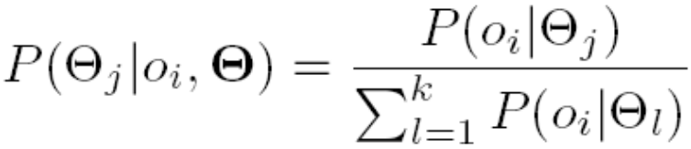
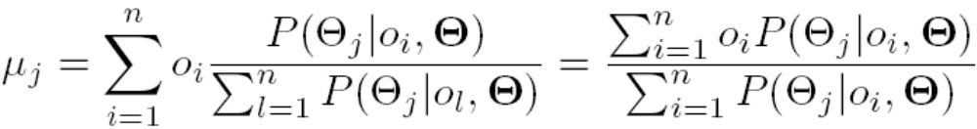
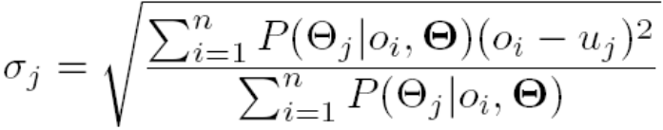
Computing Mixture Models with EM
Given n objects O = {o₁, …, o_{n}}, we want to mine a set of parameters Θ = {θ₁, …, θ_{k}} s.t.,P(O|Θ) is maximized, where θ_{j} = (μ_{j}, σ_{j}) are the mean and standard deviation of the j-th univariate Gaussian distribution
We initially assign random values to parameters θ_{j}, then iteratively conduct the E- and M- steps until converge or sufficiently small change
At the E-step, for each object o_{i}, calculate the probability that o_{i} belongs to each distribution,
At the M-step, adjust the parameters θ_{j} = (μ_{j}, σ_{j}) so that the expected likelihood P(O|Θ) is maximized

Slide 24
Advantages and Disadvantages of Mixture Models
Strength
  Mixture models are more general than partitioning and fuzzy clustering
  Clusters can be characterized by a small number of parameters
  The results may satisfy the statistical assumptions of the generative models
Weakness
  Converge to local optimal (overcome: run multi-times w. random initialization)
  Computationally expensive if the number of distributions is large, or the data set contains very few observed data points
  Need large data sets
  Hard to estimate the number of clusters

Slide 25
Chapter 11. Cluster Analysis: Advanced Methods
Probability Model-Based Clustering
Clustering High-Dimensional Data
Clustering Graphs and Network Data
Clustering with Constraints
Summary

Slide 26
Clustering High-Dimensional Data
Clustering high-dimensional data (How high is high-D in clustering?)
  Many applications: text documents, DNA micro-array data
  Major challenges:
    Many irrelevant dimensions may mask clusters
    Distance measure becomes meaningless—due to equi-distance
    Clusters may exist only in some subspaces
Methods
  Subspace-clustering: Search for clusters existing in subspaces of the given high dimensional data space
    CLIQUE, ProClus, and bi-clustering approaches
  Dimensionality reduction approaches: Construct a much lower dimensional space and search for clusters there (may construct new dimensions by combining some dimensions in the original data)
    Dimensionality reduction methods and spectral clustering

Slide 27
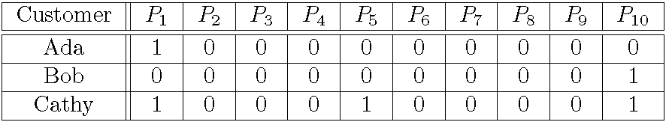
Traditional Distance Measures May Not Be Effective on High-D Data
Traditional distance measure could be dominated by noises in many dimensions
Ex. Which pairs of customers are more similar?
By Euclidean distance, we get,
  despite Ada and Cathy look more similar
Clustering should not only consider dimensions but also attributes (features)
  Feature transformation: effective if most dimensions are relevant (PCA & SVD useful when features are highly correlated/redundant)
  Feature selection: useful to find a subspace where the data have nice clusters

Slide 28
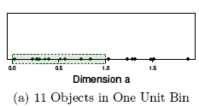
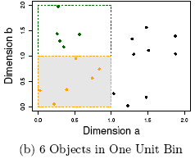
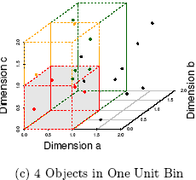
The Curse of Dimensionality
(graphs adapted from Parsons et al. KDD Explorations 2004)
Data in only one dimension is relatively packed
Adding a dimension “stretch” the points across that dimension, making them further apart
Adding more dimensions will make the points further apart—high dimensional data is extremely sparse
Distance measure becomes meaningless—due to equi-distance

Slide 29
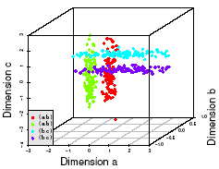
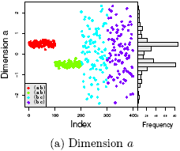
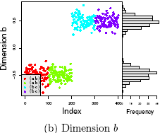
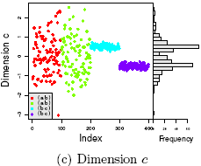
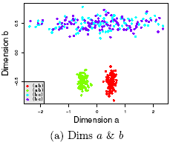
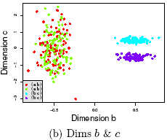
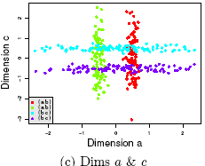
Why Subspace Clustering?
(adapted from Parsons et al. SIGKDD Explorations 2004)
Clusters may exist only in some subspaces
Subspace-clustering: find clusters in all the subspaces

Slide 30
Subspace Clustering Methods
Subspace search methods: Search various subspaces to find clusters
  Bottom-up approaches
  Top-down approaches
Correlation-based clustering methods
  E.g., PCA based approaches
Bi-clustering methods
  Optimization-based methods
  Enumeration methods

Slide 31
Subspace Clustering Method (I): Subspace Search Methods
Search various subspaces to find clusters
Bottom-up approaches
  Start from low-D subspaces and search higher-D subspaces only when there may be clusters in such subspaces
  Various pruning techniques to reduce the number of higher-D subspaces to be searched
  Ex. CLIQUE (Agrawal et al. 1998)
Top-down approaches
  Start from full space and search smaller subspaces recursively
  Effective only if the locality assumption holds: restricts that the subspace of a cluster can be determined by the local neighborhood
  Ex. PROCLUS (Aggarwal et al. 1999): a k-medoid-like method

Slide 32
CLIQUE: SubSpace Clustering with Aprori Pruning
Salary (10,000)
Vacation (week)
7
7
6
6
5
5
4
4
3
3
2
2
1
1
0
age
0
age
20
30
40
50
60
20
30
40
50
60
τ = 3
Vacation
Salary
30
50
age

Slide 33
Subspace Clustering Method (II): Correlation-Based Methods
Subspace search method: similarity based on distance or density
Correlation-based method: based on advanced correlation models
Ex. PCA-based approach:
  Apply PCA (for Principal Component Analysis) to derive a set of new, uncorrelated dimensions,
  then mine clusters in the new space or its subspaces
Other space transformations:
  Hough transform
  Fractal dimensions

Slide 34
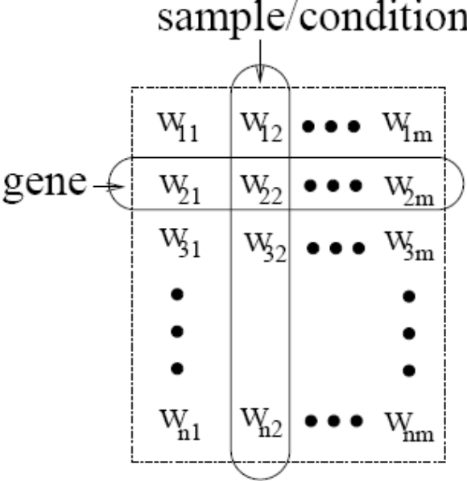
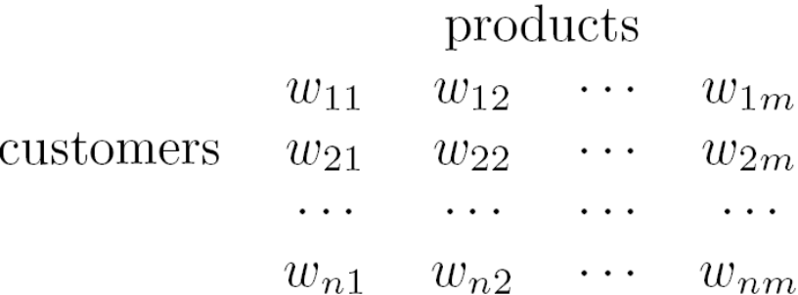
Subspace Clustering Method (III):
Bi-Clustering Methods
Bi-clustering: Cluster both objects and attributes simultaneously (treat objs and attrs in symmetric way)
Four requirements:
  Only a small set of objects participate in a cluster
  A cluster only involves a small number of attributes
  An object may participate in multiple clusters, or does not participate in any cluster at all
  An attribute may be involved in multiple clusters, or is not involved in any cluster at all
Ex 1. Gene expression or microarray data: a gene sample/condition matrix.
  Each element in the matrix, a real number, records the expression level of a gene under a specific condition
Ex. 2. Clustering customers and products
  Another bi-clustering problem

Slide 35
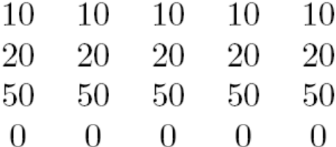
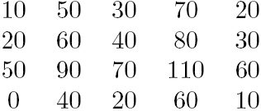
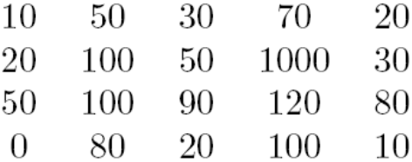
Types of Bi-clusters
Let A = {a₁, ..., a_{n}} be a set of genes, B = {b₁, …, b_{n}} a set of conditions
A bi-cluster: A submatrix where genes and conditions follow some consistent patterns
4 types of bi-clusters (ideal cases)
  Bi-clusters with constant values:
    for any i in I and j in J, e_{ij} = c
  Bi-clusters with constant values on rows:
    e_{ij} = c + α_{i}
    Also, it can be constant values on columns
  Bi-clusters with coherent values (aka. pattern-based clusters)
    e_{ij} = c + α_{i} + β_{j}
  Bi-clusters with coherent evolutions on rows
    e_{ij} (e_{i1j1}− e_{i1j2})(e_{i2j1}− e_{i2j2}) ≥ 0
    i.e., only interested in the up- or down- regulated changes across genes or conditions without constraining on the exact values

Slide 36
Bi-Clustering Methods
Real-world data is noisy: Try to find approximate bi-clusters
Methods: Optimization-based methods vs. enumeration methods
Optimization-based methods
  Try to find a submatrix at a time that achieves the best significance as a bi-cluster
  Due to the cost in computation, greedy search is employed to find local optimal bi-clusters
  Ex. δ-Cluster Algorithm (Cheng and Church, ISMB’2000)
Enumeration methods
  Use a tolerance threshold to specify the degree of noise allowed in the bi-clusters to be mined
  Then try to enumerate all submatrices as bi-clusters that satisfy the requirements
  Ex. δ-pCluster Algorithm (H. Wang et al.’ SIGMOD’2002, MaPle: Pei et al., ICDM’2003)

Slide 37
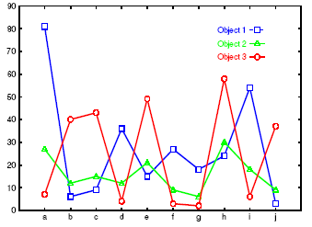
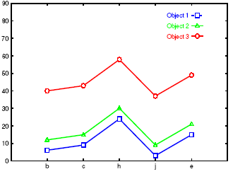
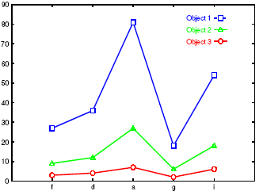
Bi-Clustering for Micro-Array Data Analysis
Left figure: Micro-array “raw” data shows 3 genes and their values in a multi-D space: Difficult to find their patterns
Right two: Some subsets of dimensions form nice shift and scaling patterns
No globally defined similarity/distance measure
Clusters may not be exclusive
  An object can appear in multiple clusters

Slide 38
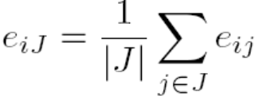
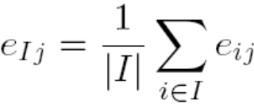
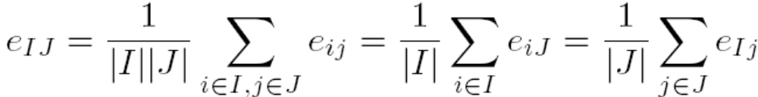
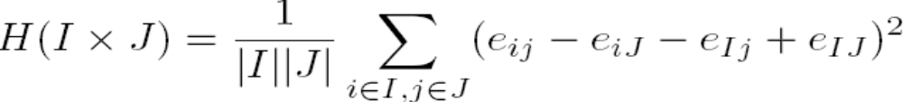
Bi-Clustering (I): δ-Bi-Cluster
For a submatrix I x J, the mean of the i-th row:
  The mean of the j-th column:
  The mean of all elements in the submatrix is
  The quality of the submatrix as a bi-cluster can be measured by the mean squared residue value
A submatrix I x J is δ-bi-cluster if H(I x J) ≤ δ where δ ≥ 0 is a threshold. When δ = 0, I x J is a perfect bi-cluster with coherent values. By setting δ > 0, a user can specify the tolerance of average noise per element against a perfect bi-cluster
  residue(e_{ij}) = e_{ij} − e_{iJ} − e_{Ij} + e_{IJ}

Slide 39
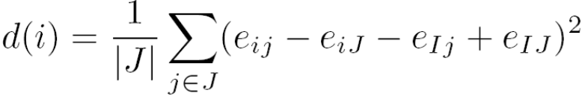
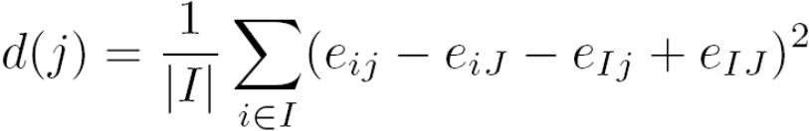
Bi-Clustering (I): The δ-Cluster Algorithm
Maximal δ-bi-cluster is a δ-bi-cluster I x J such that there does not exist another δ-bi-cluster I′ x J′ which contains I x J
Computing is costly: Use heuristic greedy search to obtain local optimal clusters
Two phase computation: deletion phase and additional phase
Deletion phase: Start from the whole matrix, iteratively remove rows and columns while the mean squared residue of the matrix is over δ
  At each iteration, for each row/column, compute the mean squared residue:
  Remove the row or column of the largest mean squared residue
Addition phase:
  Expand iteratively the δ-bi-cluster I x J obtained in the deletion phase as long as the δ-bi-cluster requirement is maintained
  Consider all the rows/columns not involved in the current bi-cluster I x J by calculating their mean squared residues
  A row/column of the smallest mean squared residue is added into the current δ-bi-cluster
It finds only one δ-bi-cluster, thus needs to run multiple times: replacing the elements in the output bi-cluster by random numbers

Slide 40
Bi-Clustering (II): δ-pCluster
Enumerating all bi-clusters (δ-pClusters) [H. Wang, et al., Clustering by pattern similarity in large data sets. SIGMOD’02]
Since a submatrix I x J is a bi-cluster with (perfect) coherent values iff e_{i1j1} − e_{i2j1} = e_{i1j2} − e_{i2j2}. For any 2 x 2 submatrix of I x J, define p-score
A submatrix I x J is a δ-pCluster (pattern-based cluster) if the p-score of every 2 x 2 submatrix of I x J is at most δ, where δ ≥ 0 is a threshold specifying a user's tolerance of noise against a perfect bi-cluster
The p-score controls the noise on every element in a bi-cluster, while the mean squared residue captures the average noise
Monotonicity: If I x J is a δ-pClusters, every x x y (x,y ≥ 2) submatrix of I x J is also a δ-pClusters.
A δ-pCluster is maximal if no more row or column can be added into the cluster and retain δ-pCluster: We only need to compute all maximal δ-pClusters.

Slide 41
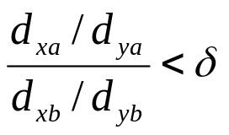
MaPle: Efficient Enumeration of δ-pClusters
Pei et al., MaPle: Efficient enumerating all maximal δ-pClusters. ICDM'03
Framework: Same as pattern-growth in frequent pattern mining (based on the downward closure property)
For each condition combination J, find the maximal subsets of genes I such that I x J is a δ-pClusters
  If I x J is not a submatrix of another δ-pClusters
  then I x J is a maximal δ-pCluster.
Algorithm is very similar to mining frequent closed itemsets
Additional advantages of δ-pClusters:
  Due to averaging of δ-cluster, it may contain outliers but still within δ-threshold
  Computing bi-clusters for scaling patterns, take logarithmic on
    will lead to the p-score form

Slide 42

Dimensionality-Reduction Methods
Dimensionality reduction: In some situations, it is more effective to construct a new space instead of using some subspaces of the original data
Ex. To cluster the points in the right figure, any subspace of the original one, X and Y, cannot help, since all the three clusters will be projected into the overlapping areas in X and Y axes.
  Construct a new dimension as the dashed one, the three clusters become apparent when the points projected into the new dimension
Dimensionality reduction methods
  Feature selection and extraction: But may not focus on clustering structure finding
  Spectral clustering: Combining feature extraction and clustering (i.e., use the spectrum of the similarity matrix of the data to perform dimensionality reduction for clustering in fewer dimensions)
    Normalized Cuts (Shi and Malik, CVPR’97 or PAMI’2000)
    The Ng-Jordan-Weiss algorithm (NIPS’01)

Slide 43



Spectral Clustering:
The Ng-Jordan-Weiss (NJW) Algorithm
Given a set of objects o₁, …, o_{n}, and the distance between each pair of objects, dist(o_{i}, o_{j}), find the desired number k of clusters
Calculate an affinity matrix W, where σ is a scaling parameter that controls how fast the affinity W_{ij} decreases as dist(o_{i}, o_{j}) increases. In NJW, set W_{ij} = 0
Derive a matrix A = f(W). NJW defines a matrix D to be a diagonal matrix s.t. D_{ii} is the sum of the i-th row of W, i.e.,
    Then, A is set to
A spectral clustering method finds the k leading eigenvectors of A
  A vector v is an eigenvector of matrix A if Av = λv, where λ is the corresponding eigen-value
Using the k leading eigenvectors, project the original data into the new space defined by the k leading eigenvectors, and run a clustering algorithm, such as k-means, to find k clusters
Assign the original data points to clusters according to how the transformed points are assigned in the clusters obtained

Slide 44


Spectral Clustering: Illustration and Comments
Spectral clustering: Effective in tasks like image processing
Scalability challenge: Computing eigenvectors on a large matrix is costly
Can be combined with other clustering methods, such as bi-clustering

Slide 45
Chapter 11. Cluster Analysis: Advanced Methods
Probability Model-Based Clustering
Clustering High-Dimensional Data
Clustering Graphs and Network Data
Clustering with Constraints
Summary

Slide 46
Clustering Graphs and Network Data
Applications
  Bi-partite graphs, e.g., customers and products, authors and conferences
  Web search engines, e.g., click through graphs and Web graphs
  Social networks, friendship/coauthor graphs
Similarity measures
  Geodesic distances
  Distance based on random walk (SimRank)
Graph clustering methods
  Minimum cuts: FastModularity (Clauset, Newman & Moore, 2004)
  Density-based clustering: SCAN (Xu et al., KDD’2007)

Slide 47

Similarity Measure (I): Geodesic Distance
Geodesic distance (A, B): length (i.e., # of edges) of the shortest path between A and B (if not connected, defined as infinite)
Eccentricity of v, eccen(v): The largest geodesic distance between v and any other vertex u ∈ V − {v}.
  E.g., eccen(a) = eccen(b) = 2; eccen(c) = eccen(d) = eccen(e) = 3
Radius of graph G: The minimum eccentricity of all vertices, i.e., the distance between the “most central point” and the “farthest border”
  r = min _{v∈V} eccen(v)
  E.g., radius (g) = 2
Diameter of graph G: The maximum eccentricity of all vertices, i.e., the largest distance between any pair of vertices in G
  d = max _{v∈V} eccen(v)
  E.g., diameter (g) = 3
A peripheral vertex is a vertex that achieves the diameter.
  E.g., Vertices c, d, and e are peripheral vertices

Slide 48






SimRank: Similarity Based on Random Walk and Structural Context
SimRank: structural-context similarity, i.e., based on the similarity of its neighbors
In a directed graph G = (V,E),
  individual in-neighborhood of v: I(v) = {u | (u, v) ∈ E}
  individual out-neighborhood of v: O(v) = {w | (v, w) ∈ E}
Similarity in SimRank:
  Initialization:
  Then we can compute s_{i+1} from s_{i} based on the definition
Similarity based on random walk: in a strongly connected component
  Expected distance:
  Expected meeting distance:
  Expected meeting probability:
P[t] is the probability of the tour

Slide 49



Graph Clustering: Sparsest Cut
G = (V,E). The cut set of a cut is the set of edges {(u, v) ∈ E | u ∈ S, v ∈ T } and S and T are in two partitions
Size of the cut: # of edges in the cut set
Min-cut (e.g., C₁) is not a good partition
A better measure: Sparsity:
A cut is sparsest if its sparsity is not greater than that of any other cut
Ex. Cut C2 = ({a, b, c, d, e, f, l}, {g, h, i, j, k}) is the sparsest cut
For k clusters, the modularity of a clustering assesses the quality of the clustering:
The modularity of a clustering of a graph is the difference between the fraction of all edges that fall into individual clusters and the fraction that would do so if the graph vertices were randomly connected
The optimal clustering of graphs maximizes the modularity
l_{i}: # edges between vertices in the i-th cluster
d_{i}: the sum of the degrees of the vertices in the i-th cluster

Slide 50
Graph Clustering: Challenges of Finding Good Cuts
High computational cost
  Many graph cut problems are computationally expensive
  The sparsest cut problem is NP-hard
  Need to tradeoff between efficiency/scalability and quality
Sophisticated graphs
  May involve weights and/or cycles.
High dimensionality
  A graph can have many vertices. In a similarity matrix, a vertex is represented as a vector (a row in the matrix) whose dimensionality is the number of vertices in the graph
Sparsity
  A large graph is often sparse, meaning each vertex on average connects to only a small number of other vertices
  A similarity matrix from a large sparse graph can also be sparse

Slide 51
Two Approaches for Graph Clustering
Two approaches for clustering graph data
  Use generic clustering methods for high-dimensional data
  Designed specifically for clustering graphs
Using clustering methods for high-dimensional data
  Extract a similarity matrix from a graph using a similarity measure
  A generic clustering method can then be applied on the similarity matrix to discover clusters
  Ex. Spectral clustering: approximate optimal graph cut solutions
Methods specific to graphs
  Search the graph to find well-connected components as clusters
  Ex. SCAN (Structural Clustering Algorithm for Networks)
    X. Xu, N. Yuruk, Z. Feng, and T. A. J. Schweiger, “SCAN: A Structural Clustering Algorithm for Networks”, KDD'07

Slide 52

SCAN: Density-Based Clustering of Networks
How many clusters?
What size should they be?
What is the best partitioning?
Should some points be segregated?
An Example Network
Application: Given simply information of who associates with whom, could one identify clusters of individuals with common interests or special relationships (families, cliques, terrorist cells)?

Slide 53

A Social Network Model
Cliques, hubs and outliers
  Individuals in a tight social group, or clique, know many of the same people, regardless of the size of the group
  Individuals who are hubs know many people in different groups but belong to no single group. Politicians, for example bridge multiple groups
  Individuals who are outliers reside at the margins of society. Hermits, for example, know few people and belong to no group
The Neighborhood of a Vertex
  Define Γ(ν) as the immediate neighborhood of a vertex (i.e. the set of people that an individual knows )

Slide 54

Structure Similarity
The desired features tend to be captured by a measure we call Structural Similarity
Structural similarity is large for members of a clique and small for hubs and outliers

Slide 55


Structural Connectivity [1]
ε-Neighborhood:
Core:
Direct structure reachable:
Structure reachable: transitive closure of direct structure reachability
Structure connected:
[1] M. Ester, H. P. Kriegel, J. Sander, & X. Xu (KDD'96) “A Density-Based Algorithm for Discovering Clusters in Large Spatial Databases

Slide 56


Structure-Connected Clusters
Structure-connected cluster C
  Connectivity:
  Maximality:
Hubs:
  Not belong to any cluster
  Bridge to many clusters
Outliers:
  Not belong to any cluster
  Connect to less clusters
hub
outlier

Slide 57
Algorithm
2
3
μ = 2
ε = 0.7
5
1
4
7
6
0
8
11
12
10
9
13

Slide 58
Algorithm
2
3
μ = 2
ε = 0.7
5
1
4
7
6
0
8
11
12
10
9
0.63
13

Slide 59
Algorithm
2
3
μ = 2
ε = 0.7
5
1
4
7
6
0.67
0
8
11
0.82
12
0.75
10
9
13

Slide 60
Algorithm
2
3
μ = 2
ε = 0.7
5
1
4
7
6
0
8
11
12
10
9
13

Slide 61
Algorithm
2
3
μ = 2
ε = 0.7
5
1
4
7
6
0
8
11
12
10
9
0.67
13

Slide 62
Algorithm
2
3
μ = 2
ε = 0.7
5
1
4
7
6
0
8
0.73
11
12
0.73
0.73
10
9
13

Slide 63
Algorithm
2
3
μ = 2
ε = 0.7
5
1
4
7
6
0
8
11
12
10
9
13

Slide 64
Algorithm
2
3
μ = 2
ε = 0.7
5
1
4
7
0.51
6
0
8
11
12
10
9
13

Slide 65
Algorithm
2
3
μ = 2
ε = 0.7
5
1
4
7
6
0
11
0.68
8
12
10
9
13

Slide 66
Algorithm
2
3
μ = 2
ε = 0.7
5
1
4
7
6
0
8
11
12
0.51
10
9
13

Slide 67
Algorithm
2
3
μ = 2
ε = 0.7
5
1
4
7
6
0
8
11
12
10
9
13

Slide 68
Algorithm
2
3
μ = 2
ε = 0.7
5
0.51
1
4
7
0.68
6
0
11
0.51
8
12
10
9
13

Slide 69
Algorithm
2
3
μ = 2
ε = 0.7
5
1
4
7
6
0
8
11
12
10
9
13

Slide 70

Running Time
Running time = O(|E|)
For sparse networks = O(|V|)
[2] A. Clauset, M. E. J. Newman, & C. Moore, Phys. Rev. E 70, 066111 (2004).

Slide 71
Chapter 11. Cluster Analysis: Advanced Methods
Probability Model-Based Clustering
Clustering High-Dimensional Data
Clustering Graphs and Network Data
Clustering with Constraints
Summary

Slide 72
Why Constraint-Based Cluster Analysis?
Need user feedback: Users know their applications the best
Less parameters but more user-desired constraints, e.g., an ATM allocation problem: obstacle & desired clusters

Slide 73
Categorization of Constraints
Constraints on instances: specifies how a pair or a set of instances should be grouped in the cluster analysis
  Must-link vs. cannot link constraints
    must-link(x, y): x and y should be grouped into one cluster
  Constraints can be defined using variables, e.g.,
    cannot-link(x, y) if dist(x, y) > d
Constraints on clusters: specifies a requirement on the clusters
  E.g., specify the min # of objects in a cluster, the max diameter of a cluster, the shape of a cluster (e.g., a convex), # of clusters (e.g., k)
Constraints on similarity measurements: specifies a requirement that the similarity calculation must respect
  E.g., driving on roads, obstacles (e.g., rivers, lakes)
Issues: Hard vs. soft constraints; conflicting or redundant constraints

Slide 74
Constraint-Based Clustering Methods (I):
Handling Hard Constraints
Handling hard constraints: Strictly respect the constraints in cluster assignments
Example: The COP-k-means algorithm
  Generate super-instances for must-link constraints
    Compute the transitive closure of the must-link constraints
    To represent such a subset, replace all those objects in the subset by the mean.
    The super-instance also carries a weight, which is the number of objects it represents
  Conduct modified k-means clustering to respect cannot-link constraints
    Modify the center-assignment process in k-means to a nearest feasible center assignment
    An object is assigned to the nearest center so that the assignment respects all cannot-link constraints

Slide 75
Constraint-Based Clustering Methods (II):
Handling Soft Constraints
Treated as an optimization problem: When a clustering violates a soft constraint, a penalty is imposed on the clustering
Overall objective: Optimizing the clustering quality, and minimizing the constraint violation penalty
Ex. CVQE (Constrained Vector Quantization Error) algorithm: Conduct k-means clustering while enforcing constraint violation penalties
Objective function: Sum of distance used in k-means, adjusted by the constraint violation penalties
  Penalty of a must-link violation
    If objects x and y must-be-linked but they are assigned to two different centers, c₁ and c₂, dist(c₁, c₂) is added to the objective function as the penalty
  Penalty of a cannot-link violation
    If objects x and y cannot-be-linked but they are assigned to a common center c, dist(c, c′), between c and c′ is added to the objective function as the penalty, where c′ is the closest cluster to c that can accommodate x or y

Slide 76


Speeding Up Constrained Clustering
It is costly to compute some constrained clustering
Ex. Clustering with obstacle objects: Tung, Hou, and Han. Spatial clustering in the presence of obstacles, ICDE'01
K-medoids is more preferable since k-means may locate the ATM center in the middle of a lake
Visibility graph and shortest path
Triangulation and micro-clustering
Two kinds of join indices (shortest-paths) worth pre-computation
  VV index: indices for any pair of obstacle vertices
  MV index: indices for any pair of micro-cluster and obstacle indices

Slide 77


An Example: Clustering With Obstacle Objects
Not Taking obstacles into account
Taking obstacles into account

Slide 78
User-Guided Clustering: A Special Kind of Constraints
Work-In
Professor
Open-course
Course
person
name
course
course-id
group
office
semester
name
position
instructor
area
Publish
Publication
Group
Advise
author
title
name
professor
title
year
area
student
conf
degree
Register
User hint
student
Student
course
name
semester
Target of clustering
office
unit
position
grade
X. Yin, J. Han, P. S. Yu, “Cross-Relational Clustering with User's Guidance”, KDD'05
User usually has a goal of clustering, e.g., clustering students by research area
User specifies his clustering goal to CrossClus

Slide 79
Comparing with Classification
User hint
User-specified feature (in the form of attribute) is used as a hint, not class labels
  The attribute may contain too many or too few distinct values, e.g., a user may want to cluster students into 20 clusters instead of 3
  Additional features need to be included in cluster analysis
All tuples for clustering

Slide 80
Comparing with Semi-Supervised Clustering
Semi-supervised clustering: User provides a training set consisting of “similar” (“must-link) and “dissimilar” (“cannot link”) pairs of objects
User-guided clustering: User specifies an attribute as a hint, and more relevant features are found for clustering
Semi-supervised clustering
User-guided clustering
x
All tuples for clustering
All tuples for clustering

Slide 81
Why Not Semi-Supervised Clustering?
Much information (in multiple relations) is needed to judge whether two tuples are similar
A user may not be able to provide a good training set
It is much easier for a user to specify an attribute as a hint, such as a student’s research area
Tom Smith | SC1211 | TA
Jane Chang | BI205 | RA
Tuples to be compared
User hint

Slide 82
CrossClus: An Overview
Measure similarity between features by how they group objects into clusters
Use a heuristic method to search for pertinent features
  Start from user-specified feature and gradually expand search range
Use tuple ID propagation to create feature values
  Features can be easily created during the expansion of search range, by propagating IDs
Explore three clustering algorithms: k-means, k-medoids, and hierarchical clustering

Slide 83






Multi-Relational Features
A multi-relational feature is defined by:
  A join path, e.g., Student → Register → OpenCourse → Course
  An attribute, e.g., Course.area
  (For numerical feature) an aggregation operator, e.g., sum or average
Categorical feature f = [Student → Register → OpenCourse → Course, Course.area, null]
areas of courses of each student
Values of feature f
f(t₁)
Tuple | Areas of courses
 | DB | AI | TH
t₁ | 5 | 5 | 0
t₂ | 0 | 3 | 7
t₃ | 1 | 5 | 4
t₄ | 5 | 0 | 5
t₅ | 3 | 3 | 4
Tuple | Feature f
 | DB | AI | TH
t₁ | 0.5 | 0.5 | 0
t₂ | 0 | 0.3 | 0.7
t₃ | 0.1 | 0.5 | 0.4
t₄ | 0.5 | 0 | 0.5
t₅ | 0.3 | 0.3 | 0.4
f(t₂)
f(t₃)
f(t₄)
f(t₅)

Slide 84


Representing Features
Similarity between tuples t₁ and t₂ w.r.t. categorical feature f
  Cosine similarity between vectors f(t₁) and f(t₂)
Similarity vector V^{f}
Most important information of a feature f is how f groups tuples into clusters
f is represented by similarities between every pair of tuples indicated by f
The horizontal axes are the tuple indices, and the vertical axis is the similarity
This can be considered as a vector of N x N dimensions

Slide 85



Similarity Between Features
Values of Feature f and g
V^{f}
 | Feature f (course) |  |  |  | Feature g (group)
 | DB | AI | TH |  | Info sys | Cog sci | Theory
t₁ | 0.5 | 0.5 | 0 |  | 1 | 0 | 0
t₂ | 0 | 0.3 | 0.7 |  | 0 | 0 | 1
t₃ | 0.1 | 0.5 | 0.4 |  | 0 | 0.5 | 0.5
t₄ | 0.5 | 0 | 0.5 |  | 0.5 | 0 | 0.5
t₅ | 0.3 | 0.3 | 0.4 |  | 0.5 | 0.5 | 0
V^{g}
Similarity between two features – cosine similarity of two vectors
Notes:
But, how to compute the similarity efficiently? Computing inner product of two NxN matrices is too expensive.

Slide 86

Computing Feature Similarity
Tuples
Feature g
Similarity between feature values w.r.t. the tuples
Feature f
DB
Info sys
sim(f_{k},g_{q})=Σ_{i=1 to N} f(t_{i}).p_{k}∙g(t_{i}).p_{q}
AI
Cog sci
DB
Info sys
TH
Theory
Tuple similarities, hard to compute
Feature value similarities, easy to compute
DB
Info sys
Compute similarity between each pair of feature values by one scan on data
AI
Cog sci
TH
Theory
Notes:
Very expensive to compute directly
We convert it into another form

Slide 87
Searching for Pertinent Features
Different features convey different aspects of information
Features conveying same aspect of information usually cluster tuples in more similar ways
  Research group areas vs. conferences of publications
Given user specified feature
  Find pertinent features by computing feature similarity
Research area
Academic Performances
Demographic info
GPA
Research group area
Permanent address
GRE score
Conferences of papers
Nationality
Number of papers
Advisor

Slide 88
Heuristic Search for Pertinent Features
Work-In
Professor
Open-course
Course
person
name
course
course-id
group
office
semester
name
Overall procedure
1. Start from the user- specified feature
2. Search in neighborhood of existing pertinent features
3. Expand search range gradually
2
position
instructor
area
Group
Advise
Publish
Publication
name
professor
author
title
1
area
student
title
year
degree
conf
User hint
Register
student
Student
course
name
semester
Target of clustering
office
unit
position
grade
Tuple ID propagation is used to create multi-relational features
  IDs of target tuples can be propagated along any join path, from which we can find tuples joinable with each target tuple

Slide 89

Clustering with Multi-Relational Features
Given a set of L pertinent features f₁, …, f_{L}, similarity between two tuples
  Weight of a feature is determined in feature search by its similarity with other pertinent features
Clustering methods
  CLARANS [Ng & Han 94], a scalable clustering algorithm for non-Euclidean space
  K-means
  Agglomerative hierarchical clustering

Slide 90
Experiments: Compare CrossClus with
Baseline: Only use the user specified feature
PROCLUS [Aggarwal, et al. 99]: a state-of-the-art subspace clustering algorithm
  Use a subset of features for each cluster
  We convert relational database to a table by propositionalization
  User-specified feature is forced to be used in every cluster
RDBC [Kirsten and Wrobel’00]
  A representative ILP clustering algorithm
  Use neighbor information of objects for clustering
  User-specified feature is forced to be used

Slide 91
Measure of Clustering Accuracy
Accuracy
  Measured by manually labeled data
    We manually assign tuples into clusters according to their properties (e.g., professors in different research areas)
  Accuracy of clustering: Percentage of pairs of tuples in the same cluster that share common label
    This measure favors many small clusters
    We let each approach generate the same number of clusters

Slide 92

DBLP Dataset

Slide 93
Chapter 11. Cluster Analysis: Advanced Methods
Probability Model-Based Clustering
Clustering High-Dimensional Data
Clustering Graphs and Network Data
Clustering with Constraints
Summary

Slide 94
Summary
Probability Model-Based Clustering
  Fuzzy clustering
  Probability-model-based clustering
  The EM algorithm
Clustering High-Dimensional Data
  Subspace clustering: bi-clustering methods
  Dimensionality reduction: Spectral clustering
Clustering Graphs and Network Data
  Graph clustering: min-cut vs. sparsest cut
  High-dimensional clustering methods
  Graph-specific clustering methods, e.g., SCAN
Clustering with Constraints
  Constraints on instance objects, e.g., Must link vs. Cannot Link
  Constraint-based clustering algorithms

Slide 95
References (I)
R. Agrawal, J. Gehrke, D. Gunopulos, and P. Raghavan. Automatic subspace clustering of high dimensional data for data mining applications. SIGMOD’98
C. C. Aggarwal, C. Procopiuc, J. Wolf, P. S. Yu, and J.-S. Park. Fast algorithms for projected clustering. SIGMOD’99
S. Arora, S. Rao, and U. Vazirani. Expander flows, geometric embeddings and graph partitioning. J. ACM, 56:5:1–5:37, 2009.
J. C. Bezdek. Pattern Recognition with Fuzzy Objective Function Algorithms. Plenum Press, 1981.
K. S. Beyer, J. Goldstein, R. Ramakrishnan, and U. Shaft. When is ”nearest neighbor” meaningful? ICDT’99
Y. Cheng and G. Church. Biclustering of expression data. ISMB’00
I. Davidson and S. S. Ravi. Clustering with constraints: Feasibility issues and the k-means algorithm. SDM’05
I. Davidson, K. L. Wagstaff, and S. Basu. Measuring constraint-set utility for partitional clustering algorithms. PKDD’06
C. Fraley and A. E. Raftery. Model-based clustering, discriminant analysis, and density estimation. J. American Stat. Assoc., 97:611–631, 2002.
F. H¨oppner, F. Klawonn, R. Kruse, and T. Runkler. Fuzzy Cluster Analysis: Methods for Classification, Data Analysis and Image Recognition. Wiley, 1999.
G. Jeh and J. Widom. SimRank: a measure of structural-context similarity. KDD’02
H.-P. Kriegel, P. Kroeger, and A. Zimek. Clustering high dimensional data: A survey on subspace clustering, pattern-based clustering, and correlation clustering. ACM Trans. Knowledge Discovery from Data (TKDD), 3, 2009.
U. Luxburg. A tutorial on spectral clustering. Statistics and Computing, 17:395–416, 2007

Slide 96
References (II)
G. J. McLachlan and K. E. Bkasford. Mixture Models: Inference and Applications to Clustering. John Wiley & Sons, 1988.
B. Mirkin. Mathematical classification and clustering. J. of Global Optimization, 12:105–108, 1998.
S. C. Madeira and A. L. Oliveira. Biclustering algorithms for biological data analysis: A survey. IEEE/ACM Trans. Comput. Biol. Bioinformatics, 1, 2004.
A. Y. Ng, M. I. Jordan, and Y. Weiss. On spectral clustering: Analysis and an algorithm. NIPS’01
J. Pei, X. Zhang, M. Cho, H. Wang, and P. S. Yu. Maple: A fast algorithm for maximal pattern-based clustering. ICDM’03
M. Radovanovi´c, A. Nanopoulos, and M. Ivanovi´c. Nearest neighbors in high-dimensional data: the emergence and influence of hubs. ICML’09
S. E. Schaeffer. Graph clustering. Computer Science Review, 1:27–64, 2007.
A. K. H. Tung, J. Hou, and J. Han. Spatial clustering in the presence of obstacles. ICDE’01
A. K. H. Tung, J. Han, L. V. S. Lakshmanan, and R. T. Ng. Constraint-based clustering in large databases. ICDT’01
A. Tanay, R. Sharan, and R. Shamir. Biclustering algorithms: A survey. In Handbook of Computational Molecular Biology, Chapman & Hall, 2004.
K. Wagstaff, C. Cardie, S. Rogers, and S. Schr¨odl. Constrained k-means clustering with background knowledge. ICML’01
H. Wang, W. Wang, J. Yang, and P. S. Yu. Clustering by pattern similarity in large data sets. SIGMOD’02
X. Xu, N. Yuruk, Z. Feng, and T. A. J. Schweiger. SCAN: A structural clustering algorithm for networks. KDD’07
X. Yin, J. Han, and P.S. Yu, “Cross-Relational Clustering with User's Guidance”, KDD'05

Slide 97
Slides Not to Be Used in Class

Slide 98
Conceptual Clustering
Conceptual clustering
  A form of clustering in machine learning
  Produces a classification scheme for a set of unlabeled objects
  Finds characteristic description for each concept (class)
COBWEB (Fisher’87)
  A popular a simple method of incremental conceptual learning
  Creates a hierarchical clustering in the form of a classification tree
  Each node refers to a concept and contains a probabilistic description of that concept

Slide 99

COBWEB Clustering Method
A classification tree

Slide 100
More on Conceptual Clustering
Limitations of COBWEB
  The assumption that the attributes are independent of each other is often too strong because correlation may exist
  Not suitable for clustering large database data – skewed tree and expensive probability distributions
CLASSIT
  an extension of COBWEB for incremental clustering of continuous data
  suffers similar problems as COBWEB
AutoClass (Cheeseman and Stutz, 1996)
  Uses Bayesian statistical analysis to estimate the number of clusters
  Popular in industry

Slide 101
Neural Network Approaches
Neural network approaches
  Represent each cluster as an exemplar, acting as a “prototype” of the cluster
  New objects are distributed to the cluster whose exemplar is the most similar according to some distance measure
Typical methods
  SOM (Soft-Organizing feature Map)
  Competitive learning
    Involves a hierarchical architecture of several units (neurons)
    Neurons compete in a “winner-takes-all” fashion for the object currently being presented

Slide 102
Self-Organizing Feature Map (SOM)
SOMs, also called topological ordered maps, or Kohonen Self-Organizing Feature Map (KSOMs)
It maps all the points in a high-dimensional source space into a 2 to 3-d target space, s.t., the distance and proximity relationship (i.e., topology) are preserved as much as possible
Similar to k-means: cluster centers tend to lie in a low-dimensional manifold in the feature space
Clustering is performed by having several units competing for the current object
  The unit whose weight vector is closest to the current object wins
  The winner and its neighbors learn by having their weights adjusted
SOMs are believed to resemble processing that can occur in the brain
Useful for visualizing high-dimensional data in 2- or 3-D space

Slide 103


Web Document Clustering Using SOM
The result of SOM clustering of 12088 Web articles
The picture on the right: drilling down on the keyword “mining”
Based on websom.hut.fi Web page

Slide 104

Why Semi-Supervised Learning?
Sparsity in data: training examples cannot cover the data space well
unlabeled data can help to address sparsity

Slide 105
Semi-Supervised Learning Methods
Many methods exist: EM with generative mixture models, self-training, co-training, data-based methods, transductive SVM, graph-based methods, …
Inductive methods and Transductive methods
  Transductive methods: only label the available unlabeled data – not generating a classifier
  Inductive methods: not only produce labels for unlabeled data, but also generate a classifier
Algorithmic methods
  Classifier-based methods: start from an initial classifier, and iteratively enhance it
  Data-based methods: find an inherent geometry in the data, and use the geometry to find a good classifier

Slide 106

Co-Training

Slide 107
Graph Mincuts
Positive samples as sources and negative samples as sinks
Unlabeled samples are connected to other samples with weights based on similarity
Objective: find a minimum set of edges to remove so that all flows from sources to sinks are blocked

Slide 108
Bi-clustering and Co-clustering
Biclustering, co-clustering, or two-mode clustering allows simultaneous clustering of the rows and columns of a matrix
Given a set of m rows in n columns (i.e., an m×n matrix), a biclustering algorithm generates biclusters – a subset of rows which exhibit similar behavior across a subset of columns, or vice versa

Slide 109
Chapter 11. Cluster Analysis: Advanced Methods
Statistics-Based Clustering
Clustering High-Dimensional Data
Semi-Supervised Learning and Active Learning
Constraint-Based Clustering
Bi-Clustering and co-Clustering
Collaborative filtering
Spectral Clustering
Evaluation of Clustering Quality
Summary

Slide 110
Collaborative Filtering
Collaborative filtering (CF) is the process of filtering for information or patterns using techniques involving collaboration among multiple agents, viewpoints, data sources, etc.
  Applications involving very large data sets: sensing and monitoring data, financial data, electronic commerce and web 2.0 applications
Example: a method of making automatic predictions (filtering) about the interests of a user by collecting taste information from many users (collaborating)
  Assumption: those who agreed in the past tend to agree again in the future

Slide 111
Framework
A general 2-step process
  Look for users who share the same rating patterns with the active user (the one for which the prediction is made)
  Use the ratings of those found in step 1 to calculate a prediction
Item-based filtering (used in Amazon.com)
  Build an item-to-item matrix determining the relationships between each pair of items
  Infer the user’s taste (i.e., the prediction) using the matrix

Slide 112
Spectral Clustering
Given a set of data points A, a similarity matrix S may be defined where S_{ij} represents a measure of the similarity between points i and j (i, j ∊ A)
Spectral clustering makes use of the spectrum of the similarity matrix of the data to perform dimensionality reduction for clustering in fewer dimensions
  In functional analysis, the spectrum of a bounded operator is a generalization of eigenvalues for matrices
    A complex number λ is said to be in the spectrum of a bounded linear operator T if λI − T is not invertible, where I is the identity operator

Slide 113

Shi-Malik Algorithm
Given a set S of points, the algorithm partitions the points into two sets S₁ and S₂
Let v be the eigenvector v corresponding to the second-smallest eigenvalue of the Laplacian matrix L of S
  L = I – D^{–1/2} SD^{–1/2}, where D is the diagonal matrix
Let m be the median of the components in v
Place all points whose component in v is greater than m in S₁, and the rest in S₂

Slide 114

Example
Extraction from http://www.kimbly.com/blog/000489.html

