Slide 1
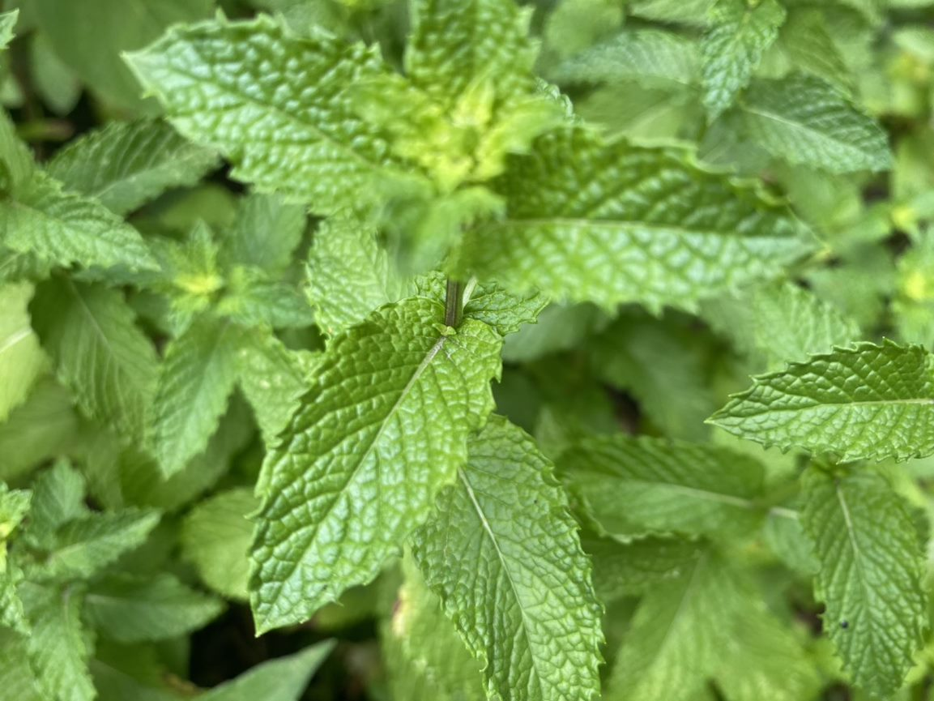
Discovering hidden patterns
in clinical data
with the vtree package
Nick Barrowman
Clinical Research Unit
Children’s Hospital of Eastern Ontario Research Institute
R/Medicine 2022

