Slide 1

Beyond the Aging Curve:
A Bayesian Framework for Distinguishing and Quantifying Injury vs. Natural Decline in MLB Pitchers
Nickolas Bartle | Saberseminar 2026
Baltimore Ravens | Wake Forest Baseball Analytics
Notes:
Good morning everyone. My name is Nickolas Bartle, and I'm a graduate baseball analyst at Wake Forest University. Today I'm excited to share research that tackles one of baseball's most persistent evaluation challenges: when we see a pitcher's velocity declining, how do we know whether we're looking at natural aging or injury-related deterioration? This distinction matters enormously for contract negotiations, roster decisions, and long-term player development.
Over the next 15 minutes, I'll walk you through a Bayesian framework that quantitatively separates these effects, show you real-world case studies, and discuss practical applications for front offices and player evaluation teams.
Show of hand here, who’s favorite player has had tommy john surgery, and was curious how they were going to perform the next season? Transition - Let me start by framing the problem more concretely:

Slide 2





About Me
I’m a current Business Strategy & Analytics Associate for the Baltimore Ravens. I primarily focus on building dashboards, constructing predictive models, and database structure.
Nickolas Bartle
Business Strategy
& Analytics Associate
Baltimore Ravens
nickbartle2@gmail.com
M: (919) 656-2434
I served as graduate analyst for Wake Forest Baseball, while completing my MSBA in May 2026. I primarily worked in pitching analytics and predictive modeling.
I served as a baseball analyst for Alabama Baseball, while also completing my undergraduate Bachelor’s of Science in Management Information Systems.
linkedin.com/in/nickolasbartle/
https://nbartle26.github.io/DigitalPortfolio/
Notes:
Talk about myself. I’m a yapper. No Biggie.

Slide 3


Research Question
PRIMARY QUESTION:
Can we quantitatively separate natural aging effects
from injury-related decline in pitcher velocity?
SUPPORTING QUESTIONS:
1. What is the population-level aging pattern for pitcher velocity?
2. When do velocity declines typically occur?
3. What are the immediate and lingering impacts of Tommy John surgery?
4. Can we predict future decline risk?
Notes:
Our primary research question is: Can we quantitatively separate natural aging effects from injury-related decline in pitcher velocity?
To answer this comprehensively, I broke it into a few targeted supporting questions:
First, what is the population-level aging pattern? We need a baseline to know what 'normal' looks like (within the dataset I’m using)
Second, what is the specific measurable impact of Tommy John surgery? Not just 'does it hurt velocity' but by how much, and does recovery follow a predictable trajectory?
Third, can we identify when individual pitchers deviate from their expected aging curve? If someone is declining faster than the population average, we want to flag that as early as possible.
These questions require different statistical approaches, which is why we developed a three-part methodology."
Notice we're asking for quantitative answers, not just 'does TJ hurt velocity' but 'how much does it hurt velocity' with proper uncertainty quantification. More on this later!
Transition: Here's how we approached this methodologically...
Possible Audience Question(s): (Personal Note)
Why focus on velocity specifically?
- Velocity is the most objectively measurable metric, least subject to ballpark effects or defensive variation, and shows the clearest aging patterns in our preliminary analysis. It is also often the most used analysis in injury analysis and modeling pitcher aging curves in research. We tested command and movement as well, which I'll discuss shortly.

Slide 4
Data & Sample
Data Source
MLB Statcast (Baseball Savant)
2015-2025 Seasons
TJ Data
Open-Source comprehensive MLB injury file (Roegele)
Surgery dates, recovery timelines, surgery type, etc.
Sample Characteristics
1,900+ pitchers analyzed
5,700+ pitcher-season observations
140+ changepoints detected
Ages 20-45 covered
Notes:
My data comes from MLB Statcast via Baseball Savant, covering 2015 through 2025: exactly 11 seasons. I chose 2015 as my starting point because that's when Statcast measurement became consistent and reliable across all ballparks.
I focused on four metrics initially: average four-seam fastball velocity, walk rate as a proxy for command, horizontal break, and induced vertical break for pitch movement. This gave me over 1,900 unique pitchers and more than 6,500 pitcher-season observations. That's substantial statistical power for population-level estimates.
For Tommy John data, I used Jon Roegele's comprehensive surgical database, which tracks not just whether surgery occurred but the specific date (I recommend checking it out for yourself, there’s a ton of other amazing data and information in it!). This is crucial because it lets us calculate precise recovery timelines. In my sample, 381 pitchers, roughly 35% , had at least one Tommy John surgery, with 30 pitchers experiencing multiple TJ surgeries. That 35% rate might seem high, but remember this is MLB pitchers only, and TJ rates have been climbing throughout this period. This sample size is substantial for population-level estimates and aligns with the scale of published aging curve research (e.g., Bradbury 2009; Fair 2008).
Transition: Now, we initially hypothesized that decline would manifest across multiple dimensions...

Slide 5
Three-Part Methodology
1️⃣ BAYESIAN HIERARCHICAL MODEL
Estimates population-level aging effects while accounting for individual variation
Posterior distributions quantify parametric uncertainty via Stan MCMC sampling
Provides future predictions using partial pooling, population mean, and posterior probability
2️⃣ CHANGEPOINT DETECTION
Identifies when significant declines occur in individual velocity trajectories
3️⃣ QUANTITATIVE FRAMEWORK & RISK SCORES
Clearly distinguishes qualitatively injury and aging effects from velocity curve
Weighted ensemble approach of multiple components
Notes:
I used three complementary statistical methods, each designed for a specific aspect of the problem.
First, a Bayesian hierarchical model. This estimates population-level aging effects while respecting individual variation. The key advantage of the Bayesian approach is that it gives me full posterior distributions, meaning we can quantify uncertainty properly rather than just getting point estimates. I used MCMC sampling via stan_glmer in R, which handles the hierarchical structure and gives us 95% credible intervals for all our predictions.
Second, changepoint detection using the PELT algorithm; that's Pruned Exact Linear Time. This is an automated method that identifies when an individual pitcher's trajectory suddenly shifts. Rather than assuming decline happens gradually, we let the data tell us when structural breaks occur. The PELT algorithm is particularly good because it penalizes complexity, so we don't overfit by detecting false changepoints. In the future I’d like to move to bcp- however at the moment I needed to weigh the effects of computing power. Third, a comprehensive risk assessment framework that integrates six independent factors: the player's current age, current velocity, velocity decline rate, whether they've hit a statistical changepoint, their injury history, and how long it's been since their most recent Tommy John surgery. We combine these into a continuous risk score from 0 to 1, as well as classify them contextually later on.
The output is player-specific projections with full uncertainty quantification, so instead of saying 'this pitcher will throw 93 mph next year,' we say 'we're 95% confident they'll be between 91 and 95 mph, with a median projection of 93.'
This three-part approach gives us both population insights and individual-level precision.“
Possible Audience Question(s): (Personal Note)
Why Bayesian instead of frequentist?
-Two main reasons: first, hierarchical modeling naturally handles partial pooling across pitchers, which improves estimates for players with limited data. Second, we wanted full posterior distributions for uncertainty quantification, not just point estimates with standard errors.
Transition: Let me show you what data we used...

Slide 6
The Bayesian Model
Velocity = Pitcher's baseline + Aging curve + Tommy John effect + noise
velocity ~ age + age² + had_TJ + years_since_TJ + (1 | pitcher)
Each pitcher gets his own baseline
Aging is a curve, not a line
Tommy John is two separate effects
A 97 mph arm and a 90 mph arm are not compared to the same starting point. Pitchers with few seasons get pulled toward the league average, so small samples cannot produce wild estimates.
The age² term lets velocity rise into the mid-20s, flatten through the prime years, and fall away faster in the mid-30s. This is estimated from the whole population at once.
One term for whether surgery ever happened, and one for how long ago it was. Together they measure both the immediate and gradual effects.
Why fit it this way? Every term comes back as a full distribution rather than a single number. That is what lets the projections carry honest 95% intervals instead of a false-precision point estimate.
Fit with stan_glmer (rstanarm), 4 chains × 2,000 iterations
Notes:
Quick detour into the machinery, then straight back to baseball.
Read the equation left to right. Every pitcher gets his own baseline, because comparing a 97 mph arm to a 90 mph arm on the same scale tells you nothing. The hierarchical structure also means a pitcher with two seasons gets pulled toward the league average, while a pitcher with ten seasons is trusted on his own record. I do not have to hand-pick a minimum innings cutoff, the model handles the weighting.
The squared age term is what makes it a curve instead of a straight line. Velocity climbs into the mid-20s, sits flat through the prime years, and drops off faster later. One shape, estimated across every pitcher at once.
Tommy John enters twice on purpose. One term asks whether it ever happened, the other asks how long ago. Splitting it lets the model separate the immediate cost of surgery from how much velocity comes back over the following seasons.
The reason for going Bayesian rather than a standard mixed model: every one of these terms comes back as a full distribution, not a single number. That is what lets me put honest intervals on the projections later instead of pretending I know a pitcher will throw 93.4 mph in 2029.
Likely question: why not more predictors, like workload or pitch mix? Answer: they matter, and they are on my future work slide. I wanted the aging and injury terms interpretable first.

Slide 7
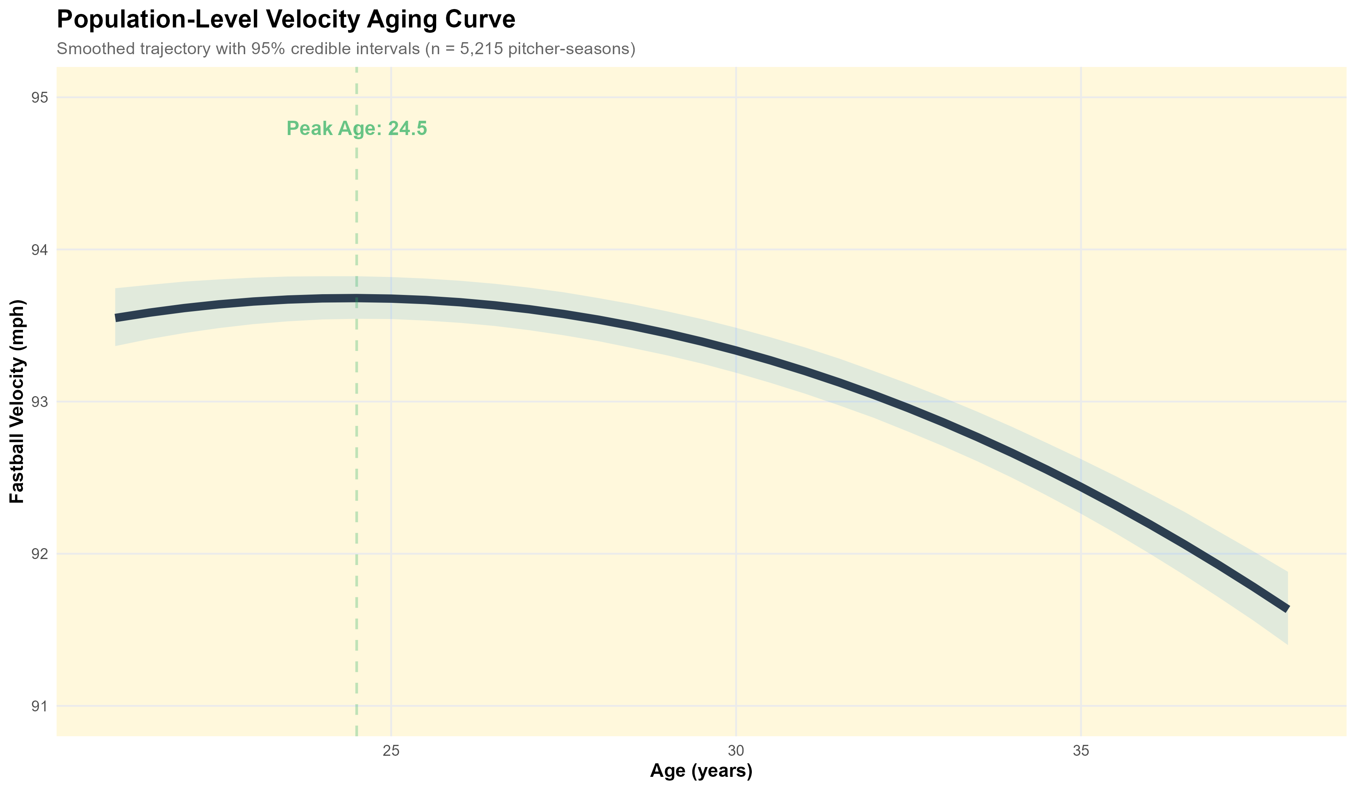
Initial Findings I: Universal Aging Curve
Notes:
This is the population-level aging curve for MLB pitchers with 95% credible intervals at the 2.5 and 97.5 percentiles. This represents over 5,700 pitcher-season observations.
The pattern is striking and matches baseball intuition. Pitchers are still developing through their early 20s then decline gradually but consistently after that. By the mid-30s, the decline accelerates.
What's noteworthy here is the confidence bands, they're relatively tight through the prime years because we have lots of data but widen after age 35 because we have fewer pitchers pitching that long, and the ones who do are a selected sample of especially durable athletes.
This curve serves as our baseline. When we see an individual pitcher deviating from this expected trajectory, that's when we start asking whether something beyond normal aging is happening.
Transition: Lets take a look at some other pitcher velo aging curves industry wide first, then look into when significant individual changes occur...

Slide 8
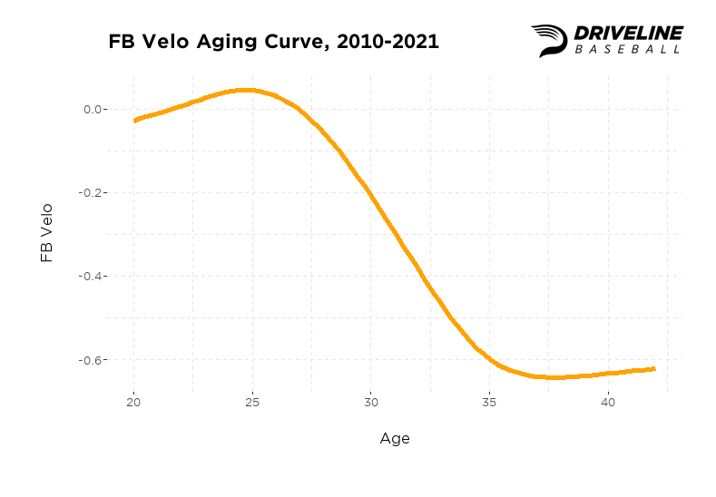
Industry Aging Curves
Notes:
Driveline info comparison/reference

Slide 9
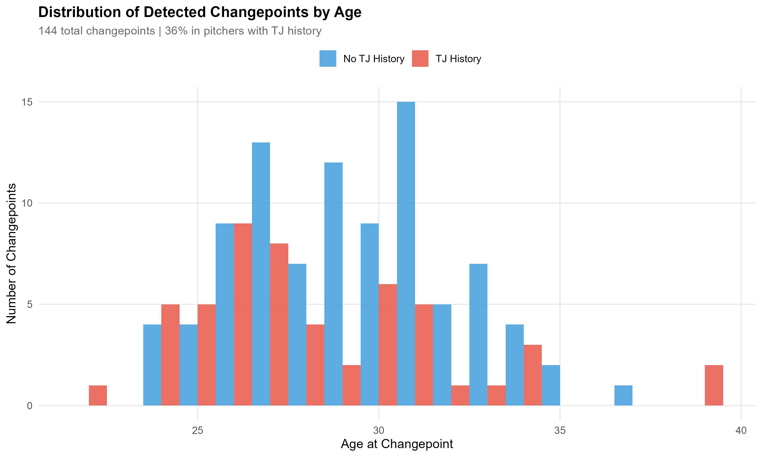
Initial Findings II: Changepoint Distribution
Notes:
Using the PELT changepoint detection algorithm, I identified 140+ statistically significant velocity changepoints across our sample. These are moments when a pitcher's trajectory shifts abruptly, not gradual decline but a structural break in the time series.
Here's what I found: 36% of detected changepoints were validated as corresponding to known TJ injuries. That validation rate is actually quite encouraging, it means my algorithm is identifying real physiological events, not just statistical noise.
The remaining 64% fall into a potential hypothetical few categories: some are mechanical changes, biomechanics, or role transitions - for instance, a starter moving to relief and altering their effort level. Some correspond to undisclosed injuries, remember, not all arm problems result in surgery. And some may reflect training changes or deliberate strategy shifts.
The key insight is that changepoints are detectable before they become obvious. The algorithm flags a shift in trajectory after 2-3 data points, which in our case means we can identify concerning trends within a single season rather than waiting two years for the pattern to become clear to the naked eye.
*The validation rate against known injuries is strong evidence that we're detecting real physiological events, not overfitting to noise."
Translation: Now let me break down what we learned about the aging curve specifically...

Slide 10
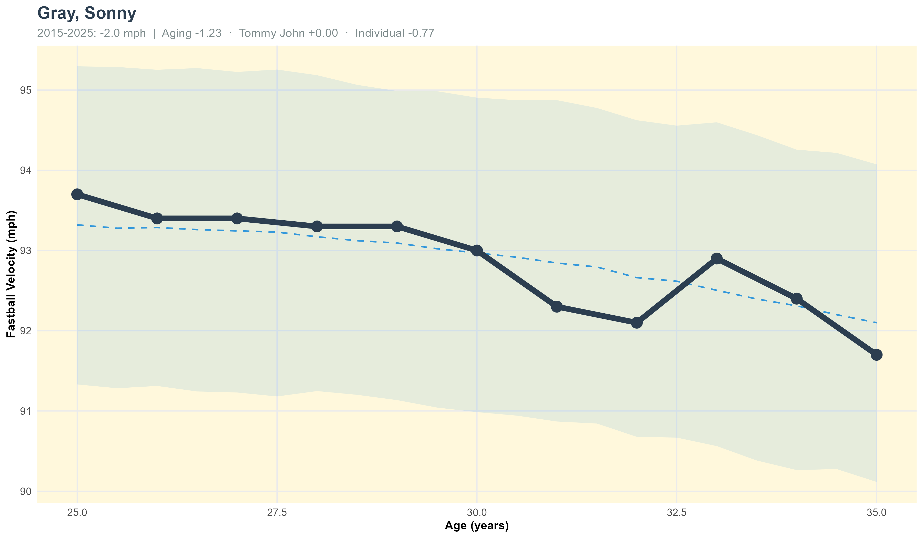
Case Study: Sonny Gray - Natural Aging
Notes:
Sonny Gray is the control case. Eleven straight seasons, age 25 through 35, no Tommy John surgery, and no detected changepoint. Velocity goes 93.7 down to 91.7, about two miles per hour across a decade.
Two things to notice. First, the model's fitted line tracks him closely the whole way. This is what the population aging curve looks like when it applies cleanly to one pitcher.
Second, and more important, the changepoint algorithm found nothing here. It's not that Gray never wavered. Look at ages 31 and 32, he dips, then comes back up at 33 before continuing down. But PELT doesn't flag that, because it's noise around a trend rather than a structural break. That's the algorithm doing its job, and it's why the changepoints we do detect in the next few slides are worth paying attention to.
His risk score is 36%, moderate, driven almost entirely by age and current velocity rather than injury history.

Slide 11
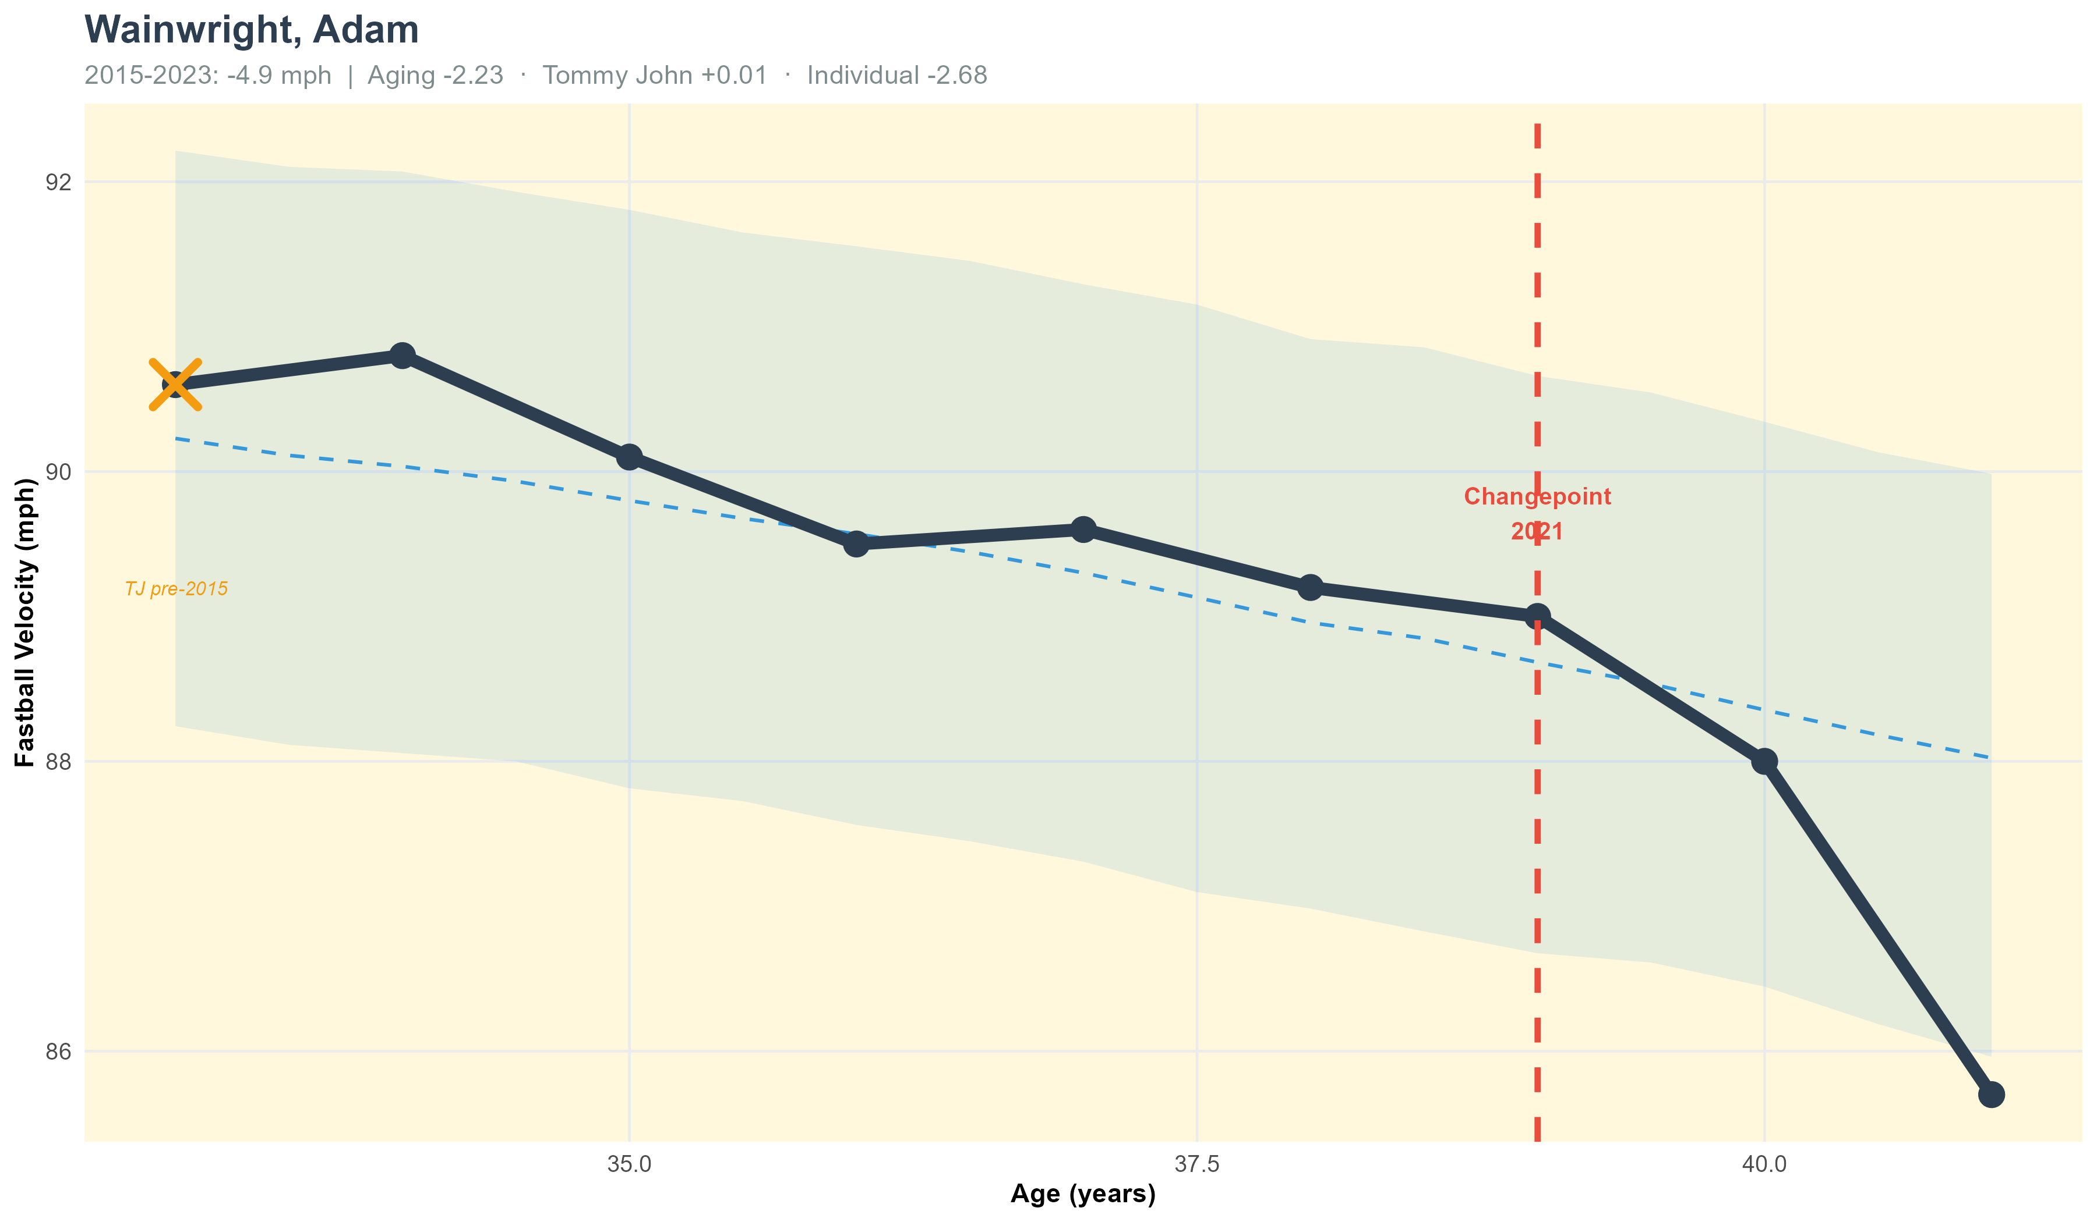
Case Study: Adam Wainwright – Natural Aging
Notes:
Adam Wainwright provides another instructive case. He had Tommy John surgery back in 2011, well before our data window begins in 2015. That yellow X marker on the far left indicates that pre-existing surgery (also applied to all other aging curves when applicable).
What we see from age 33 onwards is essentially pure aging decline. His velocity drops from about 91 mph at age 33 to 85-86 mph by age 41. Our model detected a changepoint in 2021 at age 39, where the decline accelerated.
What's crucial here is distinguishing between the old Tommy John surgery from 2011 and the aging pattern we're seeing 10-15 years later. The surgery likely reset his baseline velocity, but by age 33, he was fully recovered and what we're observing is natural age-related decline. Our model accounts for this by including 'years since TJ' as a capped variable; “after 5 years, the recovery effect variable is capped at 5 years”.
Wainwright's current 71% risk score reflects his advanced age and declining velocity as well injury concerns (although extremely minor in this case). This is a pitcher at the end of a career, declining in the expected way.
Possible Audience Question(s): (Personal Note)
How do you know the 2011 TJ surgery isn't still affecting him?
-Medical research indicates full recovery typically occurs within 18-24 months, with stabilization by year 3-5. After 15 years, we're confident the surgery is no longer the primary driver of decline. More on this later on.
Transition: Now let's look at cases where injury does play a major role...

Slide 12
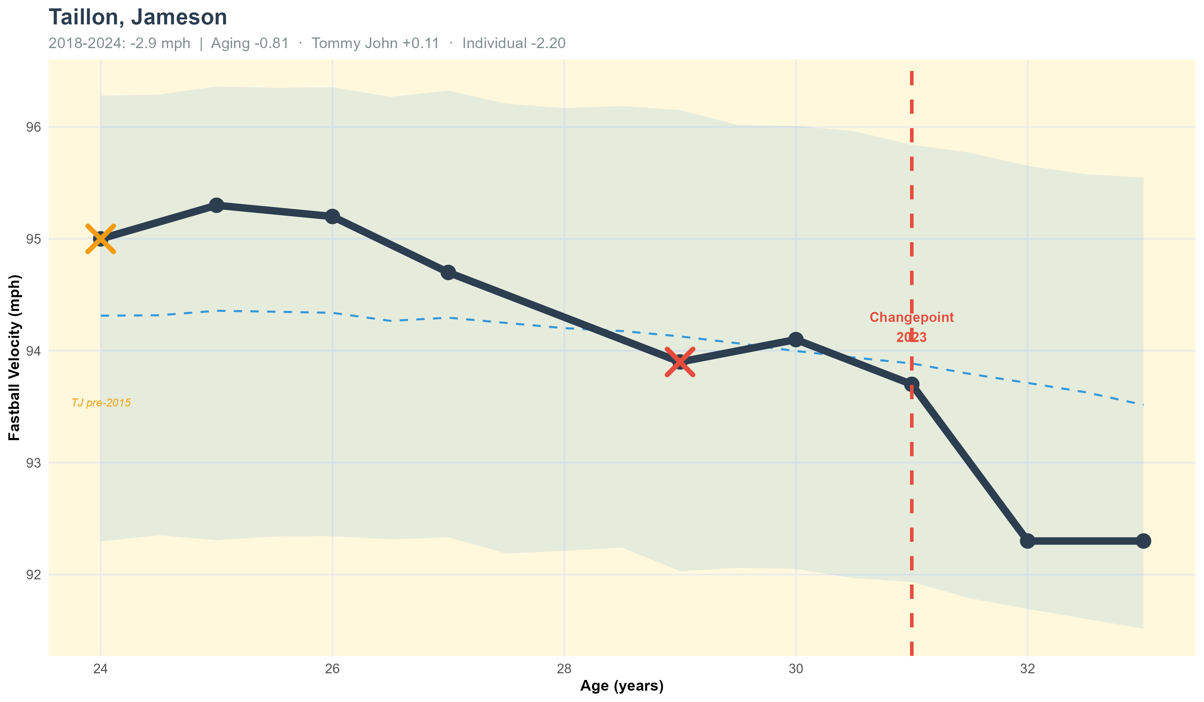
Case Study: Jameson Taillon – TJ Effects with Aging
Notes:
Jameson Taillon shows a more complex pattern: aging plus multiple Tommy John surgeries. The yellow X at age 24 indicates a pre-2015 Tommy John surgery. The red X at age 29 in 2019 shows a second surgery during our data window.
Look at the trajectory: he was maintaining 95+ mph through age 27, then notice the sharp drop after the 2019 surgery, down to about 94 mph at age 29. The model detected this as a changepoint. My hypothesis here is potential UCL deterioration in the arm that can be observed in year(s) prior to a TJ surgery recover
What's interesting is that he stabilized at this new lower baseline around 92.3 mph and has maintained that through age 32. This illustrates an important pattern we see: Tommy John surgery often results in a bounce back in velo either to the place he was currently at, or potentially more. His 44% moderate risk score reflects both the injury history and approaching age-related decline and other factors I use in my linear weighting of my factors. He's in a window where normal aging is beginning to compound with the after-effects of multiple surgeries.
Multiple TJ surgeries create a step-down pattern in velocity rather than a smooth curve, each surgery resets the baseline lower, then aging continues from there.

Slide 13
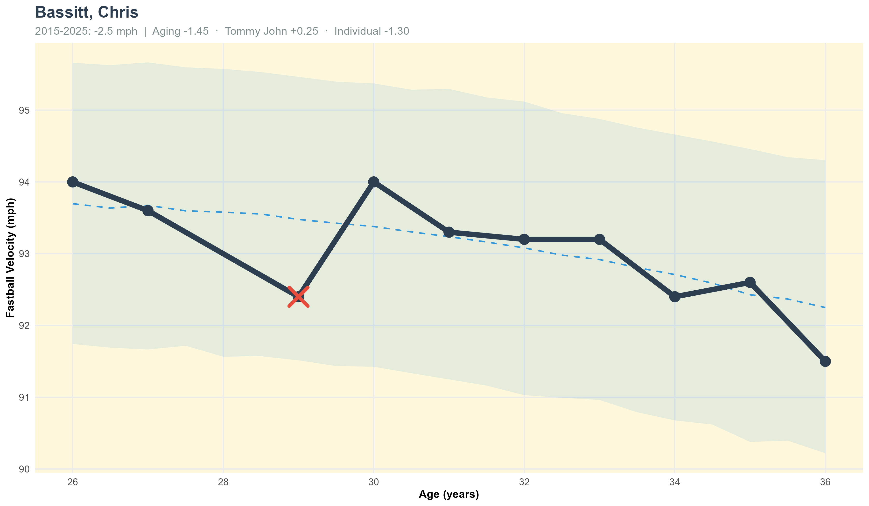
Case Study: Chris Bassitt – TJ Effects with Aging
Notes:
Chris Bassitt is the cleanest example of the framework doing what the title of this talk promises. Eleven seasons, ages 26 through 36, Tommy John in 2016, and a moderate risk score of 43%.
He lost 2.5 mph across the decade. The decomposition splits it: 1.45 from the population aging curve, 0.25 from the Tommy John terms, and 1.30 individual. Aging and individual deviation are each carrying real weight, which is what you want a decomposition to look like.
Two things worth pointing out. First, there is no changepoint on this chart, and that is not the algorithm failing. Look at the trajectory. He drops 1.2 mph in 2018, then gains 1.6 back in 2019, wobbles for four seasons, and drifts down at the end. PELT will not flag noise around a trend. Same behavior you saw on the Gray slide.
Second, and this surprised me: he threw harder two years after surgery than the year before it. That is not what most people expect from a 27-year-old having Tommy John

Slide 14
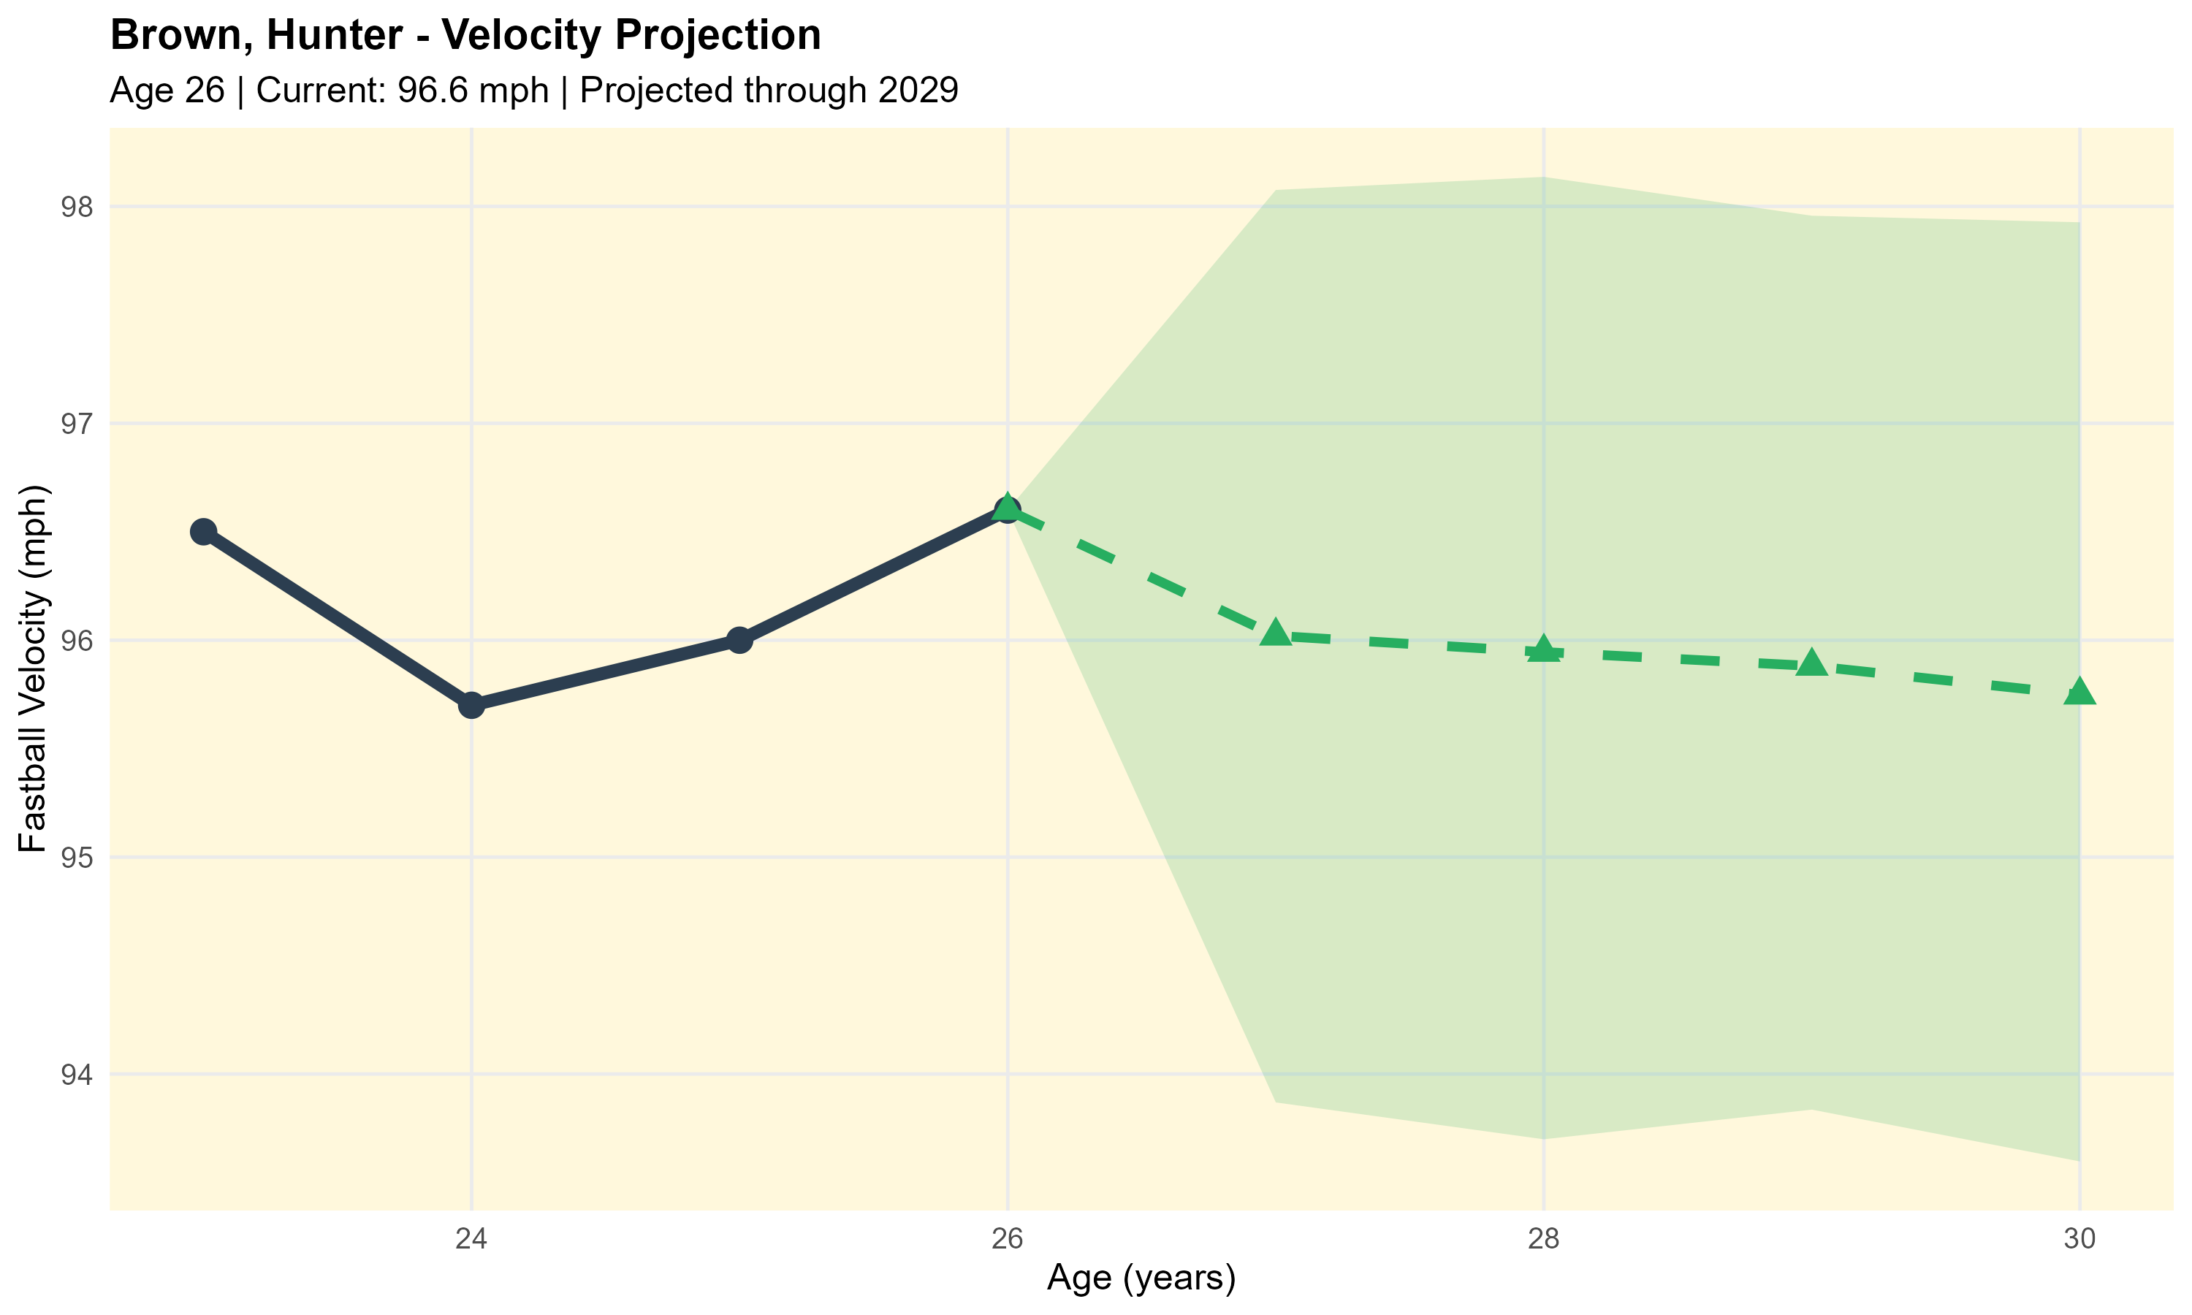
Case Study: Hunter Brown – Velocity Predictions
Notes:
Hunter Brown represents the kind of projection our model can make for developing pitchers. He's 25 years old, currently throwing 96 mph, with no Tommy John history. The green shaded region shows our projection through age 29.
Notice a few things: First, we project slight short-term decline, from 96 mph down to about 95.5 mph over the next four years. This might seem pessimistic for a young pitcher, but it reflects regression toward the mean, extremely high-velocity pitchers tend to lose a bit more velocity than average during aging, and our model is being conservative. Plus, he’s coming out of what we’ve identified as the “peak-range” so to say.
Second, look at the width of that confidence band - it's quite wide, especially in the outer years. That's appropriate uncertainty quantification. We're less certain about 2028 projections than 2025 projections.
Third, notice the footer note: 'Projections regress toward population mean (conservative for elite performers).' This is a feature, not a bug - our model doesn't assume every 96 mph thrower will maintain elite velocity. Some will, some won't, so the population-average projection is intentionally conservative.
For front office use, this kind of projection helps with arbitration valuations and extension negotiations (plus other things, these are just some examples). You can project future performance probabilistically rather than just extrapolating current stats linearly.
*Conservative projections are better than optimistic projections for risk management - you'd rather be pleasantly surprised than unpleasantly surprised.
Transition: Here's another young pitcher projection..

Slide 15
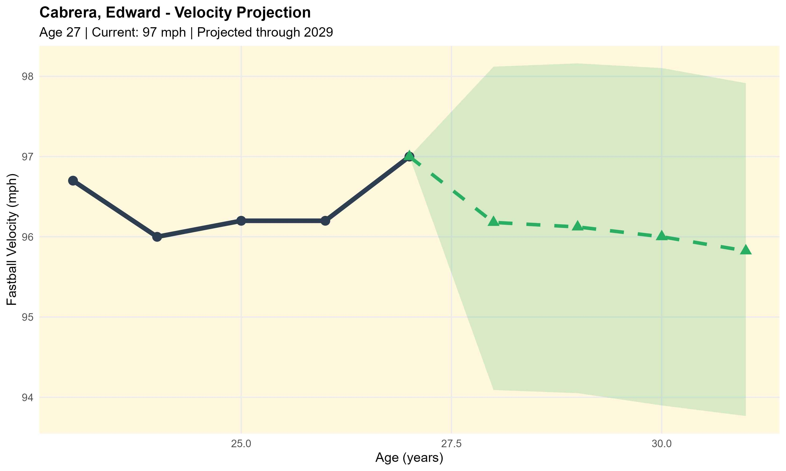
Case Study: Edward Cabrera – Velocity Predictions
Notes:
Edward Cabrera at age 26 is basically at peak velocity: 96.3 mph currently. Our projection shows him declining gradually to about 95.5 mph by age 30, with similar conservative assumptions to the Brown projection.
What I want to highlight here is the value of this for team planning. If you're considering a 4-year extension for Cabrera, this projection lets you model probable performance over the contract life. You can estimate WAR based on velocity projections, which feeds into dollars-per-WAR calculations.
The model suggests he'll lose roughly 0.8 mph over four years if healthy, that's slower decline than average because he's still in prime years. That's valuable information for contract structuring.
Transition: I have a couple other cases worth mentioning briefly...

Slide 16
Key Takeaways I
WE CAN SEPARATE AGING FROM INJURY
VELOCITY SHOWS CLEAR PATTERNS
ACTIONABLE FRAMEWORK
Bayesian models + changepoint detection = quantitative discrimination
Peak at mid 20’s, predictable decline, measurable TJ effects
Risk scores, projections, uncertainty quantification
Notes:
A few main takeaways from this work:
First, yes - we can quantitatively separate aging from injury. The combination of Bayesian hierarchical modeling and changepoint detection gives us the tools to distinguish predictable age-related decline from injury-driven structural breaks.
Second, velocity shows clear, predictable patterns.
Third, individual trajectories are detectable early. Our changepoint detection can flag concerning decline within a few seasons rather than requiring large multi-year patterns to become obvious. That early detection has substantial value for roster management.
The bottom line is that we're moving from subjective judgment - 'does this guy look done?' to quantitative assessment with proper uncertainty bounds.
Transition: Now, there's one specific aspect of Tommy John recovery I want to dive deeper into.

Slide 17
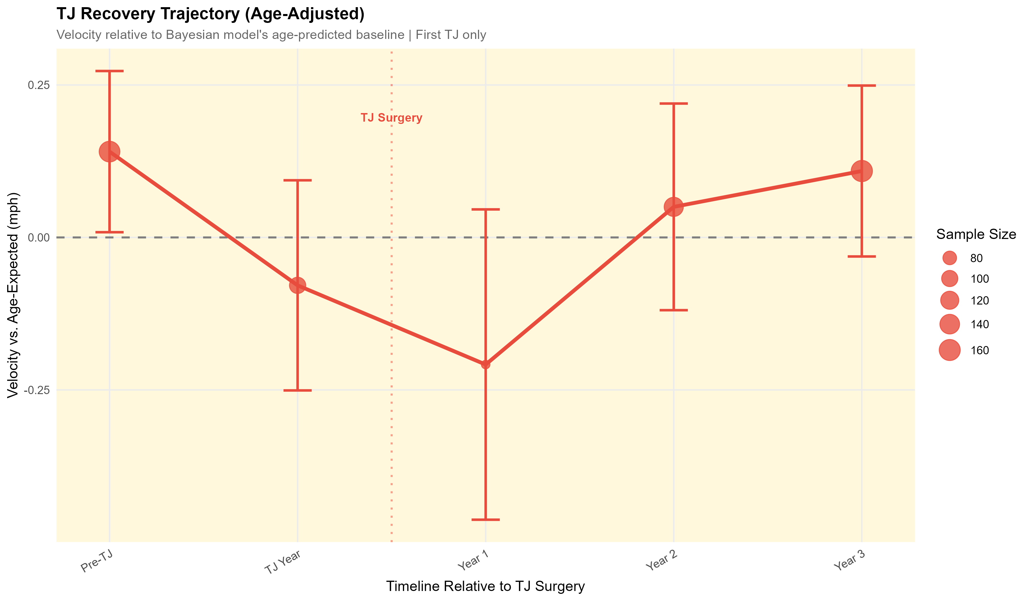
Key Takeaways II: TJ Patterns
Notes:
The error bars represent 95% confidence intervals based on actual observed velocities. Notice how wide they are in Year 1 - that reflects the high individual variation in recovery. Some pitchers bounce back quickly, others struggle.
The pattern I mentioned is clearly visible: dip to about 93.7 mph in Year 1, recovery to 94.8 mph by Year 2-3, then relative stability around 95 mph in Years 4-5.
This graph shows the injury recovery trajectory, aggregated across all pitcher in our sample who had documented TJ surgeries with at least 3 years of pre and post TJ data. We can see a trend that supports industry beliefs regarding TJ. We can see gradual decline in the years leading up to TJ, suggesting possible deterioration in the UCL. And then post-TJ, we see a rise back in velo. This can be associated due to a strong rehab program, disciplined mechanics coming back, leg strength, or a finally healthy non-deteriorating UCL!
*Now, here's what this doesn't show: survivorship bias. Pitchers who don't make it back to the majors aren't in this dataset. So, these numbers represent successful or at least return post-Tommy John recoveries. The true average impact is likely larger when you account for players who never return. That said, this is what front offices are evaluating - pitchers who did return. So, for contract valuation of post-TJ pitchers, this is the relevant distribution.
Transition: Now let me address model performance and validation...

Slide 18
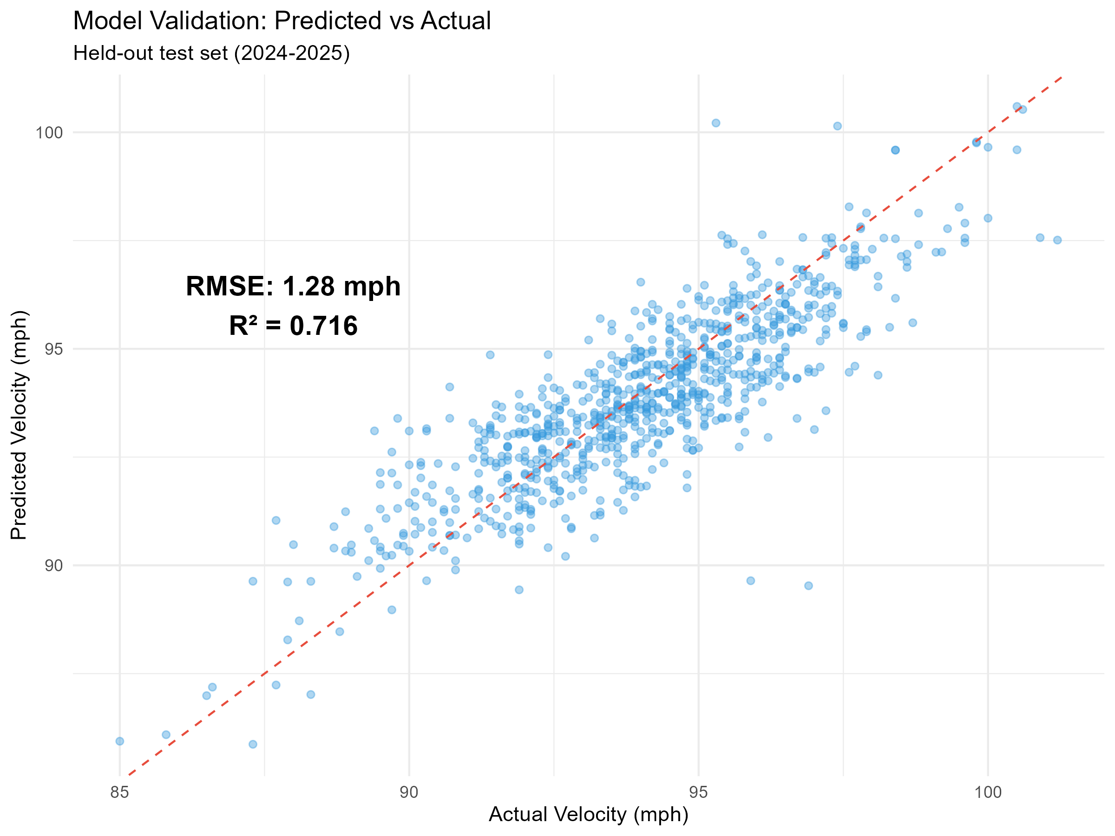
Model Performance
Training Data: 2015-2023
Test Set: 2024-2025
VELOCITY PREDICTION ACCURACY:
• RMSE: 1.28 mph
• R²: 0.716
INTERPRETATION:
• Model captures primary aging/injury signals
• Remaining variance: individual biomechanics, training, workload, etc.
Notes:
Evaluating model performance…
I used a held-out test set consisting of the 2024-2025 seasons. The model was trained only on 2015-2023 data, then evaluated on its ability to predict 2024-2025 velocities.
Our velocity prediction accuracy was: RMSE of 1.28 mph. On a baseline of roughly 90 mph, that's about 1.7% error. And R² of 0.716, meaning we explain ~72% of velocity variance.
Now, I know what some of you might be thinking - 'only 72%?' Let me provide context. Biological systems are inherently noisy. Day-to-day pitcher velocity naturally varies by 1-2 mph based on fatigue, mechanics, even weather. Published aging curve research typically achieves R² in the 0.55-0.70 range, so 0.716 is competitive with the literature. The unexplained 28% of variance represents factors we can't measure: individual biomechanics, training intensity, pitch sequencing strategy, measurement error in Statcast, minor injuries that don't require surgery. That variance is real, and we shouldn't claim to explain it.
For risk assessment correlation, our overall risk scores achieved R² of 0.716 against actual future decline. That's strong evidence the risk framework captures meaningful predictive information.
*The key point is: these metrics are appropriate for the complexity of human athletic performance. We're not trying to predict physics, we're trying to predict biology, which is fundamentally noisier.
Possible Audience Question(s): (Personal Note)
Could you get higher R² with more features?
-Possibly, but you risk overfitting. We prioritized generalizability over training set fit. Adding features like workload or pitch mix might help but increases data requirements and model complexity.
Transition: There are some interesting additional patterns worth noting...

Slide 19
Practical Applications
CONTRACT NEGOTIATIONS:
INJURY RECOVERY:
ROSTER MANAGEMENT:
TRADE TIMING:
EARLY-CAREER PROJECTIONS:
Objective risk assessment for free agents
Set realistic TJ recovery expectations
Monitor entire pitching staff risk profiles
Identify pitchers approaching high-risk windows
Optimize workload during peak years
Project velocity through contract years with uncertainty
Identify problematic recoveries early
Inform demotion/DFA decisions objectively
Maximize return before market recognizes decline
Support development and identify pitcher-specific decline onset timing
Notes:
So how does this research translate to actual front office decisions?
Contract Negotiations: When evaluating a multi-year deal for a 31-year-old pitcher, you can model expected velocity decline over the contract term. If the pitcher is projected to decline from 94 to 92 mph over four years, you can estimate impact and structure guarantees accordingly. Our framework provides the probability distribution for those projections.
Trade Deadline Decisions: If you're considering trading for a rental starter, understanding their current trajectory matters. Is their recent velocity dip normal aging or a red flag? Changepoint detection can flag concerning drops early.
Extension Timing: Our risk scores help identify optimal extension windows. A 26-year-old with clean injury history and low risk is a better extension candidate than a 28-year-old with moderate risk, even if current performance is similar.
Prospect Evaluation: Young pitchers showing unusual velocity gains might be reaching physical maturity ahead of schedule, which affects their projection curve. This could be because they’re also just a dawg.
Medical Decision Support: Velocity tracking post-injury can inform return-to-play decisions and help calibrate expectations for recovery timelines.
The key is that this provides quantitative input to decisions that used to rely primarily on traditional aging beliefs and past performance.
Transition: Now, I want to address some current limitations..

Slide 20
Current Limitations
⚠️ TIME PERIOD: 2015-2025 (Personally selected Statcast era)
⚠️ INJURY DATA: Tommy John surgery data only
→ Other injuries (shoulder, arm, back, etc.) not yet modeled
⚠️ SURVIVORSHIP BIAS: Model currently only accounts for pitchers who have successfully comeback from Tommy John surgery.
Notes:
So how does this research translate to actual front office decisions?
Contract Negotiations: When evaluating a multi-year deal for a 31-year-old pitcher, you can model expected velocity decline over the contract term. If the pitcher is projected to decline from 94 to 92 mph over four years, you can estimate impact and structure guarantees accordingly. Our framework provides the probability distribution for those projections.
Trade Deadline Decisions: If you're considering trading for a rental starter, understanding their current trajectory matters. Is their recent velocity dip normal aging or a red flag? Changepoint detection can flag concerning drops early.
Extension Timing: Our risk scores help identify optimal extension windows. A 26-year-old with clean injury history and low risk is a better extension candidate than a 28-year-old with moderate risk, even if current performance is similar.
Prospect Evaluation: Young pitchers showing unusual velocity gains might be reaching physical maturity ahead of schedule, which affects their projection curve. This could be because they’re also just a dawg.
Medical Decision Support: Velocity tracking post-injury can inform return-to-play decisions and help calibrate expectations for recovery timelines.
The key is that this provides quantitative input to decisions that used to rely primarily on traditional aging beliefs and past performance.
Transition: Now, I want to address some current limitations..

Slide 21
Future Work & Extensions
1️⃣ WORKLOAD INTEGRATION
Innings pitched, pitch counts, days rest, high-stress innings, etc.
Biomechanical stress indicators (High-effort pitches, max effort pitch percentage, usage patterns, etc.)
2️⃣ BIOMECHANICAL FACTOR(S) INTEGRATION
Elbow, shoulder, back injuries, etc.
Arm slot, release point variance, shoulder/elbow torque estimates, etc.
3️⃣ OPTIMIZE RISK FRAMEWORK
Machine learning ensemble methods
Notes:
There are several exciting directions for extending this work. (and even more that aren’t listed here!)
Multi-metric integration: Combine velocity with command and movement models for comprehensive performance projections. The statistical framework is already built - we just need to refine measurement for the other metrics.
Workload incorporation: Integrate pitch counts, innings, and multi-inning appearances. Workload almost certainly affects aging, and incorporating it would improve projections substantially.
Injury prediction: Rather than just modeling post-injury effects, can we predict pre-injury risk? Velocity decline patterns might serve as early warning signals for UCL stress. This would require prospective validation but has enormous practical value.
Pitch type expansion: Model aging curves for sliders, curveballs, changeups. Different pitch types age differently and this matters for pitcher valuation.
Survival modeling: Incorporate career longevity explicitly. Right now we model velocity conditional on still pitching; we could extend to model probability of remaining in MLB.
Biomechanical integration: If we could get motion capture data on delivery mechanics, we could potentially explain some of the currently unexplained variance in aging rates.
These extensions would require partnerships with teams who have proprietary data, but the statistical framework we've built is designed to accommodate them.
Transition: Let me talk about the methodological contribution..

Slide 22
Sourced Research & References
Ahmad, Christopher S. "Question: Will My Velocity Go Up After Tommy John Surgery?"
Medium, 2023, drchrisahmad.medium.com/question-will-my-velocity-go-up-after-
tommy-john-surgery-2fbfe03ccbcd.
Driveline Baseball. "The Makeup of a Pitcher Debuting in the Major Leagues."
Driveline Baseball, 15 Sept. 2021, www.drivelinebaseball.com/2021/09/
the-makeup-of-a-pitcher-debuting-in-the-major-leagues/.
Roegele, Jon. "Tommy John Surgery List." Google Sheets, 2015-2025, docs.google.com/spreadsheets/d/1gQujXQQGOVNaiuwSN680Hq-FDVsCwvN-3AazykOBON0/.
Notes:
This work stands on the shoulders of excellent prior research. A few key citations:
Chris Ahmad's 2023 analysis of Tommy John velocity effects was foundational for my recovery timeline expectations.
Mitchel Lichtman's aging curve work established many of the baseline patterns I built on.
Jon Roegele's comprehensive Tommy John surgery database was essential - his meticulous tracking of surgical dates enabled our recovery timeline analysis. Absolute godsend.
Stan Conte's workload research informed our thinking about injury risk factors, even though I couldn't fully incorporate workload in this iteration.
And numerous academic papers on Bayesian hierarchical modeling and changepoint detection provided the statistical foundation.
I want to emphasize that this research is incremental - it advances the conversation but doesn't reinvent it. I’m integrating existing methods in a novel way and applying them rigorously to a specific problem.
Transition: With that, I'll open it up for questions...

Slide 23
Thank You!
Questions?
nickbartle2@gmail.com
linkedin.com/in/nickolasbartle/
(919)-656-2434
https://nbartle26.github.io/DigitalPortfolio/
Notes:
Thank you for your attention. I'm happy to take questions now, and I'll be around all day if anyone wants to discuss the methodology or applications in more detail.
For those interested in code replication or collaboration, please feel free to reach out, it is also available on my GitHub and website mentioned at the bottom of the slide. I’m excited about the potential for this framework and eager to see how it might be refined and extended by the community.
Possible Audience Question(s): (Personal Note)
If a team could only use one output from your model, what should it be?
-The risk scores. They're simple, interpretable, and integrate all the information into one number. You can sort your roster by risk and immediately see who warrants close monitoring, amongst so much other things.
What would you need to make this truly production-ready for front offices?
-Real-time integration with pitch tracking systems, incorporation of workload data, and extension to other pitch types, plus cutting edge biomechanics data surely wouldn’t hurt. Technically it’s ready, but those integrations would make it seamlessly fit into existing workflows."
Do you think velocity focus over-emphasizes power pitchers?
-That's fair criticism. Command-and-control pitchers might age differently, and our framework wouldn't capture that. But I'd argue velocity is the most fundamental athletic capacity - even finesse pitchers need minimum velocity to be effective. So it's a useful starting point even if incomplete.
How would you handle relievers vs. starters differently?
-Great question. Relievers might age differently because they work at higher effort levels but accumulate less volume. Future work should stratify by role. Our current model pools them together
Closing Statement: The bottom line is simple: when a veteran pitcher's velocity drops, we can now answer the question 'is this aging or injury?' with quantitative precision rather than subjective judgment. That distinction has enormous practical value for roster management, contract negotiation, and player development. Thank you.

