Slide 1

MMI-513 TERM PROJECT PRESENTATION
Ali Ozan & Nuri Baran Ayana

Slide 2
INTRODUCTION
Base Project Selection
Searched, investigated and experimented with lots of different projects
Compared them in terms of recency, originality, complexity, similarity to original game ease of modification etc.
Found some really good and detailed projects with downsides.
Decided to stick with a Project that has a more simplistic approach to visuals.

Slide 3
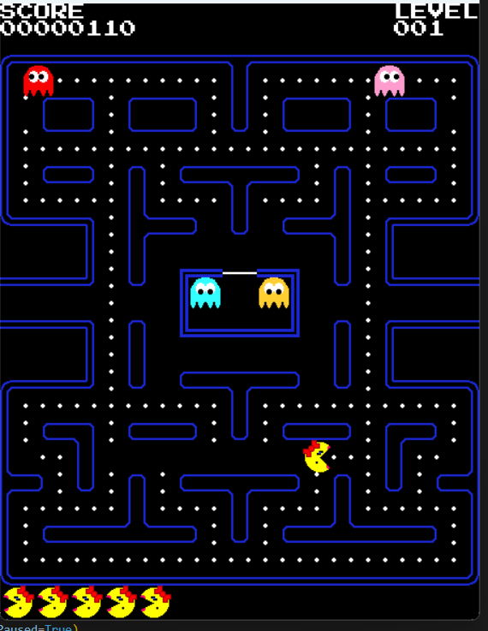
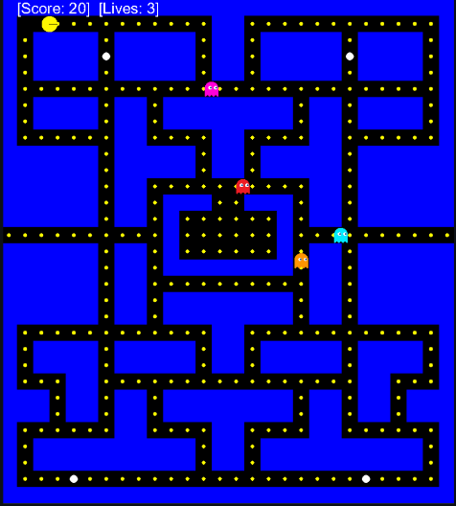
INTRODUCTION
Base Project Selection
One of the projects we have tried src: https://pacmancode.com/
The Project we have chosen src: https://github.com/janjilecek/pacman_python_pygame

Slide 4
INTRODUCTION
Base Project Details
A simple yet accurate implementation of the original game.
Map is direct copy.
Map is defined by ASCII characters (0, 1, P, O, G)
Powerup mechanics work fine.
Teleport gates are implemented and functional
Ghost have 2 movement modes: CHASE, SCATTER
Ghost movements are not ideal, they have a major issue;
They do not update their targets until they reach it.
The Project we have chosen src: https://github.com/janjilecek/pacman_python_pygame

Slide 5
MAZE GENERATION
Used the same approach of defining a 2D maze with ASCII characters.
First, we implemented Depth First Search Algorithm.
Later, implemented Prim’s Algorith as our default method.
We had the chance to compare these algorithms in a game environment.
Why Prim’s Algorithm as the default choice?
DFS results in long winding corridors and dead ends.
For a game like Pac-Man, having options and possible escape routes is crucial.
Prim’s Maze is provides a more flexible and forgiving game design

Slide 6
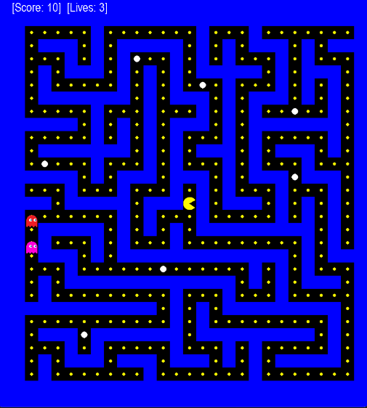
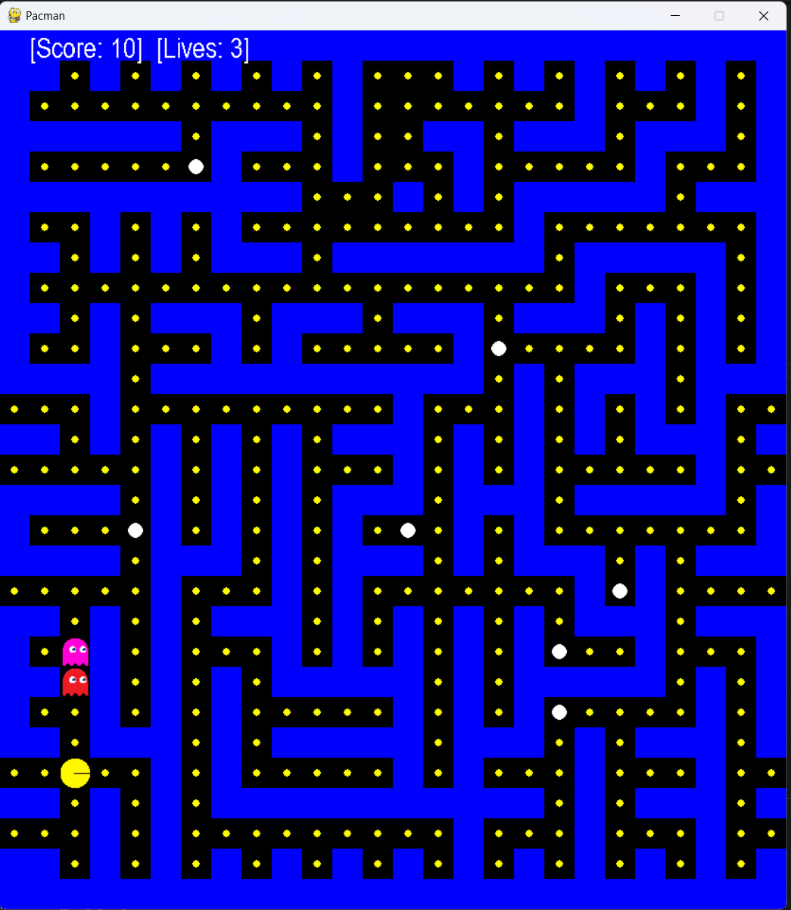
MAZE GENERATION
Comparison of two maze generation methods.
DFS Maze
Prim’s Maze

Slide 7
MAZE GENERATION
Workflow of Maze Generation
Create a 2D grid only consisting of walls (zeros).
Carve out the corridors using DFS or the Prim’s Algorithm
Pick a random place and place the player.
Place the powerups by a pre-defined count.
Open up portal gates

Slide 8
STRATEGY AI
Workflow of Strategy-AI
The placement for spawn locations of the ghosts is generated for diverse locations of the players and mazes.
Difficulty level can be arranged strategically by setting ghost spawn distance, which was set as 10.
A new ghost generation structure was created.
Ghost generation time limit can be determined, and color variety is provided.

Slide 9
TACTICAL AI
Workflow of Tactical-AI
The sensing mechanism was added. The ghost chases the player by comparing the distance with “Manhattan Distance” and searches for the player while the distance is satisfied.
If the distance score is bigger than 10, the path is selected randomly.
If the distance score is lower or equal to 10, the ghost chases Pac-Man.
A* Algorithm is for pathfinding purposes.
Now the ghost can update their paths without reaching pre-determined final points.

Slide 10
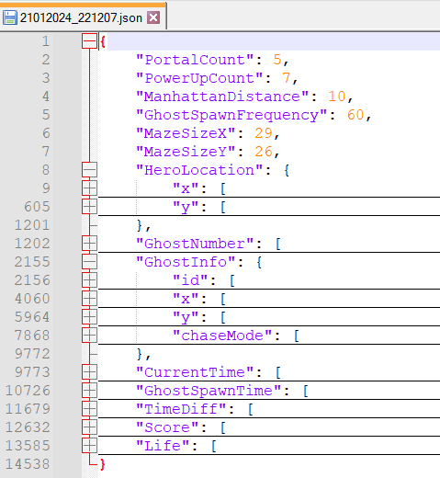
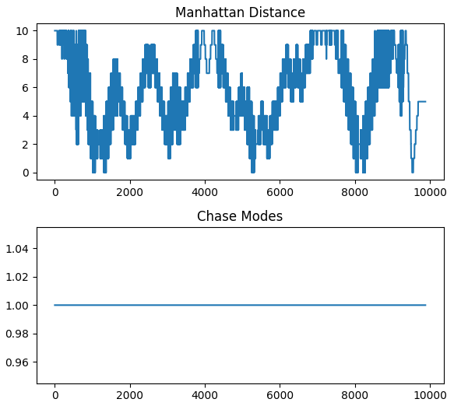
ANALYTICS
The game has the parameters of the game:
Power Up Count: 7
Portal Gate Count: 5
Map Size: 29x26
Ghost Spawn Frequency: 60
Manhattan Distance Limit: 10

Slide 11
CONCLUSION
With this term project, we have experimented with the implementation of the algorithms covered during this course.
With our enhancements, the classic Pac-Man game was transformed into a more challenging and engaging experience by gaining the abilities of:
The integration of dynamic maze generation
Strategy- and Tactical AI behaviors for the Ghost
Analytics module which can help investigate the effect of the parameters on gameplay

