Slide 1
TRNG Anomaly Detection: Autoencoder CNN

Slide 2
Autoencoder CNN Architecture
Input: [8, 64, 64] bit-planes
Encoder:
- Conv(8→32, 3x3) + ReLU
- Conv(32→32, 3x3) + ReLU
- MaxPool(2) → [32, 32, 32]
- Conv(32→64, 3x3) + ReLU
- Conv(64→64, 3x3) + ReLU
- MaxPool(2) → [64, 16, 16]
- Conv(64→128, 3x3) + ReLU → Bottleneck [128, 16, 16]
Decoder:
- ConvTranspose(128→64, 2x2, stride=2) → [64, 32, 32]
- Conv(64→64, 3x3) + ReLU
- ConvTranspose(64→32, 2x2, stride=2) → [32, 64, 64]
- Conv(32→32, 3x3) + ReLU
- Conv(32→8, 3x3) + Sigmoid → Output [8, 64, 64]
Loss: Mean Squared Error (MSE). Anomaly score = per-frame MSE.

Slide 3
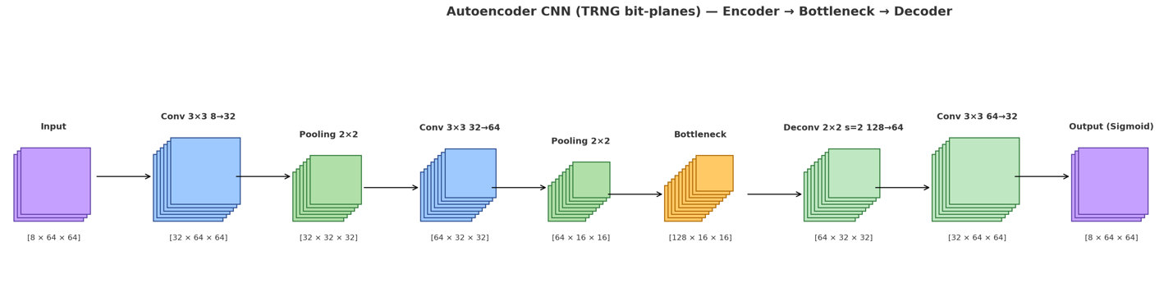
Network Diagram

Slide 4
Encoder (Feature Compression)
Input [8,64,64]: 8 bit-planes (LSB..MSB) from bytes.
Conv(8→32, 3×3) + ReLU → Local feature extraction.
Conv(32→32, 3×3) + ReLU → Stacked features, larger receptive field.
MaxPool(2) → Downsample (64→32).
Conv(32→64, 3×3) + ReLU → Higher-level features.
Conv(64→64, 3×3) + ReLU → Stable representation.
MaxPool(2) → Downsample (32→16).
Conv(64→128, 3×3) + ReLU → Bottleneck latent z.

Slide 5
Decoder (Reconstruction) + Loss
ConvTranspose(128→64, 2×2, stride=2) → Upsample (16→32).
Conv(64→64, 3×3) + ReLU → Refine upsampled features.
ConvTranspose(64→32, 2×2, stride=2) → Upsample (32→64).
Conv(32→32, 3×3) + ReLU → Clean and sharpen features.
Conv(32→8, 3×3) + Sigmoid → Reconstruct 8 bit-planes.
Loss: MSE → Minimize difference between input and reconstruction.
Anomaly score = per-frame MSE (higher = more suspicious).

Slide 6
SP800-90B
- SP 800-90B (NIST Entropy Source Standard)
Official Estimators (MCV, Collision, Markov, t-Tuple)
  These are mathematical tests defined by NIST.
  They estimate the minimum entropy (worst-case randomness) of the TRNG output.
  Example: if you get 0.975 bits/bit, it means on average each bit carries ~97.5%
  randomness.
Health Tests (RCT, APT)
  Repetition Count Test (RCT) → catches stuck bits (too many identical symbols in a row).
  Adaptive Proportion Test (APT) → checks if one symbol occurs too frequently.
  These are lightweight, online tests that can run continuously in hardware.
Gives rigorous min-entropy estimate (bits/bit)
  The standard converts randomness quality into a single number.
  This number is used to decide how much “true entropy” is inside a TRNG output.
  Very important for cryptographic systems that rely on unpredictability.
Required for certification (FIPS 140-3, Common Criteria)
  Without passing SP 800-90B, a TRNG cannot be officially certified for security products.
  This is why companies must run these tests.
Does not explain the visual failure pattern
  Limitation: The output is just numbers and pass/fail results.
  It cannot show what went wrong (e.g., which bit got stuck, or which pattern repeats).
  That’s why visual tools (Bit-planes, Heatmaps, Autoencoder residuals) are helpful
  complements.

Slide 7
Detecting Potential Risks in TRNG Outputs: Visual and AI Approaches
Bit-planes & Heatmaps → come directly from raw TRNG sequences
(different visualizations).
Autoencoder Residuals → come from a trained CNN model that learns
“what normal looks like.”

Slide 8
Detecting Potential Risks in TRNG Outputs: Visual and AI Approaches
Why Not Stop at Bit-planes & Heatmaps?
Bit-planes
  ✅ Very intuitive (easy to spot stuck bits).
  ❌ Only catches big obvious problems (e.g., all 0’s, all 1’s).
  ❌ Cannot quantify subtle bias.
Heatmaps
  ✅ More sensitive (shows repetition / diagonal structure).
  ❌ Still requires human inspection — subjective, not automated.
  ❌ Hard to set a pass/fail threshold for production monitoring.
Autoencoder Residuals (AI)
  ✅ Learns from healthy data and builds a baseline automatically.
  ✅ Produces a numeric anomaly score (MSE), so we can automate pass/fail.
  ✅ Can detect subtle deviations invisible to the eye.
  ✅ Scales better for continuous monitoring (online TRNG health tests).

Slide 9
Detecting Potential Risks in TRNG Outputs: Visual and AI Approaches
1. Bit-planes
Method: Expand TRNG byte outputs into 8 layers, each representing bit[0] to bit[7].
Interpretation:
  Random & Healthy → Black/white pixels are mixed randomly, like visual noise.
  Biased / Stuck → Almost fully bright or dark, indicating a stuck bit or strong bias.
Meaning: A quick visual sanity check, useful to detect catastrophic failures (stuck-at bits).
2. Heatmaps (n-gram / co-occurrence)
Method: Calculate the frequency and correlation of bit/byte occurrences, plotted
as intensity maps.
Interpretation:
  Random & Healthy → Colors are evenly distributed, no clear structure.
  Biased / Repetitive → Bright diagonal or clusters, meaning repeated patterns
  or probability skew.
Meaning: More sensitive than bit-planes, reveals hidden patterns or subtle bias.

Slide 10
Detecting Potential Risks in TRNG Outputs: Visual and AI Approaches
3. Autoencoder Residuals
Method: Train a CNN autoencoder on “healthy” TRNG outputs, then measure reconstruction
error (MSE).
Interpretation:
  Low residual (dark) → Data matches what the model learned → likely normal.
  High residual (bright regions) → Reconstruction fails → anomaly or deviation.
Meaning: Provides an automated anomaly detection approach, quantifying where and when
entropy quality drops.
Comparison / Takeaway:
Bit-planes → Human-eye check for stuck bits.
Heatmaps → Pattern detection & probability skew.
AE Residuals → Automated anomaly scoring & localization

Slide 11
How to Read Bright vs. Dark
Bit-planes: Bright=1, Dark=0. Random mix = healthy. Uniform brightness = bias/stuck.
Heatmaps: Brighter cells = higher probability. Diagonal dominance = repetition.
AE residuals: Bright = reconstruction failure → potential anomaly.

Slide 12
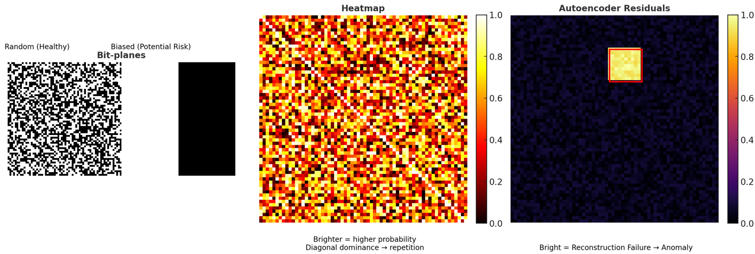
Example Diagram

Slide 13
Bit-planes
Definition: Split TRNG byte outputs into 8 binary images (bit[0] to bit[7]).
Visualization: Each image shows the distribution of a single bit position:
  White = 1
  Black = 0
Meaning:
  Random & healthy TRNG → appears as random black/white noise.
  Biased or stuck TRNG → one plane is uniformly bright or dark, showing bias
  or failure.
Use case: Quick visual sanity check for stuck bits or obvious bias.

Slide 14
Example Diagram
Heatmaps (n-gram / co-occurrence matrix)
Definition: Counts how often symbol i is followed by symbol j (pairwise correlation).
  For bits → 2×2 matrix.
  For bytes → 256×256 matrix.
Visualization: Plotted as a heatmap (thermal diagram):
  Brighter cells = higher frequency (more common transitions).
  Darker cells = lower frequency (rare transitions).
Meaning:
  Random & healthy TRNG → evenly spread heatmap, no visible structure.
  Biased TRNG → bright diagonal (repetition) or bright blocks (biased patterns).
Use case: Reveals hidden patterns and correlations beyond what bit-planes show.
Together:
Bit-planes → shows individual bit health.
Heatmaps → shows sequence correlation and bias.

