Slide 1
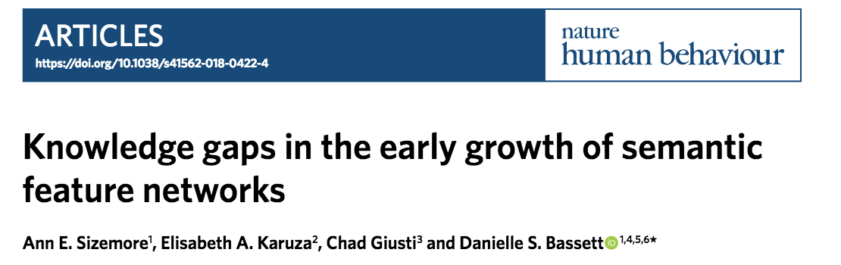
Notes:
-> This is a paper that recently came out in NHB thinking about the dynamics of semantic networks as young children learn new words

Slide 2
Question and motivation
How do kids learn new words?
Mediated by relationships between the words that kids already know?
Existing hypothesis: Word is more likely to enter the lexicon the more connected it is to related the known words (“preferential attachment”)
Are there knowledge gaps (missing unifying concept)?
Cavity as proxy for difficulty in learning word
Characterize evolution of cavities in binary network
Notes:
Knowledge gaps proxy for difficulty

Slide 3

Method
Parent report data (MacArthur-Bates Communicative Development Inventory) from 5511 parents of kids (16-30 mo)
120 English nouns
Age of acquisition = month at which > 50% of kids said word
Produces ordering of words based on age

Slide 4
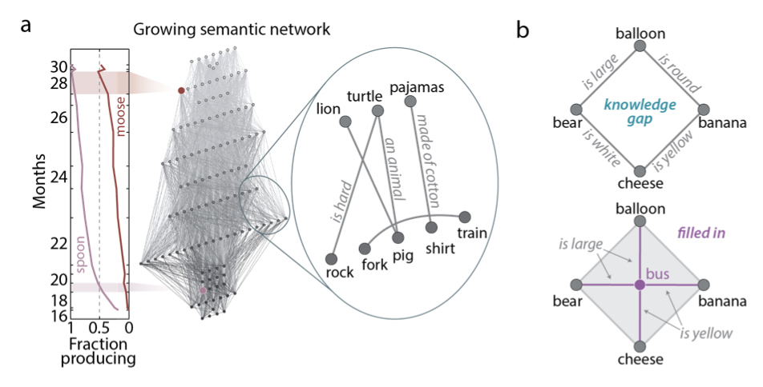
Method
Create network where nodes are words
Edges between words where feature shared (based on human judgements)
Notes:
[a] (LEFT) Word ordering is given based on the month at which 50% of children produce each word.
(RIGHT) Semantic features connect nouns (corresponding to nodes), forming the semantic network.
(CENTER) Combining the binary feature network and word production times creates a growing semantic network with nodes entering based on the first month at which 50% of children can produce the word.
[b] A ‘knowledge gap’ could be seen as a topological void within the semantic network. The connection pattern between ‘balloon’, ‘bear’, ‘cheese’, and ‘banana’ leave a gap within the graph (top), but the addition of the node corresponding to ‘bus’ and its connections fills in the cavity (bottom).
-> The features of interest in such a network are then the nodes responsible for filling in the cavity, which correspond to the temporarily missing words.

Slide 5
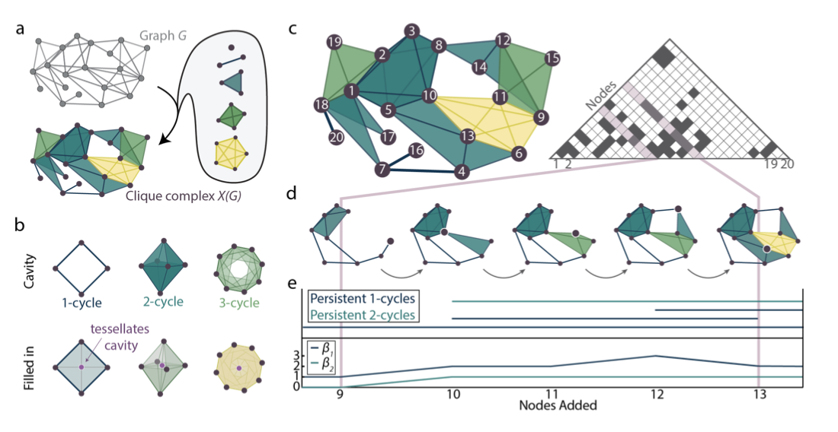
Method
Notes:
[a] allow all groups of completely connected nodes to define entities (cliques) – graph = clique complex X(G)
[b] LOOP of edges – 1 cycle; loops of trinalges – 2 cycle; buttom clique formed by maroon poitn filling in clique
-> homology counts the number of cavities in each dimension of a clique complex constructed from a binary graph.
THEN: add time dimension
[c] SEQUENCE OF SUBGRPAHS adding one node at a time
in summary – allows us to extract the number and dimension along with the longevity of topological cavities throughout the growth process.
[e] barcode: life and death of 1-cycles/2-cyles; beti curve number of cycles of each type

Slide 6
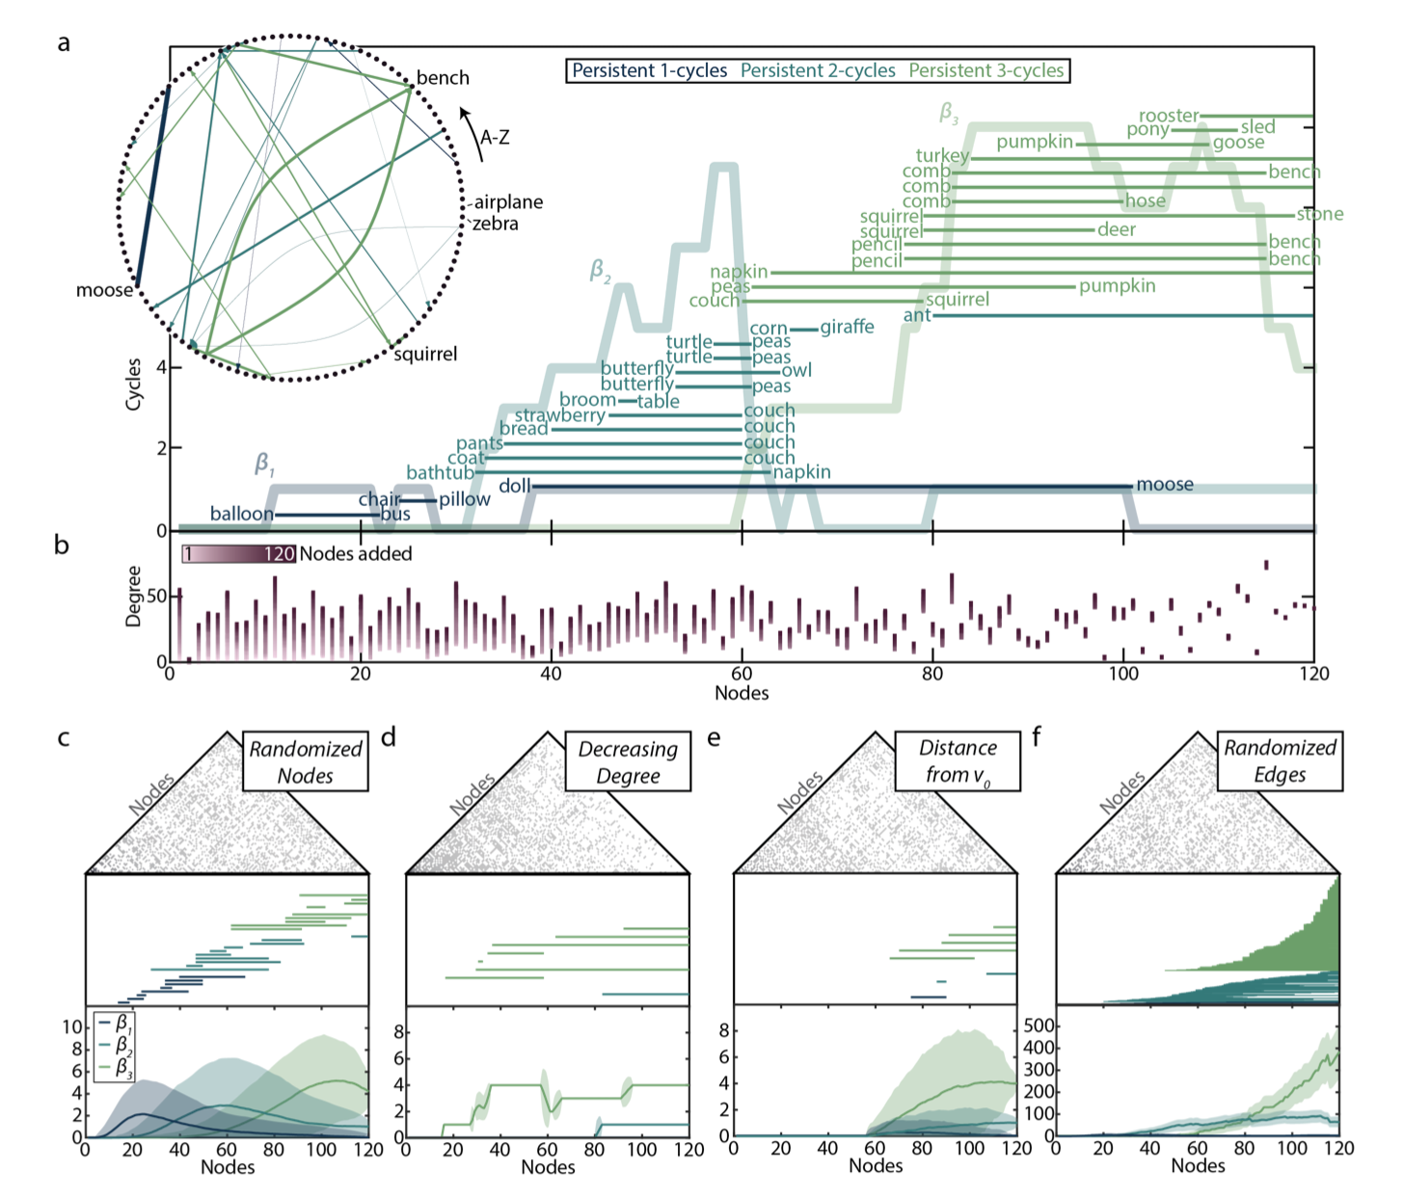
Results
Notes:
To further probe mechanisms guiding the evolution of the growing semantic structure, we construct derived n-order complex models that begin with the semantic network and alter either the node ordering or edge placement to determine which (if either) explains the observed evolving architecture.
Next, we ask if there are simple rules by which cavities form and evolve in the growing semantic network. We notice that nodes added late in the growth process have higher chances of having a high degree at the time of their addition than nodes added early in the growth process. Thus, one might hypothesize that the empirically observed pattern of Betti curves follows simply from a pattern of higher-connectivity nodes added throughout the filtration. Contrary to this simplistic expectation, we observe instead that the degree of nodes varies considerably across time with no salient trend of either a decreasing or increasing node degree (Fig. 4b). Indeed, when the final node is added there exists great variability in node degrees when plotted in the order of node addition.
Perterupe the network in diffefent ways with diff generative models
[c] Randomized nodes
[d] Ordered by decreasing degree
[e] Ordered from didstance to original noded
[f] keep node ordering constant but now randomly rewire edges while preserving node degree – very different structure
Different domains
Other tests of

Slide 7
Conclusion
Long-persisting cavities of varying dimensionality (contra strict preferential attachment rule)
Semantic network growth is a robust phenomenon that can accommodate many local changes without abrupt restructuring of its large-scale organization
Robust to input of learner
Edge properties are more important

Slide 8
Some thoughts…
No evidence that kid similarity is same as adult (e.g. what if you need to know the word to id the feature as relevant)
Not clear this represents the edge of individual kids semantic network
To what extent are these gaps an artifact of looking at a constrained network?
Predict features of slow-to-learn words?
If semantic structure varies across languages, should predict different words should be hard to learn cross-linguistically

