Slide 1
Do “seed words” boost vocabulary growth?
Molly Lewis
Lupyan Lab Meeting, 8 March 2018
Notes:
Potential, What are the most interesting questions these data can answer; how to frame it

Slide 2
Children’s vocabulary grows rapidly
… but there’s a lot of variability
Wordbank (Frank et al., 2016)

Slide 3
Hypothesis: Some words are more helpful for learning new words than others
Notes:
Identify relevant feature

Slide 4
Beckage, Hills, Smith, 2011
Compared children with small and large vocabularies, given their age
Built network of each child’s vocab
Nodes = words
Links = likelihood of two words co-occurring in speech two child (link if in top 5)
Network statistics:
In degree – mean number of edges pointing toward a node
Clustering – proportion connection of nodes
Geodesic distance – mean shortest path between two nodes

Slide 5
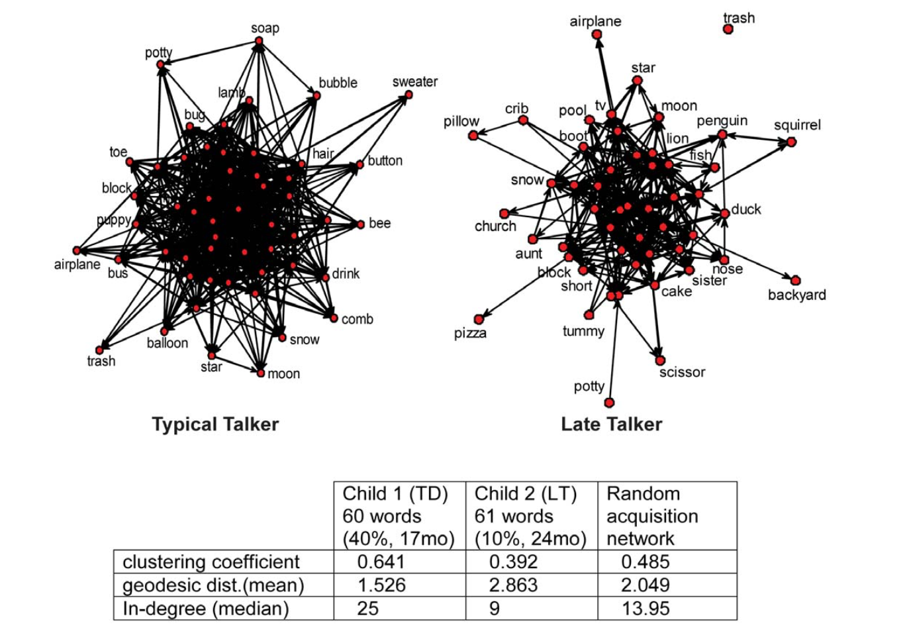
Notes:
-> Late talkers know more odd ball words
-> Pherpas LT have trouble learning new words because of the weird structure of words they already know

Slide 6
Beckage, Hills, and Smith, 2011
Late talks know “odd ball” words
Perhaps there’s a causal link between current vocab and learning new words
That is, LT have trouble learning new words because of the weird structure of words they already know
If true, we should be able to predict how many words a child will know in the future, based on the words they already know

Slide 7
Beckage and Colugna, 2013
Can you predict what words a child will know at a given age?
Null model: What proportion of the population know a word, given their age?
Jane
“blue”?
65% of 18 month olds know blue =>
P(Jane knows “blue”) = .65
16 months

Slide 8
Jane
Jane
“blue”?
“red”
“yellow”
...
15 months
16 months
P(Jane knows “blue” | {”red”|”yellow”}) =
P(“blue” and “red”) + P(“blue” and “yellow”)
P(“red”)
P(“yellow”)
8-19% improvement over null

Slide 9
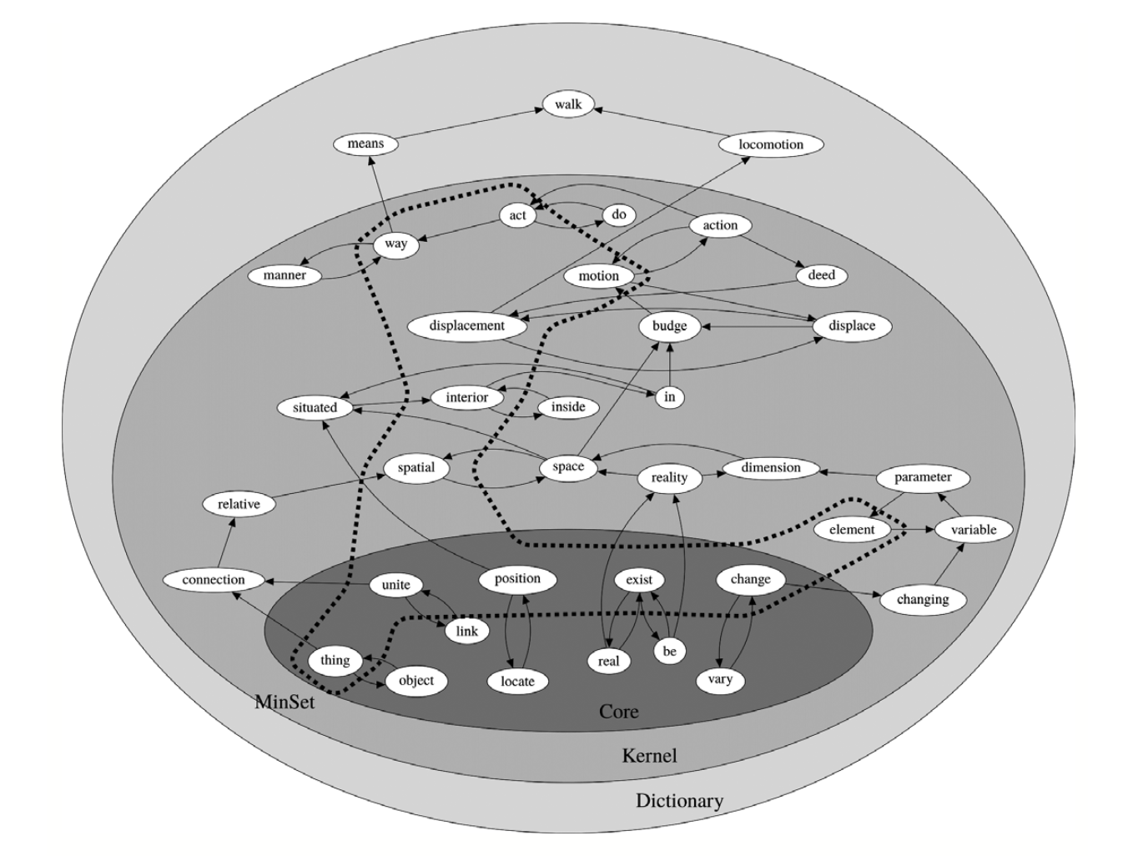
Which words are helpful?
What is the smallest set of words you need in order to define the meanings of all other words in a dictionary?
10 % - can define
rest of dictionary
1 % - can define
rest of dictionary
Strongly connected
subset
(Vincent-Lamare et al., 2016)

Slide 10
The current project
Goal: Identify set of words with low and high inductive potential (non-seed vs. seed)
Ultimate goal is to then use these words to test a causal hypothesis
Teach kids words, and ask whether kids who learn seed words know more words at t2, relative to t1

Slide 11
Method: Longitudinal data from CHILDES
N = 156
Notes:
156 children >1 trancript 18-42 month age bin
variability in words- high variability words as less predictive

Slide 12
N = 107
Notes:
0 -160

Slide 13
Method
For each time point, aggregate all transcript to create a single “corpus”
Define vocabulary at each time point
Kid knows word if they produce it at least N times (= 5)
Problem: Vocabulary size correlated with transcript length
Measure vocabulary size by residualizing out transcript length
Notes:
normalize by number of words

Slide 16
Kernal word in vocabulary
Using dictionaries intended for non-speaker of English, 1255 word in Kernal

Slide 17
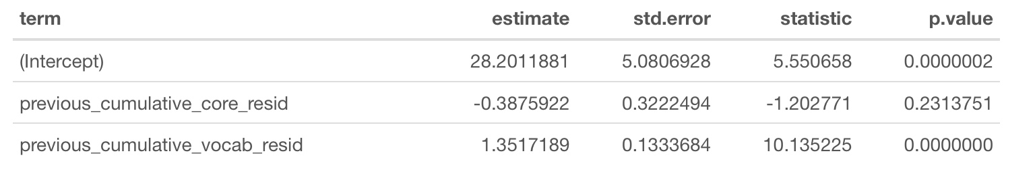
Does Kernal vocab size at t1 predict vocab size at t2?
Notes:
- core words knolwege vs. non-core words`

Slide 18
Next step:
Regression for each word
Residualized number of words ~ Age + age difference + residualized number of words + know word + (1|kid)
Get coefficient for each word and rank them
Compare to prop number of kids who know a word (data sent Gary, to get at Nicole’s question)
ALSO:
NOTES: -> core- periphery structure in networks - for each child-> are AoA adult judgemnts about corenesS? - childes network vocabuly (get closesness/betweenweess for each word) -> compute with word in vs. out- intesection of vocabulary- what words, when removed, deviated most from normative in terms of their learning trajectory* Mahesh (PNAS)

Slide 19



The word learning problem
“apple”
?
Mapping Problem
?
?
Generalization Problem
(Lewis & Frank, 2013b)

Slide 20
Here’s the lognitidunal data look like

Slide 21
Meausre of vocab -

