Slide 1
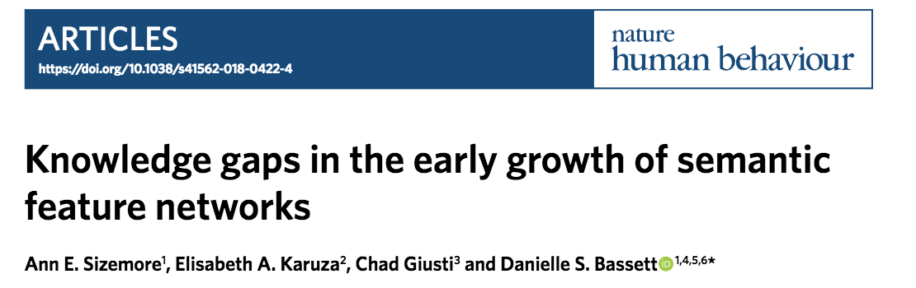

Slide 2
Question and motivation
How do kids learn new words?
Is it mediated by relationships between the words that kids already know?
Hypothesis: A kid learns a word similar to the words already known
Contra this hypothesis, they find that there are gaps (missing words) that are created and then filled in
Characterize evolution of cavities using applied topology
Notes:
Knowledge gaps proxy for difficulty

Slide 3
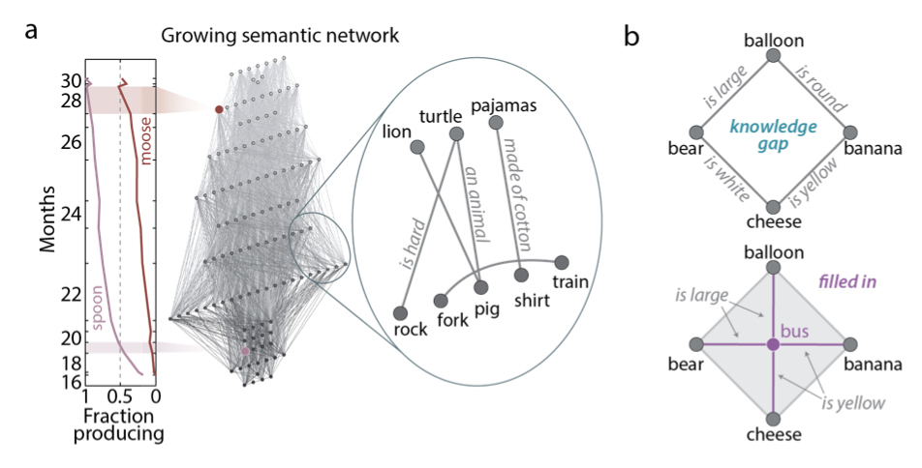
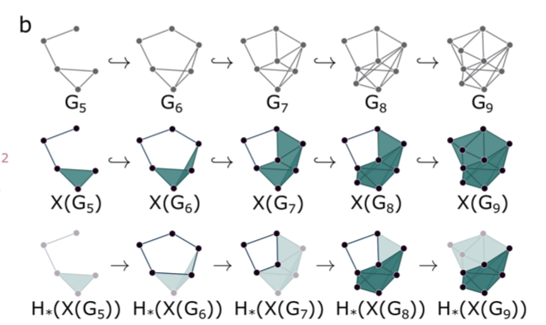
Method
Notes:
One might expect that when one grows one’s vocabulary, one tends to learn words that are similar to words already known. Such a process would leave few if any knowledge gaps, corresponding to topological cavities, within the network, and should be well-modeled by
12
a topological-distance-from-initial-node rule.

Slide 4
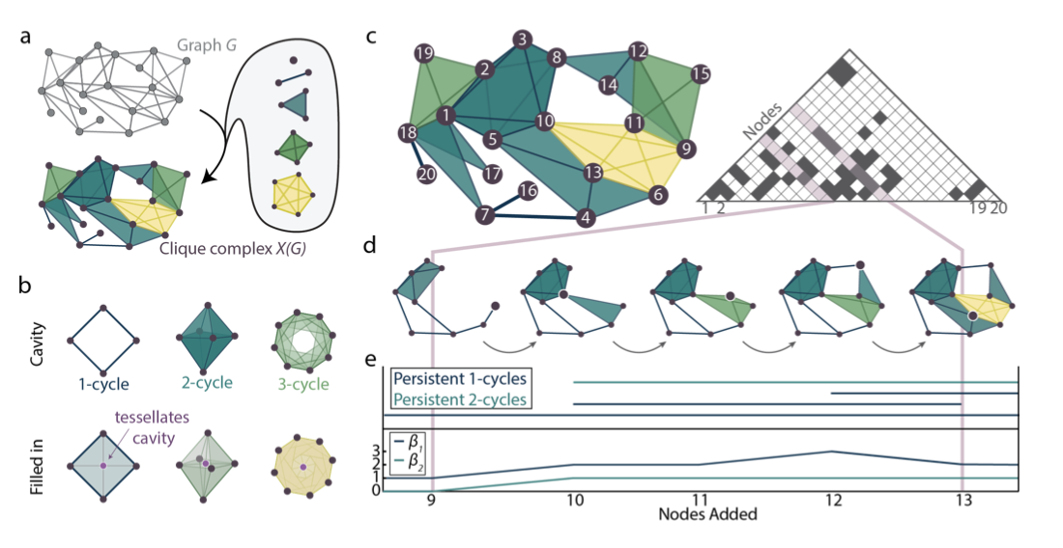
Method

Slide 5
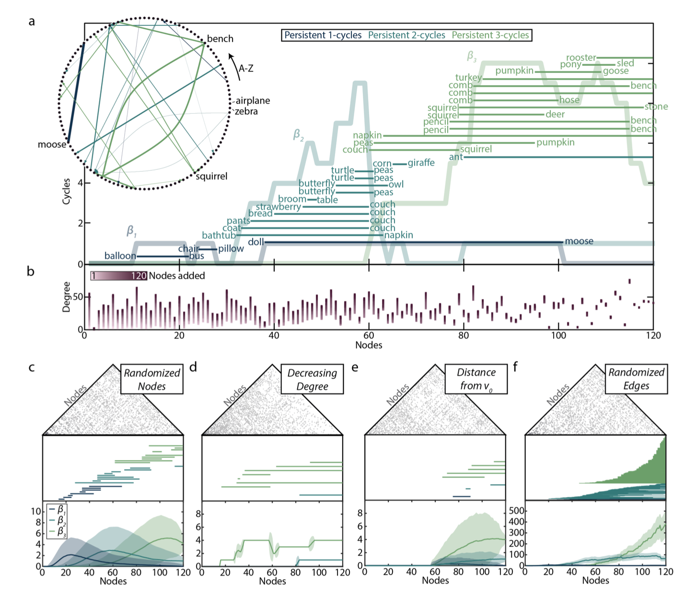
Results
Notes:
To further probe mechanisms guiding the evolution of the growing semantic structure, we construct derived n-order complex models that begin with the semantic network and alter either the node ordering or edge placement to determine which (if either) explains the observed evolving architecture.

Slide 6
Conclusion
In contrast to a growing network model, networks are created then filled
Any ordering of words produces similar topological result
Topological cavities are conserved feature of the learning process
Edge properties are more important

Slide 7
Thoughts
Massive variability in the number of words that kids know….suggests not that they know the wrong words, but that they don’t understand the appropriate relations between them?
Suggests semantic similarity is not the only driver of semantic growth?
Notes:
ach edge entering the graph with the addition
of node n a probability p = .2

Slide 8
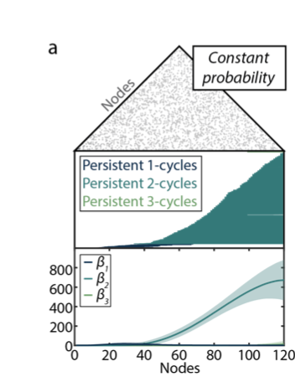
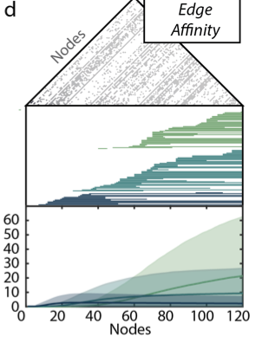
Thoughts
Notes:
ach edge entering the graph with the addition
of node n a probability p = .2

