Slide 1
The Claytronics Project and Domain-Specific Languages
Nels Beckman
SSSG Presentation
February 6th, 2006

Slide 2
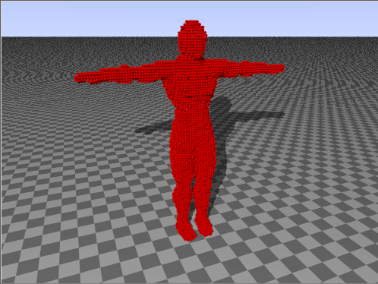
Introduction to the Claytronics Project
Goal: Use large numbers of nano-scale robots to create synthetic reality.
Think the ‘Holodeck’ from Star Trek.
Other people and objects created entirely from nano-scale robots.

Slide 3
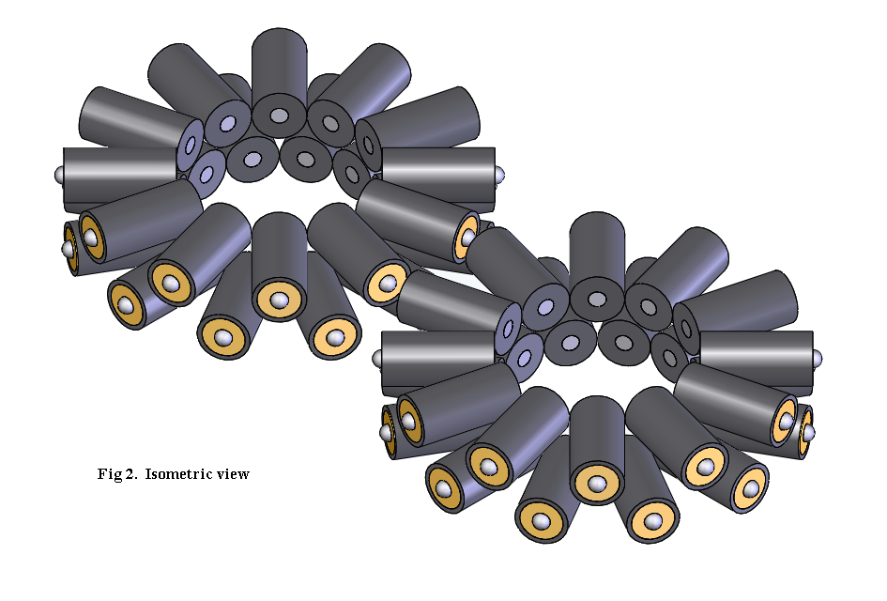
Introduction to the Claytronics Project
Catoms: the robotic substrate of the Claytronics project
Bands of electro-magnets provide locomotion
Infrared sensors allow for communication
Metal contact rings route power throughout ensemble

Slide 4
Introduction to the Claytronics Project
Movements amongst catoms produces movement of macroscopic structure
Like a hologram, but you can touch and interact with it

Slide 5
Introduction to the Claytronics Project
Movements amongst catoms produces movement of macroscopic structure
Like a hologram, but you can touch and interact with it

Slide 6
Introduction to the Claytronics Project
Current State of Claytronics
  2D Physical Prototypes, order of 2” diameter
  Applications written and tested in simulator

Slide 7
Introduction to the Claytronics Project
Project needs expertise in many areas
  Electrical Engineering
    Design and Manufacture of Nano-scale robots
  Physics
    Structural support and movement
  Robots/AI
    Motion planning, collective actuation, grasping
  Software Engineering

Slide 8
Claytronics: Interesting Problems for Software Engineers
Millions of concurrent nodes imply:
  High likelihood of bug discovery
  Necessity of localized algorithms
  Single application for all nodes
  Nodes switching roles
  Node failure is inevitable
Notes:
Interesting Problems in the Areas of
Software Analysis
Programming Languages
Even the logic errors in infrequently used paths will rear their heads eventually
For the most part, algorithms must be localized, including information contained by nodes and communications that they make. These types of algorithms are difficult to design. Often it seems as if one of these algorithms is worth a paper in its own right, and these applications are de-rigour in the Claytronics project?
The next two go together. Because nodes will be dying and moving to different locations, it is likely that they will have to switch roles. A leader of a group one moment becomes a follower later, a mover becomes a support mechanism. The sheer number of nodes means that authors will probably have to write one (or a few) applications to use on every single catom. Therefore, as a by-product nodes will contain code that shouldn’t be executed at any given time.
Failure is inevitable with such a large number of catoms. Absolutely.

Slide 9
Melt: A Claytronics Application
My Task: Program a distributed ‘Melt’ application in the Claytronics simulator
Idea:
  Go from 3D structure to flat plane of catoms
  Bring down catoms safely, don’t drop them
  Do so without global knowledge of locations
  Use C++, the language supported by the simulator

Slide 10
Melt: A Claytronics Application
Idea: Catoms that are the ground find empty spaces…

Slide 11
Melt: A Claytronics Application
Ground-floor catom finds and ‘locks’ a different catom, handing off directions to empty space.
nextMove
Catom: 5
FID: 4

Slide 12
Melt: A Claytronics Application
Message is propagated. Locked catoms form a path.
nextMove
Catom: 8
FID: 3

Slide 13
Melt: A Claytronics Application
Finally, message can no longer propagate…
nextMove
Catom: 1
FID: 6

Slide 14
Melt: A Claytronics Application
And final catom begins to move…
Next Move?

Slide 15
Melt: A Claytronics Application
And finally catom begins to move…
Catom:8
FID: 3

Slide 16
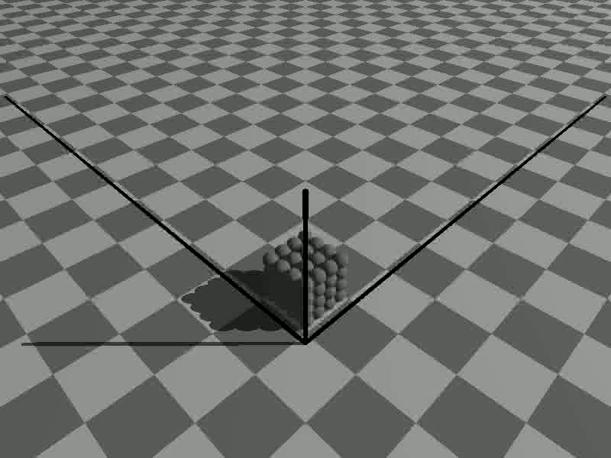
Melt: A Video

Slide 17
From here on…
What I learned
What makes programming applications difficult
What static guarantees might we like to make
How a domain-specific language might help

Slide 18
What makes programming catoms difficult?
Issues common to all distributed systems
Issues specific to Claytronics
Notes:
Certainly there is the design of the algorithms themselves, but we would like to make that the most of our problems.
We would like it so that if one of the robotics students comes up with some great balance algorithm for balancing the entire structure, there is little in the way of implementation difficulties for that student.

Slide 19
What makes programming catoms difficult?
Timing Issues/Race Conditions
Situation: Catoms must make decisions based on local information
  Difficult even with sequentially executing catoms
But we have concurrently executing catoms
  The world can change immensely between decision point and execution point
  Developer is forced to enumerate all possible environment changes
Notes:
In fact, programming an algorithm for Claytronics was fraught with all of the problems that make programming distributed system so difficult, including deadlock, livelock, divergence.

Slide 20
What makes programming catoms difficult?
Timing Issues/Race Conditions
Example:
Void onEmptySpaceReply(Message _msg) {
if(_msg->getEmptySpace() == -1) {
//...
}
else {
int empty_space = _msg->getEmptySpace();
if( hostPointer->getNeighbor(0) != null ) {
send(hostPointer->getNeighbor(0),empty_space);
}
}}
Common to Most Distributed Systems

Slide 21
What makes programming catoms difficult?
Timing Issues/Race Conditions
Example:
Void onEmptySpaceReply(Message _msg) {
if(_msg->getEmptySpace() == -1) {
//...
}
else {
int empty_space = _msg->getEmptySpace();
if( hostPointer->getNeighbor(0) != null ) {
send(hostPointer->getNeighbor(0),empty_space);
}
}}
Common to Most Distributed Systems
Space could become avail. Not a huge issue.

Slide 22
What makes programming catoms difficult?
Timing Issues/Race Conditions
Example:
Void onEmptySpaceReply(Message _msg) {
if(_msg->getEmptySpace() == -1) {
//...
}
else {
int empty_space = _msg->getEmptySpace();
if( hostPointer->getNeighbor(0) != null ) {
send(hostPointer->getNeighbor(0),empty_space);
}
}}
Common to Most Distributed Systems
Space could become occupied. Cause for some concern.

Slide 23
What makes programming catoms difficult?
Timing Issues/Race Conditions
Example:
Void onEmptySpaceReply(Message _msg) {
if(_msg->getEmptySpace() == -1) {
//...
}
else {
int empty_space = _msg->getEmptySpace();
if( hostPointer->getNeighbor(0) != null ) {
send(hostPointer->getNeighbor(0),empty_space);
}
}}
Common to Most Distributed Systems
Neighbor could die, my message will go into the void.
Notes:
Admittedly, these examples are somewhat contrived.
If the simulator method calls had been designed better, send could ‘return false’ if no one was there.
Of course algorithms can be designed to work around these sorts of things, and that’s what you end up doing, each time after exploring the possible list of things that could go wrong.
Regardless, designers do have to enumerate these kinds of things. What’s worse is that a line of code could be fine when it’s first entered (because of the small amount of states that an opposing catom could be in) but then as the application gets more complicated, someone could add in a new state that made a race condition appear.

Slide 24
What makes programming catoms difficult?
Language doesn’t support all styles of design equally
Situation: I desire to program in a mostly reactive, state-based style
  Natural for many types of Claytronics applications
  Helps support the fact that one piece of code must work in different catom situations

Slide 25
What makes programming catoms difficult?
Language doesn’t support all styles of design equally
Examples:
  Floor Catom: Catom on floor
  Sky Catom: Catom waiting for a request to extend
  Path Head: Catom actively extending the path
  Mover: Catom moving down to the ground
  Locked Catom: Member of a path
All respond to different messages, perform different actions

Slide 26
What makes programming catoms difficult?
Language doesn’t support all styles of design equally
Result:
  Jumble of if/else/case statements, nested many layers deep
  To receive messages, I must register message handler methods… Behavior results from code spread amongst several methods
Notes:
Registering message handlers is a common Object Oriented style. However, here this becomes a problem since conceptually I am focused on the states.
The resultant behavior of a catom in any one state is determined by code spread amongst if blocks from several different method (main and message handlers) and seeing how they interact is difficult for the programmer.

Slide 27
What makes programming catoms difficult?
Programming for emergent behavior
Situation: I want a cube to melt but I can only program single catoms to move.
  There is no traceability between the code I am writing and the behavior of the ensemble
  Small code changes have a tremendous effect on the result
Notes:
I don’t remember ever working on a project before where so many different times, one change in one line of code would have such a dramatic impact on the eventual result of the shape of the figure.

Slide 28
What makes programming catoms difficult?
Invalid/Unanticipated States
Situation:
  Catoms have a tendency to arrive at unintended states
  It is difficult to predict multiple paths of execution
  I want to think about one or two catoms at a time, but all catoms affect me
Notes:
When designing a series of communications between two catoms, it is infinitely easier to ignore other catoms, or downplay their effects on the situation.

Slide 29
What makes programming catoms difficult?
Invalid/Unanticipated States
Example:
  In order for all catoms to be brought down to the ground, paths must go in every direction, not just up and down.
Cube of catoms, side-view.

Slide 30
What makes programming catoms difficult?
Invalid/Unanticipated States
Example:
  In order for all catoms to be brought down to the ground, paths must go in every direction, not just up and down.
Cube of catoms, side-view.

Slide 31
What makes programming catoms difficult?
Invalid/Unanticipated States
Example:
  After I implemented this functionality, I had a problem. Often the catoms in the middle of the cube would not come down.
Cube of catoms, top-down view

Slide 32
What makes programming catoms difficult?
Invalid/Unanticipated States
Example:
  Catoms were making paths around the catoms that really needed them, and then getting stuck.
Cube of catoms, top-down view

Slide 33
What makes programming catoms difficult?
Invalid/Unanticipated States
Result:
  Not a hard problem to fix
  Hard problem to find
  Hard problem to anticipate
  A complex set of messages and circumstances can lead to strange situations
  Analyzing the message/state path of any one catom would not show me the problem
Notes:
This is somewhat of a simple/silly example, because with more forethought this particular issue could be seen, but this class of issue seemed to occur with fair frequency.
I chose to preferentially ask catoms above me rather than random selection.
I could have also chosen to let the catoms ‘back off’ of a trail if it was snaking in a non-productive direction.

Slide 34
Static Guarantees?
There are certain properties of our code that it would be very helpful to determine statically
  Any message received by a catom will eventually be handled
  The code you’ve written does indeed correspond to the emergent behavior you desire
  The physical failure of one catom doesn’t cause other catoms wait forever
  Other distributed system properties; no deadlock, livelock, race conditions…
Notes:
Catoms may receive messages while they are in a state where the message doesn’t make any sense. One strategy, instead of responding immediately is to queue up that message, in the knowledge/assumption that you will return to a state that can handle that particular message.

Slide 35
First-Cut Solutions
Model-checking
Existing models and best-practices from embedded/distributed systems community
  Strategies for avoiding/detecting deadlock
Better development tools
  Visual Debugging
  Timelines of catom messages and state transitions
Notes:
For instance, by applying model-checking to our simulation we may be able to detect conditions like the one I just described.
We could say, I want to make sure that by all combinations of these states and executions, all catoms will eventually finish in a state that is on the floor, using catom positions as part of the state space.
There are already certain tricks from the systems and database communities for preventing or dealing with some of the problems that we have discussed.
And to a certain extent, some of these problems could just be solved with better tools.
For instance I mentioned that when catoms arrived in these unknown or unplanned states, it was often difficult to reconstruct the path that they took to get there.
Well you can imagine how some specific debugging tools that provided a nice timeline of events and state transitions we could avoid some of these issues.

Slide 36
Domain-Specific Languages
Mean different things to different people
  Allow programmers to use the basic lingo of the domain (catoms, features, surfaces, holes)
    This approach has a tendency to load the language with lots of very specific constructs
  Close mapping from the thought process to the implementation
Notes:
Fd
In other words, we still want to preserve the features that we have come to expect from a good general purpose language, abstraction, generality, but we want exactly the abstractions that are common to the domain. Allowing the programmer to produce as direct a map as possible from the thought process to the code.
In other words, we would like to make the code look like the design of the application.

Slide 37
Domain-Specific Language
What might a Claytronics DSL look like?
Match programming language with basic style common to domain
  State-based style seems to be commonly used
  Language could allow definitions of states, actions, events and transitions
  Languages exist for this purpose
Notes:
IE, OO, Functional, data-flow, reactive…
This would eliminate the problem where a catom’s behavior at any given moment was defined at many different points throughout the code.

Slide 38
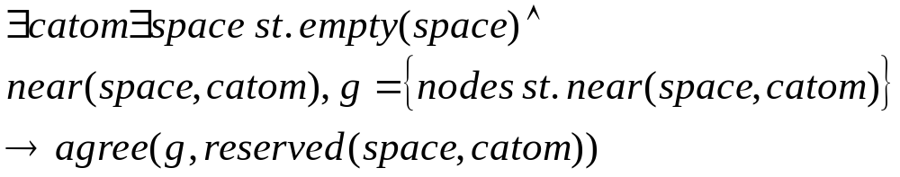
Domain-Specific Language
What might a Claytronics DSL look like?
Define emergent behavior
  Program at the level of importance, the emergent behavior
  Let the compiler handle the rest
  Eg.
Notes:
IE, OO, Functional, data-flow, reactive…
This would eliminate the problem where a catom’s behavior at any given moment was defined at many different points throughout the code.

Slide 39
Domain-Specific Language
What might a Claytronics DSL look like?
Allow for transactions
  Voting and agreement are reoccurring themes
  Help the programmer deal with race conditions
Important Questions
  What can and cannot be ‘rolled-back?’
  Should transactions be local or distributed?
Notes:
IE, OO, Functional, data-flow, reactive…
This would eliminate the problem where a catom’s behavior at any given moment was defined at many different points throughout the code.
The problem of what can be allowed inside a transaction is a funny one. We feel like we must allow communication, because it is elements of the communication process that we would so frequently like to roll back. However, what about movement?

Slide 40
End

