Slide 1
Relentless Parallelism
Nels Beckman
SIGBOVIK 2008

Slide 2
Unless You’ve Been Living in a Cave...

Slide 3
You Know...

Slide 4
You Know...
Serious

Slide 5
You Know...
Serious
Freaking

Slide 6
You Know...
Serious
Freaking
Problem

Slide 7
Coming Soon to a Future Near You

Slide 8
Coming Soon to a Future Near You
Cores!

Slide 9
Coming Soon to a Future Near You
Cores!
Cores!

Slide 10
Coming Soon to a Future Near You
Cores!
Cores!
More Cores!

Slide 11
Downing in Cores!

Slide 12
Downing in Cores!

Slide 13
Downing in Cores!

Slide 14
Some Tasks? Hard to Parallelize

Slide 15
Example
1 womb = 1 baby in 9 months

Slide 16
Example
2 womb != 1 baby in 4.5 months

Slide 17
Example
2 womb != 1 baby in 4.5 months

Slide 18
Example
2 womb != 1 baby in 4.5 months
No

Slide 19
Example
2 womb != 1 baby in 4.5 months
No
Ultra

Slide 20
Example
2 womb != 1 baby in 4.5 months
No
Ultra
Wombs

Slide 21

Example
Huffman Decoding = Human Baby

Slide 22
Example
Huffman Decoding = Human Baby
Variable Length Prefixes

Slide 23
Example
Huffman Decoding = Human Baby
Variable Length Prefixes
Hard to “Divide and Conquer”

Slide 24
Question!!!
How do we utilize those other cores!?!?!?!?!
Huff
Stuff
?
?
?

Slide 25
Answer???
Let’s make it RELENTLESSLY PARALELL!!!!!!
Huff
Stuff
?
?
?

Slide 26
Answer???
Let’s make it RELENTLESSLY PARALELL!!!!!!
Huff
Stuff
?
?
?
RELENTLESS

Slide 27
What is RELENTLESS PARALLISM?
It is definitely real

Slide 28
What is RELENTLESS PARALLISM?
It is definitely real
A series of code rewriting Rules

Slide 29
What is RELENTLESS PARALLISM?
It is definitely real
A series of code rewriting Rules
Based on MATH technology

Slide 30
What is RELENTLESS PARALLISM?
It is definitely real
A series of code rewriting Rules
Based on MATH technology
Keeps your other cores busy

Slide 31
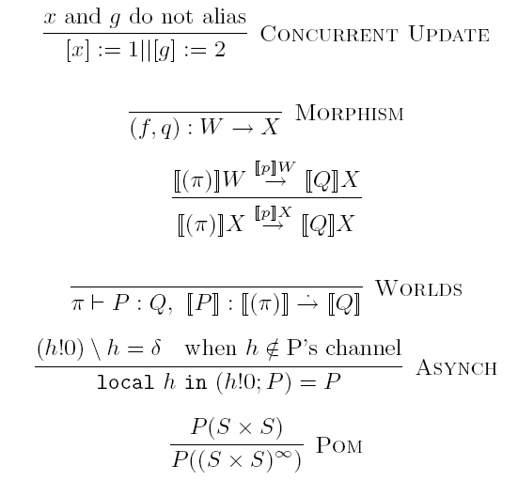
Check out this Math!

Slide 32
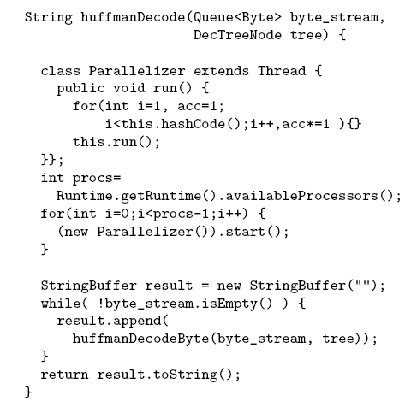

Slide 35
Demo Time

Slide 36
Done

