Slide 1
Component Markets
Developing Applications with COTS Components

Slide 2
Any Questions?

Slide 3
Agenda
High-level overview of CBSD and COTS
Case Study: When it works
Potential Problems
Case Study: When it doesn’t work
How to make it work
  Assessing Components
  Component Qualities
  Cost Estimation

Slide 4
Component-Based Software Development: An Overview
The idea: Let’s make software like integrated circuits! Assemble, don’t build software!
Component: “A piece of software written with reuse in mind that can be deployed with little or no modification.” -- Mancebo
Usually divided into
  Black box components
  White box components
Components have ‘weight’
Notes:
As we will see, these ideas are quite nice in theory, but how well do they work out in practice
Component has many definitions! This is just the one most often applied in COTS projects!
BB V WB
Specifically, people don’t really seem to agree on what the weight of a component is, we can all agree that they are larger levels of abstraction than just objects. Some people think an ORACLE database is a component, and some people don’t.
This definition of component comes from the Mancebo paper, if anyone asks. This definition is mainly just useful for the purposes of this talk, and is not the end-all be all.

Slide 5
CBSD: Promises
A component market will exist
  Bringing economies of scale to the software world
  Reduce development costs and time-to-market
  Increased vendor specialization
  Higher software quality
Standard components used to make custom software
  Thus retaining individual competitive advantage
Notes:
Here are the promises of Component-based applications
We will have the benefits of other industries
The problem with simply buying software and then using it is that it’s inherently a public thing. It’s hard to gain competitive advantage if other organizations can buy the exact same software. With component-based software, the granularity is small enough that custom software can be created using commodity components, thus giving competitive advantage.

Slide 6
Plug-and-play!
My Application
Spread-
sheet
functions

Slide 7
New Roles in the Component Market
Component System Architect
  Ensures different frameworks can cooperate
Component Framework Architect
  Ensures different components can cooperate
Component Developer
  Develops component functionality
Component Assembler
  Assembles applications from components

Slide 8
The Technologies
Components need to communicate
Standards and technologies
  OLE, ActiveX, COM/COM+
  Java Beans, EJB
  CORBA

Slide 9
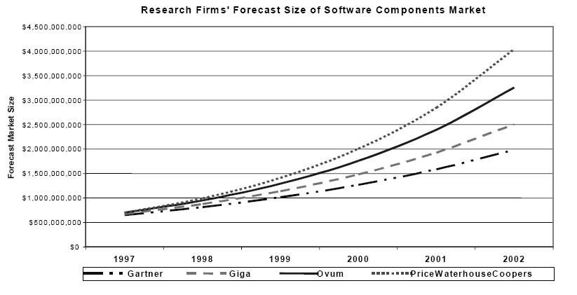
Current State of the Market
Numbers are soft, but it appears the market is on its way up
  Initially, fine-grained GUI components
  Now, more medium and large-grain server components
54% of software projects used purchased code (2000)
Notes:
Source from Yang et. Al which in turn comes from a Standish Group Survey in 2000
We also have various reports from the Gartner group (quoted from SEI tech report)
With 80% probability, 70% of all new applications in the year 2002 be made with some component building blocks. Predicted in 2000.
With 70% probability, 60% of all electronic commerce applications in the year 2000 with be made with component building blocks, Predicted in 1998.

Slide 10
Case Study: When it Works…
Hubble Space Telescope Control Center Software was redone
Goals:
  Use COTS to save money
  Extend life of HST until 2010
Mission-critical software
  High performance requirements
  High security requirements
Notes:
This restructuring began in 1995 and it was the so-called Vision 2000 project to extend the life of the Hubble telescope
It wasn’t easy enough to get the Data to the scientists who needed it
This is the control center software, so the entire mission relies on it. They had a goal of not interrupting ongoing data-collection
VERY Data-Intensive

Slide 11
Case Study: When it Works…
Final Product
  Integration of 30+ COTS/GOTS components with 1M lines of legacy code using .5M lines of glue code
Results
  Replaced 3M lines of source code
  Proof of concept delivered in 3 months
  Live system delivered in 1 year
  Brand new architecture delivers greater functionality
Notes:
The results were very encouraging. Even with the occasional integration problem, they came out ahead in terms of functionality, money and time.
Don’t have numbers to compare this against, so you’ll have to take NASA’s word that this was a very good thing.

Slide 12
CBSD: Perils
Components may provide more or less functionality than is needed
How do you know if a component performs as specified?
  Testing black-box components can be difficult
Components don’t always work with other components or with existing code
The component market fluctuates greatly
  Component lifecycles are short
  No clear, established and trustworthy vendors
Notes:
Why is it hard?
As you read in the paper, for the average component a new version comes out every 10 months, and products go unsupported after an average of 3 versions… what to do after that?
What happens if the company that made your component goes out of business? Putting source code in escrow may be a wise idea.

Slide 13
Case Study: When it Doesn’t…
The Aesop Fable
  An example of large-scale code reuse gone wrong
Summary
  Even when existing components meet our needs, they may not fit well together
Notes:
Theme: even when we can find existing code that purports to solve one of our problems, the different pieces of code may not fit well together, and may not fit with our existing code.

Slide 14
For the Rest of the Lecture…
We’re going to talk about ways to avoid the perils of using commercial software components
This work is research in progress
  Still no ‘perfect’ solution
Specific Techniques
General Guidelines

Slide 15
The Development Process
Component Assessment
Component Tailoring
‘Glue-code’ Development

Slide 16
Principles to Adhere to
Process happens where effort happens
Don’t start with requirements
Avoid premature commitments, but have a plan
Buy information early to reduce risk
Prepare for COTS change
Notes:
You learned these principles in your reading last night, but they are worth mentioning again, as they are particularly suited for the COTS development process
This tells you that the amount of time spent in each phase of development is going to vary widely for different projects.
For instance, in web-based applications, you may spend the majority of the time assessing components, because once you have found appropriate components you may essentially be done.
Whereas, consider ERM software (enterprise resource management). After acquiring this type of software, you will spend almost your entire development cycle in the tailoring phase, tailoring the specific software to your needs
Don’t let all requirements be seen as non-negotiable. You will lose a lot of advantage of using COTS components, the speed with which you can get “good enough” software. In reality you should iterate btwn assessment and req
Eg. The NASA project I mentioned used a 80% rule
Developing COTS is like buying a laptop; there is always something better on the horizon!
Don’t spend assessment effort based on what the cost of the component will be. Spend effort based on the RISK that that component’s selection will expose you to! Use massive testing and prototyping before commitment if component is a risk. Balance this risk with being in the assessment phase for too long.
From reading, component costs $200,000. Its failure cost $3Mil and 8 months.
Prepare for COTS change
Develop relationship with your vendor,
watch the market,
contract for latest versions
Reduce coupling with wrappers and interoperable standards

Slide 17
Formal Component Evaluation
(Lawlins et. Al)
“How do we select amongst many potential components?”
Purchasing a COTS component is an investment
When the investment is significant…
  Analysis should be done, on par with the analysis done for other investments
  Traditionally, this analysis has been done in an ad-hoc manner
Notes:
For an expensive component, formal evaluation is critical and must be on par with formal analysis that a business might do for any investment
(Factories, machinery, training, etc.)
“Anything less only serves to justify a predetermined choice.”
I’m going to show you one particular method here, that may serve as a good framework for component assessment. HOWEVER, keep in mind that this method has flaws that I will come to at the end, and research is somewhat incomplete in these areas.

Slide 18
Formal Component Evaluation
Uses weighted averages
  (you have seen this before!)
Even uses controls. Components are evaluated:
  By the same people
  That have the same configuration
  In the same scenarios
  Using the same data

Slide 19
Formal Component Evaluation
In general, component assessment is divided up into three stages
  Trade Study: A ‘quick and dirty’ filtering of a large number of components
  Hands-on Evaluation: A more thorough analysis of the remaining components
  Final Selection: Selection based on the results of previous stages

Slide 20
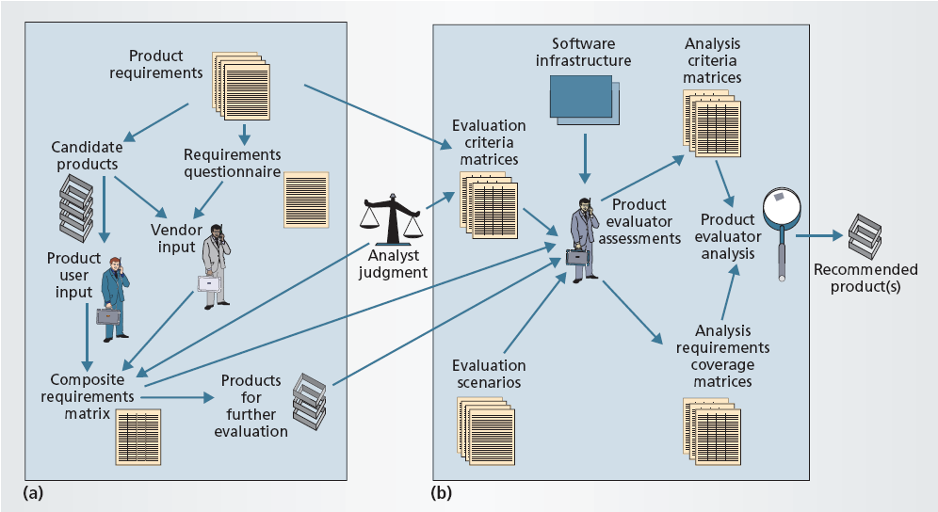
Formal Evaluation Process

Slide 21
Trade Study
Break down your requirements
  These will form the basis for questions on a questionnaire
  Requirements should be of similar granularities
  Send questionnaire to vendors and current users
Component Requirements Matrix
Components receiving half or more the possible points move on
Notes:
1
2
Components that receive less than half of the total points as shown on the components requirements matrix don’t move on
When no COTS move on, this is the time to consider
reviewing your requirements
Developing custom code

Slide 22
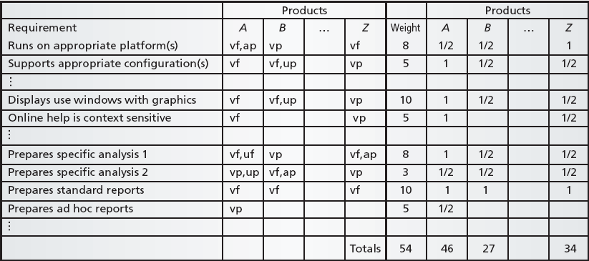
Components Requirements Matrix
Notes:
Weight requirements are based on a 0-10 scale where 10 is better
Based on responses from questionnaires and documentation, give 0, .5, or 1 to each category
0 is not fulfilling requirement
.5 is partial satisfaction
1 is total satisfaction
We then use these measurements to calculate a score

Slide 23
Hands-On Evaluation
You must actually have access to the components
  Necessary if component represents a significant investment
Use components as the basis for tests
  Scenario-Based Tests
  Examining Specific Criteria
Notes:
THIS IS A QUICK SLIDE
GO TO THE NEXT ONE FOR IMAGE
AND EXPLANTION

Slide 24
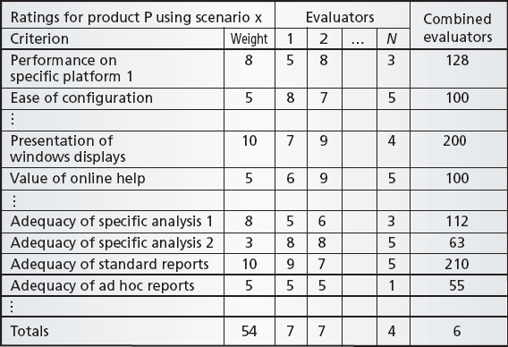
Hands-On Evaluation
Notes:
Involves running scenarios for each requirement.
Basing the results not on the requirements themselves, but on certain criteria regarding those requirements.
Example: In the requirements matrix we might say “provides XML output”
Here we would say “quality of XML output,” and then rate it
As much as possible we want to run through different usage scenarios
This will involve some amount of component tailoring and coding. Enough to run your tests and various scenarios.

Slide 25
Criticism of this Technique
This technique is primarily requirements-driven
  Tends to select “best-in-breed” components
  Should be tailored to reflect internal requirements
Assumes clean division of requirements
Full assessment not always cost effective
Notes:
As mentioned in the Boehm paper this type of selection process tends to select the best possible component in every single category. This ignores the problems of architectural mismatch, since components aren’t selected to work together.
In order to make this system work better, you may be able to add additional in-house requirements, such as “Works with the .NET platform” or “Doesn’t assume it has primary loop control.
This technique also seems to assume that your requirements break up nicely over each component. When in reality requirements will often be satisfied by several different components.
This technique encourages you to find every single component that might work. Also creating questionnaires and contacting previous users may be a significant amount of work, and should be done when the risk represented by the component reflects this need.

Slide 26
Component Selection: Revised
The previous technique selecting components was fundamentally requirements-based
Now you will see a technique for selecting components that is architecture based
Goal:
  Avoid the problems encountered in “Architectural Mismatch”

Slide 27
Architecture-Based COTS Selection
When using COTS, you accept their architectural restrictions
Component selection and architecture definition are intertwined
The following method treats them as such
Here we’ll use a simple case study to exemplify the points
  Case study come from Mancebo2005
Notes:
As we have seen in architectural mismatch, when you are using COTS-based components, you accept their implicit architectural restrictions
In this sense, it makes sense to think of the selection of COTS components and the architectural definition of your system as being intertwined activities
Here is a method for treating component selection as such

Slide 28
Architecture-Based COTS Selection
4 step, iterative process
Here we will select components for a multimedia presentation application
Think “Powerpoint 3D”
Choose
Architectural
Decisions
Model
Component
Market
List
Implementation
Approaches
Choose Best
Implementation
Approach

Slide 29
Architecture-Based COTS Selection
Possible architectures are modeled as a decisions space
Examples:
  Should graphics object know how to render themselves (KAD_{1a}), or should they be decoupled from rendering (KAD_{1b})?
  Should objects keep track of time individually (KAD_{2a}), or should their be master synchronization object (KAD_{2b})?
  Should presentations be stored in XML format (KAD_{3a}) or as serialized objects (KAD_{3b}) ?
Choose
Architectural
Decisions
Model
Component
Market
List
Implementation
Approaches
Choose Best
Implementation
Approach
Notes:
These architectural decisions are orthogonal at this point.

Slide 30
Architecture-Based COTS Selection
Perform analysis of available components
Create matrices reflecting the assumptions a capabilities of components
  Requirements fulfillment
  Component dependency
  Architectural Assumptions
Choose
Architectural
Decisions
Model
Component
Market
List
Implementation
Approaches
Choose Best
Implementation
Approach

Slide 31
Requirements Fulfillment
 | Ogre | DirectX | OpenGL | OpenAL | OGLFT | QT
Scene Mgmt. | X
Graphics API |  | X | X
Audio |  | X |  | X
3d Text |  | X |  |  | X
GUI Widgets |  |  |  |  |  | X
Notes:
This is the requirements fulfillment matrix
The X axis is the potential components that I would consider using
The Y axis lists my requirements
An X represents that that particular component fulfils a particular requirement
(Note that this are not what one would normally consider COTS components, rather you would probably call these APIs. However, this is just a function of the example I am using. The same method still applies.)

Slide 32
Component Dependency &
Architectural Assumptions
 | Graphics API | MFC | OpenGL
Ogre | X
DirectX |  | X
OGLFT |  |  | X
GLTT |  |  | X
 | Ogre | DirectX
KAD₁ | 1a
KAD₃
KAD₂
Notes:
On the left:
This is the component dependency matrix.
The Y axis is our potential components
The X axis is things on which those components depend.
On the right:
This is our architectural assumptions matrix.
Ogre assumes decision 1a, which if you remember is that graphics objects must know how to render themselves.
As is turns out, of our original architectural decisions, only one is constrained by one component. So we can eliminate decisions 2 and 3 from our matrix. This is a good thing. Usually what will happen is that in examining potential components on the market, we will find new architectural decisions that we must choose between. This is why this process must be iterated.

Slide 33

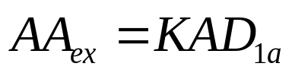

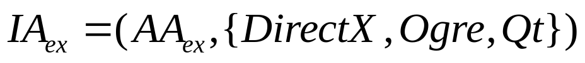
Architecture-Based COTS Selection
To determine the feasible selections:
Enumerate the architectural approaches
  Of the form:
  Example:
Enumerate implementation approaches
  Of the form:
  Example:
Choose
Architectural
Decisions
Model
Component
Market
List
Implementation
Approaches
Choose Best
Implementation
Approach

Slide 34
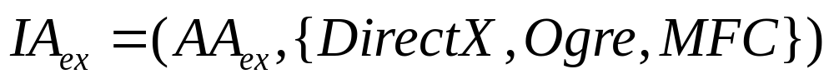
Architecture-Based COTS Selection
Choose
Architectural
Decisions
Under the constraints that this set of components:
Covers all rows in the requirements matrix
Satisfies all component dependencies
Is consistent with Architectural Approach
Model
Component
Market
List
Implementation
Approaches
Choose Best
Implementation
Approach

Slide 35
Architecture-Based COTS Selection
After all of this, you’ll come up with several feasible permutations.
These permutations are evaluated on the basis of Architecture and Implementation together.
Example:
  Portability is a high priority so you lean towards implementations that don’t require DirectX or MFC.
Choose
Architectural
Decisions
Model
Component
Market
List
Implementation
Approaches
Choose Best
Implementation
Approach

Slide 36
Component Quality
Quality Characteristics
  Dimensions of software quality
Quality Attributes
  Specific information about components that will help you determine the characteristics
Here we will cover Characteristics and Attributes specific to COTS components
Notes:
We’re going to cover the so-called “ilities” here
In particular, we are going to cover new ilities appropriate to COTS software or changes in old ilities
We will also give you specific ideas of which properties of a specific pieces of software can be used to measure those ilities

Slide 37
Where does this come from?
ISO 9126 defines Quality Characteristics
This is a proposed modification to the specification
Modified to recognized specifically what defines quality in COTS components

Slide 38
Reliability: Maturity
We would like to use stable components.
Maturity can be measured in:
  Volatility: The mean time between versions
  Evolve-ability: The number of versions
  Failure Removal: The bugs fixed in the current component
Notes:
Maturity is a characteristic of components, they have it or they don’t. These are attributes that can be used to measure maturity
It’s important to know the mean time between component versions because this will give you an indication of the average product lifecycle. Remember that products often go unsupported after several versions of the software.
The number of versions existing in the past may give you more information about a component’s lifecycle. This is also how much has the component changed since its inception. Architecture problems if it’s very different?
You can decide for yourself if more bugs removed is better or worse. The authors tend to believe worse.

Slide 39
Usability: Learn-ability
Note the difference in perspective here
  Developer’s not end-user’s usability
Can be measured with
  Time to use
  Time to configure
  Time to admin
  Time to master
Notes:
The change in usability is to reflect the fact that now developers are using the cots components.
These measurements are based on the time it would take for an average technical staff member to…
These attributed might initially be estimated by component vendor or previous users
Measured in:
The average time it takes a developer to learn how to correctly use a component
The time it takes an average developer to learn how to configure the component and to understand the configuration parameters
The time it takes to learn how to properly administer the component
The average time needed to become an expert. To learn all the various possibilities offered by that component.

Slide 40
Usability: Understand-ability
Closely related to Learn-ability
Can be measured in the quality of:
  Human-readable documentation
  Help System
  Machine-readable documentation
  Training Provided
  Demo-ed functionality
Notes:
Understandability is a characteristic that is closely tied to Leanabilitly.
The ways it can be measured are by judging the various tools given to us by the component reseller. (Essentially they say that you can’t learn a component until you understand a component.) Well these are the tools given to us to help us learn the component.
This is a an analysis of the overall quality of the component’s human-readable documentation. Things like README’s and just standard documentation
The help system metric is similar to documentation, but this is more of the quality of the automated, online help. Again, this is a subjective measurement.
Components may often come with machine readable documentation. This are things like XML files that contain information about how a component can be used or what its interfaces are, things of that nature.
Some companies may offer component training.
What percentage of the component’s functionality has actually been demoed. Important because what is demoed usually tends to reflect the highest quality functions.

Slide 41
Maintain-ability: Change-ability
Different from the traditional idea of maintain-ability
Can be measured in:
  Customizability: Number of customizable parameters
  Customizability Ratio: Parameters / Interfaces
  Change Control Capability: Difficulty of identifying component versions
Notes:
Normally when we think of maintainability, we are often describing the source code of an application. “How easy or difficult is it to maintain the source code..”
But here we’re actually talking about maintainability from a black-box perspective; the component still must be maintained. Here are two examples of sub-characteristics of maintainability.
Change-ability: This is not how easy or hard it is to modify component behavior, but rather how MUCH can it be modified. This corresponds to what you saw in Barry Boehm’s paper as Tailoring
Attributes are:
How many different parameters of the component are customizable?
This ratio may give you a sense of the difficulty of customization. A component with many parameters but few interfaces may be difficult to customize
How easily can a user identify the fact that he has several customized versions of the same component?

Slide 42
Maintain-ability: Testability
Can the proper functionality of this component be tested easily?
Can be measured in:
  POST: Does component perform environment test?
  Test suite: Is a test suite provided?
  Testable interfaces: Do interfaces allow for easy testing?
Notes:
Here we talk about how easy or difficult it is to test a component. VERY important because you likely will not have source code access, and because you won’t have full confidence most times in the quality of code. Also, these are all black-box tests that we’re talking about here, so it’s important to be able to have adequate test coverage “from the outside”
The power-on self test, provided in some components, is a nice thing to have. This gives you some basic idea of whether a component is happy in the environment in which it is operating
Does the component come with a test suite from the vendor that might help you verify proper functionality?
This one I added myself. Do the interfaces themselves allow for easy testing? As an example, does the component have to be in a fully integrated system before it will give any output? Or will it allow me to exercise certain functionality as a standalone component (In order to test my tailoring for instance.)

Slide 43
Cost Estimation
Most of you are familiar with COCOMO
COCOTS is an extension to COCOMO for COTS-based projects
Four sources of cost (In order of cost):
  Glue-Code Development
  Tailoring
  Volatility
  Assessment
Notes:
I have saved this part until the end, knowing that it would be unlikely that I would get to it.
However, it turns out to be somewhat interesting, and I would encourage you to go learn more about it if you are involved with COTS-based development
COCOTS is research in progress. This means two things
The model is probably not completely calibrated. More projects need to be examined.
COCOTS currently models only integration costs, meaning up-front costs.
In reality, COTS-based development changes cost structure all throughout the development cycle (maintenance particularly)
Sources (What they are / why the cost):
Work necessary to prepare a component to run in YOUR system / Writing glue code is constrained. Difficulties in assessment often don’t show up until the Glue Code phase, often requiring backtracking.
Work necessary to prepare a component to run in any system / This tends to follow a fairly standard process outlined by the vendor.
Costs associated with the component market itself / ?
The process by which COTS are selected / Doesn’t tend to cost that much, however successful projects do not shortchange this phase

Slide 44
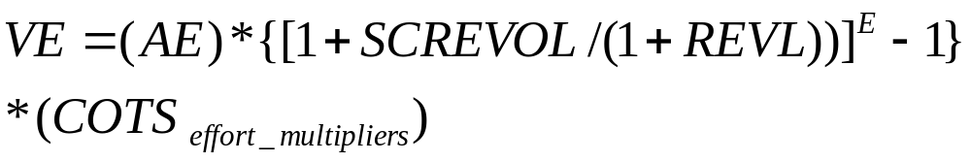
COCOTS
Assessment
Glue Code
Tailoring
Volatility
Notes:
Here the components are grouped into classes: GUI components, databases, etc.
This is similar to what you have seen in COCOMO, but with different effort multipliers. Unfortunately assumes the ability to effectively predict the size of the glue code needed, including glue code necessitated by component volatility: hard to do!
Eg of multipliers: Integrator’s experience with product. Supplied training and documentation.
Note, tailoring effort for a class is qualified by the complexity of the tailoring associated with that class
These are costs associated with the reworking of your application that occurs because of swapping COTS with newer versions. Over long periods of maintenance, these costs may dominate. It also includes costs due to requirements evolution.
LEGEND
A-scaling constant
CREVOL- percentage of glue code due to requirements change & product volatility
B-Architectural scaling factor
E-More scaling factors
SCREVOL-percentage of rework due to requirements & product volatility
REVL-percentage of rework in system due to normal project factors

Slide 45
Unknowns
Pricing model?
  Pay-per-use? Licensing fees? One time cost?
Legal issues?
  Who holds liability?
Current Processes and Metrics are insufficient

Slide 46
Any Questions?

Slide 47
References
Abts, C. Boehm, B. Clark, E.B. “COCOTS: A COTS Software Integration Lifecycle Cost Model - Model Overview and Preliminary Data Collection Findings.” USC CSE Technical Report ,USC-CSE-2000-501.
L. Bass, C. Buhman, S. Comella-Dorda, F. Long, J. Robert, R. Seacord, and K. Wallnau, “Volume I: Market Assessment of Component-Based Software Engineering,” Software Engineering Institute, Technical Note CMU/SEI-2001-TN-007, May, 2000 2001.
Bertoa, M. and Vallecillo, A. Quality Attributes for COTS Components. In Proceedings of QAOOSE02, the 6th International Workshop on Quantitative Approaches in Object-Oriented Software Engineering (Malaga, Spain, 2002).
David Garlan, Robert Allen, and John Ockerbloom. Architectural Mismatch or Why it’s hard to build systems out of existing parts. In Proceedings of the Seventeenth International Conference on Software Engineering, Seattle WA, April 1995.
Lawlis, P.K. Mark, K.E. Thomas, D.A. Courtheyn, T., “A formal process for evaluating COTS software products,” Computer, vol.34, no.5 pp.58-63, May 2001.
Mancebo, E. and Andrews, A. 2005. A strategy for selecting multiple components. In Proceedings of the 2005 ACM Symposium on Applied Computing (Santa Fe, New Mexico, March 13 - 17, 2005). L. M. Leibrock, Ed. SAC '05. ACM Press, New York, NY, 1505-1510.
Pfarr, T. and Reis, J. E. 2002. The Integration of COTS/GOTS within NASA's HST Command and Control System. In Proceedings of the First international Conference on Cots-Based Software Systems (February 04 - 06, 2002). J. C. Dean and A. Gravel, Eds. Lecture Notes In Computer Science, vol. 2255. Springer-Verlag, London, 209-221.
Vitharana, P. 2003. Risks and challenges of component-based software development. Commun. ACM 46, 8 (Aug. 2003), 67-72.
Y. Yang, J. Bhuta, B. Boehm, and D.N. Port. “Value-Based Processes for COTS-Based Applications.” IEEE Software Vol 22 No. 4, pp. 54-62. July 2005.

