Slide 1
Formal Methods in the Real World
Nels Beckman

Slide 2
Me, My Background, This Talk
Nels Beckman!
  PhD student in software engineering
  Advisor: Jonathan Aldrich
  Primary Research Interests: Atomic sections/transactional memory, type systems, concurrency
  Secondary Research Interests: Verification, static analysis, general software engineering
  WEH 8102, always ready for a good discussion

Slide 3
Me, My Background, This Talk
Worked for Microsoft Research
  Internship MSR India, in Bangalore
  Rigorous Software Engineering
    Aditya Nori & Sriram Rajamani
  Yogi Project
    Combines test generation and software model checking
    The next version of SDV

Slide 4
Me, My Background, This Talk
Other Formal Methods in the Real World
  Hardware
    Model-checking has had great success here
  Life-critical software systems
    Arguably the most important usage of formal methods
    Often required by oversight bodies

Slide 5
Me, My Background, This Talk
What I will talk about
  Formal methods for more common software projects
  Tactical applications of formal methods
  Tools you can download and use immediately
    Microsoft-centric…
  (Formal methods within my own area of understanding!)

Slide 6
The Outline
CEGAR-Style Software Model-Checking
  Technical overview
  MS Static Driver Verifier*
  The Future: Automated Unit Test Generation
The SAL Annotation Language
  Description of the Language
  PREFast and Microsoft*
  The Future: Design-by-contract with Spec#*

Slide 7
CEGAR: A Technical Overview
You read about BLAST
  An instance of CEGAR-style software model checking
  We’ll talk about
    How CEGAR works
    How CEGAR has been used at Microsoft

Slide 8
Standard CEGAR Model-Checking
Process:
void foo(int y) {
1: do {
2: lock();
3: int x = y;
4: if( * ) {
5: unlock();
6: y = y+1;
}
7: } while( x != y );
8: unlock();
}
Notes:
There’s a lot of background necessary in order to understand our contribution. On this section I may go through things a bit quickly. Slow me down if you have any questions or don’t understand this process.
1.) Start with simple program abstraction (CFG).

Slide 9
Standard CEGAR Model-Checking
0
Process:
1
void foo(int y) {
1: do {
2: lock();
3: int x = y;
4: if( * ) {
5: unlock();
6: y = y+1;
}
7: } while( x != y );
8: unlock();
}
2
7
3
5
8
4
6
9
Notes:
1.) Start with simple program abstraction (CFG). Each region has a predicate, which starts out as true. For each group of assignments, there is a corresponding edge, and for each conditional and its inverse, there is also a corresponding edge.
Here region 9 represents the error region, which is reached if the unlock() on line 8 is reached when we are already locked.
2.) Step 2 is finding an error trace. We can do breadth or depth first search on this graph from the initial region to the error region and we have an error trace.

Slide 10
Standard CEGAR Model-Checking
0
Process:
1
2: lock_0 = True ^
3: x_0 = y_0 ^
4:
5:
6:
7: x_0 = y_0 ^
8: lock_0 = False
2
7
3
5
8
4
6
9
Notes:
3.) Now we determine if the error trace is actually feasible by solving for the strongest post-condition of the error trace.
How do we do that? Well each step of the computation creates a predicate, and the resulting path is like the conjunction of those predicates.

Slide 11
Standard CEGAR Model-Checking
0
Process:
1
2: lock_0 = True ^
3: x_0 = y_0 ^
4:
5:
6:
7: x_0 = y_0 ^
8: lock_0 = False
2
7
Sat Solver
3
5
8
4
6
9
Notes:
3.) Now we determine if the error trace is actually feasible by solving for the strongest post-condition of the error trace.
How do we do that? Well each step of the computation creates a predicate, and the resulting path is like the conjunction of those predicates.
4.) The last step in the algorithm is to introduce a “refinement predicate” AT EACH POINT IN THE TRACE. This means for steps 0-4, 7-9 we remove the existing region, introduce a new region with a predicate and another region with its negation and try the whole thing over again. This predicate called the Craig interpolant is created as a side-effect of the theorem prover, and I won’t explain how it works. Eventually, if the error is not reachable, all states that can reach it will be disconnected from the graph.

Slide 12
Standard CEGAR Model-Checking
0
Process:
1:P1
1:!P1
2:P2
2:!P2
7:P7
7:!P7
3:P3
3:!P3
5
8:P8
8:!P8
4:P4
4:!P4
6
9
Notes:
4.) The last step in the algorithm is to introduce a “refinement predicate” AT EACH POINT IN THE TRACE. This means for steps 0-4, 7-9 we remove the existing region, introduce a new region with a predicate and another region with its negation and try the whole thing over again. This predicate called the Craig interpolant is created as a side-effect of the theorem prover, and I won’t explain how it works. Eventually, if the error is not reachable, all states that can reach it will be disconnected from the graph.

Slide 13
Standard CEGAR Model-Checking
0
Process:
1:P1
1:!P1
X = Y
X = Y
2:P2
2:!P2
7:P7
7:!P7
7:!P7
3:P3
3:!P3
5
8:P8
8:!P8
4:P4
4:!P4
6
9
Notes:
4.) The last step in the algorithm is to introduce a “refinement predicate” AT EACH POINT IN THE TRACE. This means for steps 0-4, 7-9 we remove the existing region, introduce a new region with a predicate and another region with its negation and try the whole thing over again. This predicate called the Craig interpolant is created as a side-effect of the theorem prover, and I won’t explain how it works. Eventually, if the error is not reachable, all states that can reach it will be disconnected from the graph.

Slide 14
Standard CEGAR Model-Checking
0
Process:
1:P1
1:!P1
X = Y
X = Y
2:P2
2:!P2
7:P7
7:!P7
7:!P7
3:P3
3:!P3
5
8:P8
8:!P8
4:P4
4:!P4
6
9
Notes:
4.) The last step in the algorithm is to introduce a “refinement predicate” AT EACH POINT IN THE TRACE. This means for steps 0-4, 7-9 we remove the existing region, introduce a new region with a predicate and another region with its negation and try the whole thing over again. This predicate called the Craig interpolant is created as a side-effect of the theorem prover, and I won’t explain how it works. Eventually, if the error is not reachable, all states that can reach it will be disconnected from the graph.

Slide 15
Microsoft’s SDV
Underlying Technology
  CEGAR
Available with Windows Driver Kit (WDK)

Slide 16
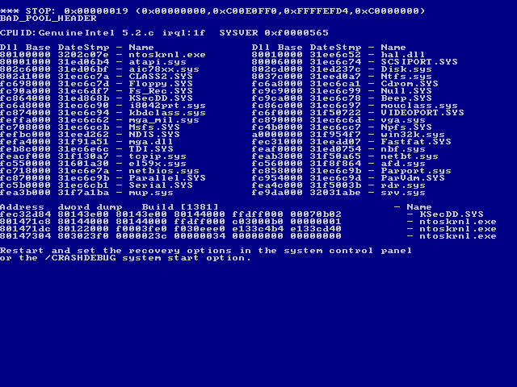
SDV Motivation
Microsoft gets blamed for failure of drivers
Notes:
The truth is, due to the underlying methodology for windows driver implementations, microsoft’s own code is technically not responsible for a lot of the blue screens that you receive. It’s John Q Programmer working for one of the hundreds of hardware companies out there who wants to have windows compatible driver.

Slide 17
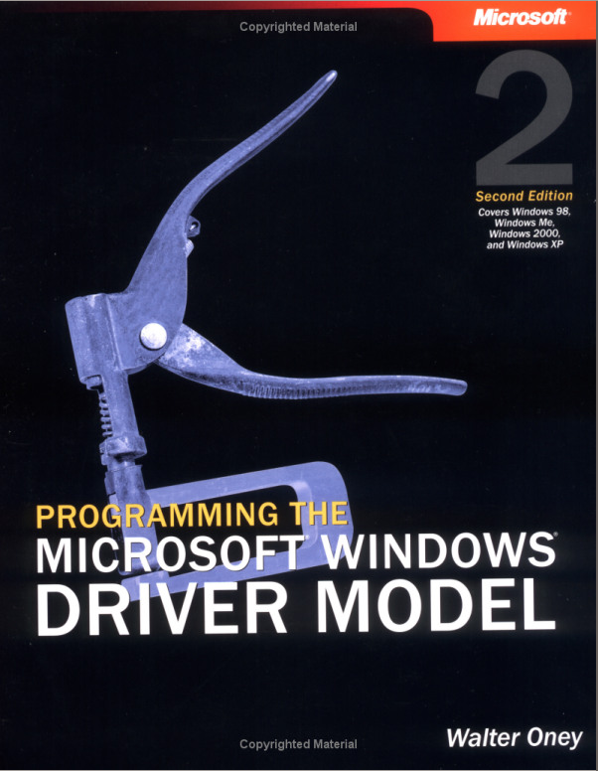
What’s the Difficulty?
The Windows Driver Model (WDM) specifies hundreds of rules
  These must be obeyed…
  Hard to test for all of them…

Slide 18
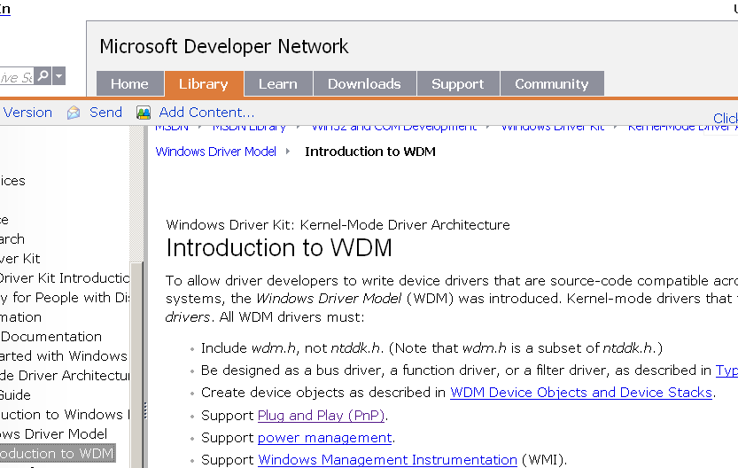
Sample Rules

Slide 19
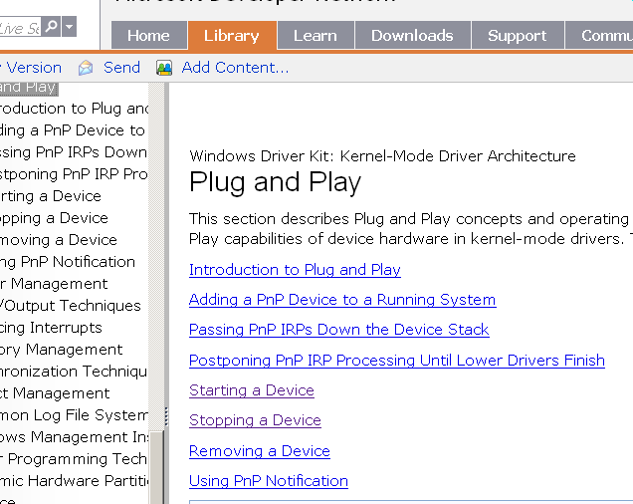
Sample Rules

Slide 20
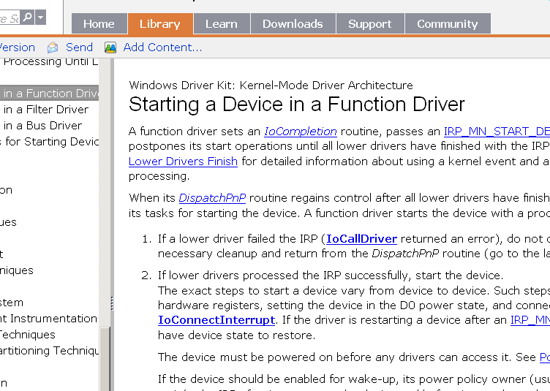
Sample Rules

Slide 21
Sample Rules
If a lower driver failed the IRP (IoCallDriver returned an error), do not continue processing the IRP. Do any necessary cleanup and return from the DispatchPnP routine (go to the last step in this list).
…If the device should be enabled for wake-up, its power policy owner (usually the function driver) should send a wait/wake IRP after it powers up the device and before it completes the IRP_MN_START_DEVICE request. For details, see Sending a Wait/Wake IRP.
Clear the driver-defined HOLD_NEW_REQUESTS flag and start the IRPs in the IRP-holding queue. Drivers should do this when starting a device for the first time and when restarting a device after a query-stop or stop IRP. See Holding Incoming IRPs When A Device Is Paused for more information.
Complete the IRP.The function driver's IoCompletion routine returned STATUS_MORE_PROCESSING_REQUIRED, as described in Postponing PnP IRP Processing Until Lower Drivers Finish, so the function driver's DispatchPnP routine must call IoCompleteRequest to resume I/O completion processing.
If the function driver's start operations were successful, the driver sets Irp->IoStatus.Status to STATUS_SUCCESS, calls IoCompleteRequest with a priority boost of IO_NO_INCREMENT, and returns STATUS_SUCCESS from its DispatchPnP routine.
If the function driver encounters an error during its start operations, the driver sets an error status in the IRP, calls IoCompleteRequest with IO_NO_INCREMENT, and returns the error from its DispatchPnP routine.
If a lower driver failed the IRP (IoCallDriver returned an error), the function driver calls IoCompleteRequest with IO_NO_INCREMENT and returns the IoCallDriver error from its DispatchPnP routine. The function driver does not set Irp->IoStatus.Status in this case because the status has already been set by the lower driver that failed the IRP.

Slide 22
Software Model-Checking to the Rescue!
SDV encodes many of these rules
  Encoded as error states
  Checks driver compliance automatically, at compile-time!

Slide 23
SDV Checks Actual Rules
E.g.
  PnpSurpriseRemove:
    The PnpSurpriseRemove rule requires that the driver does not call IoDeleteDevice or IoDetachDevice while processing an IRP_MN_SUPRISE_REMOVAL request.
    If the driver calls IoDeleteDevice or IoDetachDevice while processing an IRP_MN_SUPRISE_REMOVAL request, it violates the rule.

Slide 24
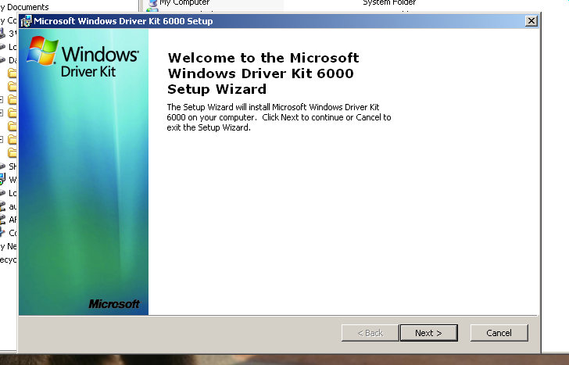
SDV Demo

Slide 25
SDV Results
SDV used on Windows Vista kernel mode drivers
  Found & fixed bugs
SDV used on sample drivers from WDK
  Found bugs that devs would copy & paste
Learn more!
  Download the WDK from Microsoft Connect (2.5GB! ☹)
  Come borrow the DVD from me

Slide 26
The Outline
CEGAR-Style Software Model-Checking
  Technical overview
  MS Static Driver Verifier*
  The Future: Automated Unit Test Generation
The SAL Annotation Language
  Description of the Language
  PREFast and Microsoft*
  The Future: Design-by-contract with Spec#*

Slide 27
Automated Test Generation?
Note...
  During model-checking, SDV uses a SAT-solver to see if a path is feasible
    SAT solver gives us a yes-no answer
    Can also give satisfying assignment
  How can we use this?
    A test case!
  Big area of research interest

Slide 28
CUTE Example
typedef struct cell {
int v; struct cell *next;
} cell;
int testme(cell *p, int x) {
if( x > 0 )
if( p != NULL )
if( 2*x + 1 == p->v )
if( p->next == p )
assert(false);
return 0;
}
Sen, K., Marinov, D., and Agha, G. 2005. CUTE: a concolic unit testing engine for C. FSE-2005

Slide 29
CUTE Example
typedef struct cell {
int v; struct cell *next;
} cell;
int testme(cell *p, int x) {
if( x > 0 )
if( p != NULL )
if( 2*x + 1 == p->v )
if( p->next == p )
assert(false);
return 0;
}
First, p = NULL and x = 0

Slide 30
CUTE Example
typedef struct cell {
int v; struct cell *next;
} cell;
int testme(cell *p, int x) {
if( x > 0 )
if( p != NULL )
if( 2*x + 1 == p->v )
if( p->next == p )
assert(false);
return 0;
}
First, p = NULL and x = 0.
Gives us PP:
(x <= 0)
Negate and give to SS:
(x > 0)

Slide 31
CUTE Example
typedef struct cell {
int v; struct cell *next;
} cell;
int testme(cell *p, int x) {
if( x > 0 )
if( p != NULL )
if( 2*x + 1 == p->v )
if( p->next == p )
assert(false);
return 0;
}
Now, p = NULL and x = 43.

Slide 32
CUTE Example
typedef struct cell {
int v; struct cell *next;
} cell;
int testme(cell *p, int x) {
if( x > 0 )
if( p != NULL )
if( 2*x + 1 == p->v )
if( p->next == p )
assert(false);
return 0;
}
Now, p = NULL and x = 43.
Gives us PP:
(x > 0) ^ (p = NULL)
Negate and give to SS:
(x > 0) ^ (p != NULL)

Slide 33
CUTE Example
typedef struct cell {
int v; struct cell *next;
} cell;
int testme(cell *p, int x) {
if( x > 0 )
if( p != NULL )
if( 2*x + 1 == p->v )
if( p->next == p )
assert(false);
return 0;
}
Now, x = 43, p = malloc(..), p->v = 0, p->next=NULL

Slide 34
CUTE Example
typedef struct cell {
int v; struct cell *next;
} cell;
int testme(cell *p, int x) {
if( x > 0 )
if( p != NULL )
if( 2*x + 1 == p->v )
if( p->next == p )
assert(false);
return 0;
}
Now, x = 43, p = malloc(..), p->v = 0, p->next=NULL
Gives us PP:
(x > 0) ^ (p != NULL) ^
(2*x + 1 != p->v)

Slide 35
CUTE Example
typedef struct cell {
int v; struct cell *next;
} cell;
int testme(cell *p, int x) {
if( x > 0 )
if( p != NULL )
if( 2*x + 1 == p->v )
if( p->next == p )
assert(false);
return 0;
}
Give to SS:
(x <= 0) ^ (p != NULL) ^
(2*x + 1 = p->v)

Slide 36
CUTE Example
typedef struct cell {
int v; struct cell *next;
} cell;
int testme(cell *p, int x) {
if( x > 0 )
if( p != NULL )
if( 2*x + 1 == p->v )
if( p->next == p )
assert(false);
return 0;
}
Now, x = 43, p = malloc(..), p->v = 87, p->next=NULL

Slide 37
CUTE Example
typedef struct cell {
int v; struct cell *next;
} cell;
int testme(cell *p, int x) {
if( x > 0 )
if( p != NULL )
if( 2*x + 1 == p->v )
if( p->next == p )
assert(false);
return 0;
}
Now, x = 43, p = malloc(..), p->v = 87, p->next=NULL
Gives us PP:
(x > 0) ^ (p != NULL) ^
(2*x + 1 = p->v) ^
(p->next != p)

Slide 38
CUTE Example
typedef struct cell {
int v; struct cell *next;
} cell;
int testme(cell *p, int x) {
if( x > 0 )
if( p != NULL )
if( 2*x + 1 == p->v )
if( p->next == p )
assert(false);
return 0;
}
Give to SS:
(x > 0) ^ (p != NULL) ^
(2*x + 1 = p->v) ^
(p->next = p)

Slide 39
CUTE Example
typedef struct cell {
int v; struct cell *next;
} cell;
int testme(cell *p, int x) {
if( x > 0 )
if( p != NULL )
if( 2*x + 1 == p->v )
if( p->next == p )
assert(false);
return 0;
}
Result:
x = 43, p = malloc(..), p->v = 87, p->next = p

Slide 40
The Outline
CEGAR-Style Software Model-Checking
  Technical overview
  MS Static Driver Verifier*
  The Future: Automated Unit Test Generation
The SAL Annotation Language
  Description of the Language
  PREFast and Microsoft*
  The Future: Design-by-contract with Spec#*

Slide 41
Quality Assurance at Microsoft
Originally: Manual Review
  Too many paths to consider as systems grew…
Later: Massive Testing
  Tests take weeks to run
  Inefficient detection of common patterns
    Non-local, intermittent, uncommon path bugs
  Vista release was full of problems
Now: Add Static Analysis
  Weeks of global analysis
  Local analysis on every check-in
  Lightweight specifications
  Huge impact
    7000+ bugs reported in June 2005
    Check-in gate eliminates large classes of bugs from codebase
Slides used with permission. Manuvir Das by way of Jonathan Aldrich

Slide 42
Microsoft’s SAL
A language for specifying contracts between functions
  Intended to be lightweight and practical
  More powerful—but less practical—contracts supported in systems with full theorem-provers.
Preconditions
  Conditions that hold on entry to a function
  What a function expects of its callers
Postconditions
  Conditions that hold on exiting a function
  What a function promises to its callers
Initial focus: memory usage
  buffer sizes, null pointers, memory allocation…
Lightweight analysis tool
  Only finds bugs within a single procedure
  Also checks SAL annotations for consistency with code
Slides used with permission. Manuvir Das by way of Jonathan Aldrich

Slide 43
Buffer/Pointer Annotations
ValidElements=“len”
  The function reads from the buffer. The number of elements in this buffer is given by the variable “len.”
WriteableElements=“len”
  The function writes to the buffer. The function will initialize the buffer and its size will be specified by the variable len.
ValidBytesLength=“bytes”
  Same as ValidElements, but the buffer will be “bytes” bytes long.
WritableBytesLength=“bytes”
  Same as WritableElements, but the buffer will be “bytes” bytes long.
Null=Yes/No
  This parameter can be NULL.
Slides used with permission. Manuvir Das by way of Jonathan Aldrich

Slide 44
Combine Properties with Pre and Post
E.g.,
void initBuffer( [Pre(WritableElements=“len”)] char* buf, int len );
[returnvalue:Post(Null=No)] char* bufferMaker();

Slide 45
PREfast: Immediate Checks
Library function usage
  deprecated functions
    e.g. gets() vulnerable to buffer overruns
  correct use of printf
    e.g. does the format string match the parameter types?
  result types
    e.g. using macros to test HRESULTs
Coding errors
  = instead of == inside an if statement
Local memory errors
  Assuming malloc returns non-zero
  Array out of bounds
Slides used with permission. Manuvir Das by way of Jonathan Aldrich

Slide 46
Other Useful Annotations
MustCheck = Yes/No
[Pre(Tainted=Yes)]
[Pre(Tainted=No)]
[Post(Tainted=No)]
Must callers check the return value?
This argument is tainted and cannot be trusted without validation.
This argument is not tainted and can be trusted
Same as above, but useful as a post-condition
Slides used with permission. Manuvir Das by way of Jonathan Aldrich

Slide 47
Other Supported Annotations
How to test if this function succeeded
How much of the buffer is initialized?
Is a string null-terminated?
Is an argument reserved?
Is this an overriding method?
Is this function a callback?
Is this used as a format string?
What resources might this function block on?
Is this a fall through case in a switch?
Slides used with permission. Manuvir Das by way of Jonathan Aldrich

Slide 48
SAL: the Benefit of Annotations
Annotations express design intent
  How you intended to achieve a particular quality attribute
    e.g. never writing more than N elements to this array
As you add more annotations, you find more errors
  Get checking of library users for free
  Plus, those errors are less likely to be false positives
    The analysis doesn’t have to guess your intention
Annotations also improve scalability
  PreFAST uses very sophisticated analysis techniques
  These techniques can’t be run on large programs
  Annotations isolate functions so they can be analyzed one at a time
Slides used with permission. Manuvir Das by way of Jonathan Aldrich

Slide 49
SAL: the Benefit of Annotations
How to motivate developers?
  Especially for millions of lines of unannotated code?
Microsoft approach
  Require annotations at checkin
    Reject code that has a char* with no [Pre=(WriteableElements=“len”)]
  Make annotations natural
    Ideally what you would put in a comment anyway
      But now machine checkable
      Avoid formality with poor match to engineering practices
  Incrementality
    Check code ↔ design consistency on every compile
    Rewards programmers for each increment of effort
      Provide benefit for annotating partial code
      Can focus on most important parts of the code first
      Avoid excuse: I’ll do it after the deadline
  Build tools to infer annotations
    Inference is approximate
      May need to change annotations
      Hopefully saves work overall
    Unfortunately not yet available outside Microsoft
Slides used with permission. Manuvir Das by way of Jonathan Aldrich

Slide 50

Case Study: SALinfer
void work()
{
int elements[200];
wrap(elements, 200);
}
void wrap( int *buf,
int len)
{
int *buf2 = buf;
int len2 = len;
zero(buf2, len2);
}
void zero( int *buf,
int len)
{
int i;
for(i = 0; i <= len; i++)
buf[i] = 0;
}
void work()
{
int elements[200];
wrap(elements, 200);
}
void wrap(pre elementCount(len) int *buf,
int len)
{
int *buf2 = buf;
int len2 = len;
zero(buf2, len2);
}
void zero( int *buf,
int len)
{
int i;
for(i = 0; i <= len; i++)
buf[i] = 0;
}
void work()
{
int elements[200];
wrap(elements, 200);
}
void wrap(pre elementCount(len) int *buf,
int len)
{
int *buf2 = buf;
int len2 = len;
zero(buf2, len2);
}
void zero(pre elementCount(len) int *buf,
int len)
{
int i;
for(i = 0; i <= len; i++)
buf[i] = 0;
}
Track flow of values through the code
Finds stack buffer
Adds annotation
Finds assignments
Adds annotation
Slides used with permission. Manuvir Das by way of Jonathan Aldrich

Slide 51
Case Study: SAL verification
void work()
{
int elements[200];
wrap(elements, 200);
}
void wrap(pre elementCount(len) int *buf,
int len)
{
int *buf2 = buf;
int len2 = len;
zero(buf2, len2);
}
void zero(pre elementCount(len) int *buf,
int len)
{
int i;
for(i = 0; i <= len; i++)
buf[i] = 0;
}
Building and solving constraints
Builds constraints
Verifies contract
Builds constraints
len = length(buf); i ≤ len
Finds overrun
i < length(buf) ? NO!
Available as part of Microsoft Visual Studio 2005
Slides used with permission. Manuvir Das by way of Jonathan Aldrich

Slide 52
Recommendation
If you use Microsoft’s tools…
  Turn on /analyze
  Annotate all functions that write to buffers
  Annotate all library functions
  Annotation other functions as possible
Slides used with permission. Manuvir Das by way of Jonathan Aldrich

Slide 53
PREFast Demo

Slide 54
Microsoft’s SAL
Learn more:
  Google ‘msdn sal’
  Play around with SAL in VS 2005

Slide 55
SDV and SAL: What’s the Connection?
Both attack tough problems with serious consequences
  SDV: Driver Correctness
  SAL: Security
Both problems attacked in a focused way
  Addressing solvable/small issues
  NOT total program correctness
This is a good guideline for using formal methods in the real world

Slide 56
The End?
Microsoft is interested in formal methods, and have successfully employed them in their development process.
They have gotten the most benefit by employing them judiciously on amenable problems, where the risk is worth the extra investment.
Get out there and play with these tools!

Slide 57
The Outline
CEGAR-Style Software Model-Checking
  Technical overview
  MS Static Driver Verifier*
  The Future: Automated Unit Test Generation
The SAL Annotation Language
  Description of the Language
  PREFast and Microsoft*
  The Future: Design-by-contract with Spec#*

Slide 58
Microsoft and Formal Methods:
On the Horizon
Spec# from Microsoft Research
  Formal specifications for OO code
  Pre & post-conditions in 1st order logic
  Works incrementally
    Use as documentation/assertions
    Later, tighten up and prove for critical code
  Has been used on Microsoft’s Next Gen, Research OS

Slide 59
Microsoft’s Spec# Project
From Microsoft Research
  The Spec# Language
    Extension to C#
    Pre/Post conditions, extended type system, etc.
  The Spec# Compiler
    Inserts dynamic tests, type-checks
  The Spec# Program Verifier
    Uses theorem prover, Boogie

Slide 60
Spec# Sample Specifications
static int abs(int x)
ensures 0 <= x ➔ result == x;
ensures x < 0 ➔ result == -x;
{
if( x < 0 ) {
return –x;
}
return x;
}
From The Spec# Programming System: An Overview, Bart Jacobs, tutorial at FM 2005.

Slide 61
Spec# Sample Specifications
class Date
{
int day;
int hour;
invariant 1 <= day && day <= 31;
invariant 0 <= hour && hour < 24;
Date(int d, int h) {
day = d; hour = h;
}
void incHour() {
expose(this) {
hour = (hour == 23) ? 0 : hour+1;
day = (hour == 0) ? day+1 : day;
}
}
}
Source: Class Invariant, Wikipedia. http://en.wikipedia.org/wiki/Class_invariant

Slide 62
Spec# Demo

Slide 63
Microsoft’s Spec#
Learn More
  Google “specsharp”
  Download the Visual Studio extension (’03 & ’05)
  Use pre/post conditions as documentation
  Talk to Kevin Bierhoff
  Watch the webcast, Adding Contracts to C#

