Slide 1
the gunit testing Harness
Achieving source code street cred

Slide 2
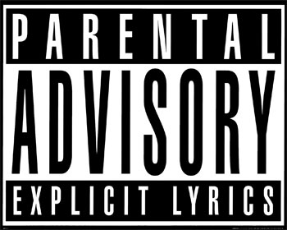
Note to Parents
This talk contains explicit software engineering references:
  A complete lack of information hiding.
  Exposed object invariants.
  Inappropriate usage of design patterns.

Slide 3


Slide 4
The Software Crisis
Uh, who shot Biggie Smalls? If we don't get them, they gon' get us all. I'm down for runnin' up on them PMs in they cubicles. We ride for y'all - all my dogs stay real. Don't think these IPOs gon' feed your seeds And pay your bills, because they not. Hackers get a little bit of love and think they hot. Talkin' 'bout how much money they got; all y'all code looks the same...
(Dead Prez et. al ‘00)

Slide 5
The Software Crisis (cont)
I’m sick of that fake-thug AOP scenario, same scenes in the UML, monotonous material. Y’all dont heqr me though.
Cause Sourceforge they just slang our code like dope. You can be next in line, and signed, and still be writing lines and broke. You would rather have AJAX, or some justice, ML or some substance?
XEmacs, or VI or freedom?
(Dead Prez et. al ‘00)

Slide 6
The Software Crisis (cont)
Still a hacker like me dont playa hate, I just stay awake. This real code, it’s hot, and it don’t stop until we get the RIAA off the block.
(Dead Prez et. al ‘00)

Slide 7
What is the Real Issue?
Our Software is Decidedly Un-Tough
According to the Standish Report ’03
  1/3 of all software projects die in drive-by shootings within the first year.
  Another 1/3 of all software projects turn soft, living in their fancy houses out in the suburbs.

Slide 8
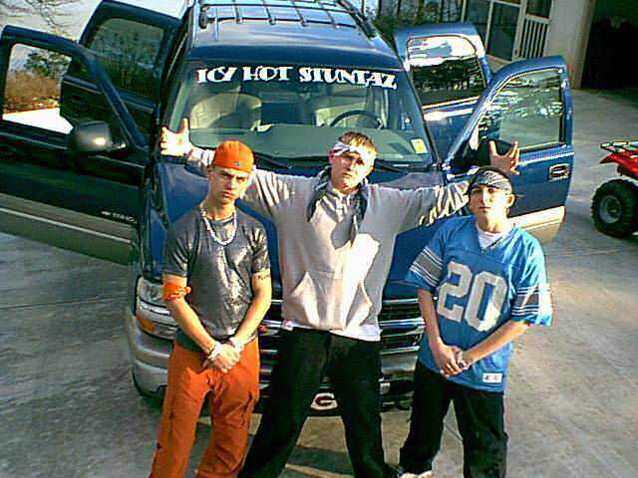

Slide 9
Existing Work
CMMI:
  Crunkability/Make-Money Index
  Developed at the Stuntin’ Engineer’s Institute (SEI)
  De-facto standard hype metric for military and government software contractors.
  Ranks the performance of a software development organization in two specific areas:
    Crunkability: Its ability to have fun, drink, and spit game at the ladies and its ability to
    Make Money: i.e. Get paid by any means necessary

Slide 10
Existing Work
Downsides
  Large amount of overhead necessary in having an organization certified.
  Appropriate for large government contractors where the crunk-ness of the entire nation is at stake.
  For small, agile software organizations, CMMI is more of a burden than anything else.

Slide 11
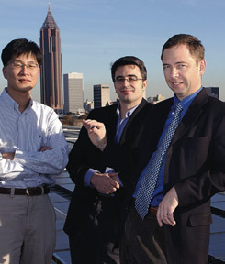
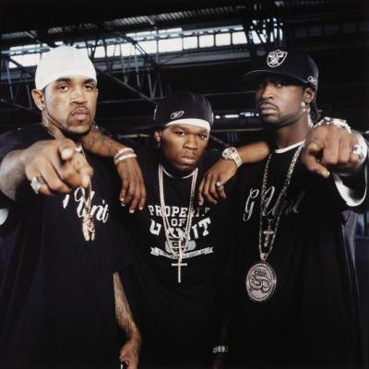
Gunit
ISR
Aftermath

Slide 12
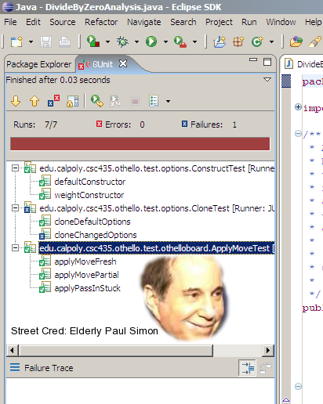
Gunit
Allows you to create and automatically run source code street cred tests.
Tests are run and validated at the touch of a button.
Results are presented in an intuitive street cred stratification.

Slide 13
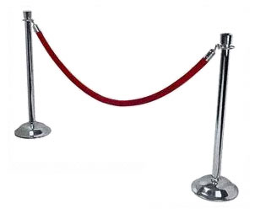
stratification
CMU Graduate Student—Being a graduate student at Carnegie Mellon University doesn’t get you very far; it won’t get you into the club, and it won’t get you court-side seats. Sometimes the truth hurts.

Slide 14
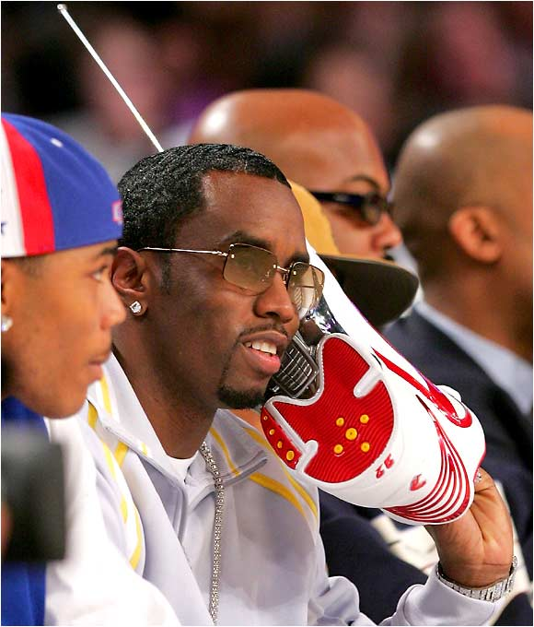
stratification
P-Diddy—This is a good indication that your source code was relatively well respected during the past, possibly because it played some pivotal role in the career of a more successful product. But when the more successful product was killed in a drive-by shooting in L.A., everyone kind of realized that your product was more about marketing than quality. Then your software did a cover of a Led Zepplin song for the Godzilla remake, which only made things worse. . .

Slide 15

Evaluation

Slide 16
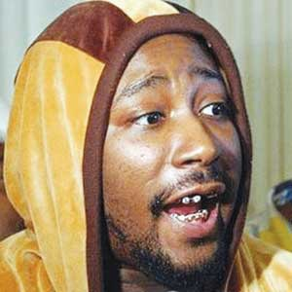
Evaluation

Slide 17
Evaluation

Slide 18

Evaluation

Slide 19
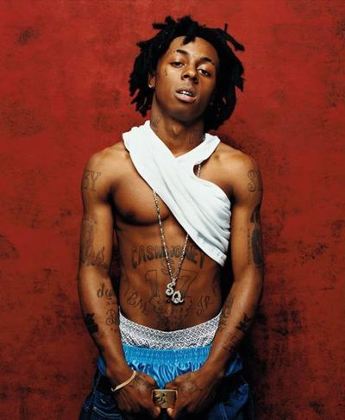
Respect

