Slide 1

Verifying Correct Usage of Atomic Blocks and Typestate
Nels E. Beckman, Kevin Bierhoff, and Jonathan Aldrich
Carnegie Mellon University
Notes:
8:43-9:10 (27)
3:22-3:46
10:38-11:01 (23)
8:03-8:25 (22)
Hi I’m Nels and I’m going to tell you about object protocols in concurrent programs.

Slide 2
Overview: Goals and Approach
Goal: Statically & Modularly Verify Concurrent Object Protocols
Challenge: Track thread-sharing modularly
Approach: Use Access Permissions
  Statically describe reference aliases
  Track abstract state
  Discard if subject to concurrent modification
  ...except in an Atomic Block
Notes:
“We will track the abstract state using a data flow analysis, but we will discard knowledge about the state if the permission on the object reference indicates that other threads may be concurrently modifying the abstract state of the object. Atomic blocks can be used to provide mutual exclusion and preserve static knowledge about the state of an object. Therefore what we want to do can be viewed as an analysis to help you get your protocols correct using atomic blocks, or to help you position your atomic blocks correctly using typestate behavioral annotations.”

Slide 3
Example: Blocking Queue
Thread-shared, blocking queue
  One Producer
  N Consumers
  Defines Protocol
  From Apache Axyl-Lucene Program
    Thanks to Allen Holub!
Meant to illustrate
  Races on abstract state of an object
  State transitions that are not atomic

Slide 4
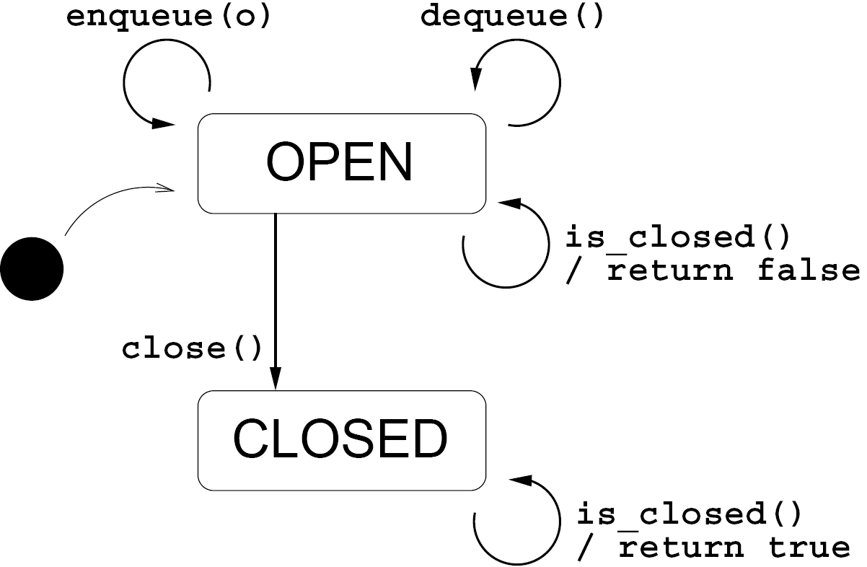




Queue: Protocol
- state
- initial state
- state transition
- transition action

Slide 5
Race on Abstract State of Queue
final Blocking_queue queue = new Blocking_queue();
(new Thread() {
@Override
public void run() {
while( !queue.is_closed() )
System.out.println("Got object: "+queue.dequeue());
// Important shut-down code…
}}).start();
for( int i=0;i<5;i++ )
queue.enqueue("Object " + i);
queue.close();

Slide 6
Race on Abstract State of Queue
final Blocking_queue queue = new Blocking_queue();
(new Thread() {
@Override
public void run() {
while( !queue.is_closed() )
System.out.println("Got object: "+queue.dequeue());
// Important shut-down code…
}}).start();
for( int i=0;i<5;i++ )
queue.enqueue("Object " + i);
queue.close();
Race!

Slide 7
State Transition Not Atomic
class Blocking_queue {
// Class definition...
public void close() {
atomic: { elements = null; }
// ...
atomic: { closed = true; }
}
}

Slide 8
State Transition Not Atomic
class Blocking_queue {
// Class definition...
public void close() {
atomic: { elements = null; }
// ...
atomic: { closed = true; }
}
}
Can be observed in inconsistent state!

Slide 9
Outline
Overview
Blocking Queue
Naive Approach
Access Permissions
Verification with Access Permissions
  Client-Side
  Provider-Side
Contributions/Related Work
Conclusion

Slide 10
Verification without Alias Control
@Override
public void run() {
while( !queue.is_closed() )
System.out.println(“Got object: ” +
queue.dequeue());
// Important shut-down code…
}
Notes:
This is a sound approach, but it fails on a pretty simple example...

Slide 11
Verification without Alias Control
@Override
public void run() {
while( !queue.is_closed() )
System.out.println(“Got object: ” +
queue.dequeue());
// Important shut-down code…
}
queue is not closed!

Slide 12
Verification without Alias Control
@Override
public void run() {
while( !queue.is_closed() )
System.out.println(“Got object: ” +
queue.dequeue());
// Important shut-down code…
}
But could be thread-shared, so forget it…

Slide 13
Verification without Alias Control
@Override
public void run() {
while( !queue.is_closed() )
System.out.println(“Got object: ” +
queue.dequeue());
// Important shut-down code…
}
Call fails, pre-condition not met.

Slide 14
Verification without Alias Control
final Blocking_queue queue = new Blocking_queue();
(...).start(); // queue escapes to thread
for( int i=0;i<5;i++ )
queue.enqueue("Object " + i);
queue.close();

Slide 15
Verification without Alias Control
final Blocking_queue queue = new Blocking_queue();
(...).start(); // queue escapes to thread
for( int i=0;i<5;i++ )
queue.enqueue("Object " + i);
queue.close();
Queue must be OPEN!

Slide 16
Verification without Alias Control
final Blocking_queue queue = new Blocking_queue();
(...).start(); // queue escapes to thread
for( int i=0;i<5;i++ )
queue.enqueue("Object " + i);
queue.close();
We must somehow encode:
The producer is ‘in control’
of the protocol!
Queue must be OPEN!

Slide 17
Access Permissions*
Predicates associated with program references
  Provided at method boundaries by annotations
  Tracked statically
  Answer 2 questions:
    “Can other program references point to the object to which this reference points?”
    “Can this reference be used to modify the object to which it points? Can other references?”
*Bierhoff and Aldrich, 2007

Slide 18
Access Permissions in Action
public static void foo(@Unique Object myObj) {
// myObj is the sole reference to the object
}
public static void bar(@Full Object myObj) {
// we can modify object through myObj
// (other non-modifying references may exist!)
}
public static void baz(@Pure Object myObj) {
// we cannot modify object through myObj
// (other references may modify this object!)
}

Slide 19
Permission Taxonomy
 |  | Other references can…
 |  | Not alias | Read-Only | Read-Modify
This reference can… | Read-Modify | @Unique | @Full | @Share
 | Read-Only | @Unique | @Imm | @Pure

Slide 20
Splitting Access Permissions
Access permissions act as pre/post conditions
  Statically checked for consistency
Some permission types can be soundly ‘split’ into other permission types
  @Unique => 1×@Full & N×@Pure
  @Full => N×@Imm
  @Full => N×@Share & M×@Pure
  etc.

Slide 21
Queue Method Signatures
@Full(requires=“OPEN”, ensures=“CLOSED”)
void close()
@Full(requires=“OPEN”, ensures=“OPEN”)
void enqueue(@Share Object o)
@Pure
@TrueIndicates(“CLOSED”)
@FalseIndicates(“OPEN”)
boolean is_closed()
@Pure(requires=“OPEN”,ensures=“OPEN”)
Object dequeue()
Notes:
The receiver permission must be full, the permission the object required is a SHARE and is consumed.

Slide 22
Queue Method Signatures
@Full(requires=“OPEN”, ensures=“CLOSED”)
void close()
@Full(requires=“OPEN”, ensures=“OPEN”)
void enqueue(@Share Object o)
@Pure
@TrueIndicates(“CLOSED”)
@FalseIndicates(“OPEN”)
boolean is_closed()
@Pure(requires=“OPEN”,ensures=“OPEN”)
Object dequeue()
Notes:
The receiver permission must be full, the permission the object required is a SHARE and is consumed.

Slide 23
Queue Method Signatures
@Full(requires=“OPEN”, ensures=“CLOSED”)
void close()
@Full(requires=“OPEN”, ensures=“OPEN”)
void enqueue(@Share Object o)
@Pure
@TrueIndicates(“CLOSED”)
@FalseIndicates(“OPEN”)
boolean is_closed()
@Pure(requires=“OPEN”,ensures=“OPEN”)
Object dequeue()
Notes:
The receiver permission must be full, the permission the object required is a SHARE and is consumed.

Slide 24
Queue Method Signatures
@Full(requires=“OPEN”, ensures=“CLOSED”)
void close()
@Full(requires=“OPEN”, ensures=“OPEN”)
void enqueue(@Share Object o)
@Pure
@TrueIndicates(“CLOSED”)
@FalseIndicates(“OPEN”)
boolean is_closed()
@Pure(requires=“OPEN”,ensures=“OPEN”)
Object dequeue()
Notes:
The receiver permission must be full, the permission the object required is a SHARE and is consumed.

Slide 25
Client-Side Verification: No Races on Abstract State
Use flow analysis, track permissions and state of references through method body
At method call sites, use pre/post-conditions
Discard object state if permission indicates concurrent modification
  @Pure or @Share
Unless inside atomic block!
Notes:
To verify the client-side behavior (that is, to help ensure that there are no races on the abstract state of an object)…

Slide 26
final Blocking_queue queue = new Blocking_queue();
(...).start();
for( int i=0;i<5;i++ )
queue.enqueue("Object " + i);
queue.close();
Notes:
So let’s actually track those permissions, first for the producer thread.

Slide 27
final Blocking_queue queue = new Blocking_queue();
(...).start();
for( int i=0;i<5;i++ )
queue.enqueue("Object " + i);
queue.close();
@Unique(queue) in OPEN
Notes:
Constructor annotation says that we get a unique permission to the object that is created, and that it starts out OPEN.

Slide 28
final Blocking_queue queue = new Blocking_queue();
(...).start();
for( int i=0;i<5;i++ )
queue.enqueue("Object " + i);
queue.close();
@Full(queue) in OPEN
Notes:
The constuctor for the thread (not shown) was annotated as consuming a @pure permission to the queue, therefore we retain a full, and we know the queue is open.

Slide 29
final Blocking_queue queue = new Blocking_queue();
(...).start();
for( int i=0;i<5;i++ )
queue.enqueue("Object " + i);
queue.close();
Method precondition met
Notes:
The constuctor for the thread (not shown) was annotated as consuming a @pure permission to the queue, therefore we retain a full, and we know the queue is open.

Slide 30
final Blocking_queue queue = new Blocking_queue();
(...).start();
for( int i=0;i<5;i++ )
queue.enqueue("Object " + i);
queue.close();
Method precondition met
Notes:
The constuctor for the thread (not shown) was annotated as consuming a @pure permission to the queue, therefore we retain a full, and we know the queue is open.

Slide 31
final Blocking_queue queue = new Blocking_queue();
(...).start();
for( int i=0;i<5;i++ )
queue.enqueue("Object " + i);
queue.close();
@Full(queue) in CLOSED
Notes:
The constuctor for the thread (not shown) was annotated as consuming a @pure permission to the queue, therefore we retain a full, and we know the queue is open.

Slide 32
@Override
public void run() {
while( !queue.is_closed() )
System.out.println("Got object: “ +
queue.dequeue());
// Important shut-down code…
}
Notes:
On the consumer side of things, we start out with pure permission to the queue, given by the state invariant of this thread object, and required by its constructor.

Slide 33
@Override
public void run() {
while( !queue.is_closed() )
System.out.println("Got object: “ +
queue.dequeue());
// Important shut-down code…
}
@Pure(queue)
from class invariant...
Notes:
On the consumer side of things, we start out with pure permission to the queue, given by the state invariant of this thread object, and required by its constructor.

Slide 34
@Override
public void run() {
while( !queue.is_closed() )
System.out.println("Got object: “ +
queue.dequeue());
// Important shut-down code…
}
@Pure(queue) in
OPEN
Notes:
The dynamic state test gives us static information about the state of the queue.

Slide 35
@Override
public void run() {
while( !queue.is_closed() )
System.out.println("Got object: “ +
queue.dequeue());
// Important shut-down code…
}
@Pure(queue) in
OPEN
Notes:
But because the pure permission indicates that other references may be used to modify the object that queue points to, we discard our knowledge of the queue’s state.

Slide 36
@Override
public void run() {
while( !queue.is_closed() )
System.out.println("Got object: “ +
queue.dequeue());
// Important shut-down code…
}
ERROR!
Notes:
Now we do not satisfy the method’s precondition…

Slide 37
But with ‘atomic’
@Override
public void run() {
while( true ) {
atomic: {
if( !queue.is_closed() )
System.out.println("Got object: “+queue.dequeue());
else
return;
}
}
// Important shut-down code…
}
Notes:
If instead, we had used an atomic block for the purposes of mutal exclusion, then we would know that no other threads could modify the abstract state of the queue, and we would not be forced to discard the information about the queue’s state!

Slide 38
Implementation-Side Verification: Transitions are Atomic
States can be annotated with concrete invariants
  Predicates over fields
Use packing/unpacking for modular verification
  Invariants must be reestablished before method returns
Unpacking a @Full, @Pure, or @Share object must be within an atomic block
Notes:
To verify the client-side behavior (that is, to help ensure that there are no races on the abstract state of an object)…
Packing/Unpacking methodology for OO verification comes from: DeLine and others

Slide 39
Verification Example
@ClassStates({
@State(name=“CLOSED”,
inv=“closed == true * elements == null”), ...})
class Blocking_queue {
private List elements;
private boolean closed;
// ...
@Full(requires=“OPEN”,ensures=“CLOSED”)
void close() {
atomic: { elements = null; }
// ...
atomic: { closed = true; }
}
// ...
}
Notes:
Note here, that our state invariants could just as easily depend on the ABSTRACT state of our fields, allowing us to have interrelated typestate.

Slide 40
Verification Example
@ClassStates({
@State(name=“CLOSED”,
inv=“closed == true * elements == null”), ...})
class Blocking_queue {
private List elements;
private boolean closed;
// ...
@Full(requires=“OPEN”,ensures=“CLOSED”)
void close() {
atomic: { elements = null; }
// ...
atomic: { closed = true; }
}
// ...
}
Notes:
Note here, that our state invariants could just as easily depend on the ABSTRACT state of our fields, allowing us to have interrelated typestate.

Slide 41
Verification Example
@ClassStates({
@State(name=“CLOSED”,
inv=“closed == true * elements == null”), ...})
class Blocking_queue {
private List elements;
private boolean closed;
// ...
@Full(requires=“OPEN”,ensures=“CLOSED”)
void close() {
atomic: { elements = null; }
// ...
atomic: { closed = true; }
}
// ...
}
Unpacks from OPEN state.
Notes:
Note here, that our state invariants could just as easily depend on the ABSTRACT state of our fields, allowing us to have interrelated typestate.

Slide 42
Verification Example
@ClassStates({
@State(name=“CLOSED”,
inv=“closed == true * elements == null”), ...})
class Blocking_queue {
private List elements;
private boolean closed;
// ...
@Full(requires=“OPEN”,ensures=“CLOSED”)
void close() {
atomic: { elements = null; }
// ...
atomic: { closed = true; }
}
// ...
}
Packs to CLOSED state.
Notes:
Note here, that our state invariants could just as easily depend on the ABSTRACT state of our fields, allowing us to have interrelated typestate.

Slide 43
Verification Example
@ClassStates({
@State(name=“CLOSED”,
inv=“closed == true * elements == null”), ...})
class Blocking_queue {
private List elements;
private boolean closed;
// ...
@Full(requires=“OPEN”,ensures=“CLOSED”)
void close() {
atomic: { elements = null; }
// ...
atomic: { closed = true; }
}
// ...
}
Error! Atomic block ends while receiver unpacked
Notes:
Note here, that our state invariants could just as easily depend on the ABSTRACT state of our fields, allowing us to have interrelated typestate.

Slide 44
Outline
Overview
Blocking Queue
Naive Approach
Access Permissions
Verification with Access Permissions
  Client-Side
  Provider-Side
Contributions/Related Work
Conclusion

Slide 45
Contributions
Implementation
Formalized as Type System
Proven sound in multi-threaded programs
  Proof includes explicit threads and sharing
  At run-time, object can never be in “wrong state.”
  Bierhoff & Aldrich don’t consider threads (OOPSLA ’07)
Full/Pure is both useful and surprising...
Notes:
Most existing concurrency systems have “exclusive read when in atomic,” “thread local” and “read only” permissions. Our system has these all, and a new relationship, full/pure which is quite useful to the thread on the ‘writing’ side.

Slide 46
Maintaining Knowledge Over Thread-Shared Objects
With Full:
  One object can depend on state of a mutable, thread-shared, un-encapsulated object
Works b/c of exclusive nature of Full

Slide 47
Maintaining Knowledge Over Thread-Shared Objects
With Full:
  One object can depend on state of a mutable, thread-shared, un-encapsulated object
Works b/c of exclusive nature of Full
Worker
Thread
Obj.
Consumer
Thread
Obj.
Consumer
Thread
Obj.
Thread
Pool
Queue

Slide 48
Maintaining Knowledge Over Thread-Shared Objects
With Full:
  One object can depend on state of a mutable, thread-shared, un-encapsulated object
Works b/c of exclusive nature of Full
@StateInvariants({
@State(name=“OPEN",
inv=“full(queue) in OPEN”),
@State(name=“CLOSED", inv=“full(queue) in CLOSED”)
})
class ThreadPool {
private Blocking_queue queue;
...
}
Worker
Thread
Obj.
Consumer
Thread
Obj.
Consumer
Thread
Obj.
Thread
Pool
Queue
Notes:
-Concurrent separation logic has a permission similar to our unique and immutable, and it has a critical protected permission that cannot be aliased.
-The jacobs approach and the rodriguez approach both use ownership. They don’t have cannot maintain knowledge over thread-shared objects in the manner, and do not allow for ownership transfer.

Slide 49
Maintaining Knowledge Over Thread-Shared Objects
With Full:
  One object can depend on state of a mutable, thread-shared, un-encapsulated object
Not possible in existing approaches
  Concurrent Sep Logic: unique, immutable, ‘critical-protected’
  Jacobs et al., Rodriguez et al.: Ownership
@StateInvariants({
@State(name=“OPEN",
inv=“full(queue) in OPEN”),
@State(name=“CLOSED", inv=“full(queue) in CLOSED”)
})
class ThreadPool {
private Blocking_queue queue;
...
}
Notes:
-Concurrent separation logic has a permission similar to our unique and immutable, and it has a critical protected permission that cannot be aliased.
-The jacobs approach and the rodriguez approach both use ownership. They don’t have cannot maintain knowledge over thread-shared objects in the manner, and do not allow for ownership transfer.

Slide 50
Related Work
Other Differences:
  Abstract Mutable Object State
    Other approaches powerful, but low level
  Atomic Blocks
Discussed in Paper
  OO Verification
    Jacobs et al. (Spec#)
    Rodriguez et al. (JML)
    Vaziri et al.
  Concurrency Logics
    Owicki/Gries & Conccurrent Sep. Logic
    Rely/Guarantee
    Fractional Permissions
  Data Race Detectors

Slide 51
Conclusion
Static, Modular Verification of Object Protocols in Concurrent Programs
  Access Permissions for alias control
  Atomic blocks for mutual exclusion
  Proven Sound (See Paper, TR)
Download the tool, source, more examples
  www.nelsbeckman.com/research/atomicver/
  (Also provides Dimensions and Fractions)

