Slide 1
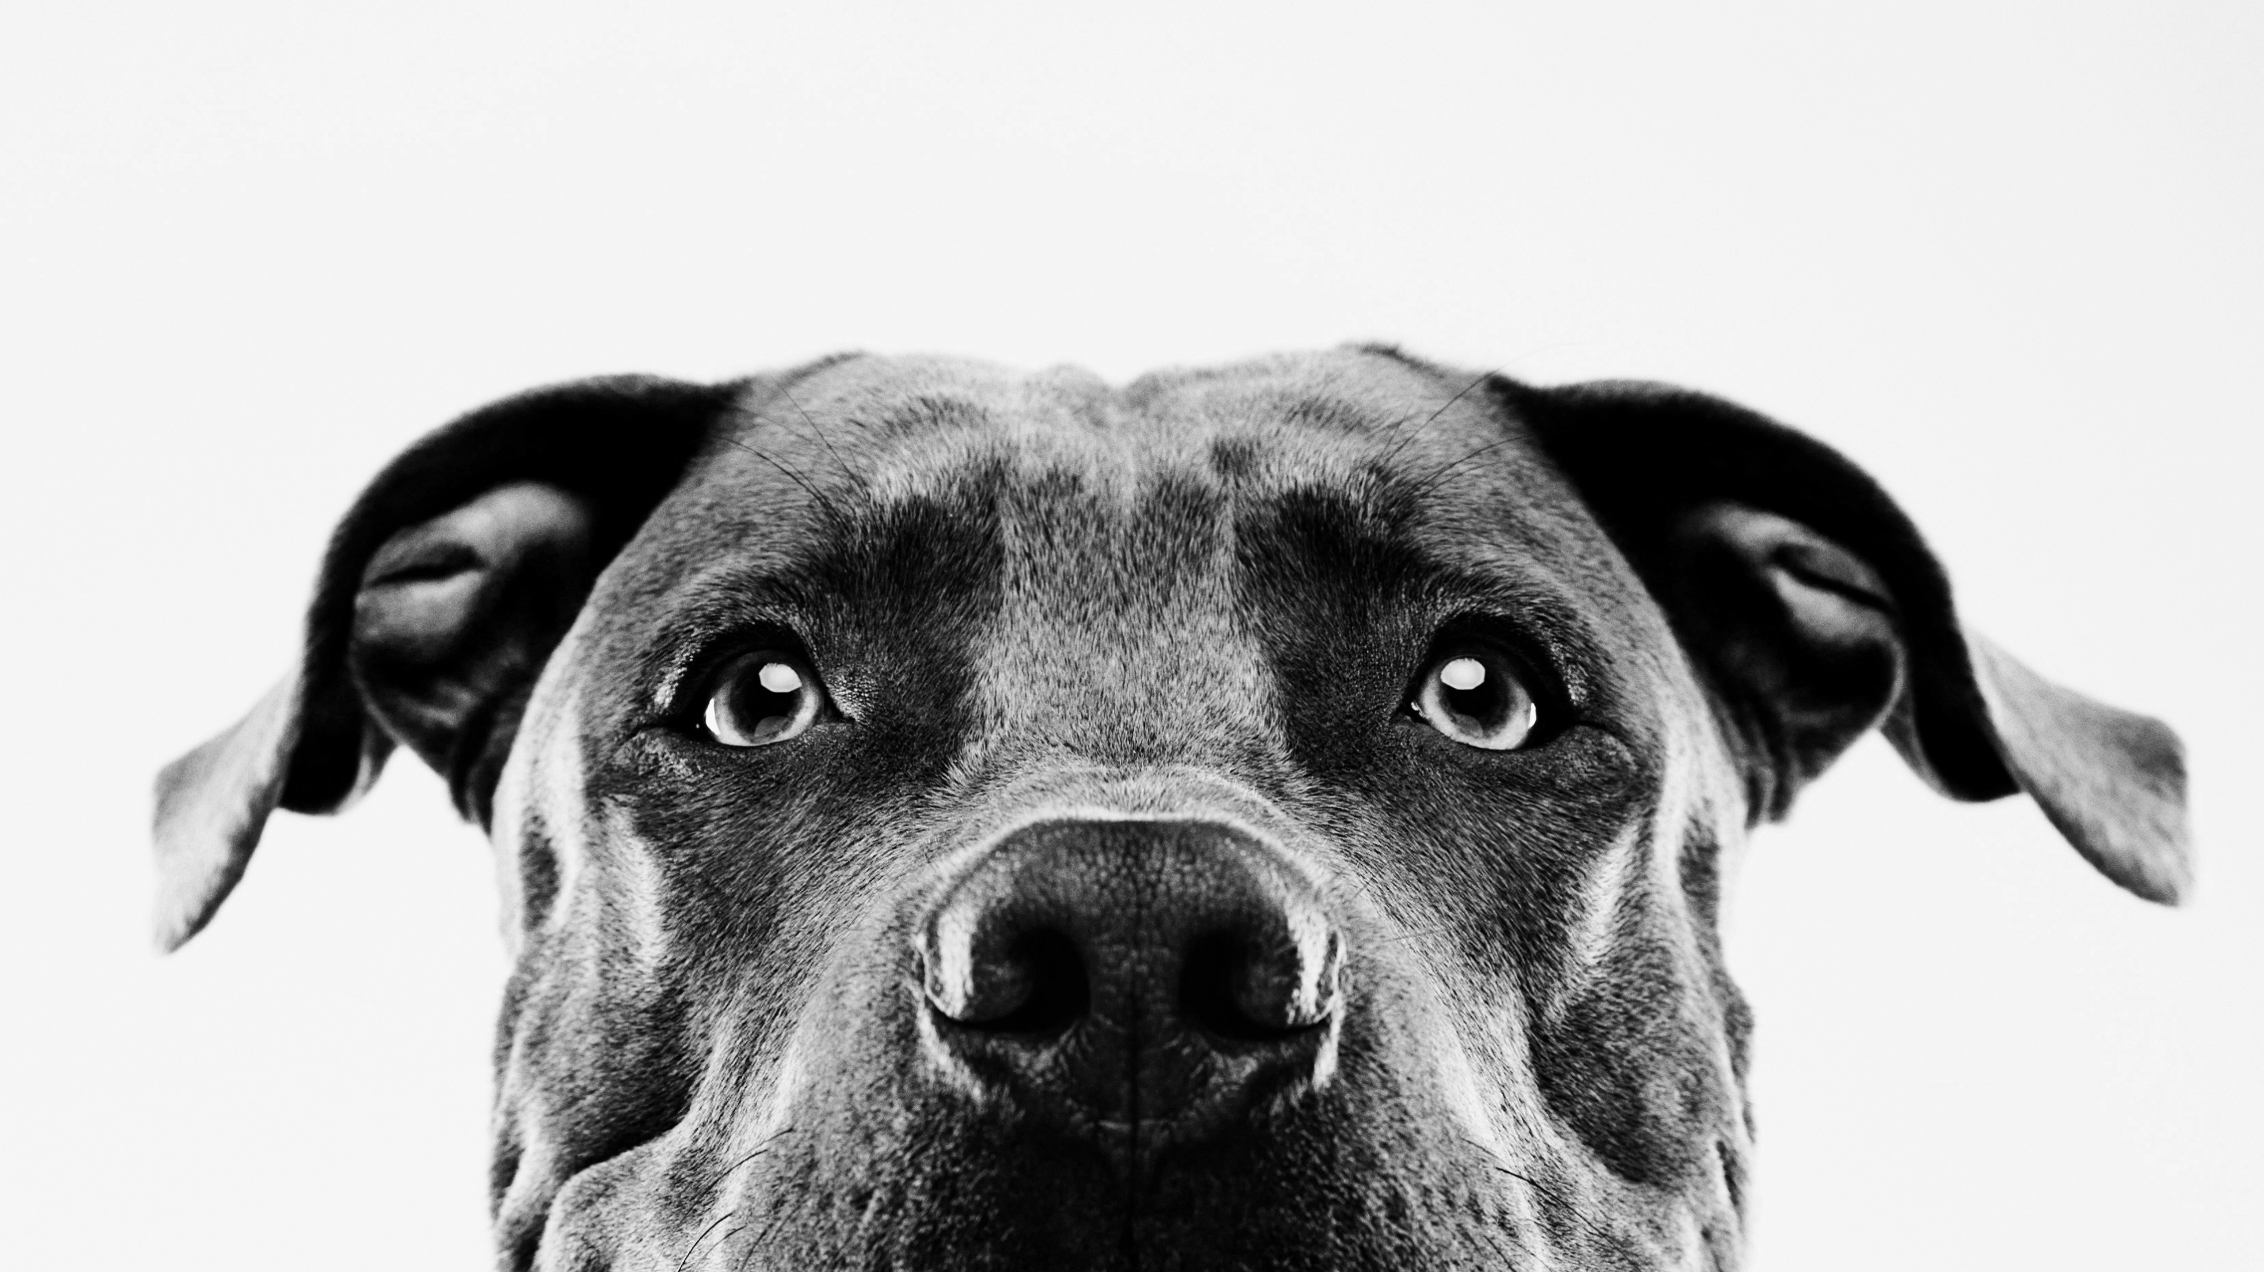
Body Paw-sitive
Unleashing your dog’s Potential
Notes:
NATALIE
Hello, we’re Team B (Natalie, Emma, Nadia, Lucy and Talia)
We’ve a created website for a company called Body Pawsitive – A dog fitness provider which seeks to unleash your dog’s potential!

Slide 2
Product Brief
Find and book onto exercise classes for their dogs
Gain TAILored fitness advice
with class recommendations
Review bookings through a user dashboard
Notes:
Through our website, customers are able to:
Find and book exercises classes for their dogs
Gain tailored fitness advice based on their dog breed, size and energy level and from that, receive personalized class recommendations
Functionality for both the customer and business administrator to review bookings through a personal dashboard.
The core business model for this product was the ability to promote and sell classes, so this remained the main focus throughout the project.
We went with this idea due to the scope of functionality that a fitness app could cover but realized, whilst there were lots of current options on the market for human fitness apps, there were very few options for our doggy friends and felt like there was a niche here for us to cover.

Slide 3
Sprints
Design and create minimum viable product
01
Fully integrate the front and back end of the website
02
Add in ‘Nice-to-have’ user stories and fix any outstanding issues.
03
Notes:
Intense first sprint of 4 days, during which time we needed to set the parameters of the project so that everyone had a clear vision for what we were trying to achieve.
Sprint 1 objective:
Design and create minimum viable product and included:
Creating the database structure and populating with initial data
Design the brand and front-end of the website
Developing the code for our first three user stories –
Create a basic booking form which pushed data into the database –
Sprint 2 Objective
Fully integrate the front and back end of the website
Develop technical function of the booking form so that it linked back data into 4 different related tables through the foreign keys.
Develop code to cover instructor access to booking data
Sprint 3 Objective
Add in ‘Nice to Have’ User stories (such as the user logins, class recommendations, customer and user dashboards) and fix any outstanding issues from Sprint 1 and 2

Slide 4

Product DEMO
Notes:
Homepage
Branding and Design
Guiding the user through the different sections of the website – simple and clear messaging.
Responsive website
Light/Dark Function
Buttons to pull user through the page
Consideration for how the images laid out between the light and dark functions
Class Booking Form
Recommendations
Sign Up and Customer Dashboard
Login and Admin Dashboard

Slide 5
Project Approach
Project Kick-off - Identifying the strengths of each team member
SCRUM Master and Agile Rituals
Pair Coding
Learning Opportunities
Communication
Notes:
We kicked off our project by identifying the strengths and interests of each team member so we that we could quickly get the project off the ground, as we had a very limited timeframe. Natalie took on the role of Scrum Master in the early stages, pulling together project boards to organise and assign tasks to each member of the team, setting agendas for meetings and facilitating Agile Rituals (Sprint planning, Stand Ups, Retrospectives) etc. We planned sprints around Tuesday check in with our instructor so that we could utilise session as best as possible to ask questions and get help. Helpful to have outside perspective on the progress we had made as a team.
Together, we identified main objectives and tasks for each Sprint.
We decided to pair up on the main tasks so that the full weight of responsibility wasn’t on any one individual
We wanted to make sure each member was supported in their task and worked flexibly to cover work where needed
We saw this project as a learning opportunity so shared learning as we solved different problems, demoing how different code worked and sharing helpful tutorials and resources.
We kept regular Communication through team meetings, updating on progress via WhatsApp which, due to time limitations, acted as a “Daily Stand Up “ for us- in particular towards the end of the project.
Mindful of different member’s other commitments and made sure to be kind and respectful around this.

Slide 6
Overcoming Challenges
Database
Activity Table
Event Table
Booking Form
User Selection (Activity)
User Selection (Event
Database
Customer Details Table
Booking Table
Event Table
Activity Table
Notes:
Pulling together to tackle coding challenges
One of the main challenges with our code was pulling data to inform user selection in the booking form and then pushing back the full booking form back into the database as this required information pushing back into four different tables in our database. For example, Natalia and Talia worked on the code to pull through the data and create the drop down options, but then had difficulty with getting the back references to work. At which point Emma stepped in as a new pair of eyes to review the code and figure out why it wasn’t pushing through.
We took a similar approach to creating the dashboards for Customer and Admin with Natalie and Nadia working together to learn how to do this.
Being careful not to affect the front end design when adding in back end functionality. Example of recommendation table.

Slide 7
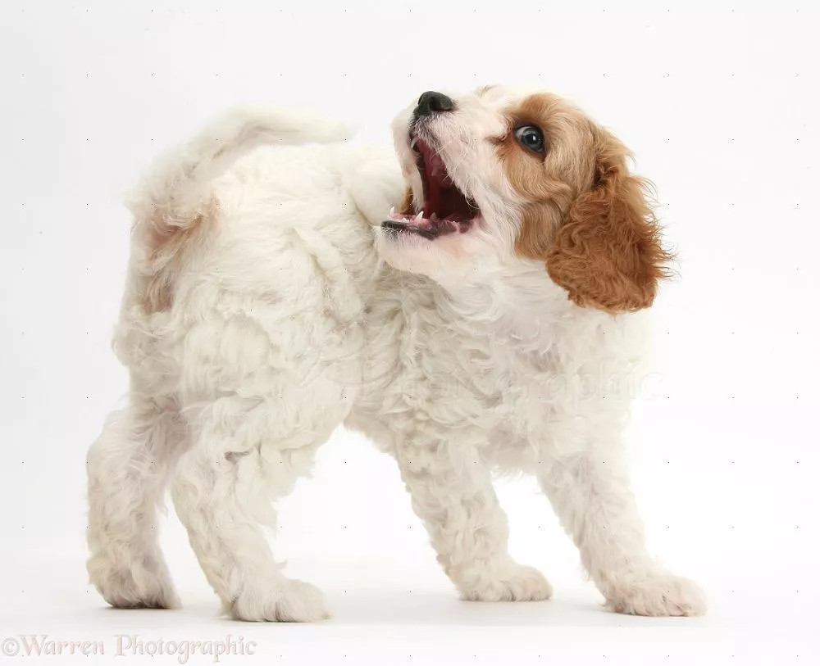
Things we’ve Learnt
Knowing when to stop
The importance of using branches properly in GIT
Working together to support each other’s learning and build confidence in our work

Slide 8

Questions

