Slide 1

PantryChef
Group 10
Nicholas Behrje, Nicholas Dean,
Pramath Pancholi, Travis White

Slide 2
What It Is
Tool for people who cook
Store and organize ingredient list
Search, discover, and save recipes

Slide 3
How It Works
Store list of ingredients
Check ingredients desired in recipe
Search for recipes
Select recipe
Check full list of ingredients, directions, etc.
Save recipe

Slide 4
Food2Fork API
Send request to Food2Fork with list of ingredients
Receive response with list of valid recipes containing sent ingredients
Send request to Food2Fork with recipe
Receive response with ingredients list, image, link to source

Slide 5
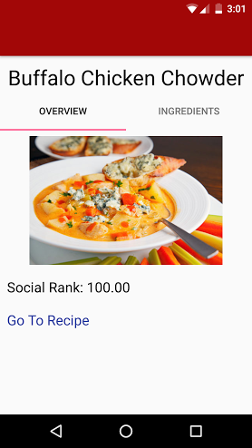
Demonstration

