Slide 1
Beam Search - Algorithm
Nicholas Elliot

Slide 2
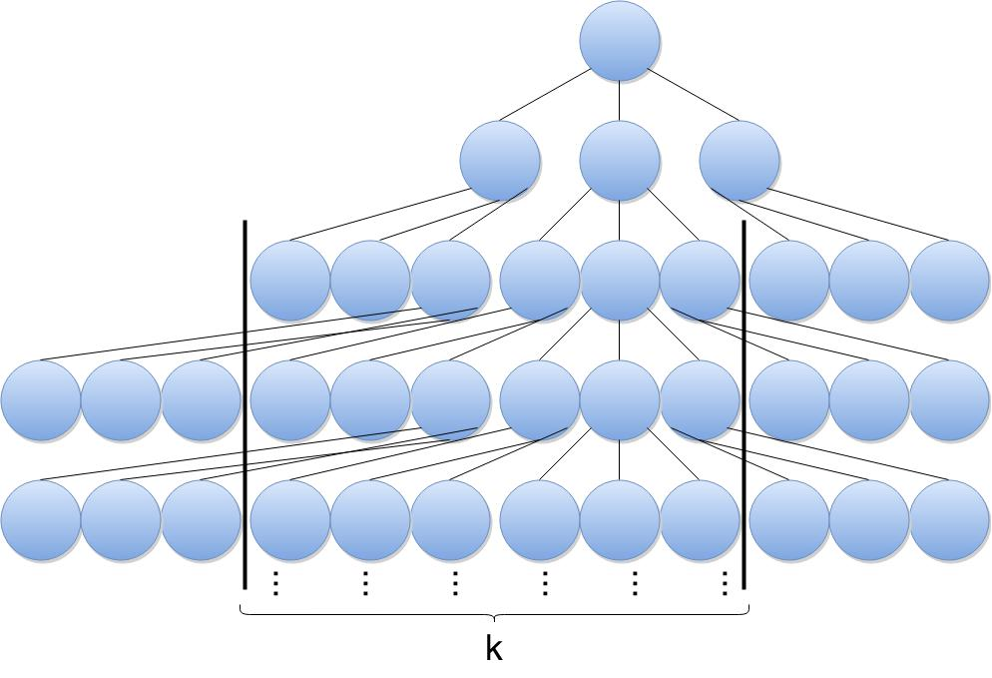
Beam Search
Beam search is a search algorithm based on heuristic.
In a graph, the most promising nodes (with the best heuristic) are expanded.
Beam search is an optimization of best-first search, reducing memory requirements.
Best-first orders all partial solutions (states) by heuristic.
In beam search, the number of best partial solutions is limited by a predetermined quantity (k).
Limiting the number of explored solutions increases memory efficiency but sacrifices completeness (guarantee of solution) and optimality (guarantee of best solution).

Slide 3
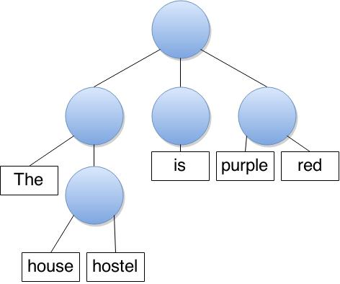
History/Uses
The term "beam search" was coined by Raj Reddy, Carnegie Mellon University, 1976.
Used in systems with limited memory capacity to store entire search tree.
“Machine Translation”

Slide 4
beamSearch(problemSet, memorySize):
openList = new memory of size memorySize
tree = problemSet.tree
node = tree.root
Add node to openList
while (node is not a goal node):
Delete node from openList
Expand node and obtain its children, evaluate those children
Place remaining, non-pruned children into openList
If memory is full and has no room for new nodes, remove the worst
node = the least costly node in openList

Slide 5
Performance
Operation | Rope | String
Build | O(n) | O(n)
Iterate over e/ character | O(n) | O(n)
Index | O(log n) | O(1)
Concatenate | O(log n) | O(n)
Split | O(log n) | O(1)
Insert | O(log n) | O(n)
Delete | O(log n) | O(n)

