Slide 1
Beam Search - Algorithm
Nicholas Elliot

Slide 2
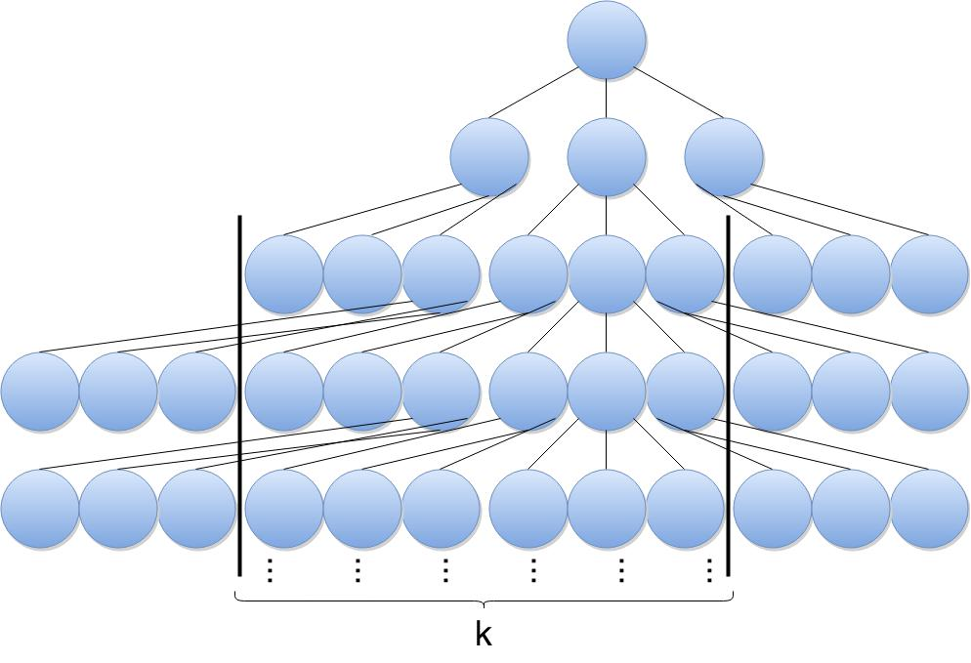
Beam Search
Beam search is a search algorithm based on heuristic.
heuristic – educated approximation (not exact)
In a graph, the most promising nodes (with the best heuristic) are expanded.
Beam search is an optimization of best-first search, reducing memory requirements.
Best-first orders all partial solutions (states) by heuristic.
In beam search, the number of best partial solutions is limited by a predetermined quantity (k).
Limiting the number of explored solutions increases memory efficiency but sacrifices completeness (guarantee of solution) and optimality (guarantee of best solution).

Slide 3
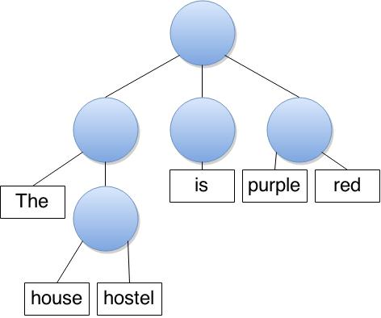
History/Uses
The term "beam search" was coined by Raj Reddy, Carnegie Mellon University, 1976.
Used in systems with limited memory capacity, unable to store entire search tree.
“Machine Translation”

Slide 4
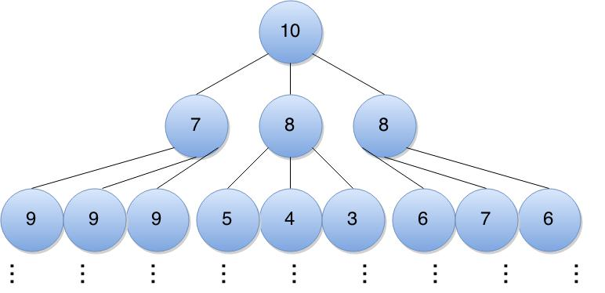
Algorithm
beamSearch(problemSet, memorySize):
openList = new memory of size memorySize;
tree = problemSet.tree;
node = tree.root;
Add node to openList;
while (node is not a goal node):
Delete node from openList;
Expand node and obtain its children;
Place children into openList;
If memory is full and has no room for new nodes, remove worst node(s);
node = the least costly node in openList;

Slide 5
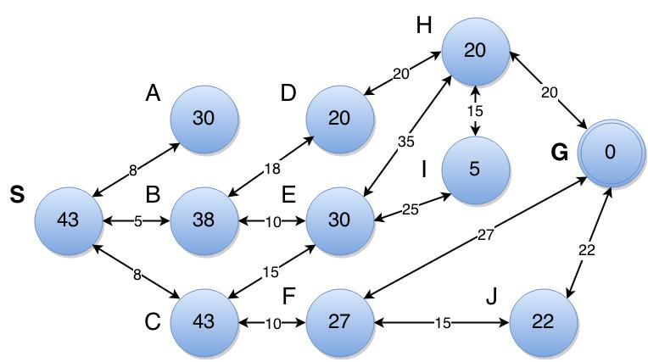
Pathfinding
k = 2

Slide 6
Complexity
Complexity | Best-First Search | Beam Search
Performance | O(b^{d}) | O(k^{d})
Space | O(n) | O(k)
b – breadth
d - depth
k – memory size

