Slide 1
Beam Search- Algorithm
Nicholas Elliot

Slide 2
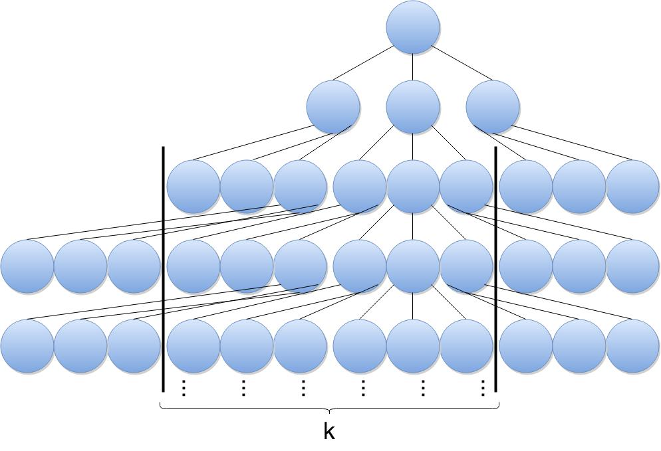
Beam Search
Beam search is a search algorithm based on heuristic.
In a graph, the most promising nodes (with the best heuristic) are expanded.
Beam search is an optimization of best-first search, reducing memory requirements.
Best-first orders all partial solutions (states) by heuristic.
In beam search, the number of best partial solutions is limited by a predetermined quantity (k).
Limiting the number of explored solutions increases memory efficiency but sacrifices completeness (guarantee of solution) and optimality (guarantee of best solution).

Slide 3
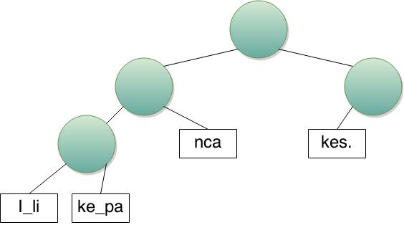
Weight
Each node has a weight value equal to the length of its string plus the sum of all leaf nodes' weight in its left subtree.
YOU: Label each node with its weight

Slide 4
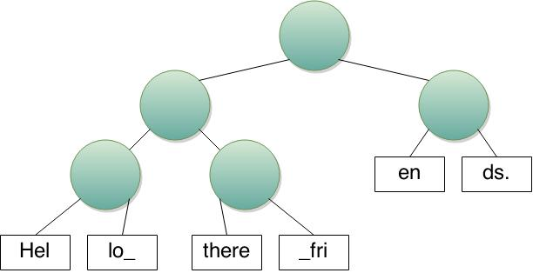
Index – O(log n)
Here is code for index:
def index(root, i):
if weight(root) <= i:
return index(root.right, i - weight(root))
else:
if root.left != None:
return index(root.left, i)
else:
return root.data[i]
YOU: Trace the rope to find index(root, 12)

Slide 5
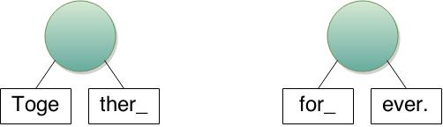
Concatenate – O(log n)
Concat(S1, S2): concatenate two ropes, S1 and S2, into a single rope.
A concatenation can be performed simply by creating a new root node with left = S₁ and right = S₂
YOU: Concat these two separate ropes into a single rope.

Slide 6
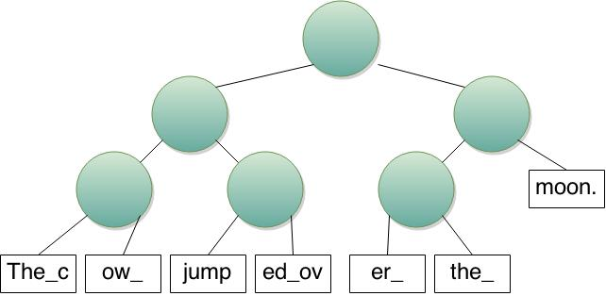
Split – O(log n)
Split (i): split the rope into two new strings S1 and S2
There are two cases that must be dealt with:
The split point is at the end of a string (i.e. after the last character of a leaf node)
The split point is in the middle of a string.
YOU: Perform split(15)
Redraw the rope to compensate for the case 2.
Then, draw a line through the rope, across the branches to be removed.

Slide 7
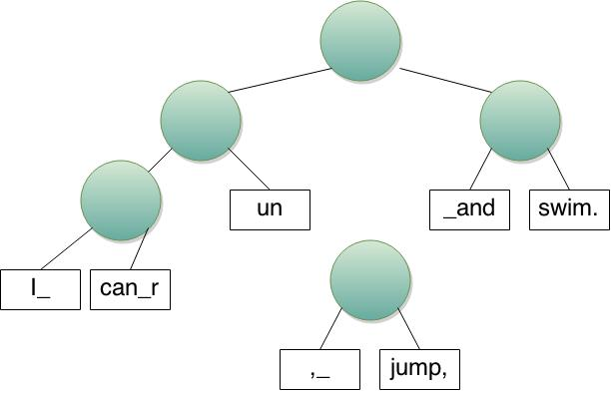
Insert – O(log n)
Insert(i, S): instert string S at position i.
Operation can be completed by:
Split()
Concat()
Concat()
YOU: Insert(9, “,_jump,”)

Slide 8
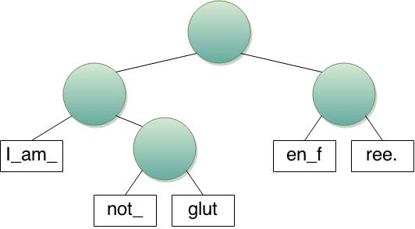
Delete – O(log n)
Delete(i, j): delete the substring at indices i to j Rope to form a new Rope.
Operation can be complete by:
Split()
Split()
Concat()
YOU: Delete(5, 9)

Slide 9
Performance
Operation | Rope | String
Build | O(n) | O(n)
Iterate over e/ character | O(n) | O(n)
Index | O(log n) | O(1)
Concatenate | O(log n) | O(n)
Split | O(log n) | O(1)
Insert | O(log n) | O(n)
Delete | O(log n) | O(n)

