Slide 1

Building Diagram Frame Web Part
using the SPFx framework for better experience embedding Visio diagrams on modern pages
Nikolay Belykh
Notes:
Thank you for joining me this demo,
I’ll try to share some experience of building a web part and pushing it to the AppSource, so that any organization can install it form the store.

Slide 2






Nikolay Belykh About me
Independent Software Developer/Consultant (Vienna)
Former MVP (Visio, Office & services) https://unmanagedvisio.com
GitHub nbelyh
Stack Overflow nbelyh
LinkedIn nbelyh
VS Marketplace Nikolay Belykh
VisPlan
Notes:
Now working on my own projects (web parts) and as a consultant.
Was MVP in the past, not anymore
Mention VisPlan
The web site

Slide 3
Overview
Motivation: replacing classic Visio diagram web part
Demo
Hosting Visio Online API, wrapping office.js (code)
Using FluentUI and SPFx controls for UI (code)
Using Azure DevOps for build, SPFx localization extension for translation
Submitting to the AppSource store, ISV portal, procedure and feedback
Thank you (links)
Notes:
Two reasons, a good reason and a real reason.
A good reason – to build a replacement for a Visio classic web part that is not available in the modern experience.
A real reason – to check the path of publishing web part to an App store, so that a commercial web part can be published later as well
Brief demo to explain the need and what it looks like
How it works and the libraries used
Some points of interest, like setting up a continuous integration/deployment for a web part and localizing it
App Source short review

Slide 4
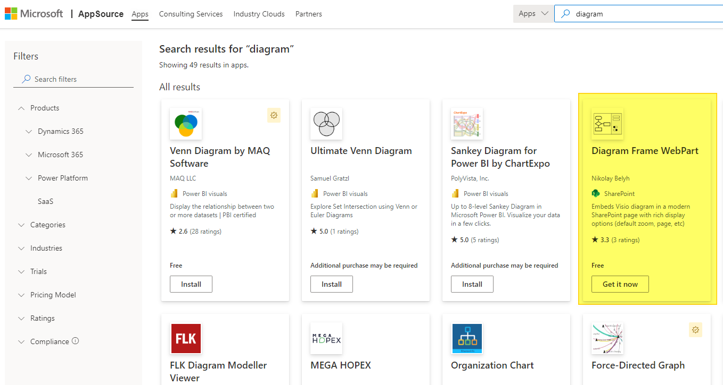
Diagram Frame in Microsoft AppSource store
Open-source web part published to the public AppSource store
Available for any organization to install using the store UI
Can be also installed “manually” by direct admin upload to app catalog
Notes:
Open the app source and show the web part
Show how it can be installed from App Source
Mention the rating and that there was no chance to respond to 1-star reviews like “can’t install” or “does not work”, but now there is
Show it in the new app management center
Mention deploying to teams

Slide 5
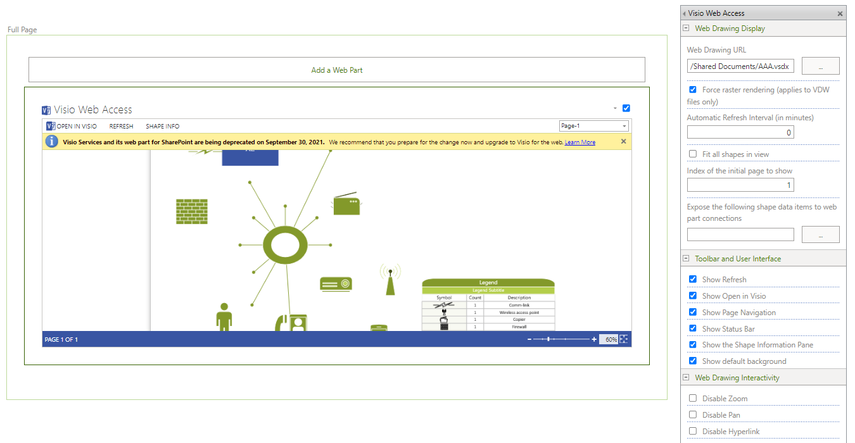
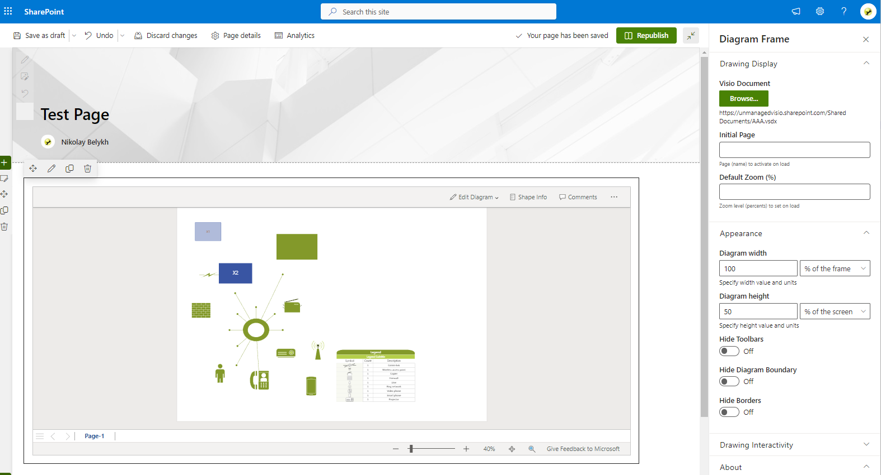
Motivation: Classic Visio web part and Diagram Frame web part
Notes:
What is Visio
Microsoft office Diagramming tool with long history
Demo classic web part and show the controls for it
Mention File Viewer without any options
Show the Diagram Frame web part with sidebar settings

Slide 6
Visio Online API
Allows Embedding Visio diagram in your app
Provides basic methods for controlling the frame content and manipulating the diagram
The diagram is embedded as an IFRAME
Available as npm package(@microsoft/office-js @types/office-js)
https://learn.microsoft.com/en-us/office/dev/add-ins/reference/overview/visio-javascript-reference-overview
Notes:
Mention Microsoft Visio embedding UI (minimalistic, read-only)
WOPI

Slide 7
Code overview, libraries used
Project created using @microsoft/sharepoint yo webpart generator
SPFx framework 1.15 (typescript, react)
pnp-js (for convenient access to SharePoint)
Fluent UI 8 (basic UI and adapt to the site theme)
SPFx controls react (https://pnp.github.io/sp-dev-fx-controls-react)
Placeholder
File Picker (adapted)
Custom property control implementation sample
Notes:
File picker: from current site, from URL (incl. share URL), upload, from one drive.
URL conversion for compatibility with Visio Online API embedding
Mention Full Page support, teams support, detection of those modes.
Theme support

Slide 8
“Infrastructure” tools used
Azure DevOps (public pipeline, free for starter and open-source projects) connected to GitHub https://dev.azure.com/unmanagedvisio/UV-GitHub-Public/_build?definitionId=18&_a=summary
GitHub releases plugin
SPFx localization extension (translating UI to other languages). CSV/XLSX file support by Elio Struyf: https://marketplace.visualstudio.com/items?itemName=eliostruyf.vscode-spfx-localization

Slide 9
Publishing to the AppSource
Need to register in Microsoft partner center
The app is submitted via partner portal
EULA, Privacy policies are important
Review and testing loop took a few weeks (free)
Many thanks to SPFx submission team for the guidance.
https://learn.microsoft.com/en-us/sharepoint/dev/spfx/publish-to-marketplace-overview
Notes:
Open partner center to give an idea

Slide 10
Thank you
Web Part GitHub repository:
https://github.com/nbelyh/VisioOnlineSpfxWebPart
App Source store:
https://appsource.microsoft.com/en-us/product/office/wa200002491
Web part website:
https://unmanagedvisio.com/products/diagram-frame-sharepoint-visio-web-part
My Contacts
@nbelyh (GitHub, LinkedIn)
n.belykh@unmanagedvisio.com, nbelyh@gmail.com

