Slide 1
UML Requirements
Decision tables & Use cases

Slide 2
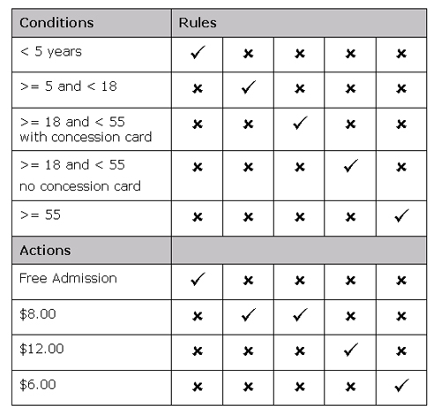
Decision Tables
Test Cases
Conditions
Outcomes
Notes:
Image credit: http://hsc.csu.edu.au/ipt/project_work/3287/decision_table.jpg

Slide 3
Decision Tables Example
A login system on a banking website has a decision table to authenticate users.
A user must go to the login page.
A user must provide valid card number.
A user must provide a valid password
A user can only have 3 attempts before the account is frozen
Notes:
Image credit: http://hsc.csu.edu.au/ipt/project_work/3287/decision_table.jpg

Slide 4
Decision Tables Example
Conditions
User goes to login page | Y | N | Y | Y
User inputs correct card number | Y | Y | Y | Y
User inputs Correct password | Y | Y | N | Y
Attempts > 3 | N | N | N | Y
Outcomes
User is taken to Accounts page
User is taken to login page
User’s account is frozen
Notes:
Image credit: http://hsc.csu.edu.au/ipt/project_work/3287/decision_table.jpg

Slide 5
Decision Tables Example
Conditions
User goes to login page | Y | N | Y | Y
User inputs correct card number | Y | Y | Y | Y
User inputs Correct password | Y | Y | N | Y
Attempts > 3 | N | N | N | Y
Outcomes
User is taken to Accounts page | Y
User is taken to login page | N
User’s account is frozen | N
Notes:
Image credit: http://hsc.csu.edu.au/ipt/project_work/3287/decision_table.jpg

Slide 6
Decision Tables Example
Conditions
User goes to login page | Y | N | Y | Y
User inputs correct card number | Y | Y | Y | Y
User inputs Correct password | Y | Y | N | Y
Attempts > 3 | N | N | N | Y
Outcomes
User is taken to Accounts page | Y | N
User is taken to login page | N | Y
User’s account is frozen | N | N
Notes:
Image credit: http://hsc.csu.edu.au/ipt/project_work/3287/decision_table.jpg

Slide 7
Decision Tables Example
Conditions
User goes to login page | Y | N | Y | Y
User inputs correct card number | Y | Y | Y | Y
User inputs Correct password | Y | Y | N | Y
Attempts > 3 | N | N | N | Y
Outcomes
User is taken to Accounts page | Y | N | N
User is taken to login page | N | Y | Y
User’s account is frozen | N | N | N
Notes:
Image credit: http://hsc.csu.edu.au/ipt/project_work/3287/decision_table.jpg

Slide 8
Decision Tables Example
Conditions
User goes to login page | Y | N | Y | Y
User inputs correct card number | Y | Y | Y | Y
User inputs Correct password | Y | Y | N | Y
Attempts > 3 | N | N | N | Y
Outcomes
User is taken to Accounts page | Y | N | N | N
User is taken to login page | N | Y | Y | Y
User’s account is frozen | N | N | N | Y
Notes:
Image credit: http://hsc.csu.edu.au/ipt/project_work/3287/decision_table.jpg

Slide 9
Decision Tables Questions
When are these tables useful?
What does a star mean?
Notes:
Image credit: http://hsc.csu.edu.au/ipt/project_work/3287/decision_table.jpg

Slide 10
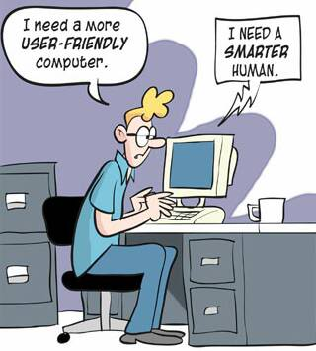
Use Cases
Describing user actions
Notes:
Photo credit: http://i717.photobucket.com/albums/ww173/prestonjjrtr/Funny/userfriendly.jpg

Slide 11
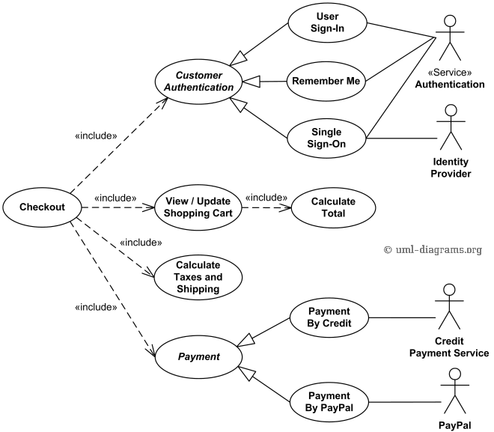
Use case Diagrams
Actors
Use Cases
Relationships
Descriptions

Slide 12
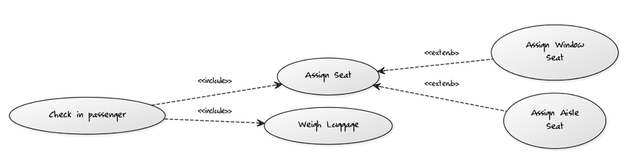
Include vs extend
Include: When one action requires another. Reuse an action
Extend: When one action can be replaced by another (inheritance)

Slide 13

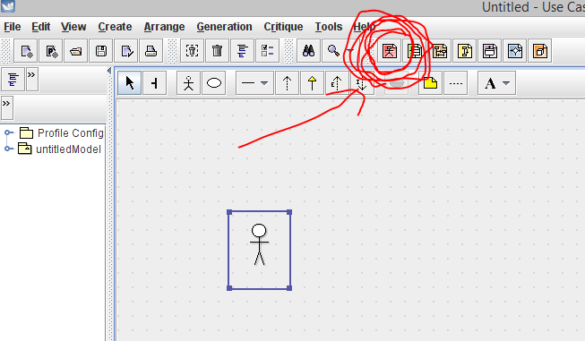
ArgoUML
Make Use case diagrams by pressing the red button on top

Slide 14
Exercise
The VP Communication of ECSESS needs a new way to send the livewire newsletter to the students in EE, SE and CE. Currently students send him emails and subsequently he sends an email blast to many people including those who do not wish to receive the live wire.
What he would like is system where ECSE students can login to their MyMcGill account and post their announcements or campus events, these news items can be edited or removed. Those news events would come up on a news feed that students can view in their MyMcGill page. Of course, he would like to have administrative rights in order to prevent abuse. This would allow him to edit and remove abusive posts.
Draw a use case Diagram to represent the user interface for this scenario. Be sure to have more than one actor and the correct relations between the actions and the actors.

Slide 15
Use Case Description
Describes a use case in the following manner:
Goals
Entry conditions
Flow of events
Exit condition

Slide 16
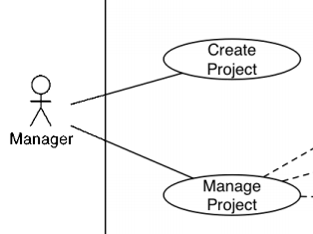
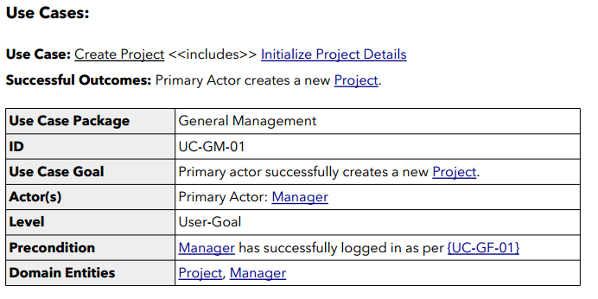
Use Case Description
Notes:
Taken from sample SRS

Slide 17
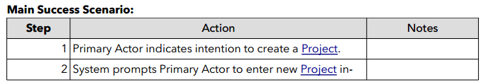
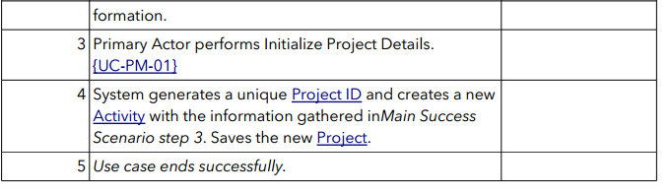
Use Case Description
Notes:
Taken from sample SRS

Slide 18
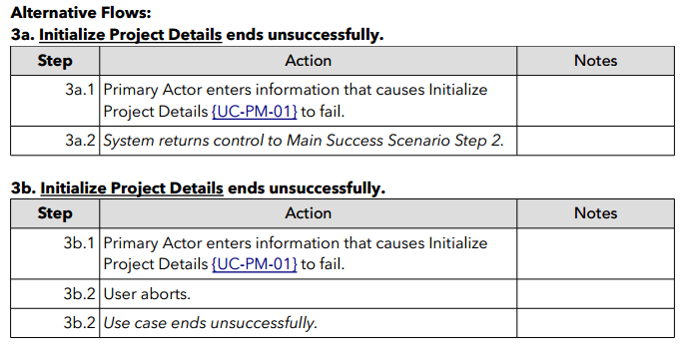
Use Case Description
Notes:
Taken from sample SRS

Slide 19
Use Case Description Exercise
Create a use Case description for one of the use Cases from the Newsletter example
Notes:
Taken from sample SRS

Slide 20
Use Case Concept Questions
Is there inheritance for actors in Use case Diagrams?
Can a software component be an Actor?
Do Use Case Diagrams describe High Level concepts or Low Level Concepts?

Slide 21
Use Case Concept Questions
SRS Due Sunday FEB 15
Good luck Have Fun

Slide 22
References
Class notes
Sample SRS on My Courses

