Slide 1
Unit Testing
Testing stuff to make sure they work

Slide 2
Testing Principles
Check compliance with requirements
Check compliance after changes (regression)
Methodology to isolate problems
Reduce costs of maintenance

Slide 3
Good practices
Requirements are clearly testable
Components are easily divisible into individual pieces
Write tests offline
Create tests for ranges of values and boundaries
Create tests for types
Create tests for multiple states
Think of all the extremes

Slide 4
Types of Test
Functional
Behavioral
Performance
Integration
System
What types of tests we could write

Slide 5
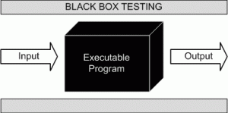
Functional Test

Slide 6
Triangle Example
A programmer wrote the following function for a math library. Come up with some test cases for the function defined below. Hint: there can be up to 21

Slide 7
Triangle Example
But my program would never send negative numbers, do I still have to test?
YES!
Unit tests make no assumptions

Slide 8
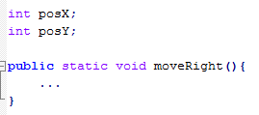
Behavioral Test (state)

Slide 9

Performance Testing

Slide 10
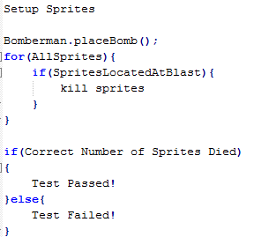
Integration Testing

Slide 11
System Testing
Play the Game!
Does it open?
Will it crash?

Slide 12
JUnit
Getting Set up
Testing Library

Slide 13
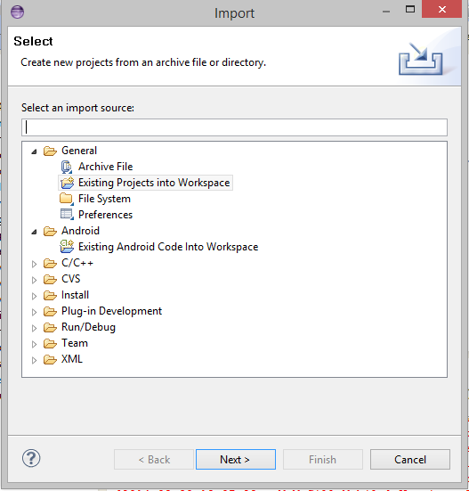
Importing a project
File -> Import -> Existing project into Workspace -> Browse for project

Slide 14
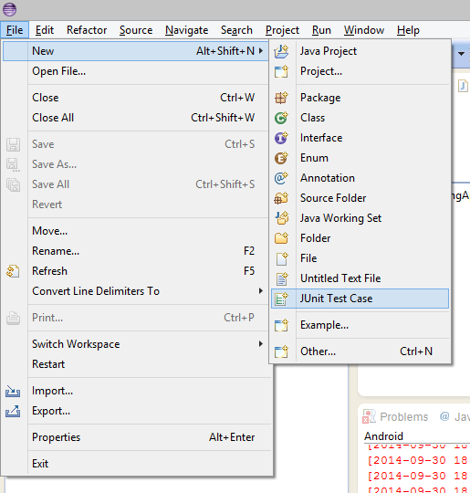
Setting up a Test
File -> new-> Junit Test case

Slide 15
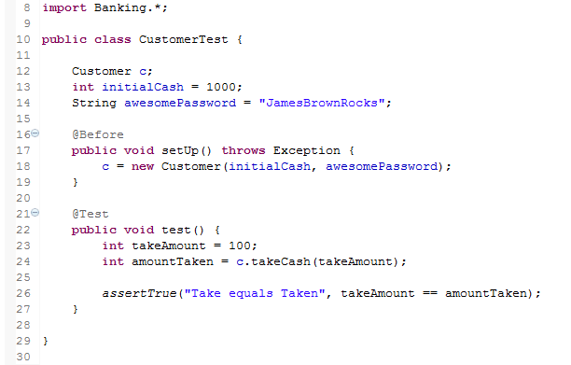
Junit Structure
Import Classes under test
Declare Objects under Test
Flag to execute this method before test
Flag to indicate this method is a test case
Assertion decides if test will pass or fail

Slide 16
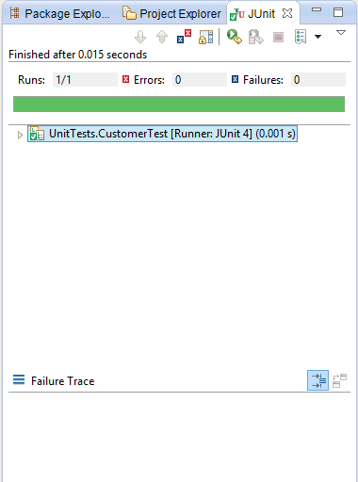
Running Tests
Right Click on Test class -> Run as -> JunitTest

Slide 17
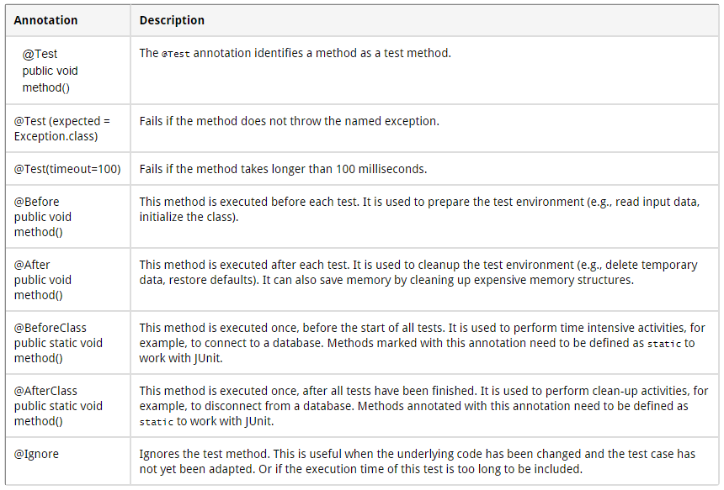
Junit Annotations
Notes:
Taken from http://www.vogella.com/tutorials/JUnit/article.html

Slide 18
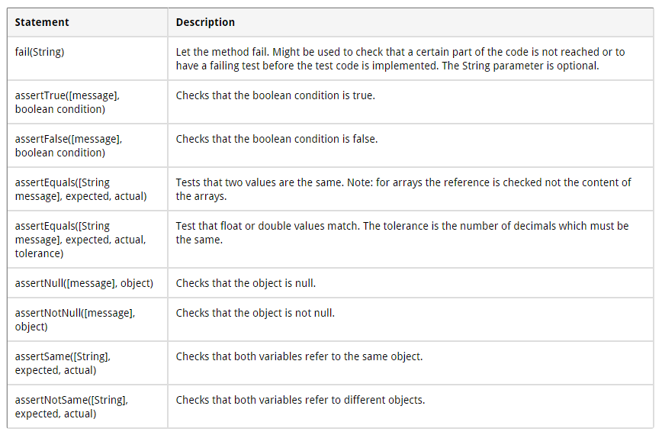
Junit Assertions
Notes:
Taken from http://www.vogella.com/tutorials/JUnit/article.html

Slide 19
Banking Example
Load the project and test the Account Class:
Does the account class deposit the correct amount of money
Does the account class withdraw the correct amount of money
Does the account class handle null Customers
Does the account class properly handle negative numbers

Slide 20
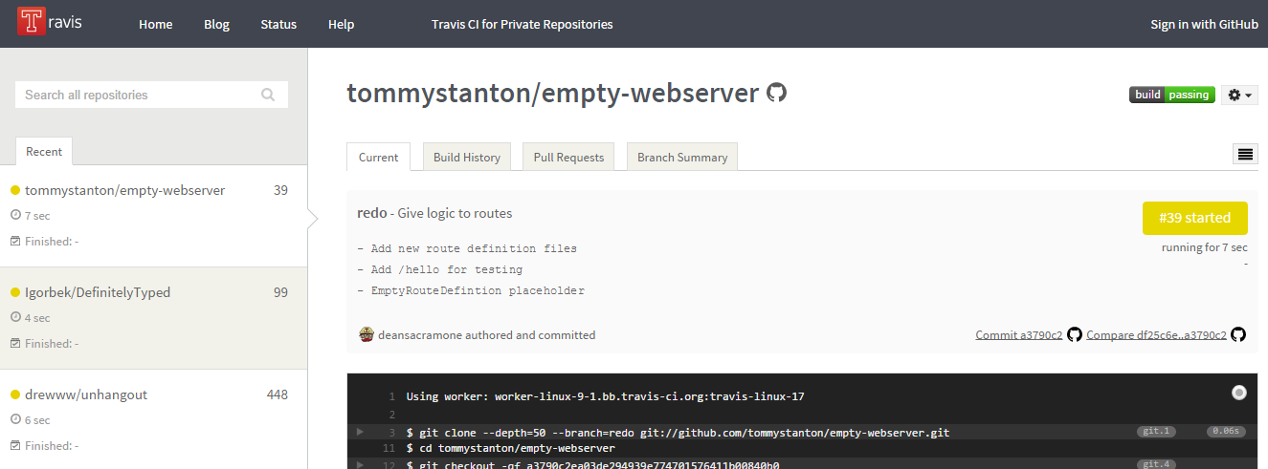
Continuous Integration with Travis

Slide 21
Regression? Continuous integration?
Regression testing is rerunning tests to make sure new code does not break old, but still relevant tests.
Continuous integration with Travis allows users to push code often and automatically run tests based on commits

Slide 22
References
http://www.vogella.com/tutorials/JUnit/article.html
http://docs.travis-ci.com/user/getting-started/

