Slide 1
UML
Sequence Diagrams and class diagrams

Slide 2
UML Software
Argo UML http://argouml-downloads.tigris.org/
Software Locally stored on computer
Good isolation between types of UML
Runs on all platforms
Draw.io https://www.draw.io/
Syncs with Google drive or Dropbox
Lots of options
Creately https://creately.com
No Registration Required

Slide 3
Breakdown
UML Sequence Diagram
Sequence Diagram Exercise
UML Class Diagram
Class Diagram Exercise

Slide 4
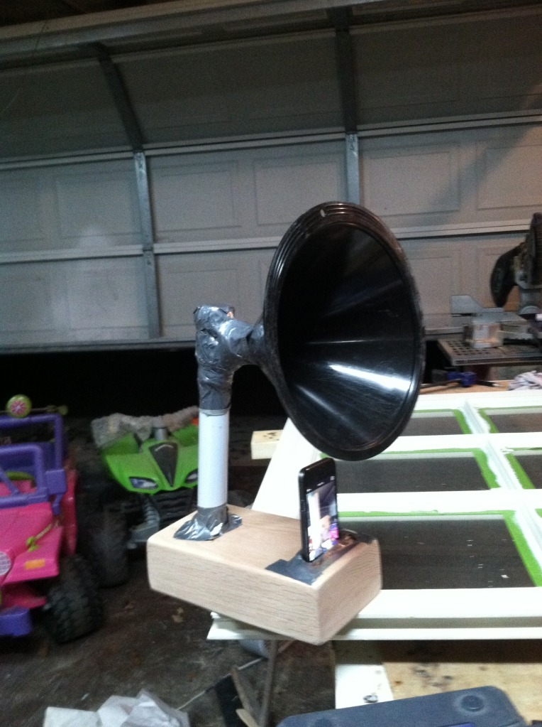
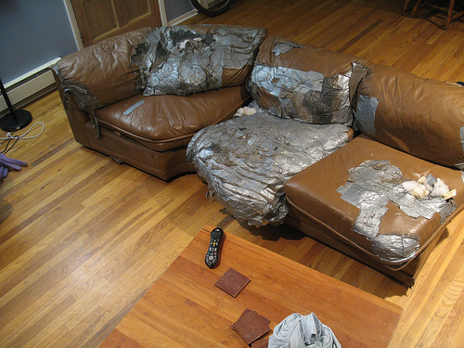
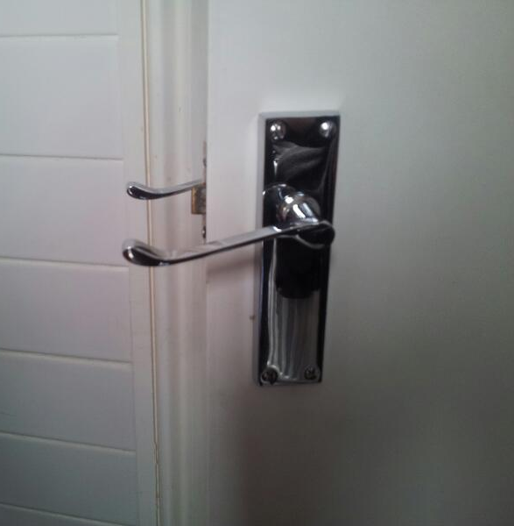
Design Documentations omitted
Notes:
Humor obtained from reddit.com/r/diwhy

Slide 5
Universal Modelling Language
Collection of standardized graphics used to describe software systems
Many types of standards used to describe many different types of interactions
Sequence diagrams
Class diagrams
Use case diagrams
Widely used in industry
Widely used in ECSE321

Slide 6
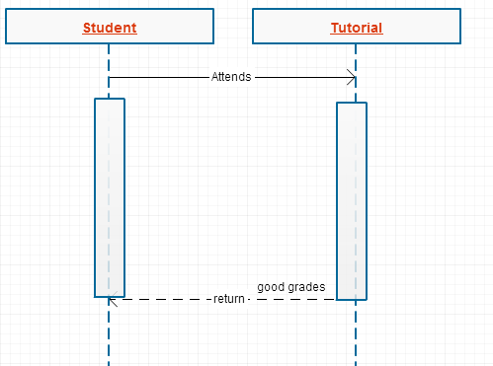
Sequence Diagrams
It can describe sequences of events

Slide 7
UML Sequence Diagrams
Describes interaction between objects
Also indicates timing and order between those interactions

Slide 8
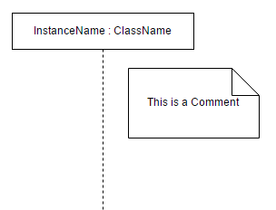
UML Sequence Diagrams (Basics)

Slide 9
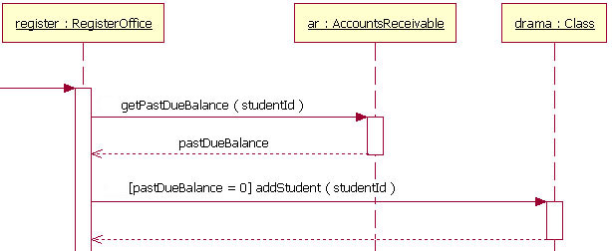
UML Sequence Diagrams (Parts)
Life Lines
Messages
Return Values
Conditions
Notes:
Image obtained from: http://www.ibm.com/developerworks/rational/library/content/RationalEdge/feb04/3101_figure7.jpg

Slide 10
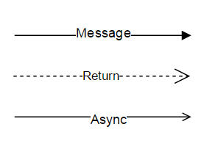
UML Sequence Diagrams (Arrows)
Message
Return value
Asynchronous message
Notes:
Image obtained from: http://www.ibm.com/developerworks/rational/library/content/RationalEdge/feb04/3101_figure7.jpg

Slide 11
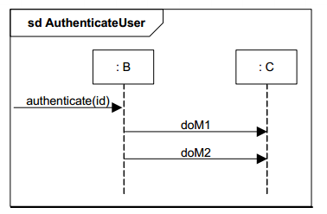
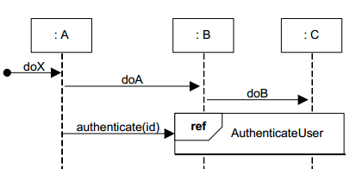
UML Sequence Diagrams (Abstraction)
Abstract away complicated interactions
Use frames to reference to other interactions
Notes:
Image obtained from: http://www.ibm.com/developerworks/rational/library/content/RationalEdge/feb04/3101_figure7.jpg

Slide 12
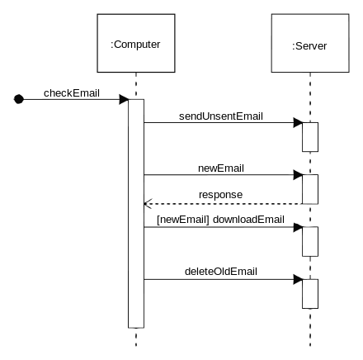
Simple Example
Notes:
Taken from http://upload.wikimedia.org/wikipedia/commons/thumb/9/9b/CheckEmail.svg/440px-CheckEmail.svg.png

Slide 13
Pop Quiz
In a racing game, are sequence diagrams useful for describing car components and its various attributes?
You are designing the user interface for a tablet PC used in the construction industry, under what scenario would you use a sequence diagram?
Notes:
Taken from http://upload.wikimedia.org/wikipedia/commons/thumb/9/9b/CheckEmail.svg/440px-CheckEmail.svg.png

Slide 14
Exercise
McGill University is upgrading its room booking services for students. Students can now use an online portal to book all rooms at anytime for a small fee.
To request a room the student will input the time at which to make the booking and the amount of students the room needs to hold. This information will be sent the booking system which will find a room that fits all the students at the requested time, if it such a room exists. The booking system will hold the room in pending for 5 business days for inconvenience. Then, the booking system will also send an invoice to the requester’s student account charging them for the booking along with a confirmation email to the student’s mail.mcgill.ca email.
Draw a sequence diagram using software mentioned above to represent the events described above. Be sure to have at least 2 classes, the relevant arrows and conditions. Make any assumptions necessary for a plausible scenario.
Notes:
Image obtained from: http://www.ibm.com/developerworks/rational/library/content/RationalEdge/feb04/3101_figure7.jpg

Slide 15
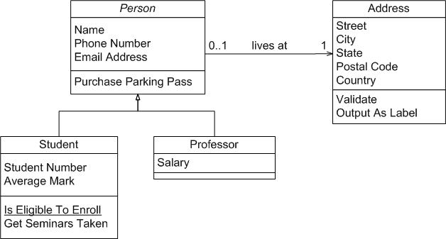
Class diagrams
The other thing you need to know about UML. Describes relationships.

Slide 16
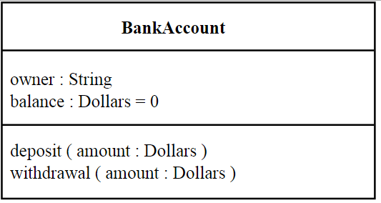
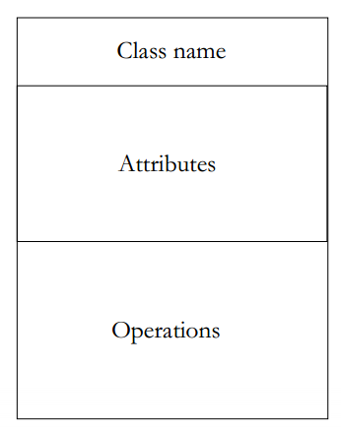
Class Diagrams
Class Name
Java Members
Java Methods

Slide 17
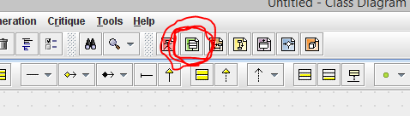
Class Diagrams in ArgoUml

Slide 18
Relationships
Has A (Association, Aggregation, Composition)
Is A (inheritance)

Slide 19

Association
Taken from http://en.wikipedia.org/wiki/Class_diagram

Slide 20

Aggregation
Taken from http://en.wikipedia.org/wiki/Class_diagram
Destroying the container does not destroy the content

Slide 21

Composition
Taken from http://en.wikipedia.org/wiki/Class_diagram

Slide 22
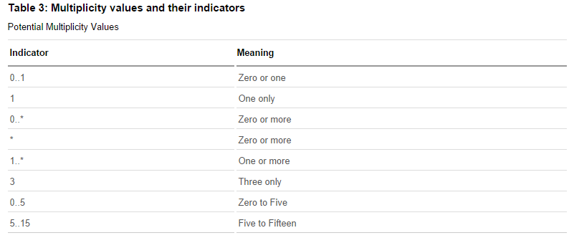
Multiplicity
Taken from http://www.ibm.com/developerworks/rational/library/content/RationalEdge/sep04/bell/

Slide 23
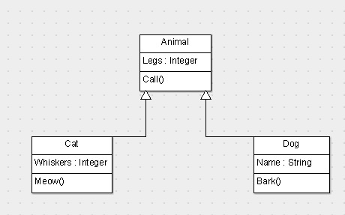
Inheritance

Slide 24
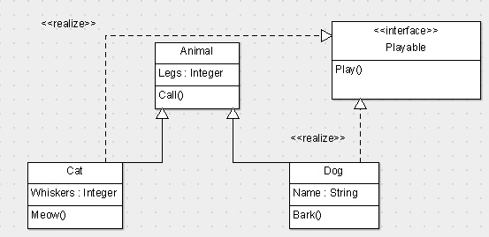
Interfaces
Class Name
Methods

Slide 25
Exercise
You have been asked to design the backend system of a library. The library has books, videos, and CDs that it loans to its users. All library material has a id# and a title. In addition, books have one or more authors, videos have one producer and one or more actors, while CDs have one or more entertainers. The library maintains one or more copies of each library item (book, video or CD). Copies of all library material can be loaned to users. Reference-only material is loaned for 2hrs and can’t be removed from the library. Other material can be loaned for 2 weeks. For every loan, the library records the user, the loan date and time, and the return date and time. For users, the library maintains their name, address and phone number.
Draw a use class diagram using the software mentioned previously. You may choose to be as detailed as you like
Notes:
Exercise provided courtesy of Professor Aditya Mahajan

Slide 26
References
http://www.ibm.com/developerworks/rational/library/3101.html
http://www.objectmentor.com/resources/articles/umlClassDiagrams.pdf
http://www.ibm.com/developerworks/rational/library/content/RationalEdge/sep04/bell/
http://en.wikipedia.org/wiki/Class_diagram
http://slides.com/dominiccharleyroy/

