Slide 1
Requirement Modelling
Domain Modelling

Slide 2
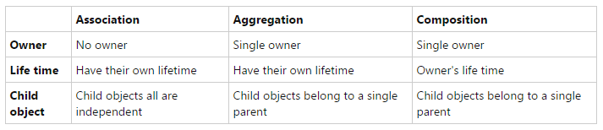
UML Revisited
Inheritance: Book is a library Item
Association: Borrowers uses the library
Aggregation: User Has a loan
Composition: Library Has all the Items
Notes:
Image obtained from:
http://www.codeproject.com/Articles/330447/Understanding-Association-Aggregation-and-Composit

Slide 3
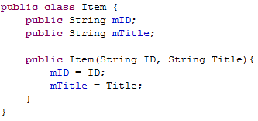
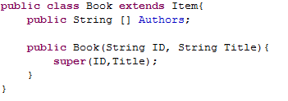
Inheritance
Inheritance: Book is a library Item
Notes:
Image obtained from:
http://www.codeproject.com/Articles/330447/Understanding-Association-Aggregation-and-Composit

Slide 4
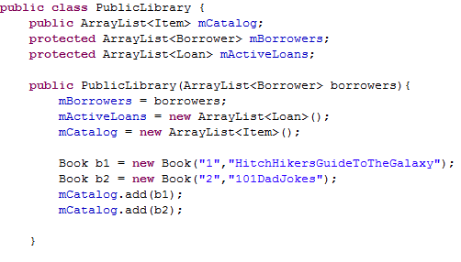
Composition
Composition: Library Has all the Items
Notes:
Image obtained from:
http://www.codeproject.com/Articles/330447/Understanding-Association-Aggregation-and-Composit

Slide 5
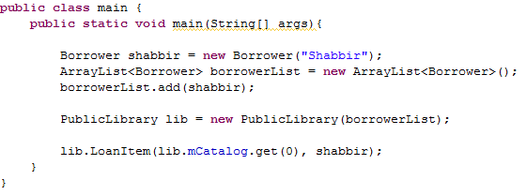
Association
Association: Borrowers uses the library
Notes:
Image obtained from:
http://www.codeproject.com/Articles/330447/Understanding-Association-Aggregation-and-Composit

Slide 6

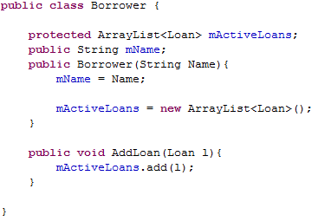
Aggregation
Aggregation: User Has a loan
Notes:
Image obtained from:
http://www.codeproject.com/Articles/330447/Understanding-Association-Aggregation-and-Composit

Slide 7
Discussions and Exercise
What is the difference between Composition, Aggregation and Association?
How can you tell when to use aggregation vs association?
How will the code change if library and Item is an association rather than composition?
How Can I draw the fact that The library keeps track of both users and loans without users having knowledge of loans?
Notes:
Image obtained from:
http://www.codeproject.com/Articles/330447/Understanding-Association-Aggregation-and-Composit

Slide 8
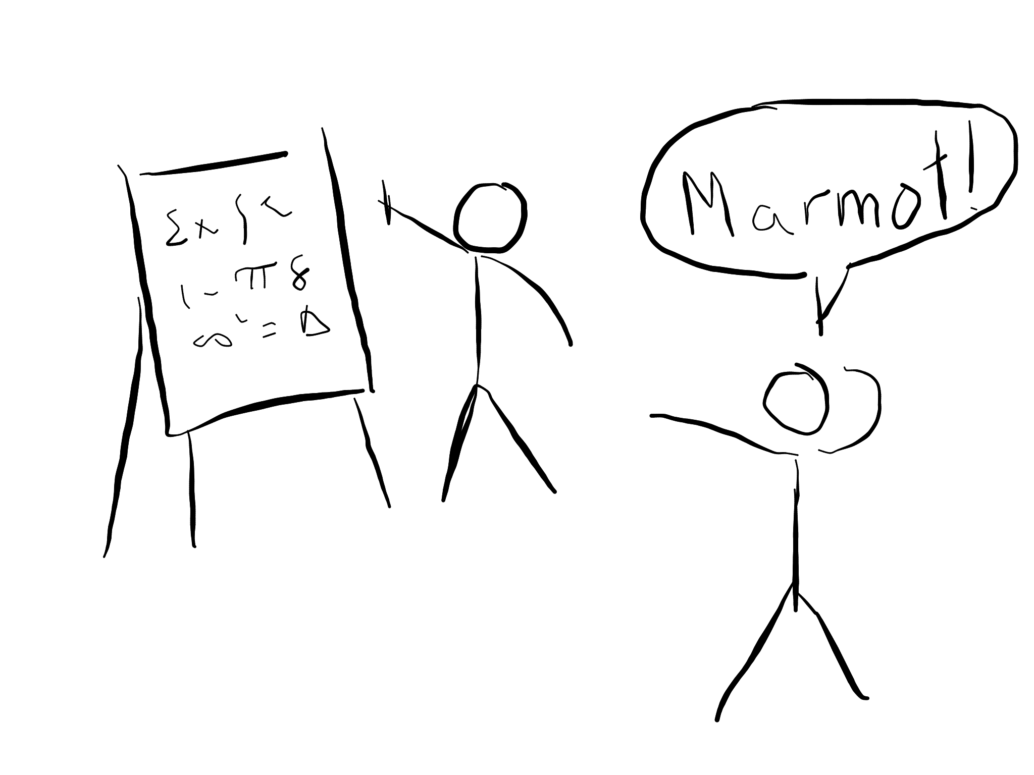
Domain Modelling
Explaining a problem using Pictures

Slide 9
Domain Modelling
Domain Modelling is a way to model (explain) a problem in the real world using diagrams
A Domain Modelling is not a class Diagrams
Notes:
Image obtained from:
http://www.codeproject.com/Articles/330447/Understanding-Association-Aggregation-and-Composit

Slide 10
Domain Modelling Constructs
Domain Modelling is a way to model (explain) a problem in the real world using diagrams
A Domain Modelling is not a class Diagrams
Notes:
Image obtained from:
http://www.codeproject.com/Articles/330447/Understanding-Association-Aggregation-and-Composit

Slide 11
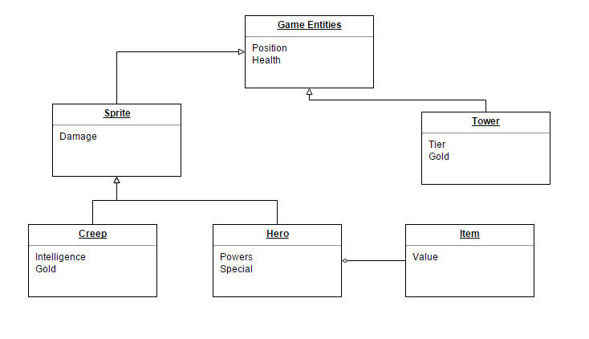
Example
Notes:
Image obtained from:
http://www.codeproject.com/Articles/330447/Understanding-Association-Aggregation-and-Composit

Slide 12
Exercise
Define a domain model that corresponds to the below domain description showing. The domain model should be defined as a UML class diagram showing class generalization/specialization, class attributes, identifiers, multiplicities, and associations.
A book has a title, author, publisher and an ISBN number. A book contains many sections identified by a section number and title. Sections can be of the type: normal, table of contents, or index. A normal section may contain many chapters. A chapter is identified by a chapter number, a title and the number of pages it occupies.
Notes:
Image obtained from:
http://www.codeproject.com/Articles/330447/Understanding-Association-Aggregation-and-Composit

Slide 13
Domain Modelling pro tips
Beware of which relationships you choose (association vs composition vs aggregation)
If a generalization exists use it
Don’t forget multiplicities

Slide 14
References
http://www.codeproject.com/Articles/330447/Understanding-Association-Aggregation-and-Composit
http://aviadezra.blogspot.ca/2009/05/uml-association-aggregation-composition.html

